Slide 1

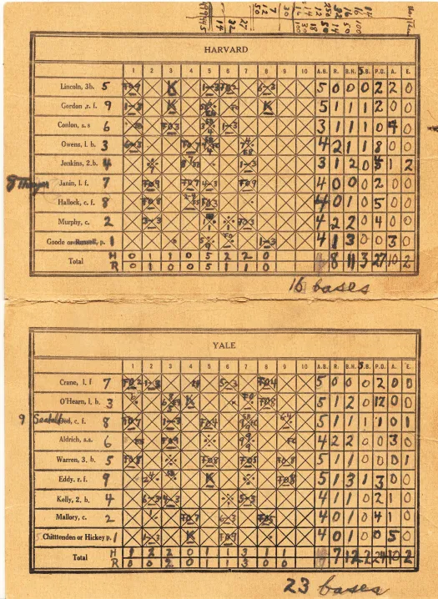
shinycustomloader
shinycustomloader
shinycustomloader
shinycustomloader
shinycustomloader
retrosheetshow
shinycustomloader
shinycustomloader
shinycustomloader
http://hexb.in/sticker.html

