Slide 1
Deep Learning Application on Automating Chest Diseases Detection from Radiographs
Theophane Godonou, Vamsi S Jandhayala, Orcun Kurugol, Phong Le
Team 35 - CSE 6250 - Georgia Tech

Slide 2
Problem Description
Detection of diseases from medical images.
X-rays are a widely used form of medical imaging.
Access to patients data is limited.
Automatic and reliable disease classification model is cost effective.
Use of deep learning and big data tools is a promising approach.
Notes:
The detection of diseases from medical imaging is complex and expensive. X-rays are very common in medical imaging. Overall access to patients datasets is limited but some datasets are trying to solve that. An automatic and reliable disease classification model would reduce the cost and time needed. The recent emergence of big data tools for image feature extraction with deep convolutional neural networks to perform image classification have given quite promising results and our approach will follow the same path.

Slide 3
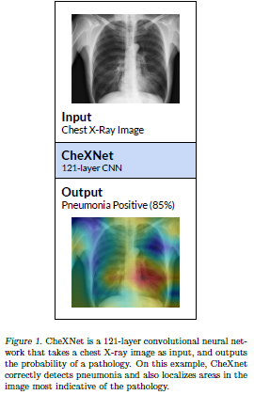
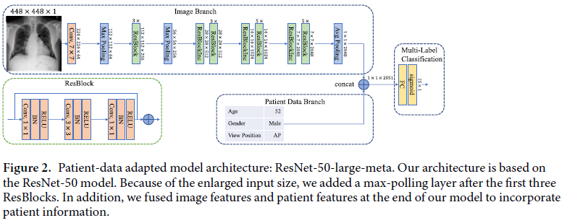
Related Work
Notes:
Going through multiple literature surveys, we were inspired by many applications of NIH in disease detection. For instance, the NIH dataset was built and published by Wang et al. While Baltruschat et al did a research on comparing different deep learning models on multi-label classification.

Slide 4
NIH Chest X-ray Dataset
112120 images of 1024 x 1024 pixels
30805 unique patients
15 classes : 14 diseases and a No findings class
Patients can have multiple diseases.
Notes:
The dataset has almost the same number of men and women. The patients age is quite diverse with an average of 46 years. The images can be collected in more than one patient visit. Many patients have just one image but some have more than one. The pathologies were extracted using text-mining techniques on the attached radiological report. Many patients have multiple pathologies simultaneously.

Slide 5
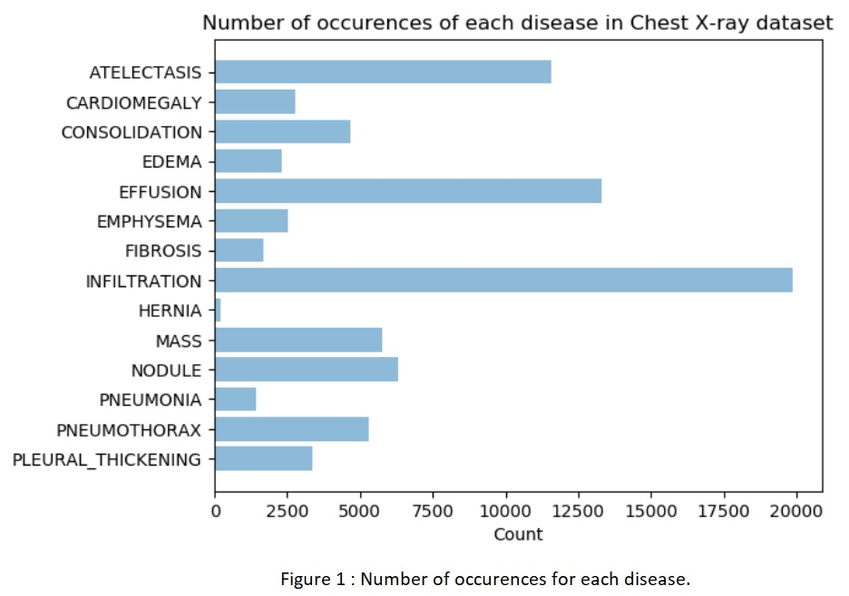
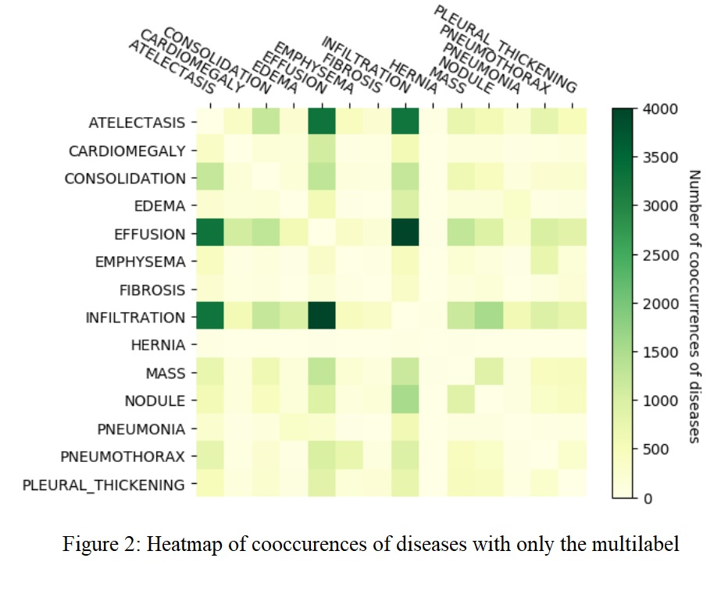
Occurrences of Pathologies
Notes:
The number of occurrences varies depending on the pathology. As seen on Figure 1, Hernia is the least frequently occurring disease in the Chest X-ray dataset while infiltration occurs most frequently. Some pathologies tend to co-occur. For instance Infiltration and effusion are the most likely to occur together as seen in the heatmap from Figure 2.

Slide 6
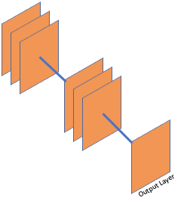
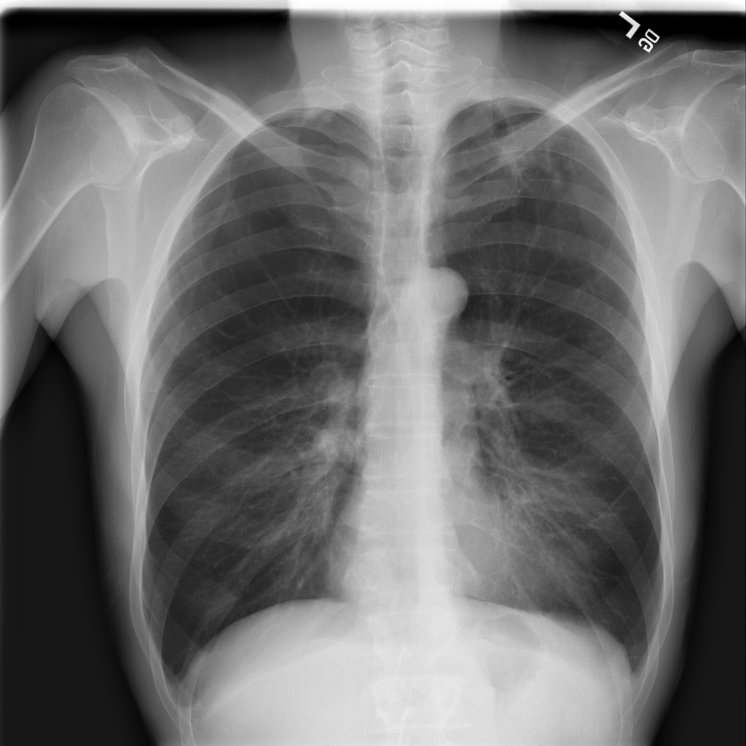





Experiment Setup
Process Flow
Image Transformation
Model Training
8x14GB RAM, 8 cores
2x112GB RAM, 2GPU, 18 cores
2x224GB RAM, 4GPU, 36 cores
Tech stack
Notes:
To prepare for our experimental setup, we decided to use Azure Databricks as it can integrate nicely with other technology stack such Azure Datalake Store, pre-installed pytorch. In addition, Databricks is built on top of Spark and Jupyter Notebook, and it's very flexible to use scala, python or R on the same environment.
One of the goals of our project is to measure the impact of different image sizes to the model performance. To do that, we have to pre-transform the images before using in our model. We used Torchvision to resize the images into two bucket (512x512 and 256x256) and then normalize them before exporting them into parquet files. This whole transformation process was completed using Spark on 8 worker machines.
Once we completed exporting transformed data, we set up another set of clusters to reload and train our models. Each cluster will train each model in parallel. And due to memory limitation, we had to load and unload partial data for training and validation.

Slide 7
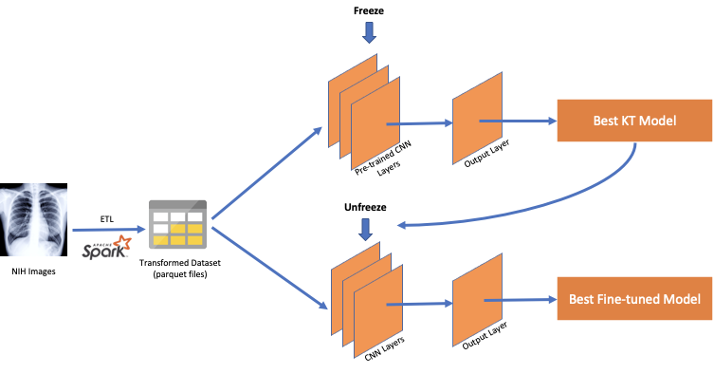
Proposed Method
Notes:
In our research, we target to achieve two goals: how the image size impacts the model performance and how we can fine-tune the pretrained PyTorch ResNet-50 and DenseNet-121 models.
To setup a baseline, we built a simple CNN architecture with 2 layers to run through our dataset. The performance of this model is used as baseline for our improvement. In this figure, you would find how we apply Knowledge Transfer and fine-tuning in our architect on both ResNet an DenseNet models.
In the first stage, the pre-trained CNN layers were frozen. We replaced the fully connected output layer with a layer with our own fully connected classification layer, producing an output vector of size 14 and applied a BCE loss function with positive weights calculated based on the ratio between positive and negative labels for optimization.
Once the best model was found using the validation AUC score, we unfroze all the layers and trained the whole network again with the same training data to choose the best model again using the validation AUC score.
Utilizing our ETL framework, we trained lower and higher resolution KT and fine-tuned models using ResNet-50 and DenseNet-121 in parallel and compared their results as well as how they fared against our baseline.

Slide 8
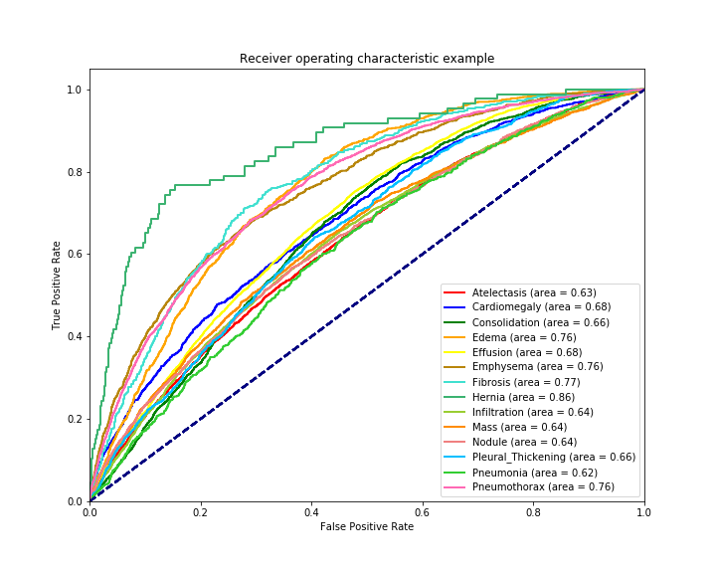
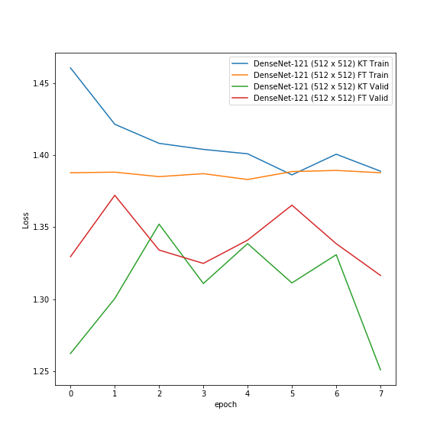
Experimental Results
ROC curves for fine-tuned DenseNet-121 model
Loss per epoch for 8 epochs
Notes:
The simple CNN, the ResNet-50, and the DenseNet-121 architectures were evaluated based on loss per epoch and AUC score from a Receiving Operating Characteristic (ROC) curve.
The training data set for the DenseNet-121 KT based model approached losses of around 1.39 for training and 1.25 validation while the fine tuned DenseNet-121 model had losses of 1.25 and 1.33 respectively.
Additionally, Hernia seemed to show an ROC curve with a higher AUC score of approximately 0.86, whereas Pneumonia had the lowest AUC score of around 0.62.

Slide 9
Experimental Results (Cont’d)
Model | Average AUC Score
CNN with 2 Hidden Layers | 0.6329
ResNet-50 KT (256x256) | 0.6663
ResNet-50 fine-tuned (256x256) | 0.6670
ResNet-50 KT (512x512) | 0.6868
ResNet-50 fine-tuned (512x512) | 0.6901
DenseNet-121 KT (256x256) | 0.6842
DenseNet-121 fine-tuned (256x256) | 0.6843
DenseNet-121 KT (512x512) | 0.6977
DenseNet-121 fine-tuned (512x512) | 0.6978
Average AUC scores of models
Notes:
Further, as seen from the table of average AUC scores, for both the ResNet-50 and DenseNet-121 models the average AUC scores of the models trained on 512 x 512 size images was consistently greater than the average AUC scores of the models trained on 256 x 256 images.

Slide 10
Discussion & Conclusion
Modular framework can be used for different classification tasks while ETL pipeline and and CNN models can be used independently
As the data set is imbalanced, Type-II errors were penalized based on the ratio of negative to positive labels
Knowledge transfer gave a head-start while fine-tuning the best model only improved results marginally
Using higher resolution images yielded 2% higher AUC scores resulting in ~70% AUC. Using original sized images is expected to improve the AUC score
Ensemble methods and/or utilization of demographics data can improve the AUC scores further
Notes:
We utilized a modular framework that can be used for different classification tasks. At the same same time, our ETL pipeline and CNN models can be used independently. As the dataset is imbalanced, we penalized Type-II errors based on negative to positive label ratio so that we would balance the importance of positive and negative labels. Usage of pre-trained models for knowledge transfer gave us a head start for feature extraction. Fine tuning the best model after unfreezing all layers only gave us marginal improvements. Our experiments showed that higher resolution images yielded 2% higher AUC scores, reaching to ~70% which is comparable to some state of the art research. Using the original size images is expected to improve the AUC score and ensemble methods or utilization of demographics data available in the dataset can improve the results even further.

