Slide 1
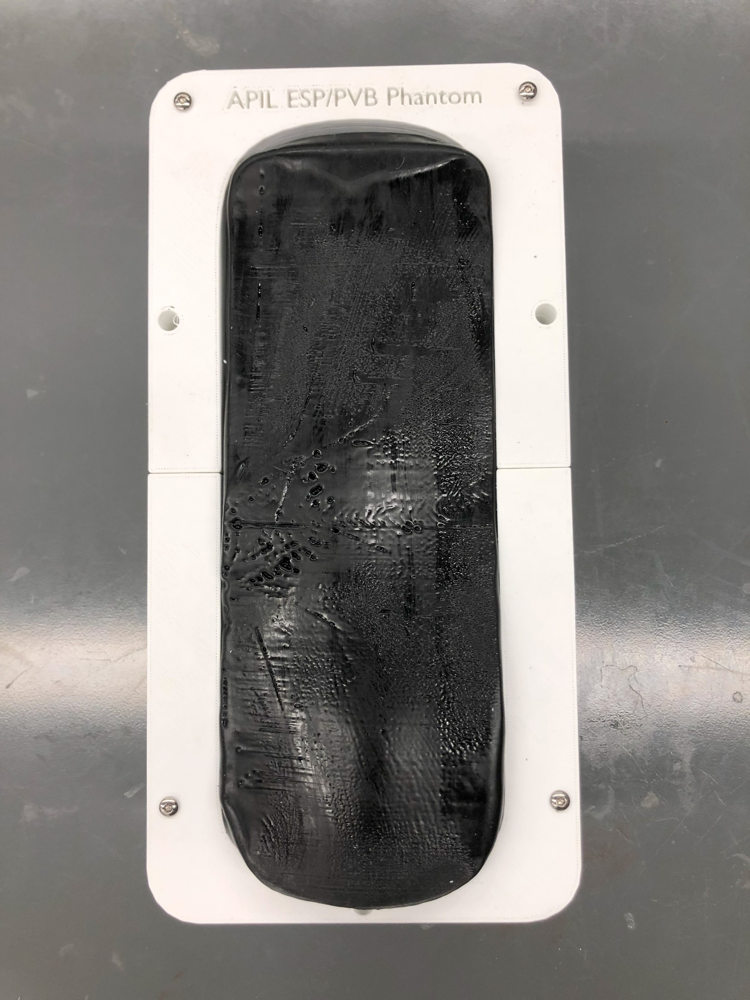

Slide 2
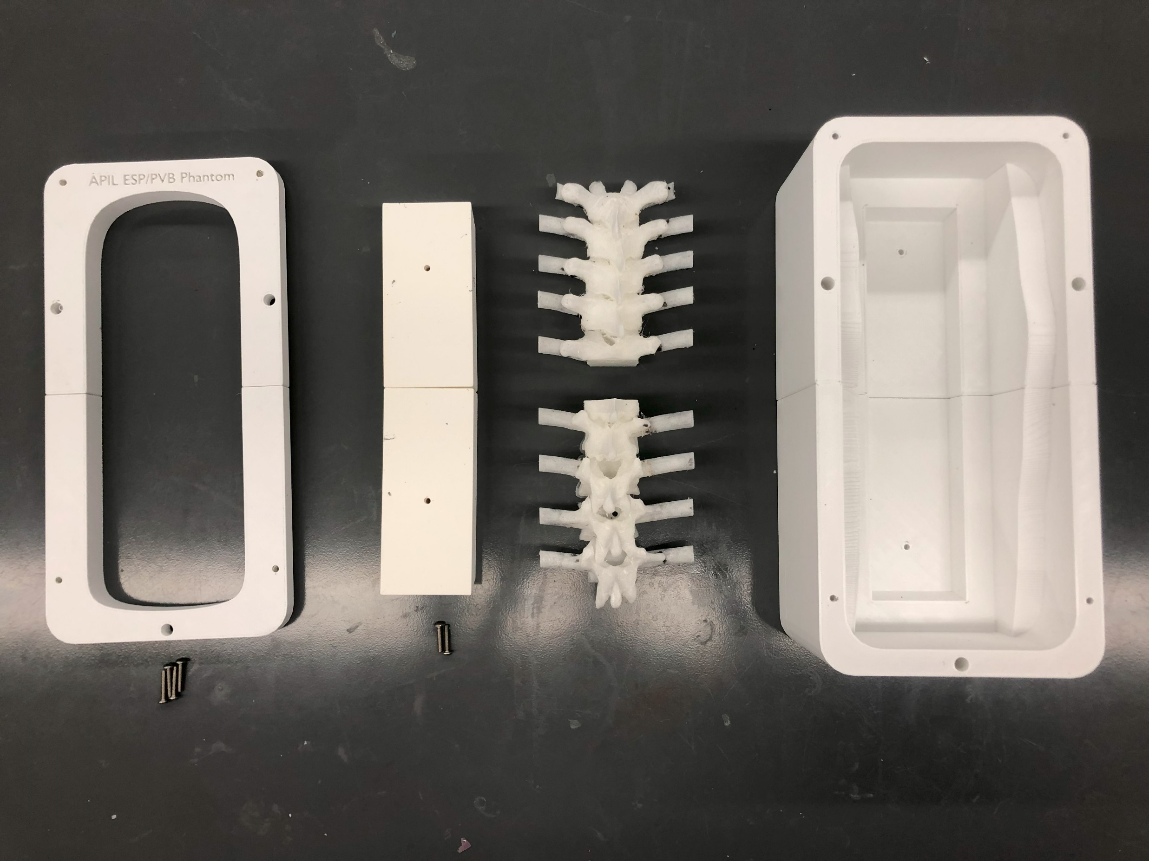
pvb_esp_phantom_case
pvb_esp_phantom_case_cover
T6_L2_spine_insert_base
TG_L2_spine_insert
2 x M4*16
4 x M4*20

Slide 3
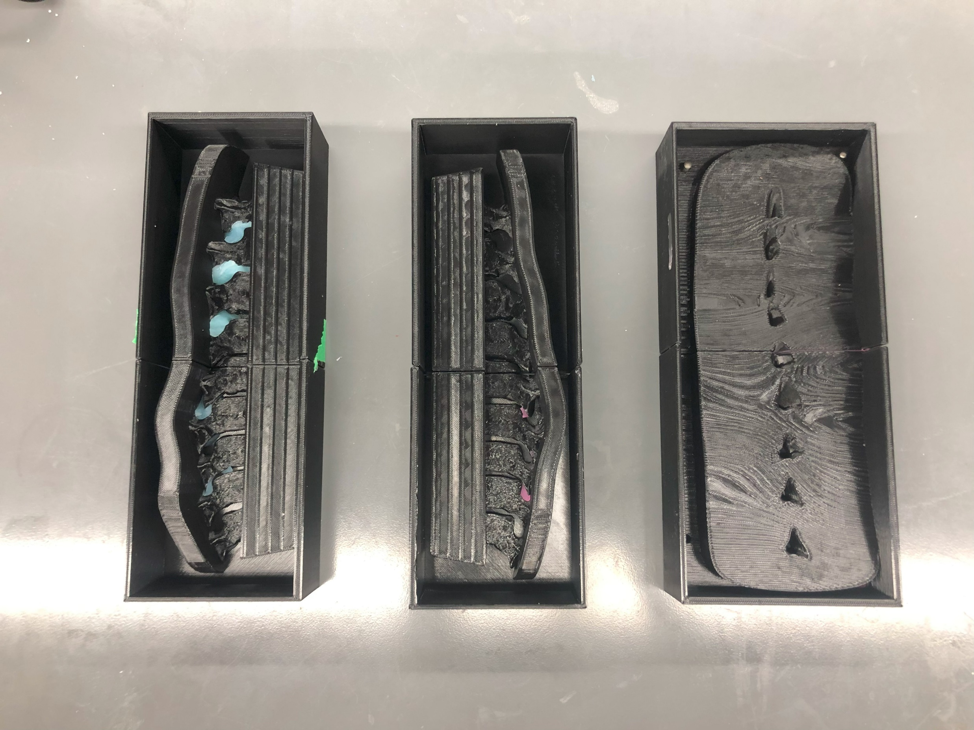
bottom_intermediate_mold_1
layers_intermediate_mold
bottom_intermediate_mold_2

Slide 4
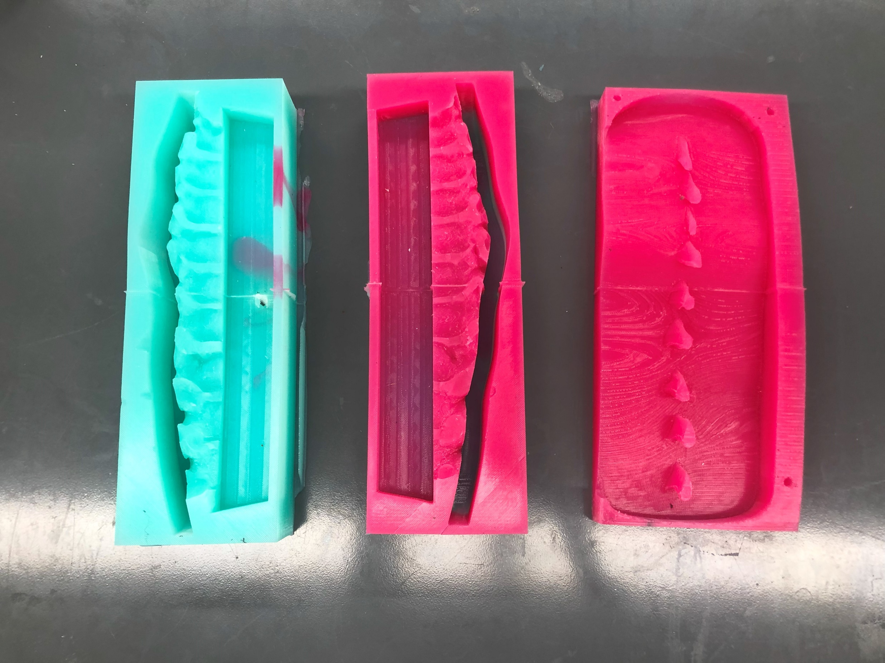
Bottom mold #1
Bottom mold #2
Layers mold

