Slide 1
BADVideo
(Brighten And De-noise Video)
Tyler Hayes

Slide 2
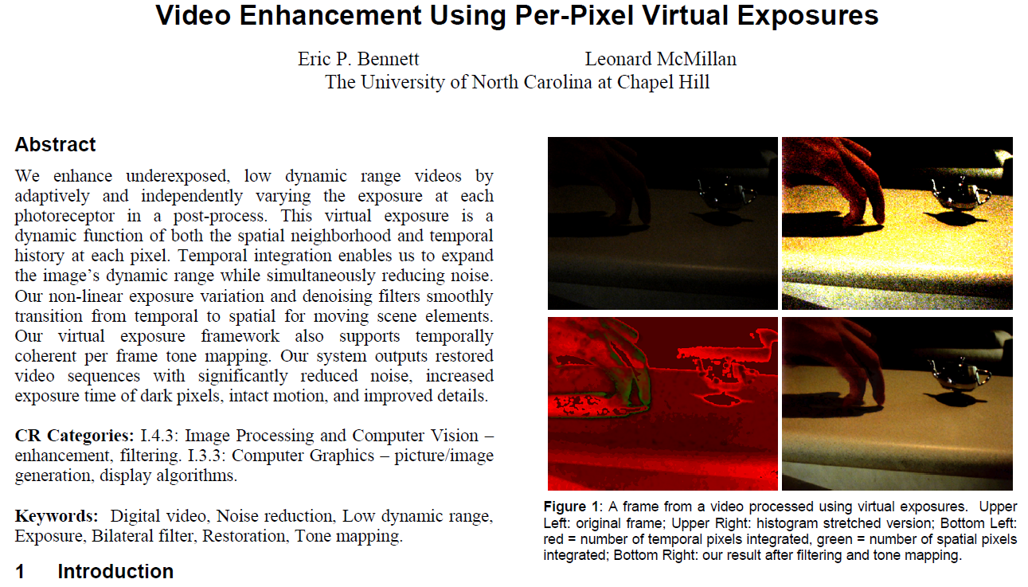
The Project
System project
“Video Enhancement Using Per-Pixel Virtual Exposures” by Eric P. Bennett and Leonard McMillan
Correcting underexposed videos while reducing noise

Slide 3
Languages & Tools
C++/CLI with OpenCV
Visual Studio 2010
Git
Homemade videos

Slide 4
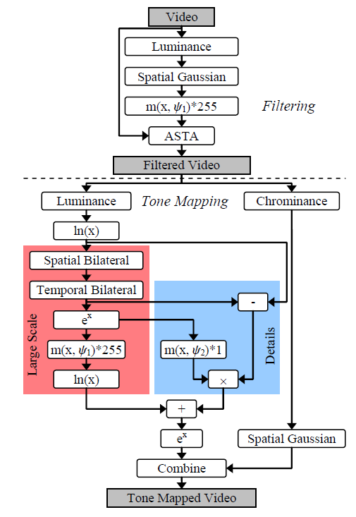
The Plan
Learn OpenCV basics
Open/play/save video files
Calculate luminance
Apply Gaussian filter
Implement tone mapping
function m(x, ψ)
Implement ASTA filter
Implement complete tone
mapper

Slide 5
Done so far
Learn OpenCV basics
Open/play/save video files
Calculate luminance
Apply Gaussian filter
Implement tone mapping
function m(x, ψ)
Implement ASTA filter
Implement complete tone
mapper

Slide 6
DEMO

