Slide 1
User Interaction Metrics for Hybrid Mobile Applications
Tom Hastings
Masters Project

Slide 2
Introduction
Developers have finite resources
How can we help a developer maximize her ROI when testing?
Target widely used functionality within the application
User interaction can tell us a lot about the most used portions of an application
How can we track user interaction?
Based on user interaction, how can we determine functionality within the application that is popular?
We provide a novel approach to gather user behavior insights and provide actionable analytics for developers
Notes:
Understanding user behavior and interactions in mobile applications is critical for developers to understand where to spend limited resources when adding, updating, and testing features but current tools do not do a good job of providing actionable insights
A typical developer spends more than half of his time on necessary tasks unrelated to writing code[1]. User behavior insights can provide value to the developer when its time to code and implement new features
Google Analytics and New Relic provide user insights but they fall short when it comes to identifying user interactions and behaviors as it pertains to individual features of mobile applications

Slide 3
Evaluation Criteria
Would it be worth while to create an application which collects metrics for mobile hybrid applications?
Are we able to identify user behaviors?
Are we able to identify frequency of function usage?

Slide 4
Contributions
A novel Node framework module which collects user interaction metrics
A system which collects (via REST API) and displays data in time series format
A developer survey study
Discussion of insights that could be gathered using our tool and approach

Slide 5
Background Information
“JavaScript is the most commonly used programming language on earth.” [1]
Hybrid App
PhoneGap (Adobe)
React Native (Facebook)
Apache Cordova
Facebook, Tesla, Instagram, Airbnb, Walmart, & Skype to name a few
Users want stability – Achieve stability through testing and knowing what to test [2]
[1] https://insights.stackoverflow.com/survey/2016
[2] http://opensourcesurvey.org/2017/

Slide 6
Developer Survey
Would it be helpful to understand how users use an application?
Would it be helpful to see what features and functions are popular?
Are developers concerned with privacy?
We think so. But do others?
Surveyed 34 developers with 20 questions

Slide 7
Developer Survey
Would it be helpful to understand how users use an application?
Would it be helpful to see what features and functions are popular?
Are developers concerned with privacy?
We think so. But do others?
Surveyed 34 developers with 20 questions

Slide 8
Survey Findings
What did we find?
61.8% of developers think user metric collection is important
76.5% believe it is important to know how often features of an application are used
88% of developers want to maximize time when maintaining existing applications
83.2% want to know how users use an application
79.4% would prioritize work based on user behavior.
85.3% of developers are not concerned about user privacy while collecting usage metrics

Slide 9
The Application
Novel middleware node module
NodeJS application with RESTful API
MySQL
User management
API token management
Metric storage
Grafana Front-end
Simulate user input for fictitious application

Slide 10
Middleware How it works
Collects metrics for a period of time (default is 5 minutes)
@ end of period data is pushed to metrics API endpoint
Middleware clears metrics and starts fresh

Slide 11
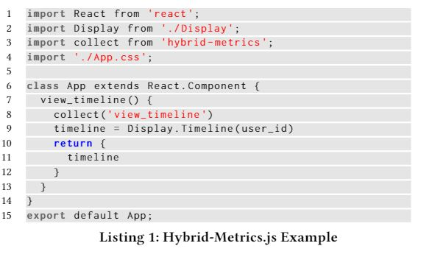
Middleware Example
View_timeline() -> API: {
FunctionName: “view_timeline”,
usage: number_of_times_used_in_period) }

Slide 12
REST API
Simple Node.js application
Utilizes Express for routes and REST methods
Connects to MySQL database and inserts data

Slide 13
Grafana
Provides time-series dashboard
Flexible and accepts multiple data sources
Only used one in our research
Easily differentiate between functions in UI
Set time period

Slide 14
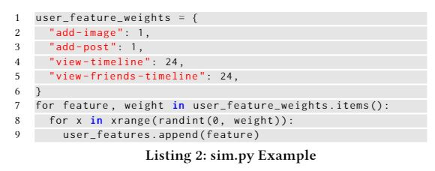
Simulated case study
Does this method work the way we think it will?
Simulated Application
2 types of functions creator and consumer
4 Functions
View-timeline
View-friends-timeline
Add-post
Add-video
Weighted creator and consumer functions
100% of all content created on Twitter is created by 3% of users
Introduced popular new feature into simulation

Slide 15
Evaluation
Would it be worth while to create an application which collects metrics for mobile hybrid applications?
83.2% of developers surveyed want to know how users use their application
88% of developers want to maximize time when maintain existing applications
79.4% would prioritize work based on user behavior metrics.
Yes, it would be worthwhile to find a method to collect these metrics.

Slide 16
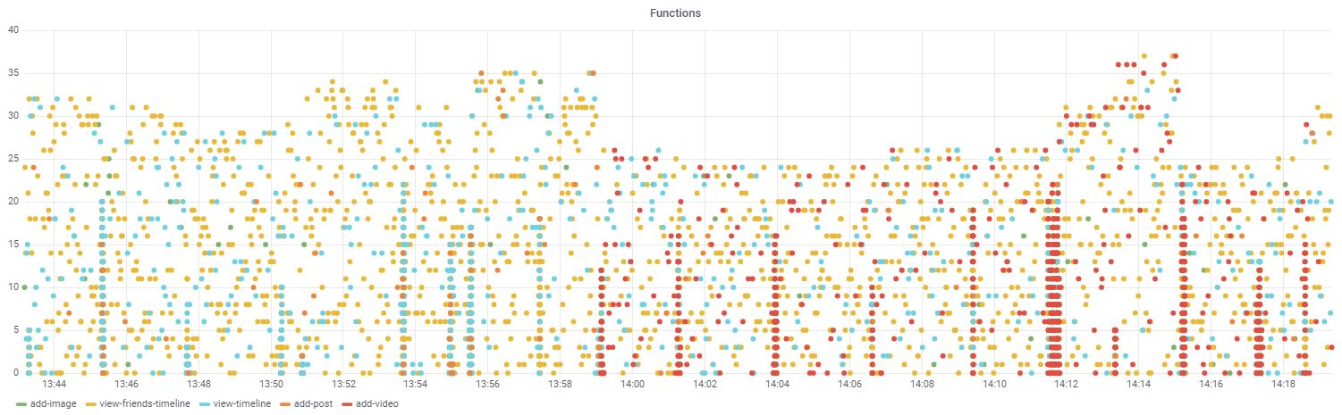
Evaluation (Continued)
Are we able to identify user behaviors?
During our simulation we included a popular new feature: add-video

Slide 17
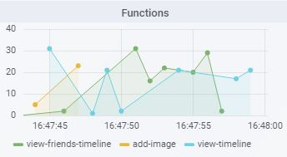
Evaluation (Continued)
Are we able to identify the frequency of function usage?

Slide 18
Conclusion
Answered evaluation questions
Provided REST API web service
Novel node.js middleware
Developer Survey

Slide 19
What I learned
Telling a story in a research paper is challenging
Latex is powerful
IRB takes time… even for a simple survey
Time-series analysis can show interesting metrics
Docker makes setup time almost nothing
Node.js is my favorite language
Modeling using Python is fun – my assumptions are probably wrong

Slide 20
Questions?

Slide 21
Related Work
Wu et all crowd-source user interaction metrics from UI
Ferreira et all have a tool called AWARE which captures context events on mobile applications which are pushed to the cloud
Not many academia papers on user behavior / user interaction tracking using instrumentation
Google Analytics & New Relic provide analytical insights for developers using web applications

