Slide 1
Project BOMR
Dauvin Ludovic
Gieruc Théo
Henry Jonathan
Krafft Guillaume
Basics of mobile robotics

Slide 2
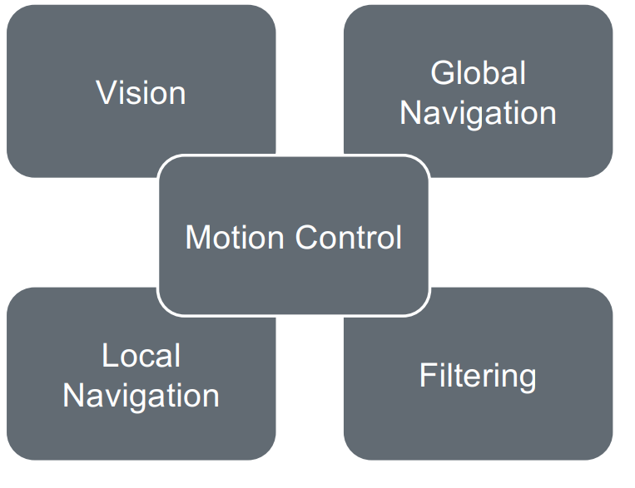
Choices
Vision: color differentiation and shape detection
Filter: Kalman
Path planning: visibility graph and Dijkstra algorithm
Local navigation: ANN

Slide 3
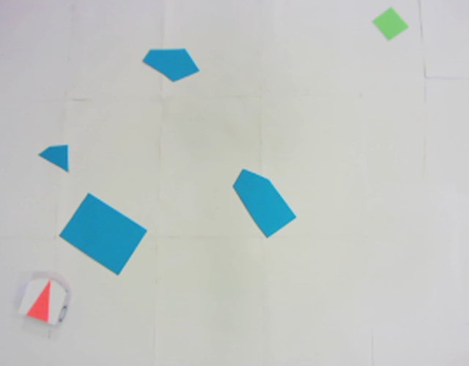
Playing field
Our playing field is separated in 4 categories: obstacles, robot, goal and the field himself, each with its own color.
obstacles: blue
goal: green
robot: red

Slide 4
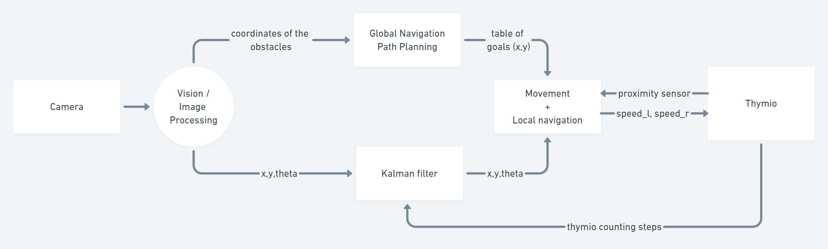
Module interaction

Slide 5
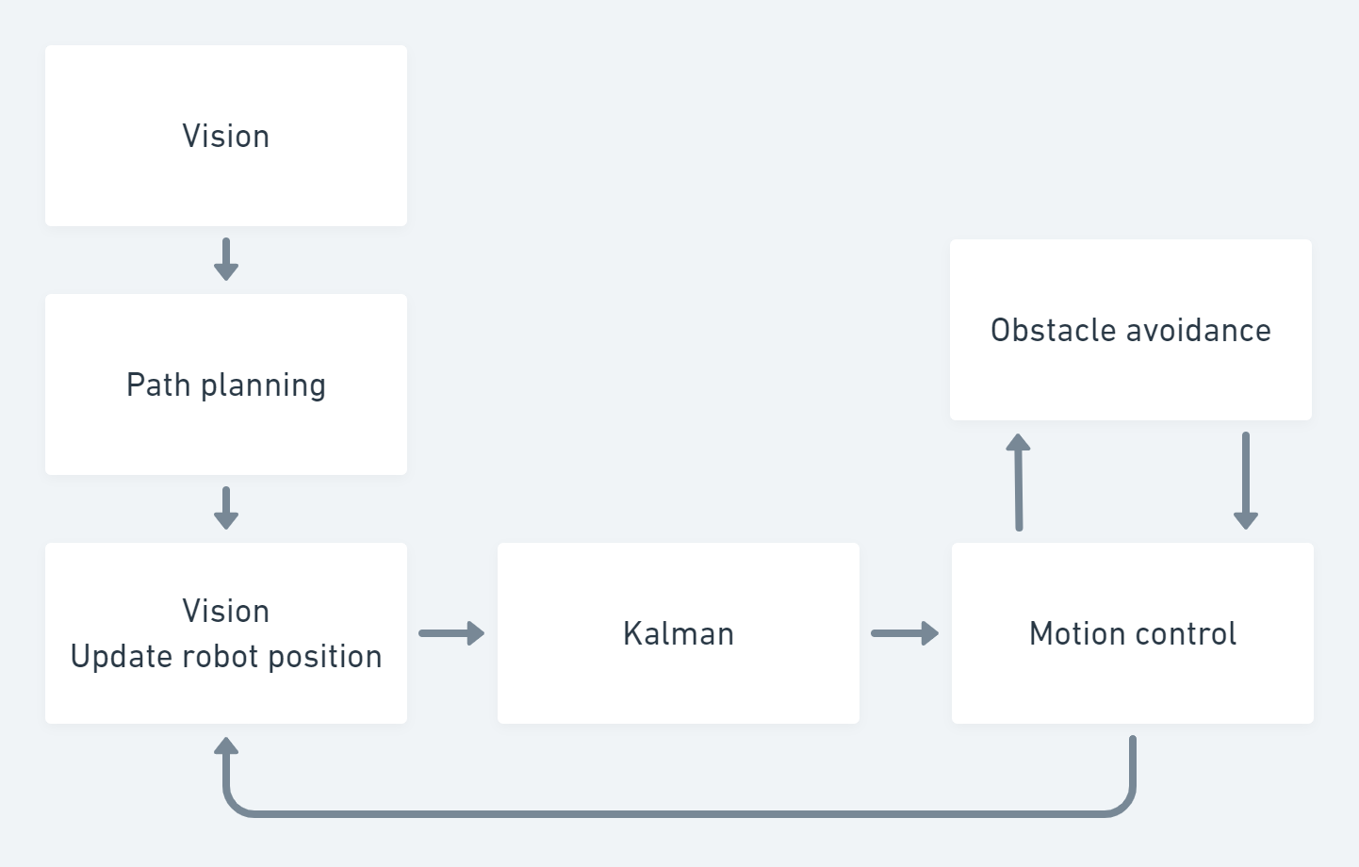
Implementation

