Slide 1
GitHub Introduction
GEN242: Data Analysis in Genome Biology Thomas Girke

Slide 2
Overview
Topics covered in this tutorial:
What are Git and GitHub?
Installing Git
Git basics from the command-line
GitHub basics from the command-line
SSH Key authentication for private repos
Using GitHub from RStudio
Online file upload workflow
Viewing static HTML files on GitHub Pages
Note
This class makes heavy use of GitHub. Homework and course projects are submitted and graded via GitHub Classroom.

Slide 3
GitHub in GEN242
Homework assignments are submitted and graded on GitHub Classroom
Course projects use private GitHub repositories — one per project, shared within each team
Each student needs a personal GitHub account → github.com/personal
GitHub provides unlimited free public repositories
Via GitHub Education students can get extended free private repos
New to GitHub? Start with the Hello World quick guide

Slide 4
What are Git and GitHub?
Git — local version control
Tracks changes in files over time
Works locally on your machine
Enables branching, merging, full history
Free and open source
GitHub — remote collaboration
Online hosting service built on Git
Stores repositories in the cloud
Adds issues, pull requests, forks
Enables code sharing and review

Slide 5
Tip
Git + GitHub together = local version control synced with a remote shared repository.

Slide 6
Installing Git
OS | Command / Method
Windows | Installer from git-scm.com
macOS | brew install git or Xcode Command Line Tools
Linux (Debian/Ubuntu) | sudo apt install git
Linux (Fedora/RHEL) | sudo dnf install git

Slide 7
Note
When using Git from RStudio, set the path to the Git executable under: Tools → Global Options → Git/SVN
Practice in the browser (no install needed): try.github.io

Slide 8
Git Basics — Core Commands
Command | Stages | Best for
git add myfile.txt | One file only | Selective, careful commits
git add . | All changes under current directory | Daily use — simple and intuitive
git add -A :/ | All changes in entire repo | Working inside a subdirectory
Get help
git <command> --help
Initialize a new repository
mkdir my_dir cd my_dir git init # creates a hidden .git/ folder to track history
Stage files for commit
git add myfile.txt # stage a specific file git add . # stage all changes in current directory (recommended for daily use) git add -A :/ # stage all changes in entire repo regardless of working directory

Slide 9
For most workflows git add . is sufficient. Use git add -A :/ if you are working inside a subdirectory and want to be sure nothing elsewhere in the repo is missed.
Tip
List files to ignore (temp files, outputs) in a .gitignore file at the repository root. Regular expressions are supported — see GitHub docs.
Commit a snapshot
git commit -am "describe your changes" # -a stages all tracked modified files # -m sets the commit message inline

Slide 10
GitHub Basics — Remote Workflow
1. Link your local repo to GitHub
Create the repository on GitHub first (leave README/license/.gitignore unchecked), then:
git remote add origin git@github.com:<user_name>/<repos_name>.git
Warning
Do not initialize the GitHub repo with any files — that causes merge conflicts on the first push.
2. Push local commits to GitHub
git push # first push; after this, just: git push
3. Clone an existing repository
git clone git@github.com:<user_name>/<repos_name>.git
4. Daily workflow
git pull # sync before you start editing # ... make your changes ... git commit -am "describe changes" # commit locally git push # send to GitHub

Slide 11
SSH Keys for Private Repositories
Private GitHub repositories (like your GEN242 homework repos) require SSH Key authentication. Password-based access is no longer supported by GitHub.
Why SSH Keys?
Secure, password-less authentication
One key pair generated per computer (laptop, HPCC cluster — each needs its own)
Public key lives on GitHub; private key stays on your machine
Setup steps
Step 1 — Generate a key pair on your machine (or on the HPCC cluster):
ssh-keygen -t ed25519 -C "your_email@example.com"
Step 2 — Display the public key and copy it:
cat ~/.ssh/id_ed25519.pub
Step 3 — Add it to GitHub: Settings → SSH and GPG keys → New SSH key → paste → Save
Tip
For the HPCC cluster: generate the key pair on the cluster and upload ~/.ssh/id_rsa.pub to GitHub. See HPCC SSH Key docs.

Slide 12
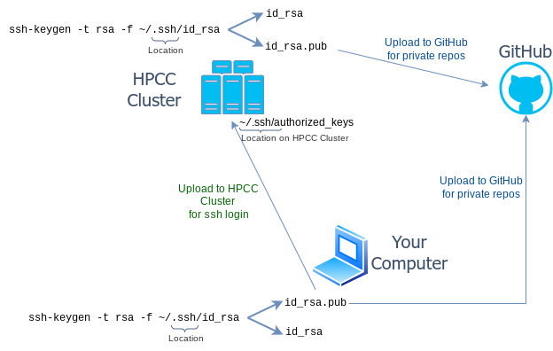
SSH Key Authentication Flow
Each computer that needs to push/pull from a private repo requires its own key pair. Upload each computer’s public key to GitHub separately.
SSH Key Workflow

Slide 13
Exercise — Full Git Workflow
Run this after creating your GitHub repository (see HW01 instructions):
# Clone the remote repository to your machine git clone git@github.com:<user_or_org>/<repo_name> cd <repo_name> # Sync any remote changes git pull # Create a test file, stage, commit, and push touch test git add . # or: git add test to stage only this file git commit -am "add test file" git push # Now edit 'test' directly on GitHub online, then pull the change back: git pull

Slide 14
Online File Upload
For users not yet comfortable with the command-line, GitHub supports browser-based uploads:
On your repository page click Add file → Upload files
In the file path field, type a subdirectory path and placeholder filename:
Homework/HW1/dummy.txt
Upload your actual file to the newly created directory
Delete dummy.txt afterward
Note
GitHub does not display empty directories — the placeholder file trick creates the folder structure first so your real file has somewhere to land.

Slide 15
GitHub from RStudio
One-time setup
Install Git — git-scm.com
Tell RStudio where Git is: Tools → Global Options → Git/SVN
(Optional) Configure SSH Keys from within RStudio — see Happy Git with R
Clone a repository into RStudio
File → New Project → Version Control → Git → paste repository URL
Commit and push changes
Tools → Version Control → Commit
Check the files you want to stage in the Staging Area
Write a commit message in the box
Click Commit, then Push
Tip
Useful RStudio keyboard shortcuts: support.rstudio.com

Slide 16
Viewing HTML Files on GitHub Pages
By default GitHub renders raw HTML source, not the page. Enable GitHub Pages to serve rendered HTML:
Make your repository public
Go to Settings → Pages
Under Source select Deploy from a branch
Choose branch main, click Save
Wait for the URL — then append your HTML file path to view it
Note
The GEN242 course site itself is hosted this way via GitHub Pages. Example repo: github.com/tgirke/View_HTML_on_GitHub

Slide 17
Summary
Action | Command
Initialize repo | git init
Stage files | git add . or git add -A :/
Commit changes | git commit -am "message"
Link to remote | git remote add origin <url>
Push to GitHub | git push
Pull from GitHub | git pull
Clone a repo | git clone <url>

Slide 18
Daily workflow
git pull # always sync first # ... edit your files ... git commit -am "your message" # commit locally git push # push to GitHub
Next: T2 — Linux & HPCC Cluster

