Slide 1
BVE, spherical harmonics,
and SFNO
A lecture and study guide for the climatology prediction task
Fluid dynamics, the SHT, Gaussian grids, and learned operators
01
Notes:
Source slide 1. BVE, spherical harmonics, and SFNO
A lecture and study guide for the climatology prediction task
Evidence: Original learning sequence

Slide 2
The model and the learning question
The barotropic vorticity equation (BVE) describes one horizontal layer of fluid on a rotating
sphere.
We assume constant density and zero horizontal divergence. The state has no vertical
variation.
Chapter 1 develops the fluid equations. Chapter 2 defines the SHT and its Gaussian grid.
Chapter 3 connects spectral dynamics to the learned map and its output head.
After study, you should be able to recover wind from vorticity, explain a spectral solver,
and assess an SFNO output head.
H, R1
02
Notes:
Source slide 2. The model and the learning question
The barotropic vorticity equation (BVE) describes one horizontal layer of fluid on a rotating sphere.
We assume constant density and zero horizontal divergence. The state has no vertical variation.
Chapter 1 develops the fluid equations. Chapter 2 defines the SHT and its Gaussian grid. Chapter 3 connects spectral dynamics to the learned map and its output head.
After study, you should be able to recover wind from vorticity, explain a spectral solver, and assess an SFNO output head.
Evidence: H, R1
H: Held, The barotropic vorticity equation. https://www.gfdl.noaa.gov/wp-content/uploads/files/user_files/pjp/barotropic.pdf
R1: Isca pinned a290bc376d84d0ee83adbb80eb374b9f629c3534: src/atmos_spectral_barotropic/barotropic_dynamics.F90. https://github.com/ExeClim/Isca/blob/a290bc376d84d0ee83adbb80eb374b9f629c3534/src/atmos_spectral_barotropic/barotropic_dynamics.F90

Slide 3





Chapter 1: coordinates and physical quantities
Let
be the sphere radius,
the longitude, and
the latitude. Angles use radians.
The eastward and northward velocities are
and
, in
. Relative vorticity
measures
local rotation, in
.
A longitude step shrinks with latitude. The geometry enters every derivative.
H, equations 3-8
03
Notes:
Source slide 3. Chapter 1: coordinates and physical quantities
Let $a$ be the sphere radius, $\lambda$ the longitude, and $\phi$ the latitude. Angles use radians.
The eastward and northward velocities are $u$ and $v$, in $\mathrm{m\,s^{-1}}$. Relative vorticity $\zeta$ measures local rotation, in $\mathrm{s^{-1}}$.
A longitude step shrinks with latitude. The geometry enters every derivative.
LaTeX: ds_\lambda=a\cos\phi\,d\lambda,\qquad ds_\phi=a\,d\phi,\qquad dA=a^2\cos\phi\,d\phi\,d\lambda
Evidence: H, equations 3-8
H: Held, The barotropic vorticity equation. https://www.gfdl.noaa.gov/wp-content/uploads/files/user_files/pjp/barotropic.pdf

Slide 4


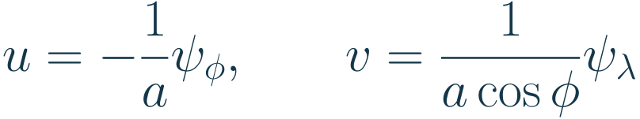
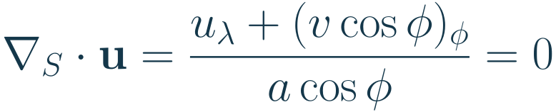
One streamfunction determines the wind
For a smooth nondivergent flow, a scalar streamfunction
determines both velocity
components.
Subscripts denote partial derivatives. These formulas give
units of
.
The spherical divergence vanishes because the mixed derivatives cancel.
H, equations 3, 6, 7
04
Notes:
Source slide 4. One streamfunction determines the wind
For a smooth nondivergent flow, a scalar streamfunction $\psi$ determines both velocity components.
Subscripts denote partial derivatives. These formulas give $\psi$ units of $\mathrm{m^2\,s^{-1}}$.
LaTeX: u=-\frac{1}{a}\psi_\phi,\qquad v=\frac{1}{a\cos\phi}\psi_\lambda
The spherical divergence vanishes because the mixed derivatives cancel.
LaTeX: \nabla_S\cdot\mathbf u=\frac{u_\lambda+(v\cos\phi)_\phi}{a\cos\phi}=0
Evidence: H, equations 3, 6, 7
H: Held, The barotropic vorticity equation. https://www.gfdl.noaa.gov/wp-content/uploads/files/user_files/pjp/barotropic.pdf

Slide 5
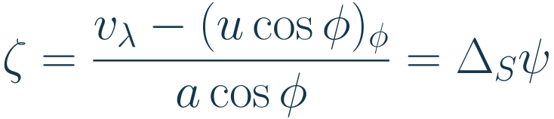

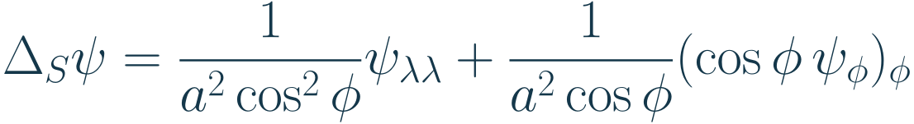
Vorticity is the spherical Laplacian
Taking the radial curl of the wind gives relative vorticity.
The Laplace-Beltrami operator
is the Laplacian on the sphere of radius
.
Thus a vorticity field determines the velocity after solving one Poisson equation.
H, equations 4-7; R1
05
Notes:
Source slide 5. Vorticity is the spherical Laplacian
Taking the radial curl of the wind gives relative vorticity.
LaTeX: \zeta=\frac{v_\lambda-(u\cos\phi)_\phi}{a\cos\phi}=\Delta_S\psi
The Laplace-Beltrami operator $\Delta_S$ is the Laplacian on the sphere of radius $a$.
LaTeX: \Delta_S\psi=\frac{1}{a^2\cos^2\phi}\psi_{\lambda\lambda}
+\frac{1}{a^2\cos\phi}(\cos\phi\,\psi_\phi)_\phi
Thus a vorticity field determines the velocity after solving one Poisson equation.
Evidence: H, equations 4-7; R1
H: Held, The barotropic vorticity equation. https://www.gfdl.noaa.gov/wp-content/uploads/files/user_files/pjp/barotropic.pdf
R1: Isca pinned a290bc376d84d0ee83adbb80eb374b9f629c3534: src/atmos_spectral_barotropic/barotropic_dynamics.F90. https://github.com/ExeClim/Isca/blob/a290bc376d84d0ee83adbb80eb374b9f629c3534/src/atmos_spectral_barotropic/barotropic_dynamics.F90

Slide 6




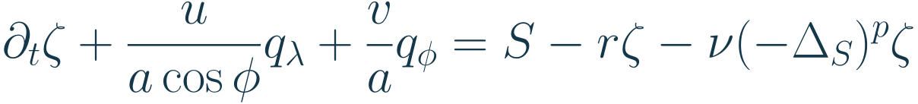




The forced barotropic vorticity equation
Earth's rotation contributes planetary vorticity
.
is the rotation rate in
.
The sum
is absolute vorticity. A parcel carries
unchanged when forcing and dissipation
vanish.
has units
. The drag rate
has units
and is nonnegative. The diffusion coefficient
has units
and is nonnegative. The integer
is at least 1. Higher
damps small
scales more selectively.
H, equations 8-12; R1, R2
06
Notes:
Source slide 6. The forced barotropic vorticity equation
Earth's rotation contributes planetary vorticity $f$. $\Omega$ is the rotation rate in $\mathrm{rad\,s^{-1}}$.
The sum $q$ is absolute vorticity. A parcel carries $q$ unchanged when forcing and dissipation vanish.
LaTeX: q=\zeta+f,\qquad f=2\Omega\sin\phi
LaTeX: \partial_t\zeta+\frac{u}{a\cos\phi}q_\lambda+\frac{v}{a}q_\phi
=S-r\zeta-\nu(-\Delta_S)^p\zeta
$S$ has units $\mathrm{s^{-2}}$. The drag rate $r$ has units $\mathrm{s^{-1}}$ and is nonnegative. The diffusion coefficient $\nu$ has units $\mathrm{m^{2p}\,s^{-1}}$ and is nonnegative. The integer $p$ is at least 1. Higher $p$ damps small scales more selectively.
Evidence: H, equations 8-12; R1, R2
H: Held, The barotropic vorticity equation. https://www.gfdl.noaa.gov/wp-content/uploads/files/user_files/pjp/barotropic.pdf
R1: Isca pinned a290bc376d84d0ee83adbb80eb374b9f629c3534: src/atmos_spectral_barotropic/barotropic_dynamics.F90. https://github.com/ExeClim/Isca/blob/a290bc376d84d0ee83adbb80eb374b9f629c3534/src/atmos_spectral_barotropic/barotropic_dynamics.F90
R2: Isca pinned a290bc376d84d0ee83adbb80eb374b9f629c3534: src/atmos_spectral_barotropic/stirring.F90. https://github.com/ExeClim/Isca/blob/a290bc376d84d0ee83adbb80eb374b9f629c3534/src/atmos_spectral_barotropic/stirring.F90

Slide 7


Stirring supplies random, correlated forcing
Isca adds random forcing in selected spectral modes and localizes it in space.
Its temporal recurrence keeps part of the previous forcing. The field
is a new random
spatial innovation in units of
.
is the numerical time step. The time scale
controls how long the forcing remembers
its past.
The forcing makes future trajectories random. A finite time average can also vary between
realizations.
R2, stirring.F90:130-160, 203-226
07
Notes:
Source slide 7. Stirring supplies random, correlated forcing
Isca adds random forcing in selected spectral modes and localizes it in space.
Its temporal recurrence keeps part of the previous forcing. The field $\eta$ is a new random spatial innovation in units of $\mathrm{s^{-2}}$.
LaTeX: S_{n+1}=\rho S_n+\sqrt{1-\rho^2}\,\eta_n,\qquad
\rho=\exp(-\Delta t/\tau)
$\Delta t$ is the numerical time step. The time scale $\tau$ controls how long the forcing remembers its past.
The forcing makes future trajectories random. A finite time average can also vary between realizations.
Evidence: R2, stirring.F90:130-160, 203-226
R2: Isca pinned a290bc376d84d0ee83adbb80eb374b9f629c3534: src/atmos_spectral_barotropic/stirring.F90. https://github.com/ExeClim/Isca/blob/a290bc376d84d0ee83adbb80eb374b9f629c3534/src/atmos_spectral_barotropic/stirring.F90

Slide 8
Chapter 2: spherical harmonic transform
The spherical harmonic transform (SHT) converts a field on a sphere into coefficients of
known basis functions.
We will separate the two coordinates: Fourier analysis along longitude, then Legendre
projection in latitude.
Longitude runs around a latitude circle. Latitude runs from the south pole to the north pole.
Keep this distinction in mind at every step.
The goal is to understand the transform, its inverse, and why a Gaussian grid makes the
numerical projection accurate.
T; C
08
Notes:
Source slide 8. Chapter 2: spherical harmonic transform
The spherical harmonic transform (SHT) converts a field on a sphere into coefficients of known basis functions.
We will separate the two coordinates: Fourier analysis along longitude, then Legendre projection in latitude.
Longitude runs around a latitude circle. Latitude runs from the south pole to the north pole. Keep this distinction in mind at every step.
The goal is to understand the transform, its inverse, and why a Gaussian grid makes the numerical projection accurate.
Evidence: T; C
T: NVIDIA torch-harmonics, scalar/vector SHT and quadrature. https://github.com/NVIDIA/torch-harmonics/blob/v0.7.4/torch_harmonics/sht.py. Repository dependency pins version 0.7.4.
C: Schaeffer (2013), Efficient spherical harmonic transforms. https://arxiv.org/abs/1202.6522 ; Gaussian sampling and dealiasing: https://nschaeff.bitbucket.io/shtns/spat.html

Slide 9




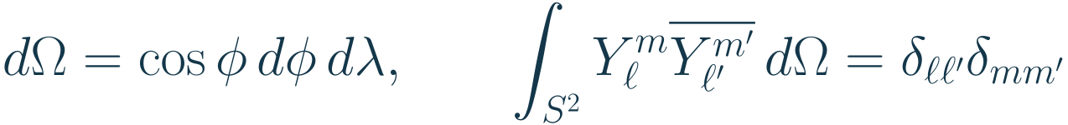

Spherical harmonics form a basis
Spherical harmonics represent a scalar field using patterns adapted to the sphere.
Degree
controls spatial scale. Order
counts longitude oscillations. Each degree
admits
from
to
.
is an associated Legendre function, the latitude shape.
normalizes the basis
under angular area,
.
The overbar means complex conjugation. The Kronecker symbol
equals
for equal
indices and
otherwise.
T, B, appendix A
09
Notes:
Source slide 9. Spherical harmonics form a basis
Spherical harmonics represent a scalar field using patterns adapted to the sphere.
Degree $\ell$ controls spatial scale. Order $m$ counts longitude oscillations. Each degree admits $m$ from $-\ell$ to $\ell$.
LaTeX: Y_\ell^m(\lambda,\phi)=N_{\ell m}P_\ell^m(\sin\phi)e^{im\lambda},
\qquad -\ell\le m\le\ell
$P_\ell^m$ is an associated Legendre function, the latitude shape. $N_{\ell m}$ normalizes the basis under angular area, $d\Omega$.
LaTeX: d\Omega=\cos\phi\,d\phi\,d\lambda,\qquad
\int_{S^2}Y_\ell^m\overline{Y_{\ell'}^{m'}}\,d\Omega
=\delta_{\ell\ell'}\delta_{mm'}
The overbar means complex conjugation. The Kronecker symbol $\delta$ equals $1$ for equal indices and $0$ otherwise.
Evidence: T, B, appendix A
T: NVIDIA torch-harmonics, scalar/vector SHT and quadrature. https://github.com/NVIDIA/torch-harmonics/blob/v0.7.4/torch_harmonics/sht.py. Repository dependency pins version 0.7.4.
B: Bonev et al. (2023), Spherical Fourier Neural Operators. https://proceedings.mlr.press/v202/bonev23a/bonev23a.pdf

Slide 10
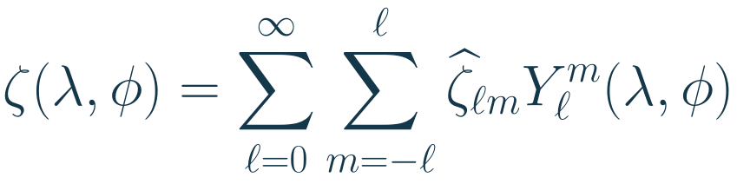



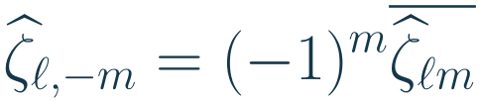
Coefficients specify amplitude and phase
A scalar field is a sum of harmonics. Each complex coefficient sets a pattern's amplitude
and longitude phase.
Degree
is constant. Degree
contains patterns proportional to
,
, and
.
Real fields combine conjugate modes. With the standard harmonic phase convention:
Larger
gives smaller spatial scales. Truncation keeps a finite range of degrees.
T; B, appendix A
10
Notes:
Source slide 10. Coefficients specify amplitude and phase
A scalar field is a sum of harmonics. Each complex coefficient sets a pattern's amplitude and longitude phase.
LaTeX: \zeta(\lambda,\phi)=\sum_{\ell=0}^{\infty}\sum_{m=-\ell}^{\ell}
\widehat\zeta_{\ell m}Y_\ell^m(\lambda,\phi)
Degree $0$ is constant. Degree $1$ contains patterns proportional to $\sin\phi$, $\cos\phi\cos\lambda$, and $\cos\phi\sin\lambda$.
Real fields combine conjugate modes. With the standard harmonic phase convention:
LaTeX: \widehat\zeta_{\ell,-m}=(-1)^m\overline{\widehat\zeta_{\ell m}}
Larger $\ell$ gives smaller spatial scales. Truncation keeps a finite range of degrees.
Evidence: T; B, appendix A
T: NVIDIA torch-harmonics, scalar/vector SHT and quadrature. https://github.com/NVIDIA/torch-harmonics/blob/v0.7.4/torch_harmonics/sht.py. Repository dependency pins version 0.7.4.
B: Bonev et al. (2023), Spherical Fourier Neural Operators. https://proceedings.mlr.press/v202/bonev23a/bonev23a.pdf

Slide 11



Latitude, colatitude, and angular area
Let
be the sine of latitude. Many references instead use colatitude
, measured from
the north pole.
This change of variable absorbs the area factor. The sphere's angular integral becomes
an ordinary integral on a rectangle.
Physical area adds
. We use angular area to normalize the harmonics, so a transform
preserves the field's units.
Y; H
11
Notes:
Source slide 11. Latitude, colatitude, and angular area
Let $\mu$ be the sine of latitude. Many references instead use colatitude $\vartheta$, measured from the north pole.
LaTeX: \mu=\sin\phi=\cos\vartheta,\qquad
\vartheta=\frac{\pi}{2}-\phi,\qquad -1\le\mu\le1
This change of variable absorbs the area factor. The sphere's angular integral becomes an ordinary integral on a rectangle.
LaTeX: d\Omega=\cos\phi\,d\phi\,d\lambda=d\mu\,d\lambda,
\qquad \int_{S^2}g\,d\Omega=\int_{-1}^{1}\int_0^{2\pi}g(\lambda,\arcsin\mu)\,d\lambda\,d\mu
Physical area adds $a^2$. We use angular area to normalize the harmonics, so a transform preserves the field's units.
Evidence: Y; H
Y: NIST DLMF, section 14.30: Spherical harmonics. https://dlmf.nist.gov/14.30
H: Held, The barotropic vorticity equation. https://www.gfdl.noaa.gov/wp-content/uploads/files/user_files/pjp/barotropic.pdf

Slide 12


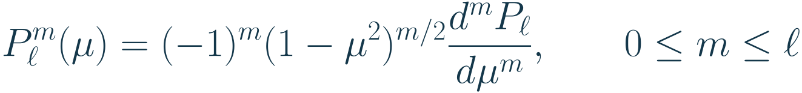
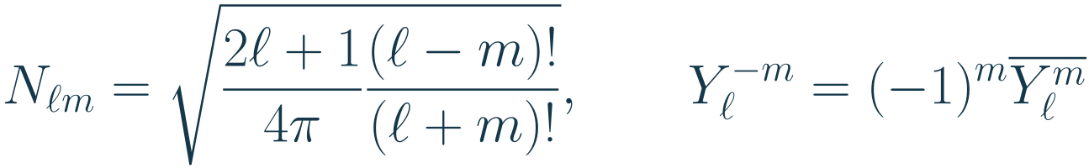

Basis normalization and Legendre functions
Let
be the ordinary Legendre polynomial with
. For nonnegative order, define
the associated function with the Condon-Shortley phase.
Our orthonormal convention fixes the scale of every coefficient.
For
, the latitude basis is an ordinary Legendre polynomial. For nonzero order, its
latitude shape changes with
.
Y, equations 14.30.1 and 14.30.6
12
Notes:
Source slide 12. Basis normalization and Legendre functions
Let $P_\ell$ be the ordinary Legendre polynomial with $P_\ell(1)=1$. For nonnegative order, define the associated function with the Condon-Shortley phase.
LaTeX: P_\ell^m(\mu)=(-1)^m(1-\mu^2)^{m/2}\frac{d^mP_\ell}{d\mu^m},
\qquad 0\le m\le\ell
Our orthonormal convention fixes the scale of every coefficient.
LaTeX: N_{\ell m}=\sqrt{\frac{2\ell+1}{4\pi}\frac{(\ell-m)!}{(\ell+m)!}},
\qquad Y_\ell^{-m}=(-1)^m\overline{Y_\ell^m}
For $m=0$, the latitude basis is an ordinary Legendre polynomial. For nonzero order, its latitude shape changes with $m$.
Evidence: Y, equations 14.30.1 and 14.30.6
Y: NIST DLMF, section 14.30: Spherical harmonics. https://dlmf.nist.gov/14.30

Slide 13

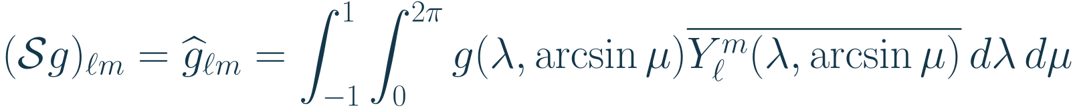

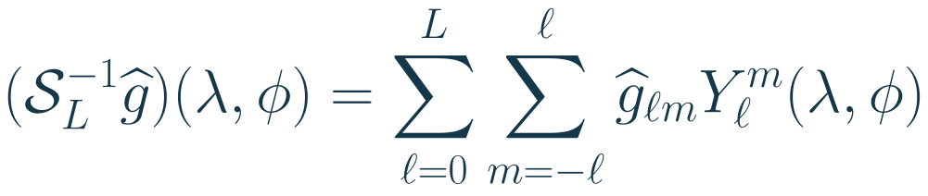
SHT definition: analysis and synthesis
Let
be a square-integrable scalar field. Analysis finds its inner products with the
orthonormal harmonics.
Synthesis rebuilds the field. A triangular cutoff
keeps every order through degree
.
For a field bandlimited to
, synthesis recovers the field exactly. For a general field, it
returns its orthogonal projection onto the retained modes.
Y; C
13
Notes:
Source slide 13. SHT definition: analysis and synthesis
Let $g$ be a square-integrable scalar field. Analysis finds its inner products with the orthonormal harmonics.
LaTeX: (\mathcal Sg)_{\ell m}=\widehat g_{\ell m}
=\int_{-1}^{1}\int_0^{2\pi}g(\lambda,\arcsin\mu)
\overline{Y_\ell^m(\lambda,\arcsin\mu)}\,d\lambda\,d\mu
Synthesis rebuilds the field. A triangular cutoff $L$ keeps every order through degree $L$.
LaTeX: (\mathcal S_L^{-1}\widehat g)(\lambda,\phi)
=\sum_{\ell=0}^{L}\sum_{m=-\ell}^{\ell}\widehat g_{\ell m}Y_\ell^m(\lambda,\phi)
For a field bandlimited to $L$, synthesis recovers the field exactly. For a general field, it returns its orthogonal projection onto the retained modes.
Evidence: Y; C
Y: NIST DLMF, section 14.30: Spherical harmonics. https://dlmf.nist.gov/14.30
C: Schaeffer (2013), Efficient spherical harmonic transforms. https://arxiv.org/abs/1202.6522 ; Gaussian sampling and dealiasing: https://nschaeff.bitbucket.io/shtns/spat.html

Slide 14
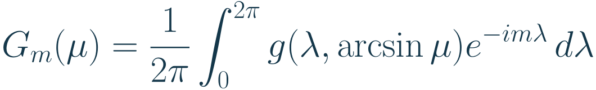

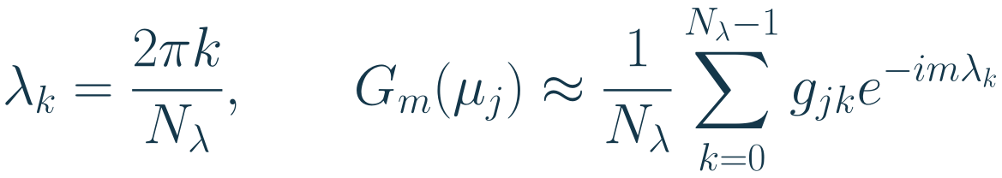
Step 1: Fourier analysis along longitude
Hold latitude fixed and travel around its circle. Longitude is periodic, so ordinary Fourier
modes are the natural basis.
Let
count longitude columns. A discrete Fourier transform acts on each row; the FFT
computes it efficiently.
The result still varies with latitude. Only the longitude coordinate has become an order
index
.
T, v0.7.4 RealSHT.forward; C
14
Notes:
Source slide 14. Step 1: Fourier analysis along longitude
Hold latitude fixed and travel around its circle. Longitude is periodic, so ordinary Fourier modes are the natural basis.
LaTeX: G_m(\mu)=\frac{1}{2\pi}\int_0^{2\pi}
g(\lambda,\arcsin\mu)e^{-im\lambda}\,d\lambda
Let $N_\lambda$ count longitude columns. A discrete Fourier transform acts on each row; the FFT computes it efficiently.
LaTeX: \lambda_k=\frac{2\pi k}{N_\lambda},\qquad
G_m(\mu_j)\approx\frac{1}{N_\lambda}\sum_{k=0}^{N_\lambda-1}g_{jk}e^{-im\lambda_k}
The result still varies with latitude. Only the longitude coordinate has become an order index $m$.
Evidence: T, v0.7.4 RealSHT.forward; C
T: NVIDIA torch-harmonics, scalar/vector SHT and quadrature. https://github.com/NVIDIA/torch-harmonics/blob/v0.7.4/torch_harmonics/sht.py. Repository dependency pins version 0.7.4.
C: Schaeffer (2013), Efficient spherical harmonic transforms. https://arxiv.org/abs/1202.6522 ; Gaussian sampling and dealiasing: https://nschaeff.bitbucket.io/shtns/spat.html

Slide 15
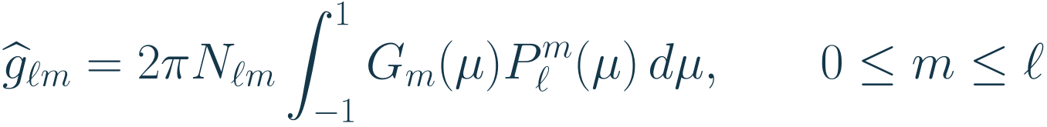

Step 2: Legendre projection in latitude
Insert the separated harmonic into the SHT definition. The longitude integral is exactly the
Fourier coefficient we just computed.
For each fixed order
, project the remaining latitude dependence onto associated
Legendre functions of degree
.
The factor
follows from our normalized Fourier coefficient. A library may distribute this
factor differently; analysis and synthesis must use the same convention.
This is the separation: Fourier in longitude, Legendre in latitude. It is not a
two-dimensional FFT on a flat rectangle.
T; C; derivation from the SHT definition
15
Notes:
Source slide 15. Step 2: Legendre projection in latitude
Insert the separated harmonic into the SHT definition. The longitude integral is exactly the Fourier coefficient we just computed.
LaTeX: \widehat g_{\ell m}=2\pi N_{\ell m}\int_{-1}^{1}G_m(\mu)P_\ell^m(\mu)\,d\mu,
\qquad 0\le m\le\ell
For each fixed order $m$, project the remaining latitude dependence onto associated Legendre functions of degree $\ell$.
The factor $2\pi$ follows from our normalized Fourier coefficient. A library may distribute this factor differently; analysis and synthesis must use the same convention.
This is the separation: Fourier in longitude, Legendre in latitude. It is not a two-dimensional FFT on a flat rectangle.
Evidence: T; C; derivation from the SHT definition
T: NVIDIA torch-harmonics, scalar/vector SHT and quadrature. https://github.com/NVIDIA/torch-harmonics/blob/v0.7.4/torch_harmonics/sht.py. Repository dependency pins version 0.7.4.
C: Schaeffer (2013), Efficient spherical harmonic transforms. https://arxiv.org/abs/1202.6522 ; Gaussian sampling and dealiasing: https://nschaeff.bitbucket.io/shtns/spat.html

Slide 16


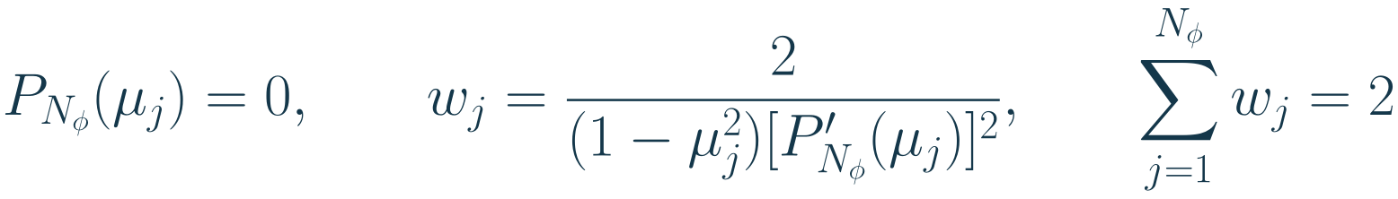

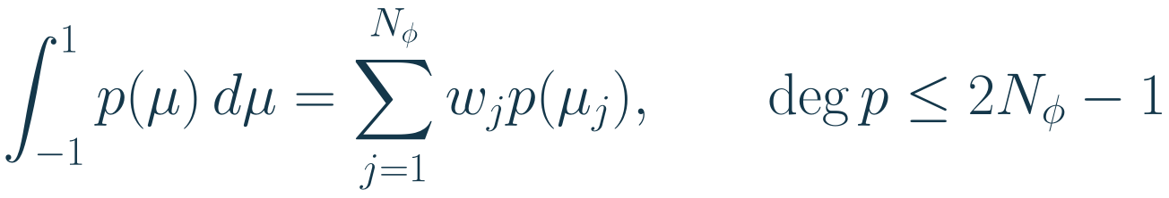
Gaussian quadrature: nodes and weights
Quadrature approximates an integral by a weighted sum. Let
count latitude nodes.
Gauss-Legendre nodes are roots of
.
With
nodes, it integrates every polynomial of degree at most
exactly, in exact
arithmetic.
For nonpolynomial integrands, the rule generally has an integration error.
Q, Gauss quadrature and Gauss-Legendre formula
16
Notes:
Source slide 16. Gaussian quadrature: nodes and weights
Quadrature approximates an integral by a weighted sum. Let $N_\phi$ count latitude nodes. Gauss-Legendre nodes are roots of $P_{N_\phi}$.
LaTeX: P_{N_\phi}(\mu_j)=0,\qquad
w_j=\frac{2}{(1-\mu_j^2)[P'_{N_\phi}(\mu_j)]^2},\qquad
\sum_{j=1}^{N_\phi}w_j=2
With $N_\phi$ nodes, it integrates every polynomial of degree at most $2N_\phi-1$ exactly, in exact arithmetic.
LaTeX: \int_{-1}^{1}p(\mu)\,d\mu
=\sum_{j=1}^{N_\phi}w_jp(\mu_j),\qquad \deg p\le2N_\phi-1
For nonpolynomial integrands, the rule generally has an integration error.
Evidence: Q, Gauss quadrature and Gauss-Legendre formula
Q: NIST DLMF, section 3.5(v): Gauss quadrature. https://dlmf.nist.gov/3.5#v

Slide 17

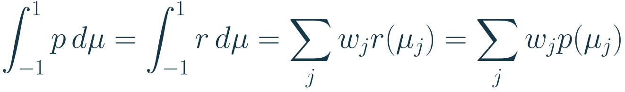
Why Gauss quadrature reaches that degree
Take any polynomial
of degree at most
. Polynomial division gives a quotient
and remainder
.
Legendre orthogonality makes the integral of
vanish. At the chosen nodes, this
product also vanishes pointwise.
The weights integrate the interpolating remainder exactly. Choosing the roots removes the
higher-degree part from both the integral and the sum.
Q; polynomial division and Legendre orthogonality
17
Notes:
Source slide 17. Why Gauss quadrature reaches that degree
Take any polynomial $p$ of degree at most $2N_\phi-1$. Polynomial division gives a quotient $q$ and remainder $r$.
LaTeX: p=P_{N_\phi}q+r,\qquad \deg q\le N_\phi-1,\qquad \deg r\le N_\phi-1
Legendre orthogonality makes the integral of $P_{N_\phi}q$ vanish. At the chosen nodes, this product also vanishes pointwise.
LaTeX: \int_{-1}^{1}p\,d\mu=\int_{-1}^{1}r\,d\mu
=\sum_j w_jr(\mu_j)=\sum_jw_jp(\mu_j)
The weights integrate the interpolating remainder exactly. Choosing the roots removes the higher-degree part from both the integral and the sum.
Evidence: Q; polynomial division and Legendre orthogonality
Q: NIST DLMF, section 3.5(v): Gauss quadrature. https://dlmf.nist.gov/3.5#v

Slide 18
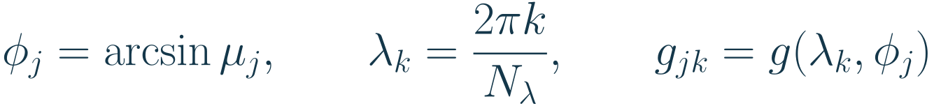
The Gaussian grid on the sphere
Convert the Gauss-Legendre nodes to latitude. Pair each row with equally spaced
longitudes to form a full Gaussian grid.
The latitude rows are symmetric about the equator and exclude the poles. They are
nonuniform in latitude and in its sine. They are not equal-area rows.
The name refers to Gauss's integration rule, not a Gaussian probability distribution. The
node locations and weights are a matched pair.
A reduced Gaussian grid uses fewer longitudes near the poles. Here we use the full grid,
with the same longitude count on every row.
E; Q; R3
18
Notes:
Source slide 18. The Gaussian grid on the sphere
Convert the Gauss-Legendre nodes to latitude. Pair each row with equally spaced longitudes to form a full Gaussian grid.
LaTeX: \phi_j=\arcsin\mu_j,\qquad
\lambda_k=\frac{2\pi k}{N_\lambda},\qquad g_{jk}=g(\lambda_k,\phi_j)
The latitude rows are symmetric about the equator and exclude the poles. They are nonuniform in latitude and in its sine. They are not equal-area rows.
The name refers to Gauss's integration rule, not a Gaussian probability distribution. The node locations and weights are a matched pair.
A reduced Gaussian grid uses fewer longitudes near the poles. Here we use the full grid, with the same longitude count on every row.
Evidence: E; Q; R3
E: ECMWF, Gaussian grids: latitude nodes and full/reduced longitude layouts. https://confluence.ecmwf.int/spaces/FCST/pages/49415103/Gaussian%2Bgrids
Q: NIST DLMF, section 3.5(v): Gauss quadrature. https://dlmf.nist.gov/3.5#v
R3: sim/barotropic_stirring.py:20-27, at repository 185e086fed79420544a1f06485f7fedf425ec100. https://github.com/tglanz/climatology/blob/185e086fed79420544a1f06485f7fedf425ec100/sim/barotropic_stirring.py

Slide 19
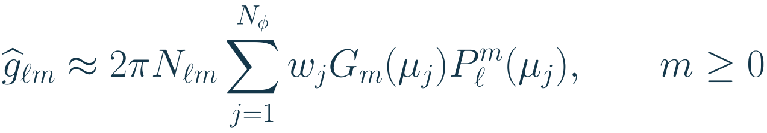

The discrete SHT combines both rules
First apply the longitude FFT to each latitude row. Then contract each order with the
weighted Legendre functions.
For a real field, negative orders follow by conjugate symmetry. Inverse synthesis
evaluates the Legendre sums at the latitude nodes, then applies an inverse longitude FFT.
No extra cosine weight belongs in this sum: the substitution
already absorbed
the spherical area factor.
T, v0.7.4 RealSHT and InverseRealSHT
19
Notes:
Source slide 19. The discrete SHT combines both rules
First apply the longitude FFT to each latitude row. Then contract each order with the weighted Legendre functions.
LaTeX: g_{jk}\ \xrightarrow{\mathrm{FFT\ in}\ \lambda}\ G_m(\mu_j)
\ \xrightarrow{\mathrm{weighted\ Legendre\ in}\ \mu}\ \widehat g_{\ell m}
LaTeX: \widehat g_{\ell m}\approx2\pi N_{\ell m}
\sum_{j=1}^{N_\phi}w_jG_m(\mu_j)P_\ell^m(\mu_j),\qquad m\ge0
For a real field, negative orders follow by conjugate symmetry. Inverse synthesis evaluates the Legendre sums at the latitude nodes, then applies an inverse longitude FFT.
No extra cosine weight belongs in this sum: the substitution $\mu=\sin\phi$ already absorbed the spherical area factor.
Evidence: T, v0.7.4 RealSHT and InverseRealSHT
T: NVIDIA torch-harmonics, scalar/vector SHT and quadrature. https://github.com/NVIDIA/torch-harmonics/blob/v0.7.4/torch_harmonics/sht.py. Repository dependency pins version 0.7.4.

Slide 20

When the sampled transform is exact
Assume a scalar field is bandlimited to degree
. To distinguish longitude orders through
, use at least
columns.
For a fixed order, the latitude integrands are products of associated Legendre functions.
The square-root factors combine into an ordinary polynomial.
Gauss-Legendre quadrature therefore gives sufficient sampling bounds for an exact
analysis-synthesis round trip.
Exactness assumes matching normalization and coordinates, and exact arithmetic.
Unresolved structure aliases into the retained modes.
C, Gaussian sampling; Q; derivation for a triangular scalar bandlimit
20
Notes:
Source slide 20. When the sampled transform is exact
Assume a scalar field is bandlimited to degree $L$. To distinguish longitude orders through $L$, use at least $2L+1$ columns.
For a fixed order, the latitude integrands are products of associated Legendre functions. The square-root factors combine into an ordinary polynomial.
LaTeX: P_\ell^m(\mu)P_{\ell'}^m(\mu)
\text{ has degree at most }\ell+\ell'\le2L
Gauss-Legendre quadrature therefore gives sufficient sampling bounds for an exact analysis-synthesis round trip.
LaTeX: N_\lambda\ge2L+1,\qquad N_\phi\ge L+1
Exactness assumes matching normalization and coordinates, and exact arithmetic. Unresolved structure aliases into the retained modes.
Evidence: C, Gaussian sampling; Q; derivation for a triangular scalar bandlimit
C: Schaeffer (2013), Efficient spherical harmonic transforms. https://arxiv.org/abs/1202.6522 ; Gaussian sampling and dealiasing: https://nschaeff.bitbucket.io/shtns/spat.html
Q: NIST DLMF, section 3.5(v): Gauss quadrature. https://dlmf.nist.gov/3.5#v

Slide 21
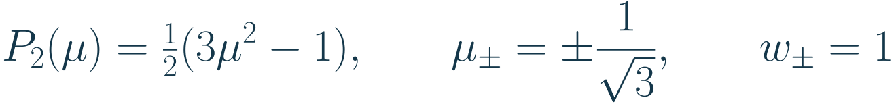

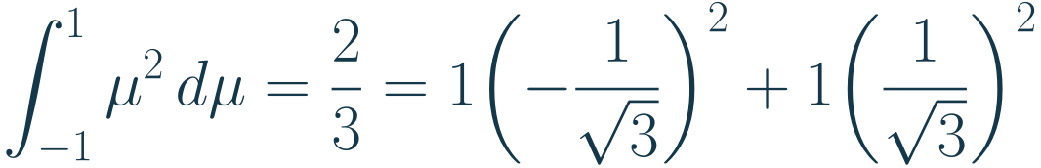


Worked example: two Gaussian latitude rows
With two latitude nodes, the ordinary Legendre polynomial and its roots give the grid and
weights.
The latitudes are approximately
. The rule integrates a quadratic exactly.
It fails for the fourth power: the integral is
, but the weighted sum is
. The degree
limit is a real constraint.
Q; direct calculation
21
Notes:
Source slide 21. Worked example: two Gaussian latitude rows
With two latitude nodes, the ordinary Legendre polynomial and its roots give the grid and weights.
LaTeX: P_2(\mu)=\tfrac12(3\mu^2-1),\qquad
\mu_\pm=\pm\frac{1}{\sqrt3},\qquad w_\pm=1
The latitudes are approximately $\pm35.264^\circ$. The rule integrates a quadratic exactly.
LaTeX: \int_{-1}^{1}\mu^2\,d\mu=\frac23
=1\!\left(-\frac{1}{\sqrt3}\right)^2+1\!\left(\frac{1}{\sqrt3}\right)^2
It fails for the fourth power: the integral is $2/5$, but the weighted sum is $2/9$. The degree limit is a real constraint.
Evidence: Q; direct calculation
Q: NIST DLMF, section 3.5(v): Gauss quadrature. https://dlmf.nist.gov/3.5#v

Slide 22


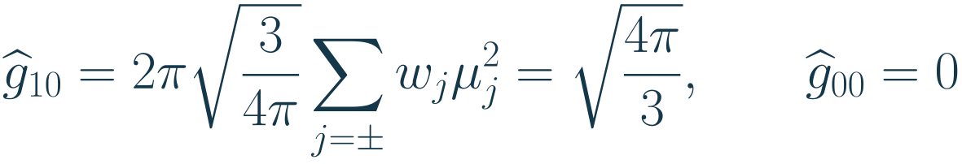

Worked example: transform a latitude pattern
Take the dimensionless field
. Its longitude Fourier transform has only
order zero.
Use the two Gaussian rows and at least three longitude columns. Since
, the
coefficient is
Synthesis gives
. Within the degree-one band, this reconstructs the original field
exactly.
Y; Q; direct calculation with the stated normalization
22
Notes:
Source slide 22. Worked example: transform a latitude pattern
Take the dimensionless field $g(\lambda,\phi)=\sin\phi=\mu$. Its longitude Fourier transform has only order zero.
LaTeX: G_0(\mu)=\mu,\qquad G_m(\mu)=0\quad(m\ne0)
Use the two Gaussian rows and at least three longitude columns. Since $P_1(\mu)=\mu$, the coefficient is
LaTeX: \widehat g_{10}=2\pi\sqrt{\frac{3}{4\pi}}
\sum_{j=\pm}w_j\mu_j^2=\sqrt{\frac{4\pi}{3}},
\qquad \widehat g_{00}=0
Synthesis gives $\widehat g_{10}Y_1^0=\mu$. Within the degree-one band, this reconstructs the original field exactly.
Evidence: Y; Q; direct calculation with the stated normalization
Y: NIST DLMF, section 14.30: Spherical harmonics. https://dlmf.nist.gov/14.30
Q: NIST DLMF, section 3.5(v): Gauss quadrature. https://dlmf.nist.gov/3.5#v

Slide 23
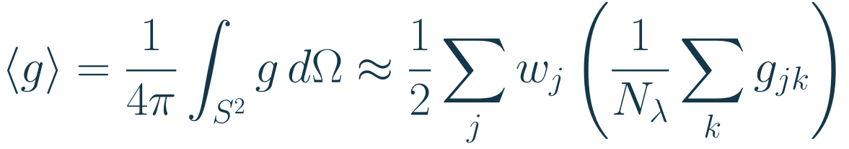
Area means on the Gaussian grid
For a sampled scalar field, a global area mean uses longitude averaging followed by the
Gaussian latitude weights.
The weights sum to
, so a constant field is unchanged. Multiplying the Gaussian weights
by another cosine changes the measure.
A zonal mean is different: it averages around one latitude circle and needs no latitude
weights. Latitude weights enter global means and area-weighted errors.
The grid is therefore part of the numerical method. Array dimensions alone do not specify
a valid transform or integral.
E; T; R4, Gaussian coordinate contract
23
Notes:
Source slide 23. Area means on the Gaussian grid
For a sampled scalar field, a global area mean uses longitude averaging followed by the Gaussian latitude weights.
LaTeX: \langle g\rangle=\frac{1}{4\pi}\int_{S^2}g\,d\Omega
\approx\frac12\sum_jw_j\left(\frac{1}{N_\lambda}\sum_kg_{jk}\right)
The weights sum to $2$, so a constant field is unchanged. Multiplying the Gaussian weights by another cosine changes the measure.
A zonal mean is different: it averages around one latitude circle and needs no latitude weights. Latitude weights enter global means and area-weighted errors.
The grid is therefore part of the numerical method. Array dimensions alone do not specify a valid transform or integral.
Evidence: E; T; R4, Gaussian coordinate contract
E: ECMWF, Gaussian grids: latitude nodes and full/reduced longitude layouts. https://confluence.ecmwf.int/spaces/FCST/pages/49415103/Gaussian%2Bgrids
T: NVIDIA torch-harmonics, scalar/vector SHT and quadrature. https://github.com/NVIDIA/torch-harmonics/blob/v0.7.4/torch_harmonics/sht.py. Repository dependency pins version 0.7.4.
R4: ml/src/ml/training/model.py at repository 185e086fed79420544a1f06485f7fedf425ec100. https://github.com/tglanz/climatology/blob/185e086fed79420544a1f06485f7fedf425ec100/ml/src/ml/training/model.py

Slide 24




Self-check: SHT and the Gaussian grid
1. At fixed latitude, which coordinate does the FFT vary? What index replaces it?
2. Why do the Gaussian weights need no extra factor of
?
3. For a field bandlimited to
, how many Gaussian latitude rows and longitude
columns suffice for an exact linear transform?
4. Why does the two-node rule integrate
exactly but fail for
?
Write the two-stage transform before reading the answers. Use our normalization to check
the factor
.
SHT chapter
24
Notes:
Source slide 24. Self-check: SHT and the Gaussian grid
1. At fixed latitude, which coordinate does the FFT vary? What index replaces it?
2. Why do the Gaussian weights need no extra factor of $\cos\phi$?
3. For a field bandlimited to $L=3$, how many Gaussian latitude rows and longitude columns suffice for an exact linear transform?
4. Why does the two-node rule integrate $\mu^3$ exactly but fail for $\mu^4$?
Write the two-stage transform before reading the answers. Use our normalization to check the factor $2\pi$.
Evidence: SHT chapter

Slide 25



Answers: SHT and the Gaussian grid
1. The FFT varies longitude
around a fixed latitude circle. Its output is indexed by longitude
order
and still depends on latitude.
2. The change of variable gives
. The weights already approximate integration in
.
3. Four Gaussian latitude rows and seven longitude columns suffice:
and
.
4. Two-node Gauss-Legendre quadrature is exact through degree three. Odd symmetry makes
both the cubic integral and its sum zero. For the fourth power they give
and
.
These are linear transform bounds. Projecting nonlinear products requires a finer grid, as we will
see in the spectral solver.
SHT chapter and worked quadrature example
25
Notes:
Source slide 25. Answers: SHT and the Gaussian grid
1. The FFT varies longitude $\lambda$ around a fixed latitude circle. Its output is indexed by longitude order $m$ and still depends on latitude.
2. The change of variable gives $d\mu=\cos\phi\,d\phi$. The weights already approximate integration in $\mu$.
3. Four Gaussian latitude rows and seven longitude columns suffice: $N_\phi\ge L+1$ and $N_\lambda\ge2L+1$.
4. Two-node Gauss-Legendre quadrature is exact through degree three. Odd symmetry makes both the cubic integral and its sum zero. For the fourth power they give $2/5$ and $2/9$.
These are linear transform bounds. Projecting nonlinear products requires a finer grid, as we will see in the spectral solver.
Evidence: SHT chapter and worked quadrature example

Slide 26
Chapter 3: spectral dynamics and SFNO
We now have a map between grid values and harmonic coefficients, with a numerical
integration rule that respects the sphere.
The BVE solver uses this map to apply known differential operators and evaluate
nonlinear products.
SFNO uses the same representation to learn transformations of hidden feature channels.
We will distinguish the physical time step, the learned spectral layer, and the final
representation of the mean-wind target.
H; B; R1; R4
26
Notes:
Source slide 26. Chapter 3: spectral dynamics and SFNO
We now have a map between grid values and harmonic coefficients, with a numerical integration rule that respects the sphere.
The BVE solver uses this map to apply known differential operators and evaluate nonlinear products.
SFNO uses the same representation to learn transformations of hidden feature channels.
We will distinguish the physical time step, the learned spectral layer, and the final representation of the mean-wind target.
Evidence: H; B; R1; R4
H: Held, The barotropic vorticity equation. https://www.gfdl.noaa.gov/wp-content/uploads/files/user_files/pjp/barotropic.pdf
B: Bonev et al. (2023), Spherical Fourier Neural Operators. https://proceedings.mlr.press/v202/bonev23a/bonev23a.pdf
R1: Isca pinned a290bc376d84d0ee83adbb80eb374b9f629c3534: src/atmos_spectral_barotropic/barotropic_dynamics.F90. https://github.com/ExeClim/Isca/blob/a290bc376d84d0ee83adbb80eb374b9f629c3534/src/atmos_spectral_barotropic/barotropic_dynamics.F90
R4: ml/src/ml/training/model.py at repository 185e086fed79420544a1f06485f7fedf425ec100. https://github.com/tglanz/climatology/blob/185e086fed79420544a1f06485f7fedf425ec100/ml/src/ml/training/model.py

Slide 27
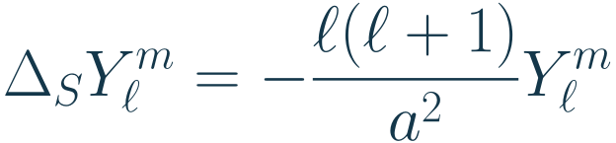
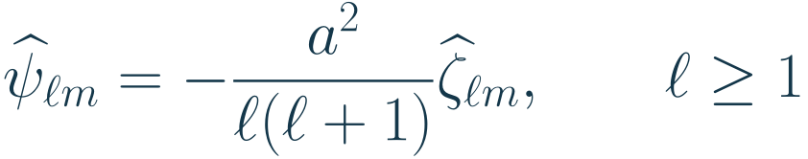

The Laplacian becomes a multiplier
Each harmonic is an eigenfunction of the spherical Laplacian. Differentiation becomes
multiplication of coefficients.
The Poisson solve is therefore a division for every nonconstant mode.
For
, the eigenvalue is zero. A smooth flow on the closed sphere has zero area-mean
relative vorticity. Set the constant
coefficient to zero as a gauge. It cannot affect wind.
H, spectral representation; R1; T
27
Notes:
Source slide 27. The Laplacian becomes a multiplier
Each harmonic is an eigenfunction of the spherical Laplacian. Differentiation becomes multiplication of coefficients.
LaTeX: \Delta_SY_\ell^m=-\frac{\ell(\ell+1)}{a^2}Y_\ell^m
The Poisson solve is therefore a division for every nonconstant mode.
LaTeX: \widehat\psi_{\ell m}
=-\frac{a^2}{\ell(\ell+1)}\widehat\zeta_{\ell m},
\qquad \ell\ge1
For $\ell=0$, the eigenvalue is zero. A smooth flow on the closed sphere has zero area-mean relative vorticity. Set the constant $\psi$ coefficient to zero as a gauge. It cannot affect wind.
Evidence: H, spectral representation; R1; T
H: Held, The barotropic vorticity equation. https://www.gfdl.noaa.gov/wp-content/uploads/files/user_files/pjp/barotropic.pdf
R1: Isca pinned a290bc376d84d0ee83adbb80eb374b9f629c3534: src/atmos_spectral_barotropic/barotropic_dynamics.F90. https://github.com/ExeClim/Isca/blob/a290bc376d84d0ee83adbb80eb374b9f629c3534/src/atmos_spectral_barotropic/barotropic_dynamics.F90
T: NVIDIA torch-harmonics, scalar/vector SHT and quadrature. https://github.com/NVIDIA/torch-harmonics/blob/v0.7.4/torch_harmonics/sht.py. Repository dependency pins version 0.7.4.

Slide 28


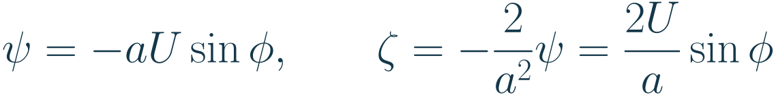

Worked example: a zonal wind
Take an eastward wind with maximum speed
at the equator.
The streamfunction formula gives
. Applying the degree-1 eigenvalue gives
.
This is an
,
mode. The signs and units agree:
has units
and
has
units
.
Recovering
from
returns the original wind. No longitude dependence enters.
streamfunction, Laplacian, and spectral inversion sections
28
Notes:
Source slide 28. Worked example: a zonal wind
Take an eastward wind with maximum speed $U$ at the equator.
LaTeX: u=U\cos\phi,\qquad v=0
The streamfunction formula gives $\psi$. Applying the degree-1 eigenvalue gives $\zeta$.
LaTeX: \psi=-aU\sin\phi,\qquad
\zeta=-\frac{2}{a^2}\psi=\frac{2U}{a}\sin\phi
This is an $\ell=1$, $m=0$ mode. The signs and units agree: $\psi$ has units $\mathrm{m^2\,s^{-1}}$ and $\zeta$ has units $\mathrm{s^{-1}}$.
Recovering $\psi$ from $\zeta$ returns the original wind. No longitude dependence enters.
Evidence: streamfunction, Laplacian, and spectral inversion sections

Slide 29
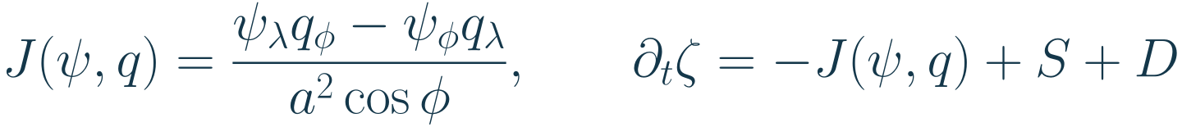


A spectral BVE step still uses the grid
The solver stores retained vorticity coefficients. It inverts the Laplacian to recover
, then
computes wind and derivatives.
The advection term multiplies fields. The solver evaluates these products on a spatial grid
and transforms the tendency back to coefficients.
Here
groups the drag and diffusion terms from the forced BVE equation. A time
integrator advances the coefficients.
Products couple modes. For example, nonzonal patterns can create a zonal contribution:
H, equations 10-12; R1
29
Notes:
Source slide 29. A spectral BVE step still uses the grid
The solver stores retained vorticity coefficients. It inverts the Laplacian to recover $\psi$, then computes wind and derivatives.
The advection term multiplies fields. The solver evaluates these products on a spatial grid and transforms the tendency back to coefficients.
LaTeX: J(\psi,q)=\frac{\psi_\lambda q_\phi-\psi_\phi q_\lambda}
{a^2\cos\phi},\qquad
\partial_t\zeta=-J(\psi,q)+S+D
Here $D$ groups the drag and diffusion terms from the forced BVE equation. A time integrator advances the coefficients.
Products couple modes. For example, nonzonal patterns can create a zonal contribution:
LaTeX: \cos^2\lambda=\tfrac12+\tfrac12\cos(2\lambda)
Evidence: H, equations 10-12; R1
H: Held, The barotropic vorticity equation. https://www.gfdl.noaa.gov/wp-content/uploads/files/user_files/pjp/barotropic.pdf
R1: Isca pinned a290bc376d84d0ee83adbb80eb374b9f629c3534: src/atmos_spectral_barotropic/barotropic_dynamics.F90. https://github.com/ExeClim/Isca/blob/a290bc376d84d0ee83adbb80eb374b9f629c3534/src/atmos_spectral_barotropic/barotropic_dynamics.F90

Slide 30

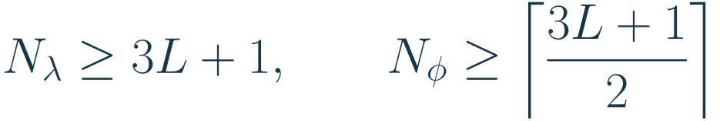
Truncation, sampling, and quadrature
Triangular cutoff
keeps degrees 0 through
and all their orders. This gives
scalar
modes before real-field symmetry.
Quadratic products reach higher modes. A finer grid prevents those modes from folding into the
retained band when projecting products back.
These are standard quadratic dealiasing bounds for this Gaussian spectral setup. The repository
rounds latitude count to even and longitude count for efficient Fourier transforms. T21 gives 32
by 64 points.
Gaussian latitude nodes are nonuniform. Their quadrature weights approximate area integrals in
. Uniform-latitude cosine weights are a different rule.
R3, barotropic_stirring.py:20-27; H; T
30
Notes:
Source slide 30. Truncation, sampling, and quadrature
Triangular cutoff $L$ keeps degrees 0 through $L$ and all their orders. This gives $(L+1)^2$ scalar modes before real-field symmetry.
Quadratic products reach higher modes. A finer grid prevents those modes from folding into the retained band when projecting products back.
LaTeX: N_\lambda\ge3L+1,\qquad
N_\phi\ge\left\lceil\frac{3L+1}{2}\right\rceil
These are standard quadratic dealiasing bounds for this Gaussian spectral setup. The repository rounds latitude count to even and longitude count for efficient Fourier transforms. T21 gives 32 by 64 points.
Gaussian latitude nodes are nonuniform. Their quadrature weights approximate area integrals in $\sin\phi$. Uniform-latitude cosine weights are a different rule.
Evidence: R3, barotropic_stirring.py:20-27; H; T
R3: sim/barotropic_stirring.py:20-27, at repository 185e086fed79420544a1f06485f7fedf425ec100. https://github.com/tglanz/climatology/blob/185e086fed79420544a1f06485f7fedf425ec100/sim/barotropic_stirring.py
H: Held, The barotropic vorticity equation. https://www.gfdl.noaa.gov/wp-content/uploads/files/user_files/pjp/barotropic.pdf
T: NVIDIA torch-harmonics, scalar/vector SHT and quadrature. https://github.com/NVIDIA/torch-harmonics/blob/v0.7.4/torch_harmonics/sht.py. Repository dependency pins version 0.7.4.

Slide 31
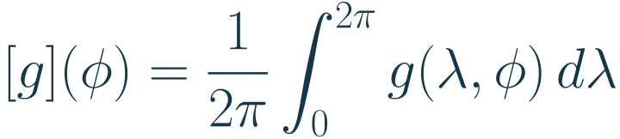
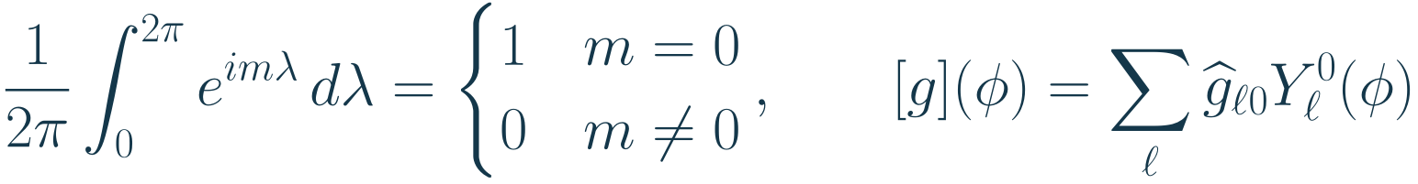
The zonal mean selects order zero
The zonal mean averages a field around each latitude circle.
Every nonzero longitude mode integrates to zero.
On a uniform longitude grid, an arithmetic mean exactly selects order
.
A spectral output head changes how the profile is represented. It gains no automatic
exactness over that discrete mean.
harmonic expansion and longitude orthogonality; R4, ZonalMeanWrapper
31
Notes:
Source slide 31. The zonal mean selects order zero
The zonal mean averages a field around each latitude circle.
LaTeX: [g](\phi)=\frac{1}{2\pi}\int_0^{2\pi}g(\lambda,\phi)\,d\lambda
Every nonzero longitude mode integrates to zero.
LaTeX: \frac{1}{2\pi}\int_0^{2\pi}e^{im\lambda}\,d\lambda
=\begin{cases}1&m=0\\0&m\ne0\end{cases},
\qquad
[g](\phi)=\sum_\ell\widehat g_{\ell0}Y_\ell^0(\phi)
On a uniform longitude grid, an arithmetic mean exactly selects order $m=0$.
A spectral output head changes how the profile is represented. It gains no automatic exactness over that discrete mean.
Evidence: harmonic expansion and longitude orthogonality; R4, ZonalMeanWrapper
R4: ml/src/ml/training/model.py at repository 185e086fed79420544a1f06485f7fedf425ec100. https://github.com/tglanz/climatology/blob/185e086fed79420544a1f06485f7fedf425ec100/ml/src/ml/training/model.py

Slide 32

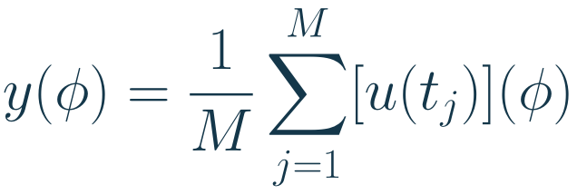


The target is a finite climatology
This project's default target is the time mean of the zonal-mean eastward wind.
is the
number of snapshots in the chosen averaging interval.
The input contains
consecutive vorticity snapshots, with
much smaller than
.
denotes learned parameters. A short random context need not identify the target
uniquely. Finite target averages retain sampling uncertainty.
Predicting this mean profile does not identify the full probability distribution of the flow.
R4; R5, compute_climatology and compute_time_mean_zonal_mean; R6, default.toml
32
Notes:
Source slide 32. The target is a finite climatology
This project's default target is the time mean of the zonal-mean eastward wind. $M$ is the number of snapshots in the chosen averaging interval.
LaTeX: y(\phi)=\frac{1}{M}\sum_{j=1}^{M}[u(t_j)](\phi)
The input contains $K$ consecutive vorticity snapshots, with $K$ much smaller than $M$.
LaTeX: X=(\zeta_{t_1},\ldots,\zeta_{t_K}),\qquad
F_\theta(X)\approx y
$\theta$ denotes learned parameters. A short random context need not identify the target uniquely. Finite target averages retain sampling uncertainty.
Predicting this mean profile does not identify the full probability distribution of the flow.
Evidence: R4; R5, compute_climatology and compute_time_mean_zonal_mean; R6, default.toml
R4: ml/src/ml/training/model.py at repository 185e086fed79420544a1f06485f7fedf425ec100. https://github.com/tglanz/climatology/blob/185e086fed79420544a1f06485f7fedf425ec100/ml/src/ml/training/model.py
R5: ml/src/ml/data/climatology.py at repository 185e086fed79420544a1f06485f7fedf425ec100. https://github.com/tglanz/climatology/blob/185e086fed79420544a1f06485f7fedf425ec100/ml/src/ml/data/climatology.py
R6: ml/configs/default.toml at repository 185e086fed79420544a1f06485f7fedf425ec100. https://github.com/tglanz/climatology/blob/185e086fed79420544a1f06485f7fedf425ec100/ml/configs/default.toml

Slide 33


Self-check A
1. Why does
have units
?
2. Why can the
vorticity coefficient not be inverted? What freedom remains in
?
3. A vorticity field contains only
,
and its real-field partner. What are its
streamfunction and zonal mean?
Try the questions before reading Answers A.
streamfunction, spectral inversion, and zonal mean sections
33
Notes:
Source slide 33. Self-check A
1. Why does $\psi$ have units $\mathrm{m^2\,s^{-1}}$?
2. Why can the $\ell=0$ vorticity coefficient not be inverted? What freedom remains in $\psi$?
3. A vorticity field contains only $\ell=2$, $m=1$ and its real-field partner. What are its streamfunction and zonal mean?
Try the questions before reading Answers A.
Evidence: streamfunction, spectral inversion, and zonal mean sections

Slide 34



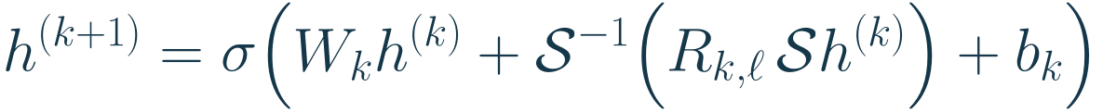



One SFNO spectral layer
A Spherical Fourier Neural Operator (SFNO) learns transformations of fields on a sphere.
Its spherical harmonic transform,
, converts hidden feature channels
into
coefficients. A learned channel matrix
mixes them at each degree
.
indexes layers.
mixes channels at each grid point,
is a bias, and
is a pointwise
nonlinear function.
The displayed form is the basic layer. Implementations can add further pointwise channel
mixing and scaling.
B, sections 3-4; R7, spherical_convolution.py
34
Notes:
Source slide 34. One SFNO spectral layer
A Spherical Fourier Neural Operator (SFNO) learns transformations of fields on a sphere.
Its spherical harmonic transform, $\mathcal S$, converts hidden feature channels $h^{(k)}$ into coefficients. A learned channel matrix $R_{k,\ell}$ mixes them at each degree $\ell$.
LaTeX: h^{(k+1)}
=\sigma\!\left(W_kh^{(k)}
+\mathcal S^{-1}\!\left(R_{k,\ell}\,\mathcal S h^{(k)}\right)
+b_k\right)
$k$ indexes layers. $W_k$ mixes channels at each grid point, $b_k$ is a bias, and $\sigma$ is a pointwise nonlinear function.
The displayed form is the basic layer. Implementations can add further pointwise channel mixing and scaling.
Evidence: B, sections 3-4; R7, spherical_convolution.py
B: Bonev et al. (2023), Spherical Fourier Neural Operators. https://proceedings.mlr.press/v202/bonev23a/bonev23a.pdf
R7: NeuralOperator pinned 98cd305099f4a2b232ed85773984f3e5991f9b1a: neuralop/layers/spherical_convolution.py. https://github.com/NeuralOperator/neuraloperator/blob/98cd305099f4a2b232ed85773984f3e5991f9b1a/neuralop/layers/spherical_convolution.py

Slide 35
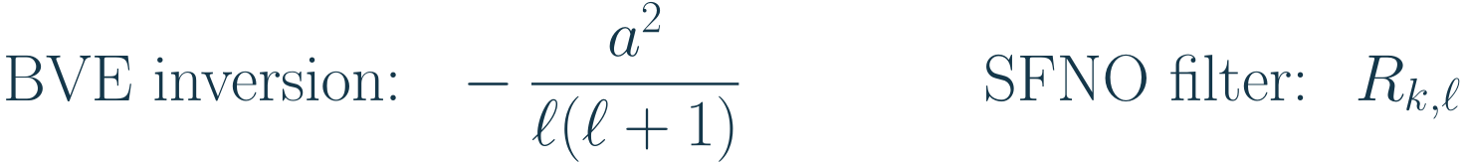
Known dynamics and learned filters
The spectral BVE solver uses known physical rules. Its Laplacian multiplier and advection
determine a time derivative.
SFNO uses trainable channel matrices. Training chooses their entries to fit the requested
input-to-output map.
Both use a harmonic basis. An SFNO layer is not a prescribed BVE time step and need not
conserve BVE invariants.
A degree-only filter supports rotation equivariance for scalar fields under suitable layer
assumptions. Coordinates, nonlinear choices, and forcing can restrict the full model's symmetry.
B; R7; R8, input coordinates and architecture
35
Notes:
Source slide 35. Known dynamics and learned filters
The spectral BVE solver uses known physical rules. Its Laplacian multiplier and advection determine a time derivative.
SFNO uses trainable channel matrices. Training chooses their entries to fit the requested input-to-output map.
LaTeX: \text{BVE inversion: }\ -\frac{a^2}{\ell(\ell+1)}
\qquad\qquad
\text{SFNO filter: }\ R_{k,\ell}
Both use a harmonic basis. An SFNO layer is not a prescribed BVE time step and need not conserve BVE invariants.
A degree-only filter supports rotation equivariance for scalar fields under suitable layer assumptions. Coordinates, nonlinear choices, and forcing can restrict the full model's symmetry.
Evidence: B; R7; R8, input coordinates and architecture
B: Bonev et al. (2023), Spherical Fourier Neural Operators. https://proceedings.mlr.press/v202/bonev23a/bonev23a.pdf
R7: NeuralOperator pinned 98cd305099f4a2b232ed85773984f3e5991f9b1a: neuralop/layers/spherical_convolution.py. https://github.com/NeuralOperator/neuraloperator/blob/98cd305099f4a2b232ed85773984f3e5991f9b1a/neuralop/layers/spherical_convolution.py
R8: NeuralOperator pinned 98cd305099f4a2b232ed85773984f3e5991f9b1a: neuralop/models/fno.py. https://github.com/NeuralOperator/neuraloperator/blob/98cd305099f4a2b232ed85773984f3e5991f9b1a/neuralop/models/fno.py

Slide 36



The current network predicts a profile
The default uses
vorticity snapshots. A T85 Isca run supplies an
,
Gaussian grid; the model reads its physical coordinates. Each time slice becomes an
input channel.
The factory builds an SFNO or FNO that returns a spatial field. The wrapper then
averages its output over longitude.
A batch adds a leading sample dimension. The output represents the finite climatology
defined earlier, not the next vorticity snapshot.
The default selects SFNO. The same output wrapper currently applies to both
architectures.
R4, model factory and wrapper; R6, default.toml
36
Notes:
Source slide 36. The current network predicts a profile
The default uses $K=10$ vorticity snapshots. A T85 Isca run supplies an $H=128$, $W=256$ Gaussian grid; the model reads its physical coordinates. Each time slice becomes an input channel.
The factory builds an SFNO or FNO that returns a spatial field. The wrapper then averages its output over longitude.
LaTeX: \mathbb R^{K\times H\times W}
\quad\xrightarrow{\text{SFNO}}\quad
\mathbb R^{1\times H\times W}
\quad\xrightarrow{\text{longitude mean}}\quad
\mathbb R^{1\times H}
A batch adds a leading sample dimension. The output represents the finite climatology defined earlier, not the next vorticity snapshot.
The default selects SFNO. The same output wrapper currently applies to both architectures.
Evidence: R4, model factory and wrapper; R6, default.toml
R4: ml/src/ml/training/model.py at repository 185e086fed79420544a1f06485f7fedf425ec100. https://github.com/tglanz/climatology/blob/185e086fed79420544a1f06485f7fedf425ec100/ml/src/ml/training/model.py
R6: ml/configs/default.toml at repository 185e086fed79420544a1f06485f7fedf425ec100. https://github.com/tglanz/climatology/blob/185e086fed79420544a1f06485f7fedf425ec100/ml/configs/default.toml

Slide 37
The transform must match the coordinates
A spherical transform assumes specific latitude nodes, row order, normalization, and
mode limits. Grid shape alone does not specify them.
Isca uses Gaussian latitudes. The current model explicitly selects Gauss-Legendre
transforms and reverses south-to-north input rows for the transform, then restores the
original row order.
The model uses the physical coordinates for positional features. Preprocessing,
area-weighted errors, checkpoints, and plots share the same coordinate contract.
A useful check samples one known harmonic on the data grid. Transforming and
reconstructing it should preserve its mode, amplitude, and physical orientation.
R4, GaussianSphericalConv and CoordinateEmbedding; docs/grids.md; T
37
Notes:
Source slide 37. The transform must match the coordinates
A spherical transform assumes specific latitude nodes, row order, normalization, and mode limits. Grid shape alone does not specify them.
Isca uses Gaussian latitudes. The current model explicitly selects Gauss-Legendre transforms and reverses south-to-north input rows for the transform, then restores the original row order.
The model uses the physical coordinates for positional features. Preprocessing, area-weighted errors, checkpoints, and plots share the same coordinate contract.
A useful check samples one known harmonic on the data grid. Transforming and reconstructing it should preserve its mode, amplitude, and physical orientation.
Evidence: R4, GaussianSphericalConv and CoordinateEmbedding; docs/grids.md; T
R4: ml/src/ml/training/model.py at repository 185e086fed79420544a1f06485f7fedf425ec100. https://github.com/tglanz/climatology/blob/185e086fed79420544a1f06485f7fedf425ec100/ml/src/ml/training/model.py
T: NVIDIA torch-harmonics, scalar/vector SHT and quadrature. https://github.com/NVIDIA/torch-harmonics/blob/v0.7.4/torch_harmonics/sht.py. Repository dependency pins version 0.7.4.

Slide 38


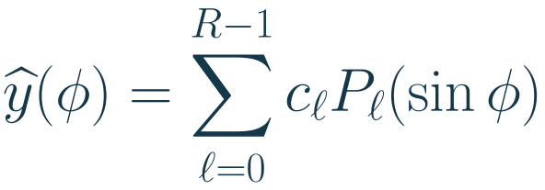

Three output representations
The current head projects to a full field and averages longitude. This leaves the SFNO
trunk free to use all longitude modes.
A direct profile head predicts
latitude values. A coefficient head predicts only
retained basis coefficients.
Here
is an ordinary Legendre polynomial and
is a learned output coefficient. This
scalar expansion compresses the profile.
The cutoff controls approximation error and output size. Removing nonzero longitude
modes throughout the trunk could discard information that helps predict the zonal target.
R4; proposed experiment; spectral stepping and zonal mean sections
38
Notes:
Source slide 38. Three output representations
The current head projects to a full field and averages longitude. This leaves the SFNO trunk free to use all longitude modes.
A direct profile head predicts $H$ latitude values. A coefficient head predicts only $R$ retained basis coefficients.
LaTeX: \widehat y(\phi)=\sum_{\ell=0}^{R-1}c_\ell P_\ell(\sin\phi)
Here $P_\ell$ is an ordinary Legendre polynomial and $c_\ell$ is a learned output coefficient. This scalar expansion compresses the profile.
The cutoff controls approximation error and output size. Removing nonzero longitude modes throughout the trunk could discard information that helps predict the zonal target.
Evidence: R4; proposed experiment; spectral stepping and zonal mean sections
R4: ml/src/ml/training/model.py at repository 185e086fed79420544a1f06485f7fedf425ec100. https://github.com/tglanz/climatology/blob/185e086fed79420544a1f06485f7fedf425ec100/ml/src/ml/training/model.py

Slide 39
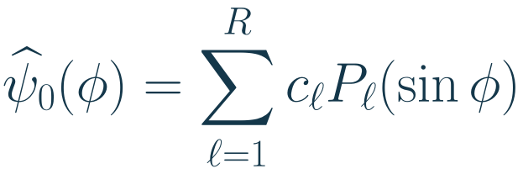
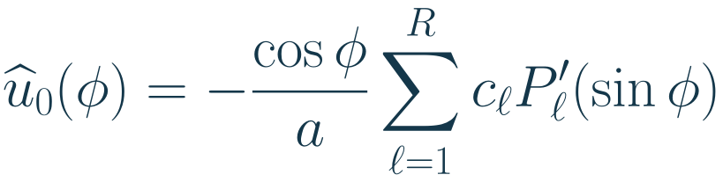
A streamfunction head respects wind geometry
The target is a tangent velocity component. A proposed head predicts a smooth
axisymmetric mean streamfunction, then derives its wind.
The prime differentiates the polynomial's argument. The cosine factor makes this smooth
axisymmetric wind vanish at each pole.
The constant streamfunction mode changes no wind, so the sum starts at
.
streamfunction derivation; T, vector harmonic transforms
39
Notes:
Source slide 39. A streamfunction head respects wind geometry
The target is a tangent velocity component. A proposed head predicts a smooth axisymmetric mean streamfunction, then derives its wind.
LaTeX: \widehat\psi_0(\phi)=\sum_{\ell=1}^{R}c_\ell P_\ell(\sin\phi)
LaTeX: \widehat u_0(\phi)
=-\frac{\cos\phi}{a}\sum_{\ell=1}^{R}c_\ell P'_\ell(\sin\phi)
The prime differentiates the polynomial's argument. The cosine factor makes this smooth axisymmetric wind vanish at each pole.
The constant streamfunction mode changes no wind, so the sum starts at $\ell=1$.
Evidence: streamfunction derivation; T, vector harmonic transforms
T: NVIDIA torch-harmonics, scalar/vector SHT and quadrature. https://github.com/NVIDIA/torch-harmonics/blob/v0.7.4/torch_harmonics/sht.py. Repository dependency pins version 0.7.4.

Slide 40
A controlled head experiment
Compare the current head, a direct profile head, and coefficient heads using the same
data, splits, normalization, and loss.
First project true target profiles onto each basis. This measures truncation error before
any model learns.
Then report prediction error, jet position, runtime, memory, and parameter count. Use
several seeds and the same held-out forcing regimes.
Include a parameter-only baseline. A better head should improve a stated tradeoff, not
merely add capacity.
Test longitude shifts explicitly. Order-zero output alone does not guarantee invariance to
shifts of the input. The current coordinate embedding and localized forcing need attention.
proposed experiment; R4; R6; R8
40
Notes:
Source slide 40. A controlled head experiment
Compare the current head, a direct profile head, and coefficient heads using the same data, splits, normalization, and loss.
First project true target profiles onto each basis. This measures truncation error before any model learns.
Then report prediction error, jet position, runtime, memory, and parameter count. Use several seeds and the same held-out forcing regimes.
Include a parameter-only baseline. A better head should improve a stated tradeoff, not merely add capacity.
Test longitude shifts explicitly. Order-zero output alone does not guarantee invariance to shifts of the input. The current coordinate embedding and localized forcing need attention.
Evidence: proposed experiment; R4; R6; R8
R4: ml/src/ml/training/model.py at repository 185e086fed79420544a1f06485f7fedf425ec100. https://github.com/tglanz/climatology/blob/185e086fed79420544a1f06485f7fedf425ec100/ml/src/ml/training/model.py
R6: ml/configs/default.toml at repository 185e086fed79420544a1f06485f7fedf425ec100. https://github.com/tglanz/climatology/blob/185e086fed79420544a1f06485f7fedf425ec100/ml/configs/default.toml
R8: NeuralOperator pinned 98cd305099f4a2b232ed85773984f3e5991f9b1a: neuralop/models/fno.py. https://github.com/NeuralOperator/neuraloperator/blob/98cd305099f4a2b232ed85773984f3e5991f9b1a/neuralop/models/fno.py

Slide 41
Self-check B
4. Why can nonzonal input modes matter when the output has only
?
5. What does an SFNO learn that a spectral BVE solver already knows?
6. Why is a coefficient head not automatically more exact or more invariant than the
current head?
Try the questions before reading Answers B.
spectral stepping, zonal mean, SFNO, and output head sections
41
Notes:
Source slide 41. Self-check B
4. Why can nonzonal input modes matter when the output has only $m=0$?
5. What does an SFNO learn that a spectral BVE solver already knows?
6. Why is a coefficient head not automatically more exact or more invariant than the current head?
Try the questions before reading Answers B.
Evidence: spectral stepping, zonal mean, SFNO, and output head sections

Slide 42




Answers A
1. Wind is a streamfunction derivative divided by radius. Angles are dimensionless. Thus
has units
, so
has units
.
2. The constant harmonic has zero Laplacian. Valid closed-sphere relative vorticity has
zero global integral. Adding a constant to
changes no wind, so choose its value as a
gauge.
3. The eigenvalue is
. Thus
. Both zonal means vanish because
and
average to zero.
streamfunction, spectral inversion, and zonal mean sections
42
Notes:
Source slide 42. Answers A
1. Wind is a streamfunction derivative divided by radius. Angles are dimensionless. Thus $\psi/a$ has units $\mathrm{m\,s^{-1}}$, so $\psi$ has units $\mathrm{m^2\,s^{-1}}$.
2. The constant harmonic has zero Laplacian. Valid closed-sphere relative vorticity has zero global integral. Adding a constant to $\psi$ changes no wind, so choose its value as a gauge.
3. The eigenvalue is $-6/a^2$. Thus $\psi=-a^2\zeta/6$. Both zonal means vanish because $m=1$ and $m=-1$ average to zero.
Evidence: streamfunction, spectral inversion, and zonal mean sections

Slide 43
Answers B
4. Nonlinear products couple modes. Opposite longitude orders can produce
. The
mean flow can therefore depend on nonzonal structure.
5. SFNO learns the input-to-output transformation through spectral channel weights and
nonlinear layers. A BVE solver applies specified tendencies and a time integrator.
6. The discrete longitude mean already selects
exactly. A coefficient cutoff
introduces truncation error. Input invariance also depends on the trunk and physical
symmetries.
Review again by deriving the wind example without notes. Retry any missed question,
then test it with a changed mode or cutoff.
worked wind example, spectral stepping, SFNO, and output heads
43
Notes:
Source slide 43. Answers B
4. Nonlinear products couple modes. Opposite longitude orders can produce $m=0$. The mean flow can therefore depend on nonzonal structure.
5. SFNO learns the input-to-output transformation through spectral channel weights and nonlinear layers. A BVE solver applies specified tendencies and a time integrator.
6. The discrete longitude mean already selects $m=0$ exactly. A coefficient cutoff introduces truncation error. Input invariance also depends on the trunk and physical symmetries.
Review again by deriving the wind example without notes. Retry any missed question, then test it with a changed mode or cutoff.
Evidence: worked wind example, spectral stepping, SFNO, and output heads

Slide 44
References: theory
H: Isaac Held. The barotropic vorticity equation. GFDL lecture notes. Geometry, streamfunction, spectral
inversion, and numerical stepping.
https://www.gfdl.noaa.gov/wp-content/uploads/files/user_files/pjp/barotropic.pdf
B: Bonev et al. Spherical Fourier Neural Operators: Learning Stable Dynamics on the Sphere. ICML
2023. Sections 3-4 and appendix A.
https://proceedings.mlr.press/v202/bonev23a.html
T: NVIDIA. torch-harmonics. Scalar and vector harmonic transforms, Legendre functions, and quadrature.
This project pins version 0.7.4.
https://github.com/NVIDIA/torch-harmonics
primary sources
44
Notes:
Source slide 44. References: theory
H: Isaac Held. The barotropic vorticity equation. GFDL lecture notes. Geometry, streamfunction, spectral inversion, and numerical stepping.
https://www.gfdl.noaa.gov/wp-content/uploads/files/user_files/pjp/barotropic.pdf
B: Bonev et al. Spherical Fourier Neural Operators: Learning Stable Dynamics on the Sphere. ICML 2023. Sections 3-4 and appendix A.
https://proceedings.mlr.press/v202/bonev23a.html
T: NVIDIA. torch-harmonics. Scalar and vector harmonic transforms, Legendre functions, and quadrature. This project pins version 0.7.4.
https://github.com/NVIDIA/torch-harmonics
Evidence: primary sources

Slide 45
References: SHT and Gaussian quadrature
Y: NIST Digital Library of Mathematical Functions, section 14.30. Harmonic normalization, conjugate
symmetry, and orthogonality.
https://dlmf.nist.gov/14.30
Q: NIST DLMF, section 3.5(v). Gaussian quadrature, polynomial exactness, and Gauss-Legendre nodes
and weights.
https://dlmf.nist.gov/3.5
C: Nathanael Schaeffer. Efficient spherical harmonic transforms aimed at pseudospectral numerical
simulations (2013). SHTns documentation and Gaussian sampling.
https://nschaeff.bitbucket.io/shtns/spat.html
primary mathematical and numerical sources
45
Notes:
Source slide 45. References: SHT and Gaussian quadrature
Y: NIST Digital Library of Mathematical Functions, section 14.30. Harmonic normalization, conjugate symmetry, and orthogonality.
https://dlmf.nist.gov/14.30
Q: NIST DLMF, section 3.5(v). Gaussian quadrature, polynomial exactness, and Gauss-Legendre nodes and weights.
https://dlmf.nist.gov/3.5
C: Nathanael Schaeffer. Efficient spherical harmonic transforms aimed at pseudospectral numerical simulations (2013). SHTns documentation and Gaussian sampling.
https://nschaeff.bitbucket.io/shtns/spat.html
Evidence: primary mathematical and numerical sources

Slide 46
References: grid and transform implementation
E: ECMWF. Gaussian grids. Full and reduced longitude layouts and Gaussian latitude placement.
https://confluence.ecmwf.int/spaces/FCST/pages/49415103/Gaussian%2Bgrids
T: NVIDIA torch-harmonics, version 0.7.4. RealSHT and InverseRealSHT: longitude FFT, weighted
Legendre contraction, grid selection, and normalization.
https://github.com/NVIDIA/torch-harmonics/blob/v0.7.4/torch_harmonics/sht.py
The derivations and worked examples use the orthonormal convention stated in this lecture. Check
conventions before comparing coefficients from another library.
primary implementation sources inspected on 2026-11-11
46
Notes:
Source slide 46. References: grid and transform implementation
E: ECMWF. Gaussian grids. Full and reduced longitude layouts and Gaussian latitude placement.
https://confluence.ecmwf.int/spaces/FCST/pages/49415103/Gaussian%2Bgrids
T: NVIDIA torch-harmonics, version 0.7.4. RealSHT and InverseRealSHT: longitude FFT, weighted Legendre contraction, grid selection, and normalization.
https://github.com/NVIDIA/torch-harmonics/blob/v0.7.4/torch_harmonics/sht.py
The derivations and worked examples use the orthonormal convention stated in this lecture. Check conventions before comparing coefficients from another library.
Evidence: primary implementation sources inspected on 2026-11-11

Slide 47
References: simulator
R1: Isca, src/atmos_spectral_barotropic/barotropic_dynamics.F90. The BVE dynamics and spectral
setup.
R2: Isca, src/atmos_spectral_barotropic/stirring.F90. Spectral forcing, spatial localization, and temporal
recurrence.
Isca pin: a290bc376d84d0ee83adbb80eb374b9f629c3534
https://github.com/ExeClim/Isca
R3: This repository, sim/barotropic_stirring.py. Grid construction and simulation settings.
Repository pin: 185e086fed79420544a1f06485f7fedf425ec100
https://github.com/tglanz/climatology
pinned source files inspected on 2026-11-11
47
Notes:
Source slide 47. References: simulator
R1: Isca, src/atmos_spectral_barotropic/barotropic_dynamics.F90. The BVE dynamics and spectral setup.
R2: Isca, src/atmos_spectral_barotropic/stirring.F90. Spectral forcing, spatial localization, and temporal recurrence.
Isca pin: a290bc376d84d0ee83adbb80eb374b9f629c3534
https://github.com/ExeClim/Isca
R3: This repository, sim/barotropic_stirring.py. Grid construction and simulation settings.
Repository pin: 185e086fed79420544a1f06485f7fedf425ec100
https://github.com/tglanz/climatology
Evidence: pinned source files inspected on 2026-11-11

Slide 48
References: machine learning
R4: ml/src/ml/training/model.py. Model factory and longitude-mean wrapper.
R5: ml/src/ml/data/climatology.py and diagnostics/convergence.py. Target computation. R6:
ml/configs/default.toml. Input variables and default settings.
These refer to repository pin 185e086fed79420544a1f06485f7fedf425ec100.
R7: neuralop/layers/spherical_convolution.py. Spherical transforms and learned filters. R8:
neuralop/models/fno.py. Input coordinates and full architecture.
NeuralOperator pin: 98cd305099f4a2b232ed85773984f3e5991f9b1a
https://github.com/NeuralOperator/neuraloperator
pinned source files inspected on 2026-11-11
48
Notes:
Source slide 48. References: machine learning
R4: ml/src/ml/training/model.py. Model factory and longitude-mean wrapper.
R5: ml/src/ml/data/climatology.py and diagnostics/convergence.py. Target computation. R6: ml/configs/default.toml. Input variables and default settings.
These refer to repository pin 185e086fed79420544a1f06485f7fedf425ec100.
R7: neuralop/layers/spherical_convolution.py. Spherical transforms and learned filters. R8: neuralop/models/fno.py. Input coordinates and full architecture.
NeuralOperator pin: 98cd305099f4a2b232ed85773984f3e5991f9b1a
https://github.com/NeuralOperator/neuraloperator
Evidence: pinned source files inspected on 2026-11-11

