Slide 1
Comparative Analysis
on
Emotion-Based Music Recommendation System

Slide 2

DEPARTMENT OF COMPUTER SCIENCE AND ENGINEERING
Emotion-Based Music Recommendation System
Under the Guidance of
DR. RATNA KUMARI CHALLA
M.Tech, (UOH), Ph.D.
Asst. Prof. In Dept of CSE RGUKT-RK Valley
WITH SINCERE REGARDS
CHILUKA SUNNY
R190276.

Slide 3


Scope of the Project
Abstract
Introduction
Problem Statement
Motivation
Contribution
Modules
Implementation
Results
Conclusion and Future Scope

Slide 4
Abstract
The music recommendation system you've developed aims to provide personalized song suggestions based on user emotions detected through facial expressions. The system uses emotion recognition technology, analyzing real-time facial expressions to detect seven distinct emotions such as happiness, sadness, surprise, anger, disgust, fear, and neutral. Based on these emotions, the system recommends songs from Spotify that match or improve the user's mood. The recommendation process integrates real-time expression detection with a user-friendly interface, making it accessible and intuitive.
The system utilizes a machine learning model built with a convolutional neural network (CNN), which has been trained on the FER 2013 dataset to recognize these emotions accurately. The architecture includes layers like Conv2D, MaxPool2D, Dropout, and Dense layers, and the model is optimized using the Adam optimizer with categorical crossentropy as the loss function. Despite achieving 76% accuracy.

Slide 5
Introduction:
Music recommendation system you've developed aims to provide personalized song suggestions based on user emotions detected through facial expressions. The system uses emotion recognition technology, analyzing real-time facial expressions to detect seven distinct emotions such as happiness, sadness, surprise, anger, disgust, fear, and neutral. Based on these emotions, the system recommends songs from Spotify that match or improve the user's mood. The recommendation process integrates real-time expression detection with a user-friendly interface, making it accessible and intuitive.
Additionally, the system’s design incorporates a neumorphism UI to enhance user interaction, providing an aesthetically pleasing experience. As part of future improvements, the system aims to make the video streaming client-side, ensuring better performance and user engagement. Another significant enhancement is the creation of a database for storing and updating song recommendations, eliminating the reliance on static CSV files.
The goal is to create a dynamic, responsive, and user-focused platform that not only recognizes emotions but also offers a personalized and enjoyable music listening experience.To enhance the music recommendation system, emotion detection accuracy can be improved with transfer learning using pre-trained model integrating audio features like tempo, key, and rhythm would offer a richer context for recommendations, combining emotional and musical attributes. Considering factors like time of day or user activity would enable smarter, context-aware recommendations.

Slide 6

Problem Statement:
The primary problem we aimed to solve in this project was to enhance the music recommendation process by incorporating emotion recognition. Specifically, we sought to detect the emotional state of a user based on their facial expressions and recommend music that aligns with their mood.
This system aims to provide a personalized and emotionally responsive music experience, going beyond traditional recommendation methods that focus on user preferences and history.
In conclusion, the Emotion-Based Music Recommendation System presents a promising solution to enhance user experience by adapting music recommendations to the user's emotional state.

Slide 7

Motivation:
The motivation behind developing an emotion-based music recommendation system stems from the need to address gaps in current recommendation algorithms. Traditional music recommendation systems primarily focus on user preferences, listening history, and genre classifications. While these factors play a significant role, they fail to capture the emotional state of the user at the time of listening. Emotions heavily influence music choices, with individuals often seeking specific songs to reflect or alter their mood.
The ability to personalize music recommendations based on emotions would enhance the user experience, creating a stronger connection to the music. Emotion detection through technologies such as facial recognition, voice sentiment analysis, and physiological data provides new opportunities to cater to users' emotional needs more precisely. Music has a profound impact on the emotional state of individuals, and its therapeutic properties are well-documented. Studies have shown that listening to music can help regulate emotions, reduce stress, and enhance overall mental well-being (Thoma et al., 2013). By incorporating emotion recognition into a music recommendation system, the project aims to provide users with a more personalized and emotionally attuned music selection, improving their mental and emotional health..

Slide 8
Contribution:
This project makes several key contributions:
1. Emotion Recognition System: We developed a robust system for recognizing emotions through facial expressions in real-time. The system utilizes deep learning techniques such as Convolutional Neural Networks (CNN) to classify facial expressions into seven emotions, including happiness, sadness, and surprise, which are critical for accurately understanding a user's emotional state.
2. Music Recommendation Algorithm: We implemented an innovative music recommendation algorithm that uses emotion recognition data to suggest songs that match or improve the user's emotional state. By analyzing the detected emotion, the system selects music from a pre-processed database of tracks that align with the identified mood, whether it’s uplifting, calming, or energizing. We designed an intuitive, neumorphic user interface that provides a seamless and engaging user experience. The UI dynamically adapts to display emotional cues and music recommendations, creating an aesthetically pleasing and user-friendly environment.

Slide 9
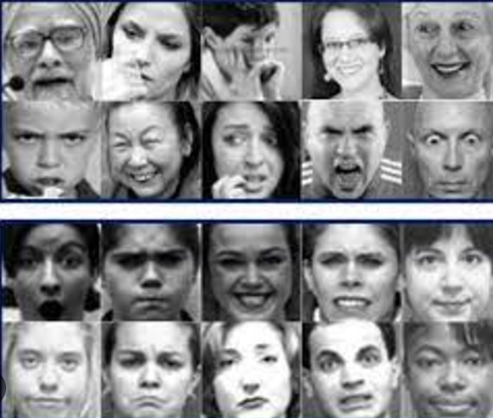
MODULES:
Overview of FER 2013 Dataset:
The FER 2013 (Facial Expression Recognition 2013) dataset is a widely used dataset for training and evaluating emotion recognition models. It was introduced as part of the ICML 2013 Challenges in Representation Learning. Below is a detailed breakdown of its features and importance. FER 2013 Dataset
Objective: The dataset is intended for the classification of emotions based on facial expressions in images.
Dataset Size: Contains 35,887 grayscale images, each sized at 48x48 pixels.
Classes: Divided into 7 emotion categories:
Angry
Disgust
Fear
Happy
Sad
Surprise
Neutral

Slide 10
Why This Model is Effective for Emotion-Based Applicatio:
Versatility:
The model is robust across different conditions, such as:Varying lighting scenariosFacial orientations and anglesDifferent age groups and ethnicitiesTo ensure precision, the model is trained on the FER 2013 dataset, which contains thousands of labeled images spanning the seven emotional categories. Real-time performance is achieved using OpenCV to process video streams on the fly.
Integration with Music Recommendations:
TheBy mapping emotions to music playlists, the model bridges the gap between technical innovation and user-centric applications. For instance:
Happy emotion → Uplifting music
Sad emotion → Comforting tracks
Practical Applications
This emotion detection model has widespread applicability, including:
Entertainment: Personalized playlists or interactive gaming experiences.

Slide 11
CNN Sequential Model :
Convolutional Neural Network (CNN) Sequential Model is vital in image processing tasks because of its ability to automatically extract meaningful features such as edges, textures, and patterns from input images. It reduces computational complexity by using shared weights (filters) and spatial pooling, making it efficient for high-dimensional data. This model is particularly effective in tasks like image classification, object detection, and emotion recognition, achieving high accuracy and robust performance.
Conv2D Layers: Extract features from the input image using filters.
MaxPooling Layers: Reduce spatial dimensions while retaining important features.
Dropout Layers: Prevent overfitting by randomly dropping neurons during training.
Dense Layers: Fully connected layers to classify features into target outputs.
Softmax Output: Converts predictions into probabilities for multi-class classification.
The emotion detection model utilizes deep learning methodologies, specifically Convolutional Neural Networks (CNN), to analyze and classify facial expressions. These methods are enhanced by real-time image and video processing tools to provide a dynamic and interactive user experience.

Slide 12
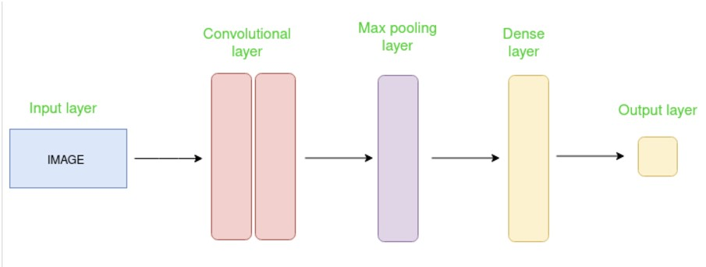
Layers of CNN Sequential Model Convolutional Neural Network (CNN) Sequential Model is vital in image processing tasks because of its ability to automatically extract meaningful features such as edges, textures, and patterns

Slide 13
Convolutional 2D Layer (Conv2D)
Conv2D layer is a fundamental building block of Convolutional Neural Networks (CNNs), designed to process 2D spatial data like images. Its main purpose is to extract features from input images by applying convolution operations.
Working of Conv2D
Input: The input to a Conv2D layer is typically an image or feature map, represented as a 3D tensor of shape (height, width, channels).
Kernel/Filter: A small matrix (e.g., 3x3 or 5x5) that slides over the input image to perform element-wise multiplication and sum.
Convolution Operation: As the filter slides, it computes a dot product between the filter and overlapping parts of the image, generating an output called the feature map.

Slide 14
MaxPooling2D Layer
The MaxPooling2D layer is a subsampling layer used in Convolutional Neural Networks to down sample feature maps, reduce spatial dimensions, and retain key features.
MaxPooling2D involves sliding a pooling window across the input feature map and selecting the maximum value in each region. This process reduces the spatial dimensions but retains the most prominent features.
Improvements Over Basic MaxPooling
Adaptive Pooling: Dynamically adjusts pooling size to generate output of a fixed dimension, regardless of input size.
Unpooling: Used in tasks like image segmentation to reverse the pooling operation and reconstruct spatial dimensions.

Slide 15

Dropout Layer
Purpose of Dropout
Overfitting Prevention: Ensures the network does not rely on specific neurons by randomly "dropping" them during training.
Generalization: Improves the model's ability to perform well on unseen data by creating a more robust representation.During each training iteration, neurons are randomly deactivated (set to zero) with a certain probability p.The remaining neurons continue to pass their outputs forward.

Slide 16
Dense Layer
The Dense layer is a core layer in neural networks, commonly referred to as a fully connected (FC) layer. Each neuron in the Dense layer is connected to every neuron in the previous layer, making it a critical component in deep learning models.
Purpose of Dense Layer
Feature Combination: Combines extracted features from earlier layers to make predictions or classifications.
Flexibility: Can be used for both linear and non-linear transformations by applying weights, biases, and activation functions.
Output Generation: Typically serves as the final layer for tasks like classification, regression, or even feature extraction.

Slide 17

IMPLEMENTATION
Frontend UI:
HTML: Structures the web application layout.
CSS: Implements neumorphism design (soft shadows, raised elements).
JavaScript: Adds interactivity, updates emotion results, and handles video streaming
UI Design:
Neumorphism: Creates soft, 3D-like elements using subtle shadows and gradients.
Buttons & Inputs: Rounded edges with light shadows for a soft, clickable effect.
Video & Emotion Display: Real-time webcam feed with dynamic emotion labels.
Song Recommendations: Displayed as card-like panels with song details and Spotify

Slide 18
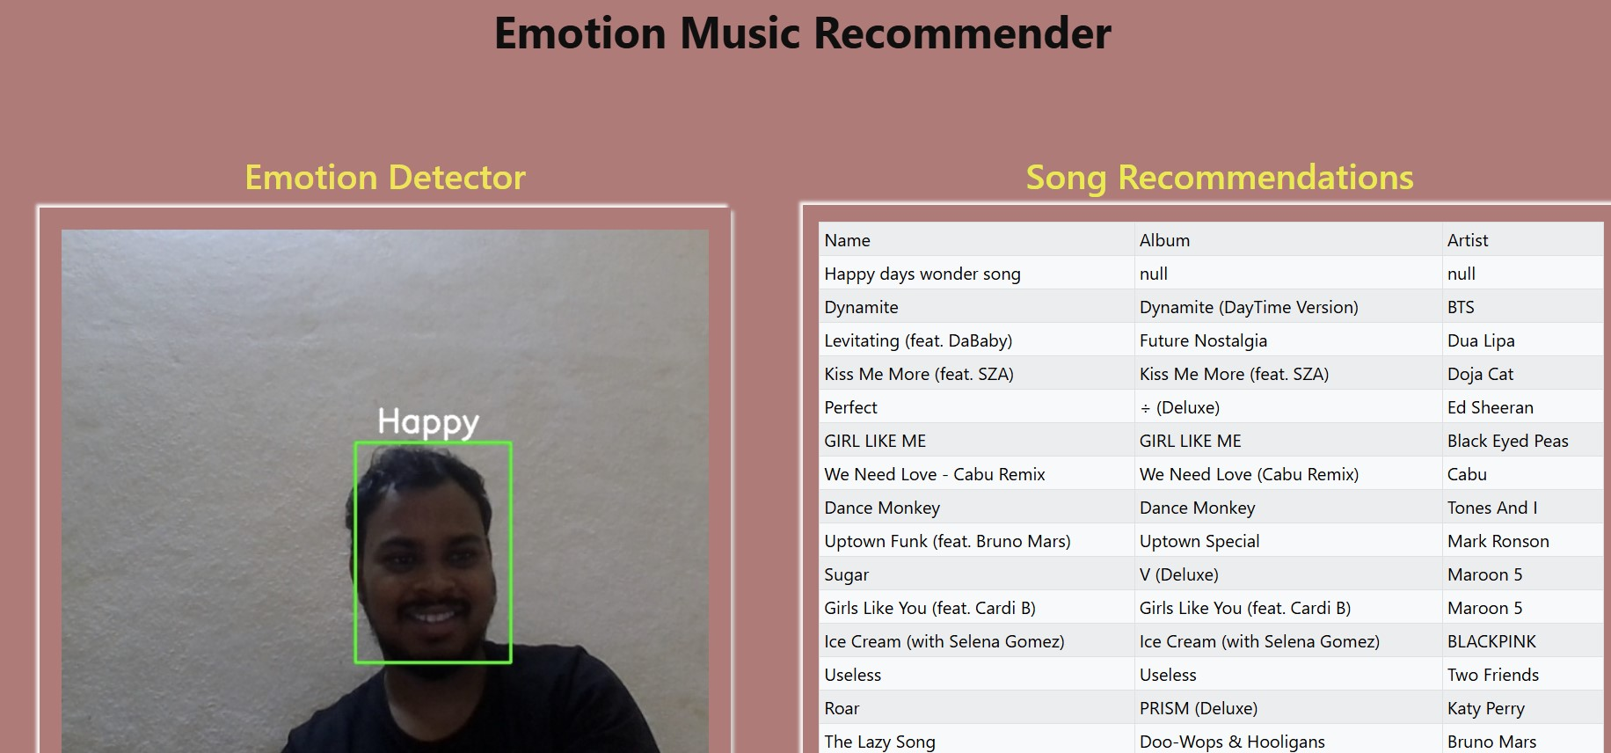
Backend
Flask: A lightweight Python web framework for handling server-side logic.
TensorFlow/Keras: For building and running the emotion detection model.
Emotion Detection:
Receives video frames from the frontend and processes them through the emotion detection model. Based on the detected emotion, the backend selects the corresponding CSV file (e.g., "happy_songs.csv", "sad_songs.csv").The CSV file is read to fetch song details, such as title, artist, and genre.

Slide 19
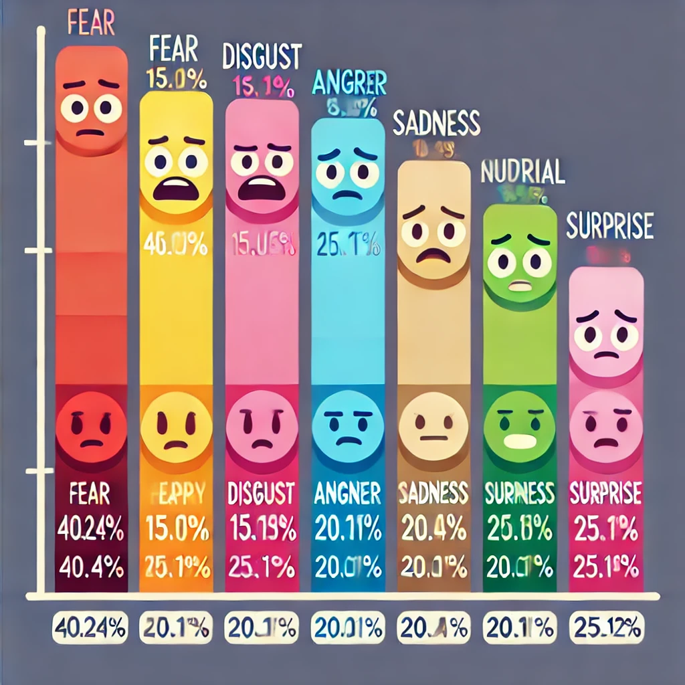
RESULT AND DISCUSSION
The Results and Discussion chapter provides insights derived from the sentiment analysis of YouTube comments. This includes visual representations, accuracy evaluation, and real-life applications, culminating in the analysis's effectiveness and relevance.

Slide 20
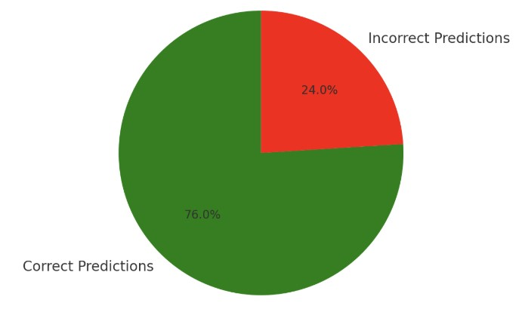
Accuracy Evaluation of the Project
The project's overall accuracy of 76% reflects a reliable performance in classifying emotions across seven categories: happy, sad, angry, fearful, surprised, disgusted, and neutral. This metric is a balanced measure of the model's ability to interpret and categorize emotional nuances effectively. While the accuracy is respectable, it also highlights opportunities for refinement to enhance precision and minimize misclassifications.

Slide 21
Significance of 76% Accuracy
An accuracy of 76% indicates that the model can correctly classify emotions in most cases. It reflects strong foundational training and the capability to handle diverse inputs effectively. While sufficient for many applications, it reveals the potential for enhancing performance for critical use cases.
The accuracy of emotion-based systems is influenced by several factors, including the dataset size, quality of annotations, and the architecture of the model used. For example, convolutional neural networks (CNNs) have shown reliable performance in emotion recognition tasks, achieving accuracy rates of on datasets like FER 2013.

Slide 22
Future Work
Exploring Advanced Architectures for Improved Accuracy:
In future work, I aim to explore and implement different advanced architectures to significantly enhance the accuracy of the emotion recognition model. Although the current architecture is functional and provides reasonable performance, it falls short of the desired level of accuracy needed for robust real-world applications.To address this limitation, I plan to experiment with state-of-the-art models .
Spotify API:
Authenticate: Use spotipy.SpotifyOAuth to handle OAuth for user login and generate a
access token.
Connect: Initialize the spotipy.Spotify object with the access token to make API calls.
Customize Results: Filter songs by attributes like energy, danceability, or tempo for
better match.
Play Songs: Provide song URIs or URLs to users for playback via Spotify.
This integrates Spotify's features seamlessly into your recommendation system.

Slide 23
CONCLUSION
In conclusion, the project the Emotion-Based Music Recommendation System integrates emotion recognition with music recommendation, providing a seamless and engaging user experience. By leveraging the FER 2013 dataset, deep learning techniques.
Flask, it achieves real-time emotion detection and offers song suggestions that resonate with the user's mood. This project combines technology and creativity, making music more personalized and enjoyable for users. The system’s neumorphism UI enhances user interaction.
Creating a visually appealing and functional platform. With ~76% accuracy, the model demonstrates reliable performance, showcasing the potential of AI-driven solutions in life.
The system stands as a testament to how innovative applications of AI can enhance user satisfaction and redefine human-computer interaction.

Slide 24
THANK YOU

