Slide 1

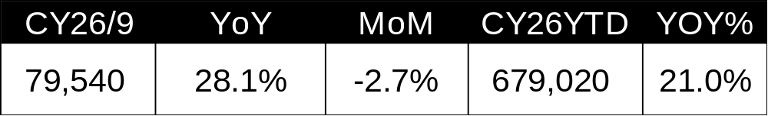
Indonesia Automobile Market -
September 2026 Wholesale Landscape
Gaikindo Category Mix (CY26/9)
Top 10 Nameplates (CY26/9)
YOY +4pts
YOY -1pts
YOY -2pts
4X2 vehicles continued to dominate the market, while Gran Max retained the top nameplate position, followed by BYD Atto 1.
Top 10 Brands (CY26/9)
YOY YTD Share Increase/Decrease
JAECOO and BYD led share gains, while Toyota and Honda recorded the largest YTD share declines.
Brand Source of Origin (CY26/9)
YOY YTD Share Increase/Decrease
Chinese brands gained 7.6 percentage points in YTD share, largely at the expense of Japanese brands.
Propulsion Mix (CY26/9)
YOY YTD Share Increase/Decrease
CBU
CKD
BEVs accounted for 20% of September sales, with YTD market share increasing by 7.6 percentage points YoY.
Source: GAIKINDO Monthly Wholesale Data. Compiled by Tomura Global Mobility Strategy.
Tomura Global Mobility Strategy

