Slide 1

Combining SonarQube and PL/I V5 for Continuous Code Quality Inspection
Thomas Zierer
October 12, 2017, GSE EM Working Group Meeting, Nürnberg

Slide 2
SonarQube
SonarQube is the leading Open Source product for continuous Code Qualtity Inspection
Very popular in the Open Source Community
Maintained by SonarSource, Geneva, Switzerland
IDE Plugins (SonarLint) for Eclipse, IntelliJ and Netbeans for instant feedback
Batch-scans are often integrated as ant, Maven or Gradle Tasks and run by a build server like Jenkins

Slide 3
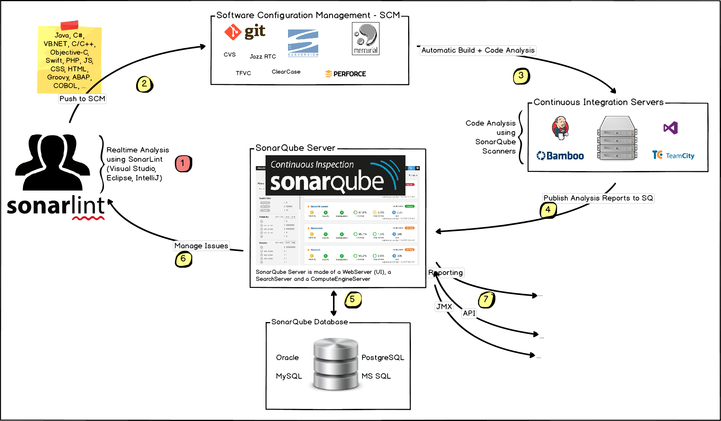
SonarQube - Architecture
The batch-scan reads the sourcefiles from the SCM and feeds its results to the SonarQube-Web-UI

Slide 4
SonarQube
Demo

Slide 5
SonarQube
The commercial version supports more languages and offers enterprise features
Open Source version:
Supports Java, C#, PHP, Python,…
Suitable for lightweight, homogenous projects
Commercial version:
Enterprise Features (Reporting, LDAP-Integration, …)
Additional languages: C/C++, COBOL, PL/I, …
So, why this session?

Slide 6
SonarQube and PL/I
SonarQube’s PL/I support is somewhat … limited
PL/I support requires SonarQube Enterprise + PLI/ Plugin. => 59.500 € / year
Apart from the fact that SonarQube has only 21 rules for the PL/I language the scanner also often fails for valid Enterprise PL/I code
As is the case with most custom PL/I scanners

Slide 7
Why is it so difficult to analyze PL/I code?
Most custom scanners are based on tools like lex and yacc which require the language to be strongly structured
In 1956 famous linguist Naom Chomsky published his hierarchy of formal languages
Java, C# etc. reside on Level-2 („Context-free“)
This makes it comparatively easy to write scanners based on tools like lex and yacc
Fortran and PL/I are known to reside on Level-1 („Context-sensitive“)
This means no lex-based scanner will ever support PL/I in it‘s full strength

Slide 8
In 25 years I came to the conclusion:
The only reliable PL/I scanner is IBM‘s Enterprise PL/I compiler

Slide 9
Enterprise PL/I
The Enterprise PL/I Compiler provides 2 highly useful features: RULES and XINFO
The RULES directive supports ~40 suboptions espescially for QA purposes
The XINFO(XML) directive exports the compiler messages in XML format
<MESSAGE>
<MSGNUMBER>IBM2418I E</MSGNUMBER>
<MSGLINE>22</MSGLINE>
<MSGFILE>21</MSGFILE>
<MSGTEXT>Variable FORCE is unreferenced.</MSGTEXT>
</MESSAGE>

Slide 10
SonarQube
With its custom language support you may „teach“ SonarQube additional languages
SonarQube is extensible through its plugin concept
Writing your own plugin is not trivial but there are some good examples
Documentation is provided here: https://docs.sonarqube.org/display/DEV/Extension+Guide

Slide 11
The Xinfo plugin
The Xinfo plugin combines Enterprise PL/I with SonarQube‘s custom language support
The plugin parses the compilers XML output and feeds it to SonarQube‘s REST interface
This works for every language that supports a XINFO-like directive: PL/I, COBOL, C/C++, Assembler
Scans may run on every kind of server: Windows, Unix, z/OS.
Restriction on z/OS: PL/I source and XML output must reside on OMVS

Slide 12
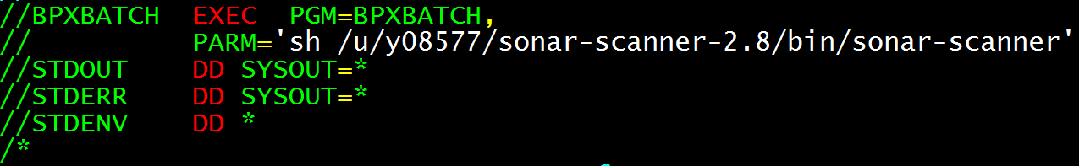
The Xinfo plugin: Executing scans
A simple shell or batch script executes the scan. You may even invoke it by JCL.
Scan is invoked via SonarQube commandline client
Successfully tested on Windows, Unix
Prereq: Sonar Server 6.3 or higher
On z/OS scans can be invoked using the IBM utility BPXBATCH:

Slide 13
The Xinfo plugin
Demo

Slide 14
Exploiting more SonarQube APIs
Integration for Debug Tool and CPD (Copy/Paste Detection)
A simple converter transforms Debug Tool Code Coverage files into the corresponding SonarQube format.
Split the sourcecode into tokens and SonarQube computes duplications.

Slide 15
Wanna try it?
The Xinfo plugin is Open Source
Xinfo plugin source code is published under Eclipse Public License (EPL) v. 1.0
Clone-URL on last slide
Every comment is honestly appreciated

Slide 16
Whats next?
There is still a lot of work to do
Remmediation costs per rule to compute the technical debt
Custom measures (for example refactor programs with too many INCLUDEs)
Automatically assign a finding to its author by questioning the SCM („blame“)

Slide 17
Thank you very much for your attention!
Thomas Zierer E-Mail: thomas.zierer@muenchen-mail.de
Fork me on GitHub: https://github.com/tgmz/sonar-xinfo-plugin

