Slide 1

Combining SonarQube and PL/I V5 for Continuous Code Quality Inspection
Thomas Zierer
October 12, 2017, GSE EM Working Group Meeting, Nürnberg

Slide 2
SonarQube
SonarQube is the leading Open Source product for Continuous Code Quality Inspection
700 enterprise customers worldwide + 80.000 other installations
Very popular in the Open Source Community
Maintained by SonarSource, Switzerland
IDE Plugins (SonarLint) for Eclipse, IntelliJ and Microsoft Visual Studio for instant feedback
Batch-scans are often integrated as ant, Maven or MSBuild Tasks and run by a build server like Jenkins

Slide 3
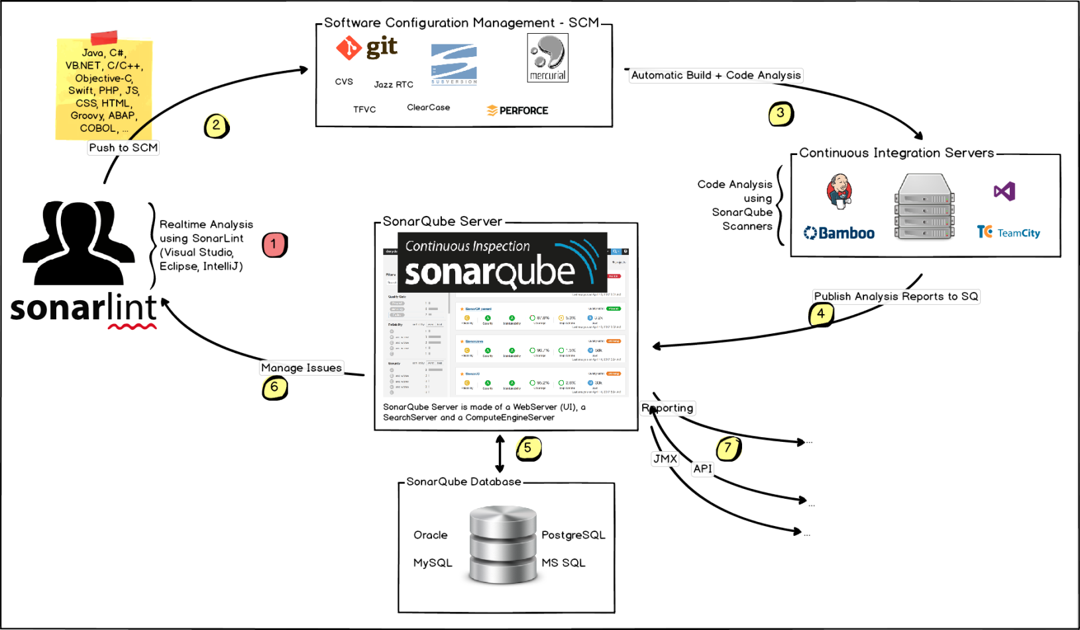

SonarQube - Architecture
The batch-scan reads the sourcefiles from the SCM, analyzes them with language-specific scanners and feeds the results to the SonarQube-Web-UI for review

Slide 4
SonarQube
Demo

Slide 5
SonarQube
The commercial version supports more languages and offers enterprise features
Open Source version:
Supports Java, C#, PHP, Python,…
Suitable for lightweight, homogenous projects
Commercial version:
Enterprise Features (Governance, Reporting, …)
Additional languages: C/C++, COBOL, PL/I, …
So, why this session?

Slide 6
SonarQube and PL/I
SonarQube’s PL/I support is limited and concentrates on distributed PL/I
PL/I support requires at least SonarQube Professional + PL/I Plugin. => 21.000 € / year
Scanner is meant for distributed PL/I, not z/OS
Plugin offers only 21 rules for the PL/I language
The scanner often fails for valid Enterprise PL/I code
As is the case with most custom PL/I scanners

Slide 7
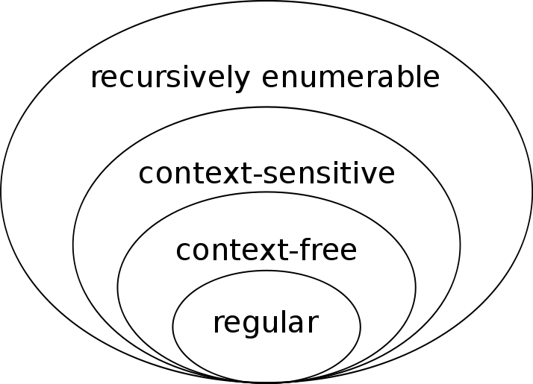
Why is it so difficult to analyze PL/I code?
Languages like Fortran and PL/I are less strongly structured than e.g. Java or C#
In 1956 famous linguist Naom Chomsky published his hierarchy of formal languages

Slide 8
Why is it so difficult to analyze PL/I code?
Most custom scanners are based on tools like lex and yacc which require the language to be at least context-free
This makes it comparatively easy to write scanners for Java or C# based on tools like lex and yacc
Fortran and PL/I are known to be context-sensitive and not context-free.
This means no such scanner will ever support PL/I in it‘s full strength

Slide 9
In 25 years I came to the conclusion:
The only reliable PL/I scanner is IBM‘s Enterprise PL/I compiler

Slide 10
Enterprise PL/I
The Enterprise PL/I Compiler provides 2 highly useful features: RULES and XINFO
The RULES directive supports ~40 suboptions espescially for QA, e.g. RULES(NOLAXIF) flags IF conditions which do not evaluate to boolean
The XINFO(XML) directive exports the compiler messages in XML format
<MESSAGE>
<MSGNUMBER>IBM2418I E</MSGNUMBER>
<MSGLINE>22</MSGLINE>
<MSGFILE>21</MSGFILE>
<MSGTEXT>Variable FORCE is unreferenced.</MSGTEXT>
</MESSAGE>

Slide 11
SonarQube
With its custom language support SonarQube can be extended to analyze new languages
SonarQube is extensible through its plugin concept
Writing your own plugin is not trivial but there are some good examples
Documentation is provided here: https://docs.sonarqube.org/display/DEV/Extension+Guide

Slide 12
The Xinfo plugin
The Xinfo plugin combines Enterprise PL/I with SonarQube‘s custom language support
The plugin parses the compilers XML output and feeds it to SonarQube‘s REST interface
This works for every language that supports a XINFO-like directive: PL/I, COBOL, C/C++, Assembler
Scans may run on every kind of server: Windows, Unix, z/OS.
Restriction on z/OS: PL/I source and XML output must reside on OMVS

Slide 13
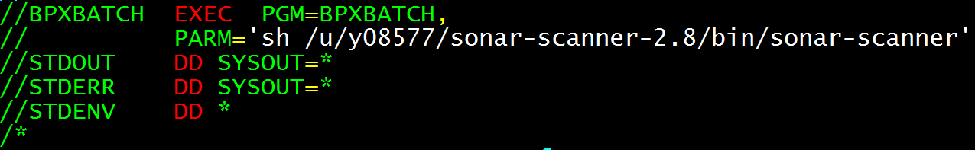
The Xinfo plugin: Executing scans
A simple shell-, batch- or JCL script executes the scan. It uses the command line client which comes along with SonarQube
Scan is invoked via SonarQube commandline client
Successfully tested on Windows, Unix
Prereq: Sonar Server 6.3 or higher
On z/OS the scan is invoked using the IBM utility BPXBATCH:

Slide 14
The Xinfo plugin – PL/I Basic
Demo

Slide 15
Exploiting more SonarQube APIs
Integration for Debug Tool and CPD (Copy/Paste Detection)
A converter transforms Debug Tool Code Coverage files into the corresponding SonarQube format to determine the test coverage
Split the sourcecode into tokens and let SonarQube compute duplications.

Slide 16
The Xinfo plugin – PL/I extended
Demo

Slide 17
Wanna try it?
The Xinfo plugin is Open Source
Xinfo plugin source code is published under Eclipse Public License (EPL) v. 2.0
Clone-URL on last slide
Every comment is honestly appreciated

Slide 18
Whats next?
There is still a lot of work to do
Remmediation costs per rule to compute the technical debt
Custom measures (for instance refactor programs with too many INCLUDEs / copybooks)
Automatically assign a finding to its author by questioning the SCM („blame“)

Slide 19
Thank you very much for your attention!
Thomas Zierer E-Mail: thomas.zierer@muenchen-mail.de
Fork me on GitHub: https://github.com/tgmz/sonar-xinfo-plugin

