Slide 1
MeetingMiner
Evidence-first meeting intelligence — search your meetings, replay the exact moment, trust every answer.
Tim Goeke · AI Cohort Demo · August 22, 2026
Notes:
0:00–0:05 — MeetingMiner turns Teams meetings into searchable, replayable evidence. Three minutes: the architecture, the decisions, then it live.

Slide 2
What it does
0:05–0:15
INGEST
Teams recordings + transcripts land as write-once evidence drops. A checkpointed pipeline derives frames, screens, transcripts, moments.
SEARCH
Hybrid keyword + semantic search over every meeting moment — snippets highlighted, filterable by meeting and corpus.
REPLAY
Every result is a moment with millisecond timing — click it and the video plays from that exact point. Answers cite evidence you can watch.
Principle: no citation, no answer — every claim traces to a replayable moment.
Notes:
0:05–0:15 — Meetings are where decisions happen and where they vanish. MeetingMiner ingests them once, then everything is search-and-replay. The rule that shapes the whole design: no citation, no answer.

Slide 3
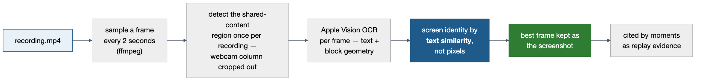
Finding the screenshots
0:15–0:30
• A screen is identified by what it says, not how it looks — OCR-text similarity survives resolution, compression, and webcam overlays where pixel matching breaks
• Identity is cross-meeting: the same deck shown next week resolves to the same screen — the lineage of a slide across the whole corpus
• Every screenshot records its frame span and capture cue; moments cite it — the visual half of every replayable citation
• Tuned on the measured corpus for slides and app views; dense spreadsheet-style screens are accepted misses
Notes:
0:15–0:30 — Before any AI answers anything, we find what was on screen. A frame every two seconds, crop the webcam column, OCR each frame — then screen identity comes from the text, not the pixels. That's what lets the same slide match across meetings, and it gives every citation its screenshot.

Slide 4
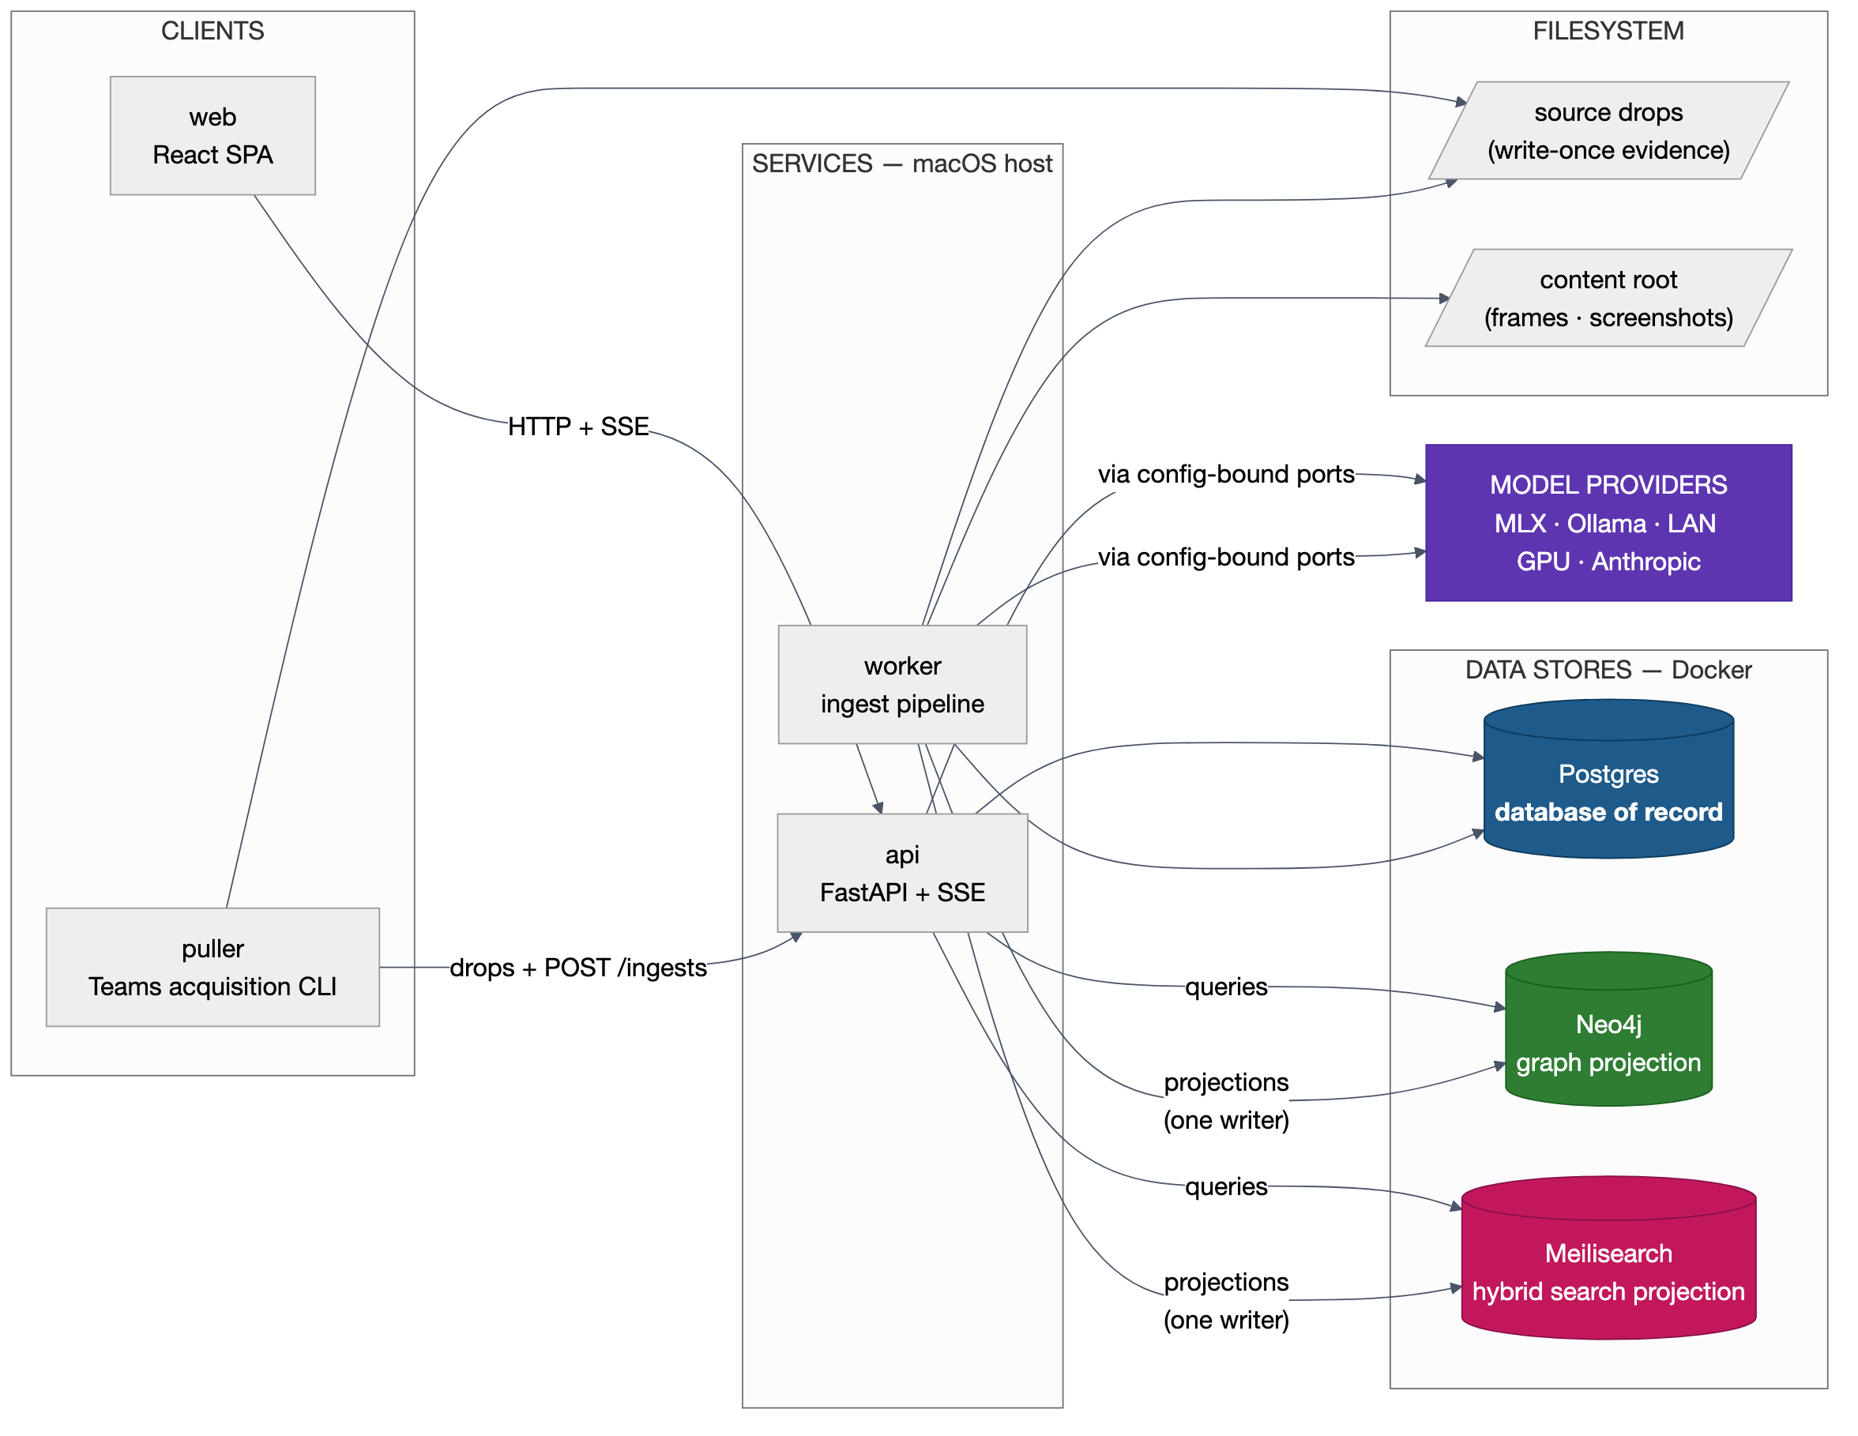
Architecture
0:30–0:45
The paradigm
• Deterministic evidence pipeline — model output never writes evidence
• Ports & adapters — every model call goes through a config-bound port
• CQRS-lite — Postgres is the record; Neo4j + Meilisearch are disposable projections with exactly one writer
• Infra in Docker, code on the Mac host — pipeline needs Apple Vision + MLX/Metal
Notes:
0:30–0:45 — One paradigm sentence carries it: deterministic evidence pipeline, ports-and-adapters at every model boundary, CQRS-lite storage. Left to right: the puller acquires from Teams, the worker derives evidence into Postgres, and projects it into a graph store and a search store. Only deterministic code writes evidence; models are behind swappable ports.

Slide 5
Technology stack — and why
0:45–1:00
Layer | Choice | Why
API + worker | Python 3.12 · FastAPI 0.141 | Typed, SSE streaming, OpenAPI → generated TS client
Web | React 19 · Vite 8 · Tailwind 4 + shadcn | Fast SPA; client generated from the live API schema
Record | Postgres 18 | Single database of record; native UUIDv7 minting
Graph | Neo4j Community 2026.07 | Deterministic Cypher traversals over the evidence graph
Search | Meilisearch 1.53 | Hybrid keyword + vector in one store; 1024-dim user-provided embeddings
Inference | MLX Whisper · Apple Vision OCR · claude-sonnet-5 (Ollama fallback) | Local-first where quality allows; every engine swappable in config.yaml — never a code change
Runtime | Docker for the 3 stores only; code as macOS host processes | Pipeline needs Metal/MLX + Apple frameworks containers can't reach
Notes:
0:45–1:00 — Boring, current technology on purpose. The one unusual call: Docker runs only the stateful stores — the pipeline runs on the Mac host because it needs Apple Vision and MLX. Every model — STT, OCR, LLM, embedder — sits behind a port bound in one config file; swapping a model is a config edit, never code.

Slide 6
The critical storage + RAG decisions
1:00–1:15
One database of record.
Every entity is a Postgres row first; its UUIDv7 is its identity in every store, payload, and citation. No second owner exists.
Projections have exactly one writer.
All Neo4j + Meilisearch writes go through one module; both stores rebuild from Postgres + config.yaml alone (make rebuild). Corruption is answered by rebuild, never by hand-editing an index.
GraphRAG is deterministic traversal.
Retrieval is hand-written, parameterized Cypher templates + hybrid search. The LLM only classifies the question and writes the answer — it never owns retrieval, so retrieval is testable.
No citation, no answer — enforced in code.
A validator resolves every [[moment:uuid]] marker against Postgres; an uncited claim means the answer never leaves the API. Not a prompt instruction.
Drafts never reach retrieval.
Extracted artifacts are human-approved before publishing; the publish gate lives inside the projection module.
Notes:
1:00–1:15 — Five decisions carry the design. Postgres is the only record. The two retrieval stores are disposable projections with a single writer — we can delete and rebuild them from the record. GraphRAG here means deterministic Cypher, not a framework owning a graph. And the citation rule is a code gate, not a prompt.

Slide 7
How evidence is encoded
1:15–1:25
Embeddings
• qwen3-embedding 0.6b (Ollama), fixed 1024-dim, computed by the projection module — store auto-embedders stay off
• Chunks: 1,400 chars with 1-turn overlap; hybrid ratio 0.3 — keyword-heavy on purpose
• Model + dimension are projection state: a mismatch fails closed; changing the model forces a full rebuild + eval rerun
Transcripts & video
• Provided transcripts are immutable; the STT verification lane (MLX whisper-large-v3-turbo) writes new rows — merge, never erase
• align reconciles VTT timing + speaker attribution + STT by text alignment; millisecond offsets anchor every citation
• Moments segmented at a 20s gap — the p90 measured over 28 real drops / 7,983 turns
Notes:
1:15–1:25 — Encoding choices are measured, not guessed: chunk size, hybrid ratio, and the 20-second moment gap all come from measuring the real pulled corpus. Provided transcripts are never overwritten — the STT lane verifies alongside, which is what keeps citations stable.

Slide 8
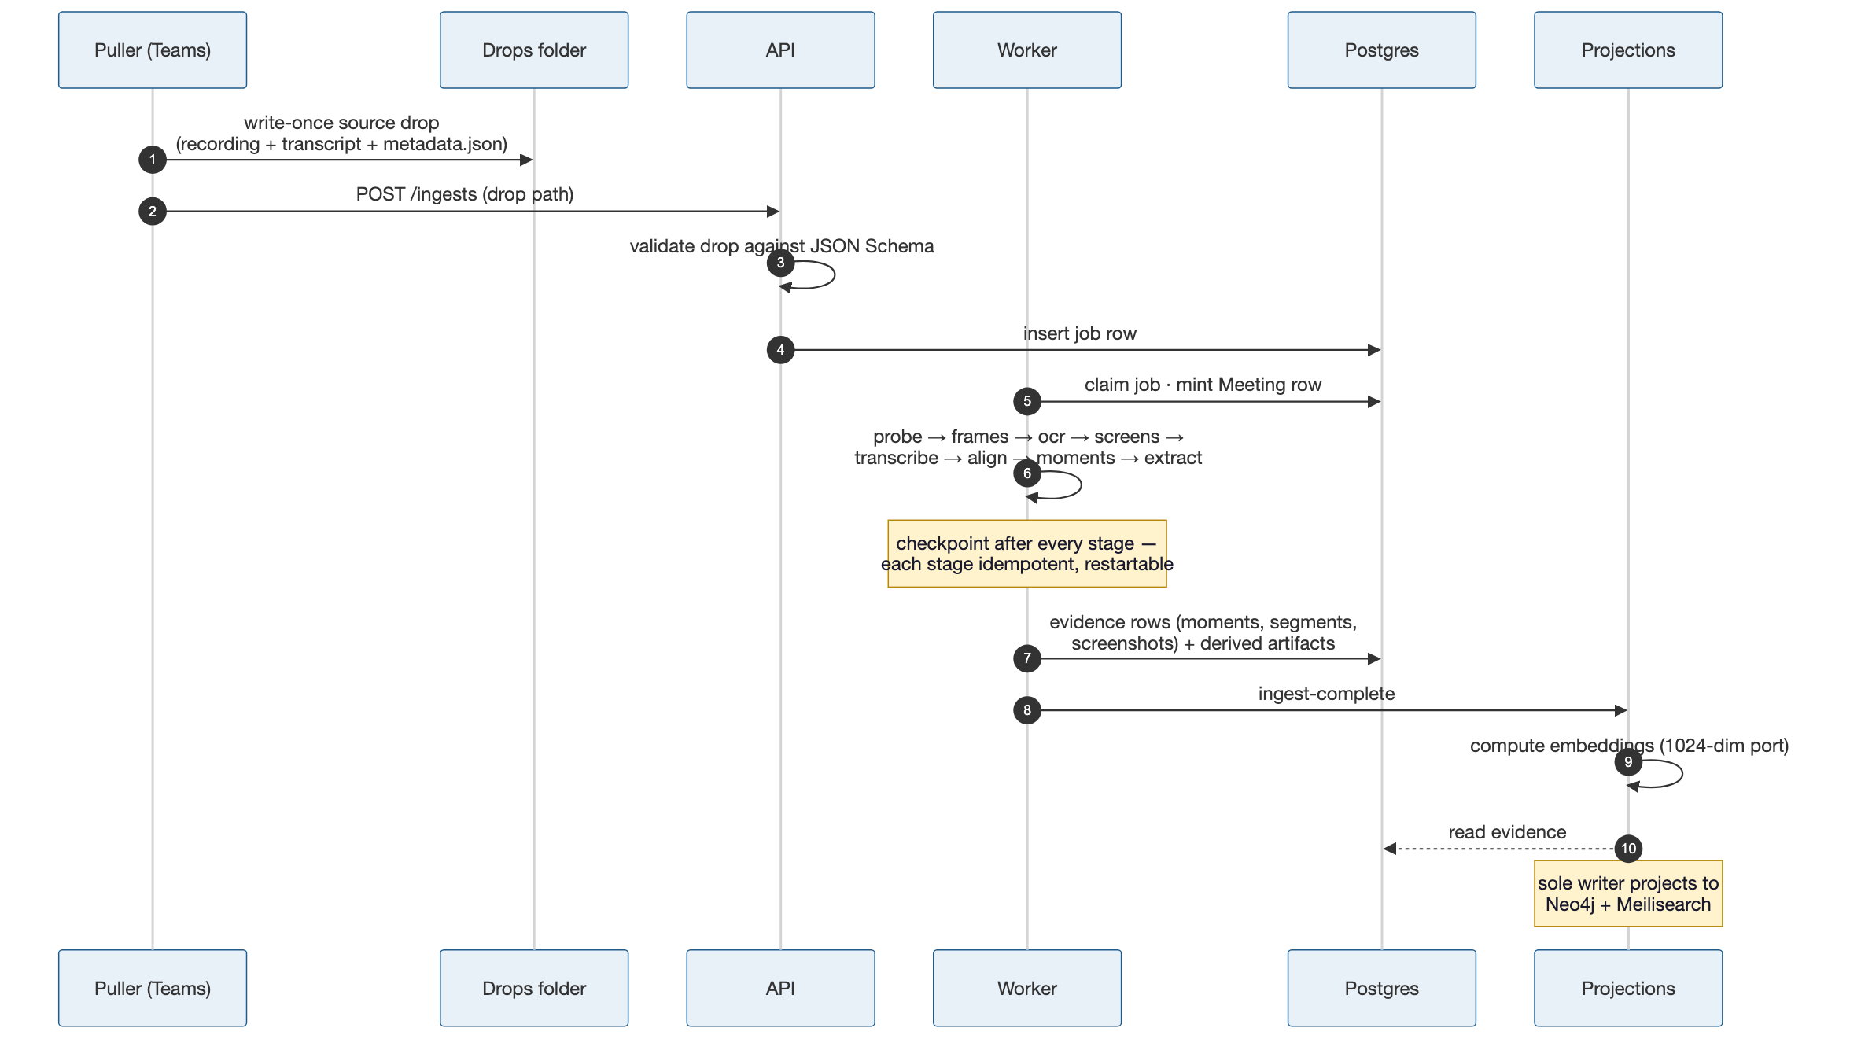
Ingestion — video & transcripts in
1:25–1:37
Derived objects
• Aligned transcript segments
• Screens — durable identity across meetings
• Screenshots + frame OCR
• Moments — the citable spans
• Artifacts: ADRs & action items (LLM-extracted, human-approved before publish)
Notes:
1:25–1:37 — Everything enters through one door: a write-once drop plus POST /ingests. The worker walks eight checkpointed, idempotent stages — a crash resumes, a rerun overwrites only its own outputs. Out come the derived objects on the right; the LLM-extracted artifacts are the only model-written data, and a human approves them before they publish.

Slide 9
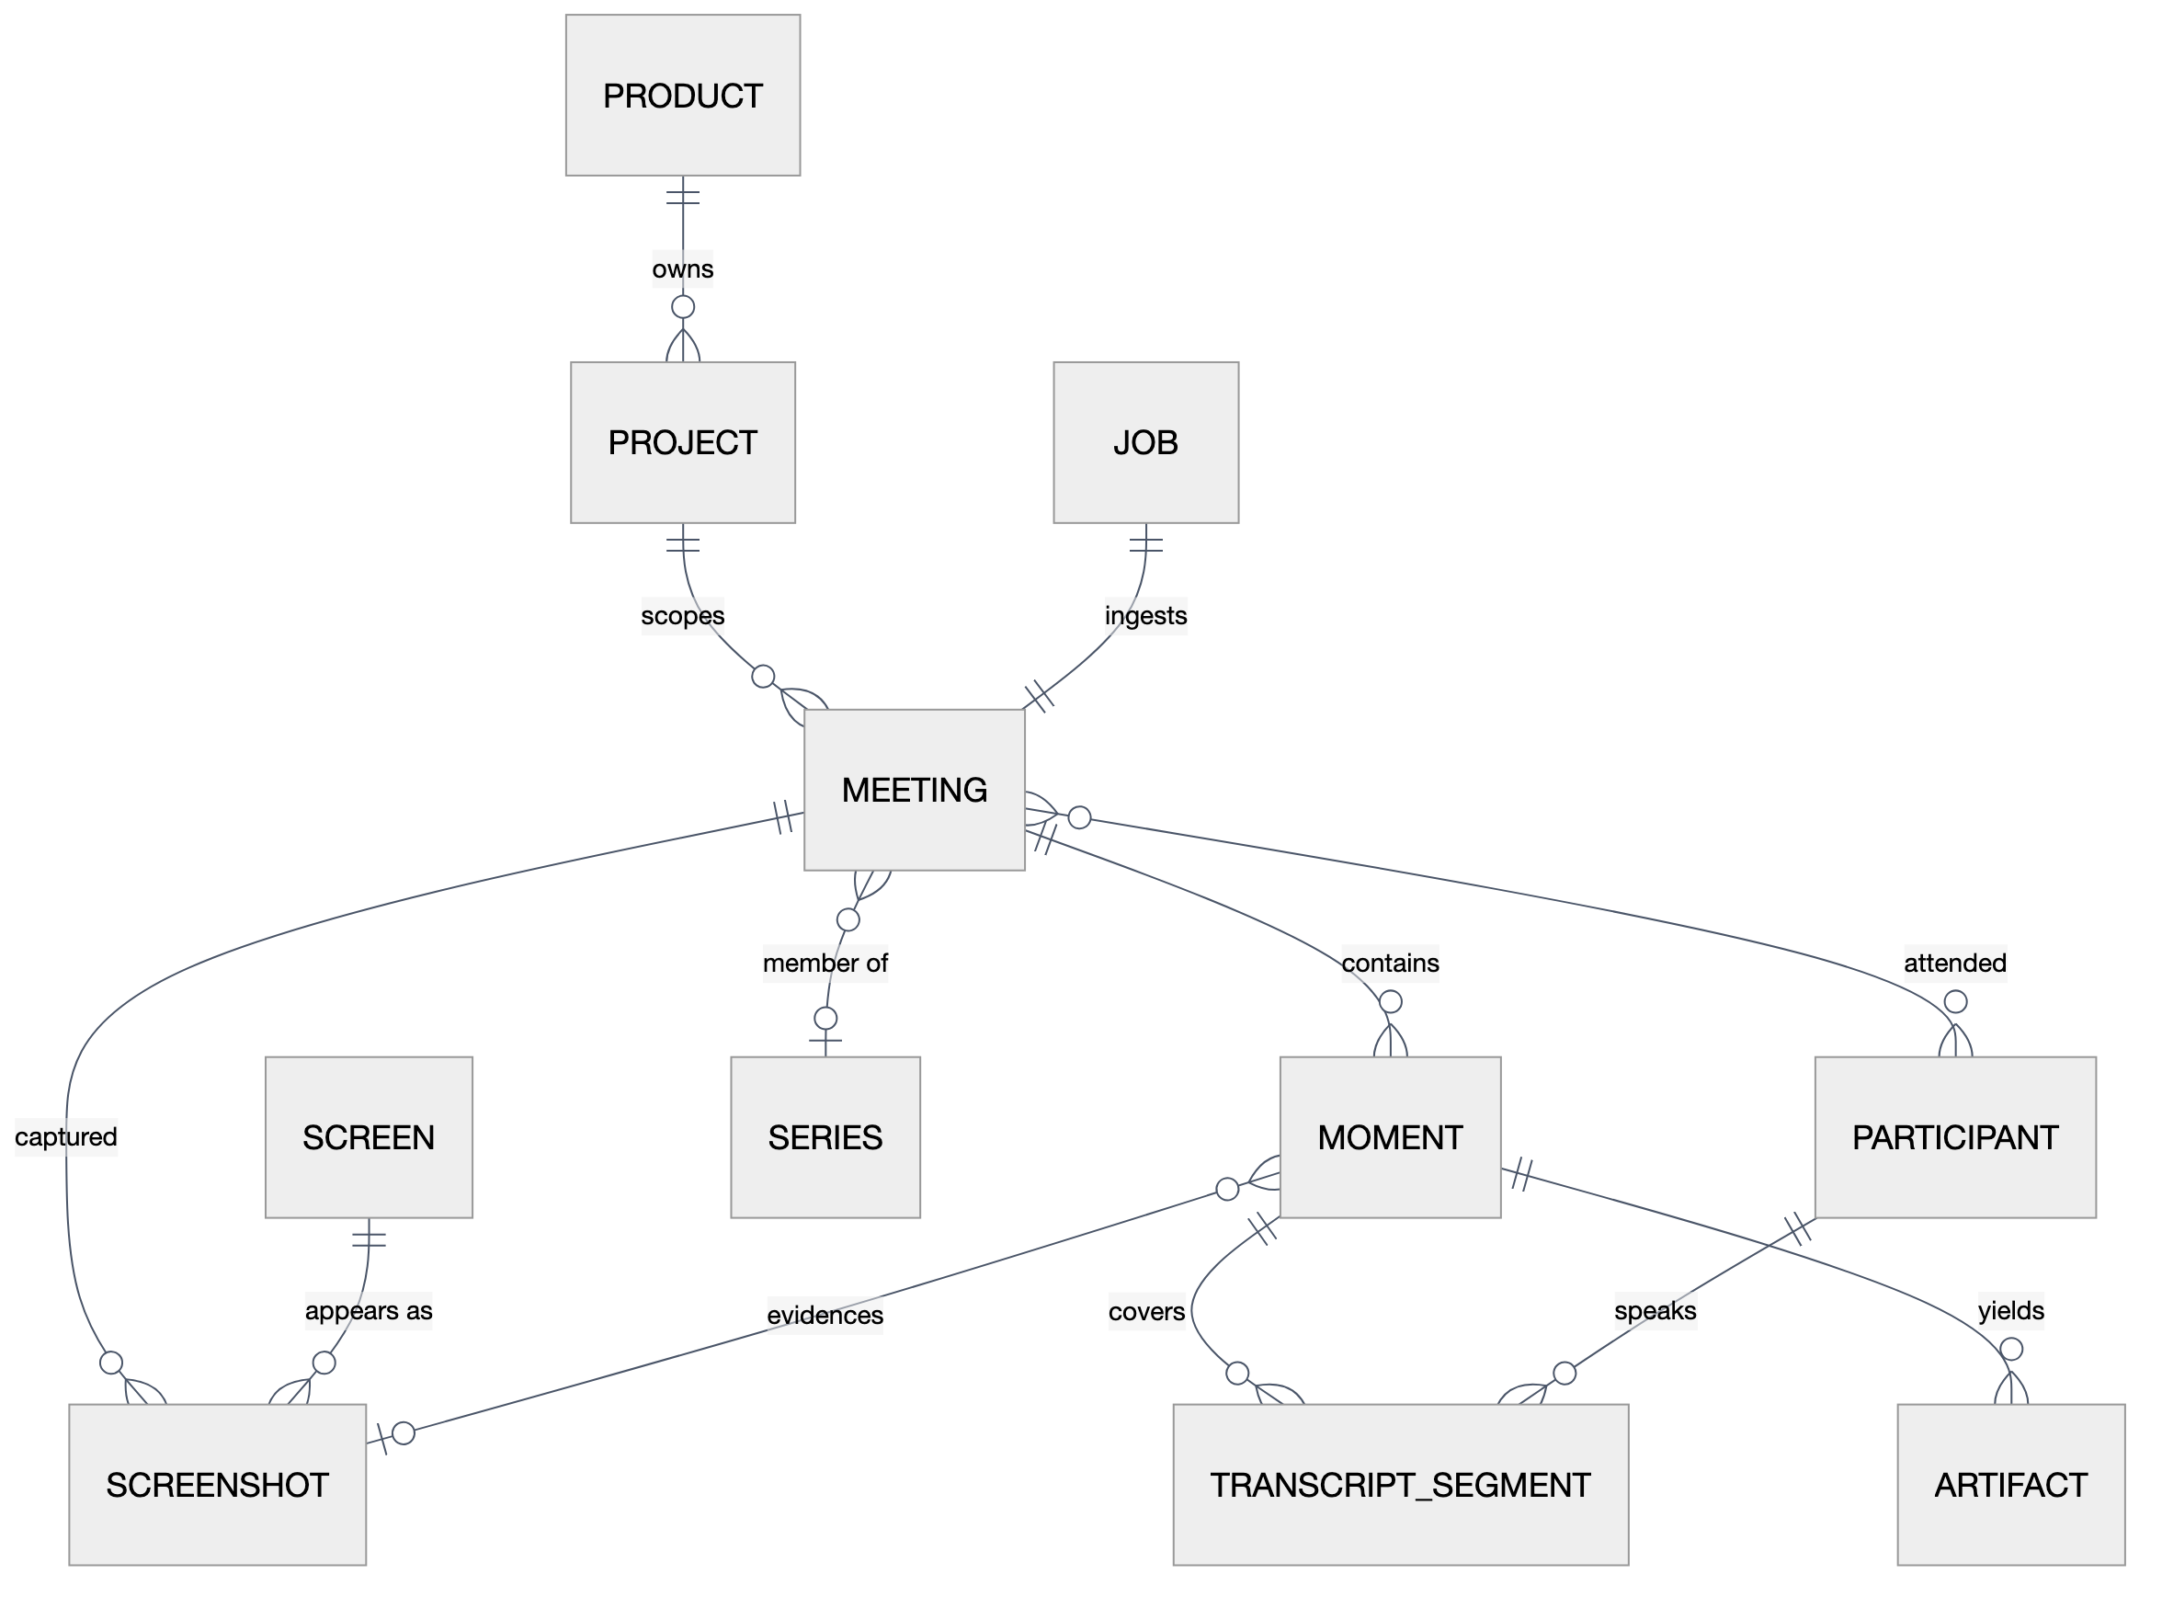
The data model
1:37–1:45
Why it holds up
• MOMENT is the citation currency — minted once, never renumbered
• SCREEN and PARTICIPANT are durable cross-meeting identities — lineage of a slide or a person across the corpus
• JOB ↔ MEETING is 1:1 — re-processing re-arms the same job, so every citation survives re-ingestion
• Relational FK graph — traversable by SQL alone; Neo4j is a projection of it
Notes:
1:37–1:45 — The moment is the atom: a span of meeting timeline tying transcript segments to a screenshot. Screens and participants persist across meetings, which is what lets us ask for the lineage of a slide. And because a meeting keeps its job and its IDs forever, citations survive re-ingestion and augmentation.

Slide 10
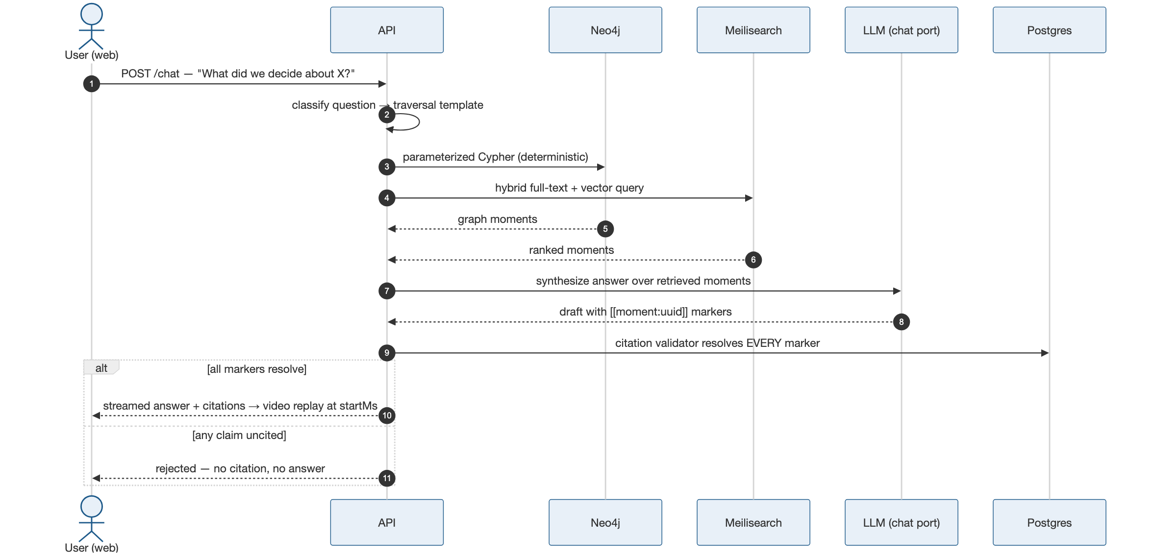
When a user asks a question
1:45–2:00
Deterministic in, deterministic out
• LLM touches only steps 7–8
• Validator rejects uncited claims — in code
• Live today: hybrid search + replay on this same path; cited chat is the Epic-3 build
Notes:
1:45–2:00 — The full Q&A path: classify to a traversal template, deterministic retrieval from both stores, LLM synthesis, then the citation validator resolves every marker against Postgres — or the answer dies. Search and replay run on this path today; the chat synthesis layer is the current epic.

Slide 11
Live demo
2:00–3:00
1 · Ingested corpus (10s)
Real Teams meetings, each ingested through the pipeline — stage-by-stage progress streamed live over SSE.
2 · Search (20s)
One query across every meeting — hybrid keyword + semantic hits, highlighted snippets, each hit a moment.
3 · Replay (25s)
Click a hit — the recording opens at that exact moment. This is what a citation resolves to.
4 · The point (5s)
Not a chatbot over notes — an evidence system. Every answer is a moment you can watch.
http://127.0.0.1:5173
Notes:
2:00–3:00 — Switch to the browser. Full word-for-word script with fallbacks: demo-script.md. Beats: meetings list w/ live stage progress → search the rehearsed query → open the hit with a screenshot → video plays at startMs → close on the evidence line.

Slide 12
Every answer is evidence you can replay.
MeetingMiner · Tim Goeke · AI Cohort 2026
Notes:
Hold during Q&A.

