Slide 1
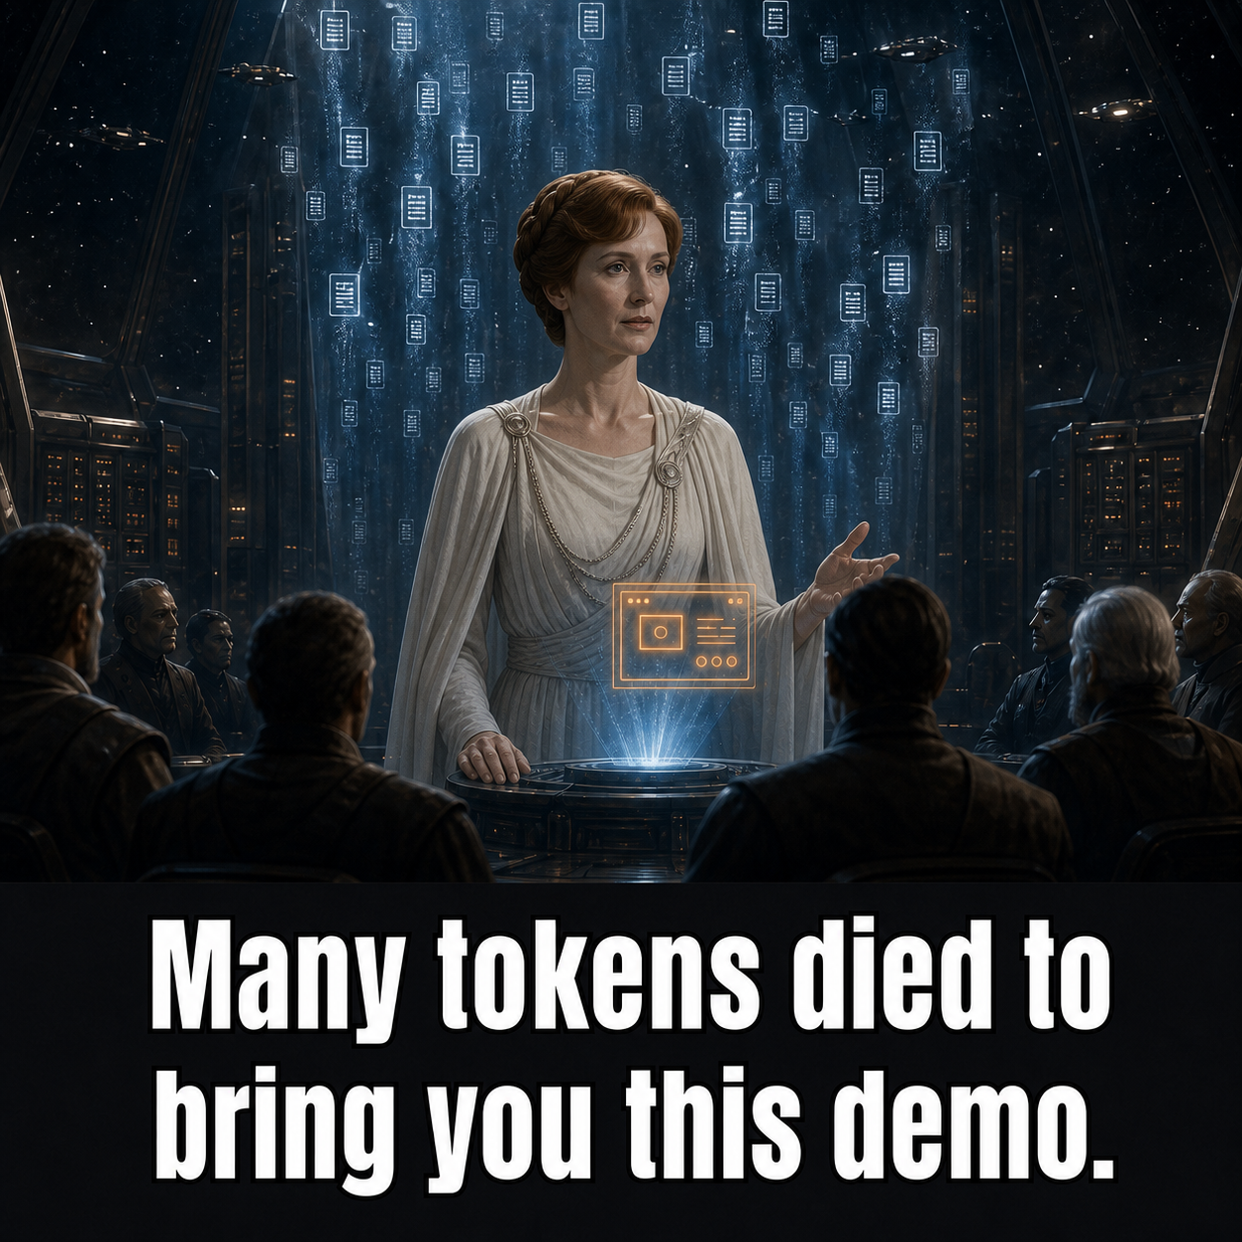
AI ENGINEERING CAPSTONE
MeetingMiner
One architecture. One promise:
prove every answer.
question
evidence
replay
Tim Goeke · AI Cohort · August 31, 2026
Notes:
Open with the promise, not the technology.
MeetingMiner is not a meeting summarizer. It is an evidence engine. You ask a question, you see the passages that support the answer, and you jump to the exact second in the recording where it was said, with the screen that was on show at the time.
Everything after this slide exists to make that one promise true.

Slide 2
PRODUCT JOURNEY
Watchback taught the first lesson: preserve the source.
The YouTube downloader became the conceptual starting point for MeetingMiner.
WATCHBACK · YOUTUBE
THE IDEA
MEETINGMINER · MEETINGS
Capture
Preserve
Investigate
A YouTube downloader that packages video, a timed transcript, metadata and a playable source.
A download becomes a corpus when the media, words and timestamps remain linked as one evidence package.
Extend the contract to meetings: ask across the corpus, cite the moment, then replay the source.
01
02
03
video · transcript · metadata
media ↔ words ↔ time
question · citation · replay
The source changed. The evidence contract survived.
MeetingMiner changes the questions—not the need to prove the answer.
02
Notes:
This did not begin as a meeting application.
Watchback was a YouTube downloader. Give it a URL and it kept four things together: the video, a timed transcript, the metadata, and a source you could still play.
The lesson was not how to download a file. It was how to keep the video, the words and the timestamps linked as one package, so that later you can prove where an answer came from.
MeetingMiner takes that same idea and points it at meetings. Same contract, harder questions.

Slide 3
THE ARCHITECTURE
A meeting goes in. An answer you can check comes out.
The arrows are what actually calls what. Only one box is allowed to be the truth.
CLIENTS
SERVICES · macOS host
reads + writes
DATA STORES · Docker
web
React app in the browser
api
FastAPI — questions, intake, live updates
Postgres — the record of truth
HTTP + SSE
Neo4j — graph copy: how meetings and topics connect
puller
Teams · YouTube · local files
worker
ingest steps that resume after a crash
POST /ingests
Meilisearch — search copy: exact words + meaning
projects · one writer
writes originals
reads
writes frames
config-bound ports
FILESYSTEM
AI MODELS · swappable, one attachment point
source drops
originals, written once, never edited
content root
frames · screenshots it generates
on this Mac (Apple Vision · MLX) · a GPU box on the LAN · Ollama · OpenAI
Only Postgres is the truth. Delete Neo4j and Meilisearch and one command rebuilds them from it.
Swap any AI model and no other box changes — that is the whole reason they attach in one place.
03
Notes:
The whole architecture in one picture. Take it slowly; everything later is detail on top of this.
Meetings arrive from three places: Microsoft Teams, YouTube, or files you drop in yourself. Whatever arrives is written down once and never edited again. That matters, because if you can edit the original you can no longer prove anything.
The app is three parts. The web app is what you click. The API takes a question and returns an answer. The worker does the slow jobs -- pulling frames out of video, reading text off screens, transcribing speech. Those jobs are stored as rows in the database, so if the machine crashes the work resumes at the step it reached instead of starting over.
Three places keep data, but only one of them counts. Postgres is the record of truth. The graph copy and the search copy are built from it, and can be deleted at any time and rebuilt. If a demo goes wrong, that is usually the fix.
The AI models plug in at one place. Some run on this Mac, one runs on a GPU box on the network, some are cloud APIs. Because they all attach at the same slot, swapping one is a config change -- nothing else in the picture moves.
If a question comes: yes, three databases is a lot for this amount of data. That is on the roadmap slide, and I would test whether Postgres alone can do it before keeping all three.

Slide 4
ARCHITECTURE · DETAIL
One record of truth. Everything else is a rebuildable copy.
ACQUIRE
CORE SERVICES
FILES + AI MODELS
REBUILDABLE COPIES
acquisition
Teams · YouTube · local
FastAPI
takes in · answers · live updates
originals, stored once
Neo4j
graph copy
files it makes
frames · screenshots
Postgres
the record of truth
React
the web app
local recording
+ transcript
Meilisearch
search copy: words + meaning
swappable AI slots
read text · hear speech · write · match meaning
Worker
restartable steps
Only Postgres is the truth. The search and graph copies can be deleted and rebuilt.
The worker runs on the Mac because two of the AI models only run there; the three stores run in Docker.
04
Notes:
Same picture, real component names, for anyone who wants them.
Acquisition is deliberately at the edge. The thing that pulls from Teams or YouTube does not write to the core database -- it drops a folder of files, and the intake path picks it up. That is why adding YouTube did not require changing the core.
FastAPI handles intake, questions, and live progress updates. Postgres owns identity, evidence, jobs and lifecycle -- when a moment gets an ID, that ID is the one every other system uses.
The worker claims steps from the database, so progress survives a crash. Frames and screenshots it generates go to a separate folder from the untouched originals.
Neo4j and Meilisearch are copies for reading, never sources of truth. React talks to the API through a client generated from the API's own contract, so the frontend cannot drift from the backend without the build failing.
The worker runs on the Mac rather than in Docker because two of the models -- Apple's on-device vision and MLX -- only run on macOS.

Slide 5
QUESTION SEQUENCE
The computer decides what to fetch. The model only writes the words.
User
API
Neo4j
Meilisearch
LLM
Postgres
your question
pick a known query shape
search by words + meaning
connected moments
best-matching moments
write an answer using only these
draft, with a marker on every claim
check every marker points at a real moment
all good → send the answer + its citations
One bad marker and nothing is sent. No citation, no answer.
05
Notes:
This is the slide that answers "how do you know it isn't making things up?"
Read it left to right. The question arrives. The API classifies it into one of a few known query shapes -- the model does not get to invent a database query. Retrieval then runs two ways at once: the graph finds connected moments, the search index finds the best matches by words and by meaning.
Only then does the language model get involved, and it is handed the retrieved passages and told to write using those alone. Its draft has to carry a marker on every claim.
Before anything is sent to the browser, a checker resolves every one of those markers against the database. If one does not point at a real moment, nothing is sent at all.
So the model writes the prose. It does not choose the evidence, and it cannot approve its own citations. If you show only one architecture slide, show this one.

Slide 6
WHAT CAME FORWARD
The quick version found the product. The careful version made it last.
BROUGHT FORWARD
THE REAL
ARCHITECTURE
THE FOUNDATION IT LANDED ON
Ask, threads, timeline
Evidence first, prose second
Screenshot + replay at the exact second
Screens built around the question
A trustworthy
evidence product
One record of truth
Jobs that survive a crash
One generated API contract
Tests, and swappable models
delightful to use
and safe to evolve
Before adding more: test whether Postgres alone can do the search, instead of running a separate search engine.
06
Notes:
Two ways of building, one product.
The quick version was built fast and loose against a growing pile of real meetings. That is what found the product -- the idea that you show evidence cards before prose, that a citation should open a screenshot, that a subject should be traceable across meetings.
The careful version was built from written specifications and acceptance criteria. That is what made it durable -- one record of truth, jobs that survive a crash, a generated API contract, tests, and models that can be swapped.
Neither approach on its own would have got here. The fast one found what to build; the careful one made it something you can keep.
The honest open question is at the bottom: at this size, three databases may be two too many. I would measure before defending them.

Slide 7
DEMO
One question. Follow the evidence to the moment.
ARC 1 · ASK → EVIDENCE → REPLAY
Ask
Citations
Moment
Screenshot
Replay
ARC 2 · THREADS → TIMELINE → MEETING
Threads
Pick a subject
Timeline
Meeting
Documents
Question: What is the DBE participation goal and how is it tracked?
LIVE
Notes:
DEMO -- five minutes, two arcs. Everything below was run against the live corpus on 2026-09-01, after re-deriving threads and rebuilding. Verified means it actually returned this; nothing here is aspirational.
ARC 1 -- ASK, EVIDENCE, REPLAY (about 2:30)
NO QUESTION IS GUARANTEED. Measured over repeated runs on 2026-08-31: the DBE
question passed 3 of 4, heated sidewalks passed 3 of 4, and the citation gate
refuses roughly half of all reasonable questions. Have two loaded and be ready
to say what a refusal means. This is the single biggest live risk in the demo.
PRIMARY QUESTION -- best answer in the corpus, 3 of 4 runs:
What is the DBE participation goal and how is it tracked?
Returns real numbers: the goal is 15%, they were around 22% as of October, and
tracking was "on pause". One citation, carrying a screenshot. Numbers, a caveat
and a named pause -- the kind of answer a person actually wanted. It also sets
up Arc 2, because DBE is a thread running through 8 meetings.
SECOND QUESTION -- 3 of 4 runs, two or three citations, all with screenshots:
What was said about heated sidewalks?
Returns a real exchange: someone asks whether heated sidewalks are going in at
the larger stations because ice is treacherous, and someone else answers that
they did consider it and did something on Central. Good because it shows a
conversation rather than a summary. Run this one if DBE refuses.
DO NOT USE -- "What is the outlook for reopening the Cedar Lake Trail?" It
passes the gate almost every time, but the answer is a hedge: "the moments
provided do not give a single definitive outlook date". Technically cited,
reads like a failure. Keep Cedar Lake for Arc 2, where the timeline is the
point, not the prose.
BEATS:
1. Type the question. Say: "one question, across fifty-nine meetings."
2. The answer streams with citations attached. Say: "every claim carries a moment -- meeting, and the exact second."
3. Click a citation. The moment opens with its screenshot.
4. Press Replay. The recording seeks to that second. Let it play three seconds, with audio.
SHOWING THE CITATION GATE ON PURPOSE. Any of these is refused rather than answered -- the model wrote a sentence without a marker and the whole answer was rejected:
What are the risks to the 2027 revenue service start date?
What has been reported about tunnel construction progress?
What did they say about ridership trends?
Say: "it wrote an answer, one sentence had no evidence behind it, so you get nothing. That rule is code, not a polite instruction to the model."
WARNING, AND BE READY FOR IT: about half of all good questions are refused this way. It is not rare. If it happens on a question you did not plan, name it and move on -- it is the strongest thing in the demo, not a bug to apologise for.
ARC 2 -- THREADS, TIMELINE, MEETING (about 2:30)
1. Click Threads. The view is empty on purpose -- a box, and the subjects the corpus suggests. Say: "a thread is a question you ask, not a list you browse."
2. Type "trail" and choose: Trail reopening outlook (Cedar Lake Trail segments) -- verified at 12 meetings across 1,548 days, March 2022 to June 2026.
Other good ones, all verified: Communications/outreach metrics (18 meetings), DBE participation (8 meetings, 1,360 days), Suburban Transit ridership trend (9), Tunnel construction progress (7), Hopkins Rail Support Facility (6), Train testing safety awareness (6).
AVOID the widest threads -- they are meeting procedure, not content: "Presentation logistics (screen share)" (47 meetings), "Meeting opening & apologies" (22), "Meeting close: announcements". If the suggestions are ordered by breadth these sit at the top and they are terrible material.
3. The timeline draws left to right across every meeting where the subject surfaced. Scroll to zoom. Say: "the zoom is semantic -- a meeting is a bar up here, a card lower down, its own moments at the bottom."
4. Zoom in and click a meeting. It opens the meeting view.
5. In the right rail, open Documents, then "Decisions & risks". Say: "this is what the extraction produced -- a document per meeting, decisions and risks with timestamps." 224 documents are indexed and searchable.
SEARCH TERMS, verified by exact phrase (moments / documents):
tunnel 107/24 · Kenilworth 57/9 · functional classification 52/8 · travel demand management 48/5 · ridership 45/29 · revenue service 40/22 · inflow and infiltration 36/0 · Cedar Lake Trail 24/8 · landscaping 12/8 · punch list 6/3
DEAD, do not type these: station art, noise wall, participation goal, trail reopening -- all zero moments.
DEMO FROM THE GREEN LINE CMC MEETINGS. Only 4 of 59 meetings have named speakers, and two of them are the Green Line Corridor Management Committee meetings (148 and 147 moments, 4 documents, 124-130 screenshots each). Everywhere else the speaker reads Unknown or SPEAKER_03, because auto-captions carry no speaker labels.
IF A MINUTE REMAINS: click Add meeting, paste a public YouTube URL, let the probe return. It shows title, duration and whether captions exist. Say: "auto captions carry no speaker labels -- it tells you before you commit." Do not wait for an ingest on stage.
DO NOT start a fresh ingest during the presentation. If anything is slow, fall back to an already-open result and continue from citation to screenshot to replay. The point is the evidence chain, not waiting for generation.

Slide 8
Q&A
Ask me where the trade-offs bite.
?
how good the search really is
whether you can trust a citation
what happens when it breaks
what it would take to run this for real
what I would build next
The strongest answer is honest about what is finished and what is not.
Notes:
Q&A -- short answers, ready to go.
How good is the search, really? Measured, not guessed -- the numbers are on the retrieval slide in the appendix. Exact-word questions and paraphrases behave differently, which is why both methods run and their results are merged.
Can I trust a citation? Every claim carries a marker, and a checker resolves each marker against the database before anything is sent. One bad marker and nothing goes out. That is code, not a prompt instruction.
What happens when it breaks? Jobs are rows in the database, so a crash resumes at the step it reached. Retrieval and the citation check fail closed -- you get no answer rather than an unsupported one. Nothing quietly substitutes a different model without saying so.
Why three databases? Postgres is the truth; the other two are copies that can be rebuilt. At this size I would test whether Postgres alone can carry search before keeping all three.
Is it production ready? No. It is local and unauthenticated. Real use needs logins, access rules, encrypted storage, audit logs, and an explicit policy on what may leave the machine.
Known rough edges -- say these before you are asked. Several artifact counters on a moment read zero, because only two kinds have a producer. Speakers show as Unknown on most meetings, because auto-captions carry no speaker labels and a supplied transcript means diarization never runs. Three meetings failed re-extraction on a malformed model reply -- the step refused the document rather than storing half of one.
What did you learn? To turn a promise into rules the code enforces, to measure retrieval instead of guessing, to keep the one real record separate from the copies you can throw away -- and that a disciplined backend does not by itself produce a good user experience.

Slide 9
Every answer is evidence you can replay.
One system, and it can rebuild itself from the evidence it kept.
MeetingMiner
Notes:
Use this close if the room gives you the final word.
The promise is already visible: an answer led back to a replayable moment, and you watched it happen.
What makes it hold up is not any one database or model. It is that the evidence is kept once and never edited, that one store is the truth and the rest can be rebuilt from it, and that no answer leaves the system without a citation that resolves.
Everything else -- which search engine, which model -- is a decision I can change on Monday without touching any of that.

Slide 10
APPENDIX · STACK DECODER
The stack, translated into plain English.
BM25
Embeddings
Exact-word search. Strong when the question reuses the transcript's wording.
Numbers that represent meaning. Useful when the user paraphrases.
RRF
Meilisearch
A fair way to merge two ranked lists when their scores cannot be compared.
The search copy: exact words and meaning in one place, rebuilt from Postgres, never the truth.
Postgres (the truth)
SSE
The one database that decides what is real. Everything else is a copy.
One HTTP connection that keeps sending progress or answer updates to the browser.
10
Notes:
Use this slide when a term becomes the question. Keep the answers concrete.
BM25 matches words. Embeddings match meaning -- text turned into numbers so that things that mean the same land near each other. Reciprocal-rank fusion is a fair way to merge two ranked lists when their scores cannot be compared directly.
Meilisearch holds the search copy: exact words and meaning in one place, rebuilt from Postgres, never the truth. Postgres is the one database that decides what is real. SSE is just a long-lived HTTP response that keeps pushing updates to the browser as work happens.

Slide 11
APPENDIX · RETRIEVAL
Hybrid search was measured, not guessed.
Recall@5 — was the right passage in the top five? · 303 test questions · 7,730 passages
60.0%
0 of 9
42.5%
37.2%
embedding models beat BM25 when the question reused the transcript's words.
32.8%
5 of 9
won when the question was a paraphrase.
exact · BM25
exact · embedding
paraphrase · BM25
paraphrase · embedding
11
Notes:
The metric is recall at five: did the correct passage show up in the first five results?
The test had 183 exact-word questions and 120 held-out paraphrase questions -- 303 in total, over 7,730 passages.
When the question reused the transcript's own wording, plain keyword search won: 37.2 percent against 32.8 for the best embedding model. Not one of the nine embedding models beat it.
When the question was a paraphrase, that flipped hard: the best embedding model reached 60 percent against 42.5 for keyword search.
That is the whole argument for running both and merging the results. It is a measured choice, not a fashionable one -- and it is the most defensible thing in the deck, because I have the numbers.

Slide 12
APPENDIX · ROADMAP
What the evidence says to do next.
01
RETEST THE MEANING MODEL
The test winner is the same size as the one shipped, so switching is a config change and a rebuild, not a migration.
02
KEEP ONE SOURCE OF TRUTH
Keep Postgres as the record, the citation rules, jobs that survive a crash, and originals that are never edited.
03
TEST FEWER DATABASES
See whether Postgres can do the search on its own before keeping two more databases forever.
04
LOCK IT DOWN
Add logins, rules about what may leave the machine, and tests that run the whole path end to end.
Goal: keep the evidence chain simple for the user and explicit for the system.
12
Notes:
If asked what comes next, answer in this order.
First, retest the meaning model. The winner of the bake-off is the same size as the one currently shipped, so switching is a config change and a rebuild, not a data migration.
Second, keep what is already right: one record of truth, the citation rules, jobs that survive a crash, and originals that are never edited. Those are the parts that would be expensive to add back later.
Third, simplify -- but only after measuring. Test whether Postgres can carry the search and the shallow graph work on its own, before committing to running two more databases forever.
Fourth, lock it down before this goes anywhere near real users: logins, rules about what may leave the machine, and tests that exercise the whole path end to end.
The goal is to keep the evidence chain simple for the person using it, and explicit for the system running it.

