Slide 1
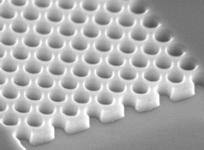
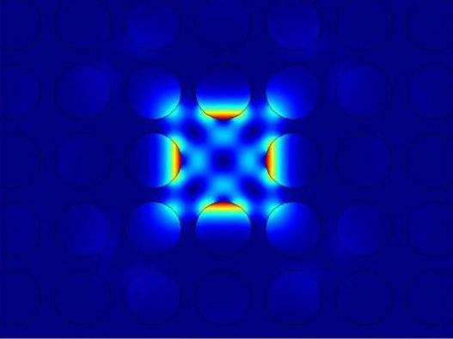
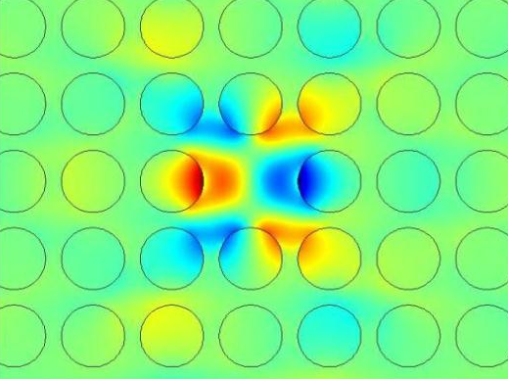
a
b
c
Fig. 1. (a) An example of experimentally realized structure. Spatial distribution of intensity (b) and electric field (c) of a single cavity mode found in Comsol simulations.

