Slide 1
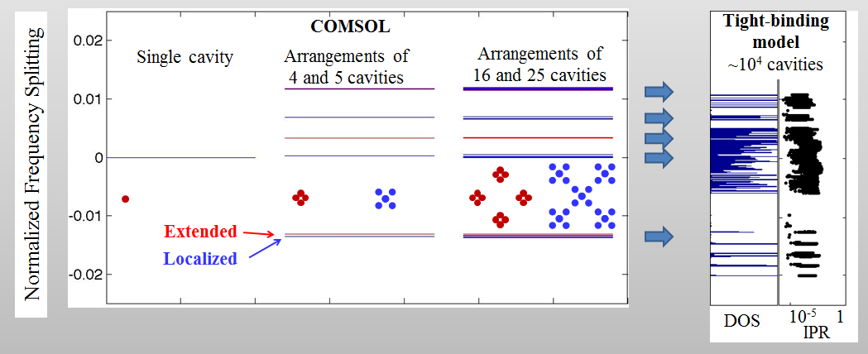
Fig. 3. Normalized frequency splitting from Comsol simulations (left). Density of states (DOS) and inverse participation ratio (IPR) for system with ~10⁴ cavities (right).

