Slide 1
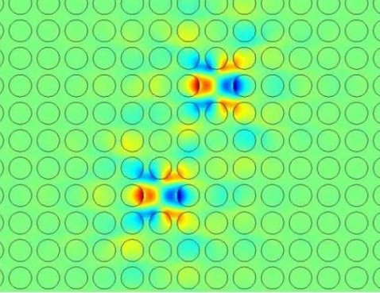
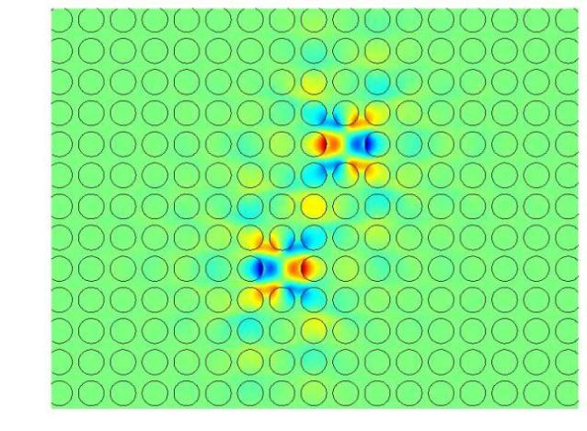
a
b
Fig. 2. Spatial distribution of electric field for a two cavity mode. Anti-symmetric state (a) and symmetric state (b).

