Slide 1
Assignment 01 - All Sorts of Sorts
Programming II / Tristan Goodell

Slide 2
{graphs_&_analysis}
[selection] / [insertion] / [bubble] / [quick]

Slide 3
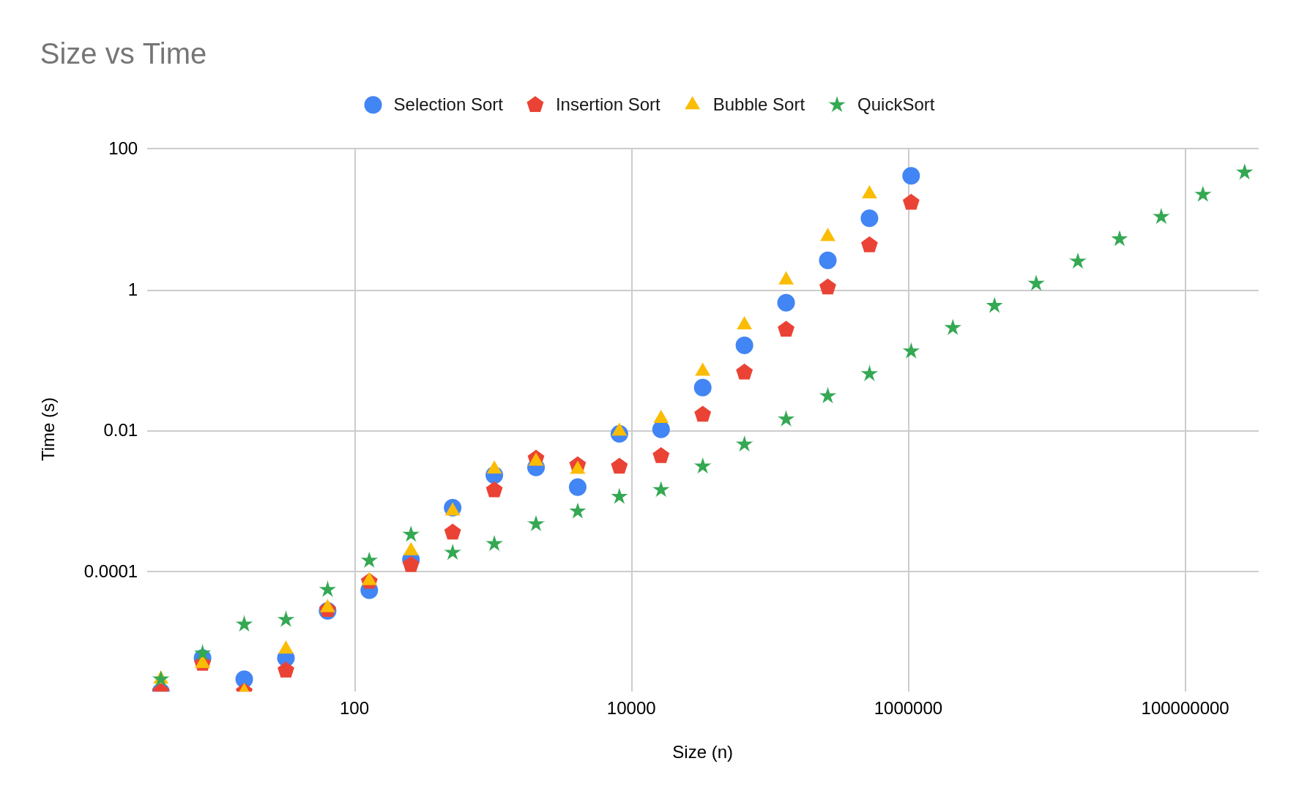
{time}

Slide 4
{time} / [discussion]
Although QuickSort is slower than the other sorts for lists smaller than n=512, it outpaces the other sorting techniques for larger lists.
Since QuickSort is faster than the other techniques, it can process lists up to size n=268435456 in less than a minute, compared to the other lists only being able to process lists up to size n=262144 in less than a minute.

Slide 5
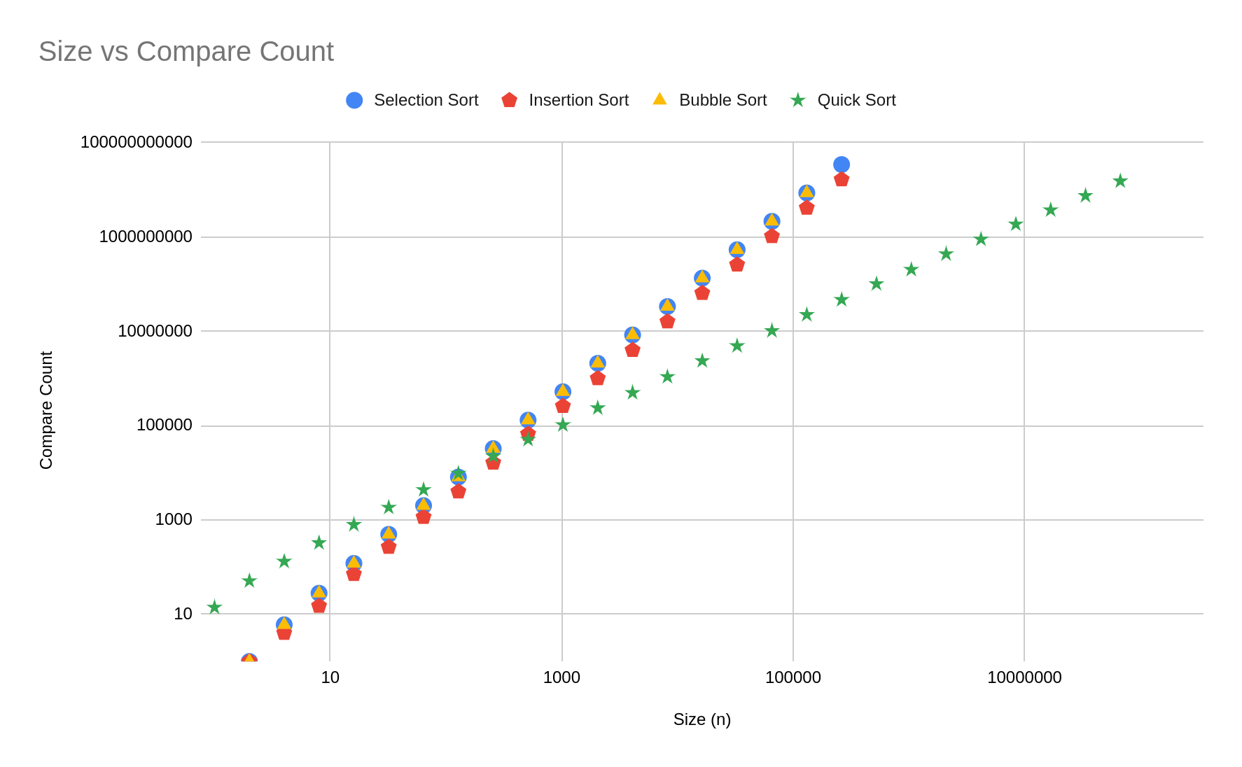
{compare_count}

Slide 6
{compare_count} / [discussion]
Once again, Quick Sort is less efficient than the other sorting techniques with lists with a length less than n=512. After that, Quick Sort becomes much more efficient and requires fewer compares to successfully sort, relative to other sorts.
The number of Compare Counts for Insertion, Selection, & Bubble sorting is incredibly similar. This is explained by all three sorts comparing values just once per loop.

Slide 7
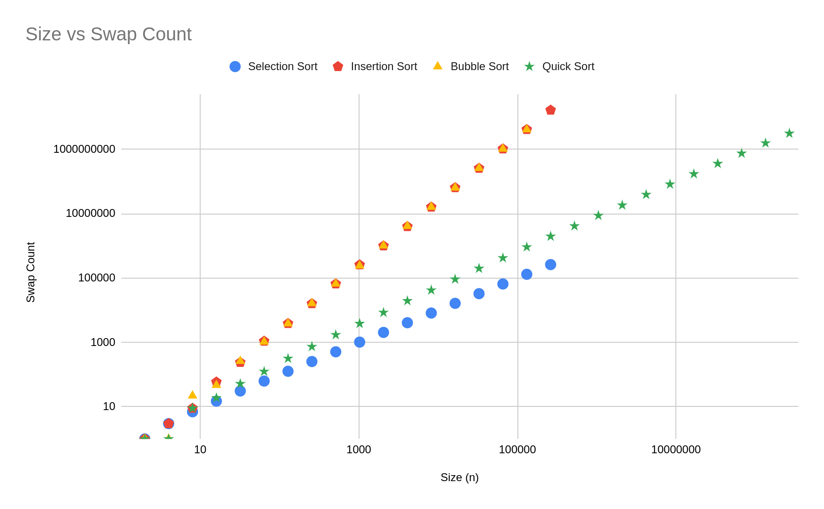
{swap_count}

Slide 8
{swap_count} / [discussion]
Selection Sort is the superior sorting technique when looking at swap count. This efficiency is caused by Selection Sort only swapping n-1 times.
Insertion and Bubble Sort swap items approximately the same number of times.
It took approximately the same number of swaps for Quick Sort to sort a list n=268435456 as it took Insertion and Bubble Sort to sort a list n=262144.
Additionally, it took approximately the same number of swaps for Selection Sort to sort a list n=262144 as it took Quick Sort to sort a list n=32768.

Slide 9
{code}
[selection] / [insertion] / [bubble] / [quick]

Slide 10
{selection_sort} / [code]
public void selectionSort()
{
for (int i=0;i<size-1;i++)
{
int minimum = i;
for(int x=i+1;x<size;x++)
{
if(inOrder(get(x),get(minimum)))
{
minimum=x;
}
}
swap(minimum,i);
}
}

Slide 11
{insertion_sort} / [code]
public void insertionSort()
{
for(int i=1;i<=size-1;i++)
{
int j=i;
while(j>0 && inOrder(get(j-1),get(j)))
{
swap(j,j-1);
j--;
}
}
}

Slide 12
{bubble_sort} / [code]
public void bubbleSort()
{
for(int i=0;i<size;i++)
{
for(int j=1;j<=size-1-i;j++)
{
if(!inOrder(get(j),get(j-1)))swap(j-1,j);
}
}
}

Slide 13
{quick_sort} / [code]
public int partition(int lo, int hi){
int pivot=get(lo);
int i=lo;
int j=hi;
while(true) {
if(get(i)<pivot){
while(get(i)<pivot){
i++; compareCount++;
}
}
else{
compareCount++;
}
if(get(j)>pivot){
while(get(j)>pivot){
j--; compareCount++;
}
}
else{
compareCount++;
}
if(i>=j){
compareCount++;
return j;
}
else{
compareCount++;
}
swap(i,j);
}
}
public void quickSort()
{
quickerSort(0,size-1);
}
public void quickerSort(int lo, int hi)
{
if (lo>=hi)
{
return;
}
int pivot=partition(lo, hi);
quickerSort(lo, pivot);
quickerSort(pivot+1, hi);
}

