Slide 1
Assignment 01 - All Sorts of Sorts
Programming II / Tristan Goodell

Slide 2
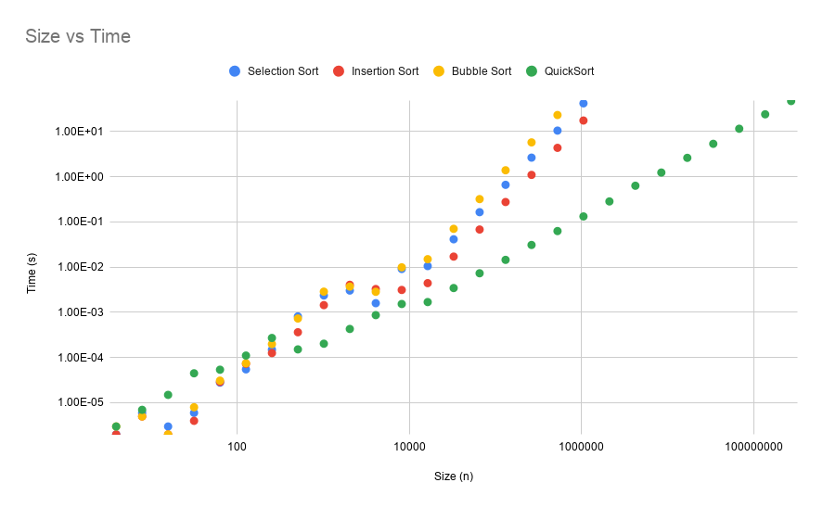
Time

Slide 3
Time / Discussion
Although QuickSort is slower than the other sorts for lists smaller than n=32, it outpaces the other sorting techniques for large lists.
Since QuickSort is faster than the other techniques, it can process lists up to size n=268435456 in less than a minute, compared to the other lists only being able to process lists up to size n=262144 in less than a minute.

Slide 4
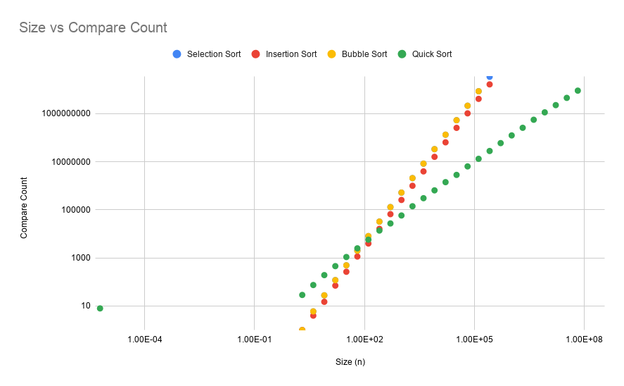
Compare Count

Slide 5
Compare Count / Discussion
Once again, Quick Sort is slower than the other sorting techniques with lists with a length less than n=32. After that, Quick Sort becomes much more efficient and requires fewer compares to successfully sort.
The number of Compare Counts for Insertion, Selection, & Bubble sorting is incredibly similar. This is probably explained by all three sorts comparing values just once per loop.

Slide 6
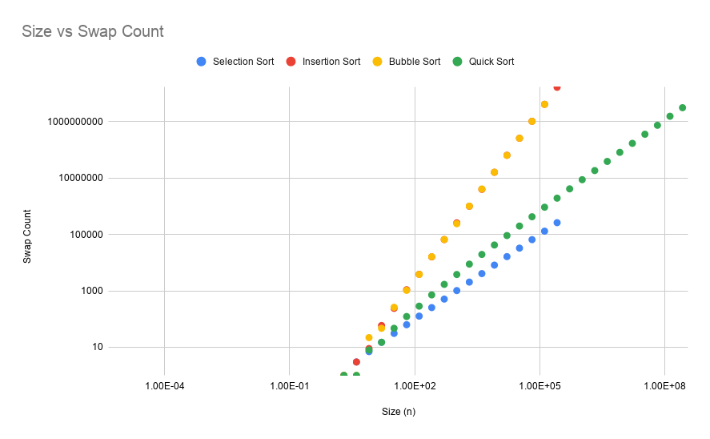
Swap Count

Slide 7
Swap Count / Discussion
Surprisingly, Selection Sort outpaces Quick Sort with the fewest swaps for all lists size n>2.
Insertion and Bubble Sort swap list items approximately the same number of times.
It took approximately the same number of swaps for Quick Sort to sort a list n=268435456 as it took Insertion and Bubble Sort to sort a list n=262144.

Slide 8
Bubble Sort / Code
public void bubbleSort()
{
for(int i=0;i<size;i++)
{
for(int j=1;j<=size-1-i;j++)
{
if(!inOrder(get(j),get(j-1)))swap(j-1,j);
}
}
}

Slide 9
Insertion Sort / Code
public void insertionSort()
{
for(int i=1;i<=size-1;i++)
{
int j=i;
while(j>0 && inOrder(get(j-1),get(j)))
{
swap(j,j-1);
j--;
}
}
}

Slide 10
Selection Sort / Code
public void selectionSort()
{
for (int i=0;i<size-1;i++)
{
int minimum = i;
for(int x=i+1;x<size;x++)
{
if(inOrder(get(x),get(minimum)))
{
minimum=x;
}
}
swap(minimum,i);
}
}

Slide 11
Quick Sort / Code
public int partition(int lo, int hi)
{
int pivot=get(lo);
int i=lo;
int j=hi;
while (true)
{
while(get(i)<pivot)
{
i++;
compareCount++;
}
while(get(j)>pivot)
{
j--;
compareCount++;
}
if(i>=j)
{
compareCount++;
return j;
}
swap(i,j);
}
}
public void quickSort()
{
quickerSort(0,size-1);
}
public void quickerSort(int lo, int hi)
{
if (lo>=hi)
{
return;
}
int pivot=partition(lo, hi);
quickerSort(lo, pivot);
quickerSort(pivot+1, hi);
}

