Slide 1
Self-Balancing Tree
Computer Programming III / Tristan Goodell

Slide 2
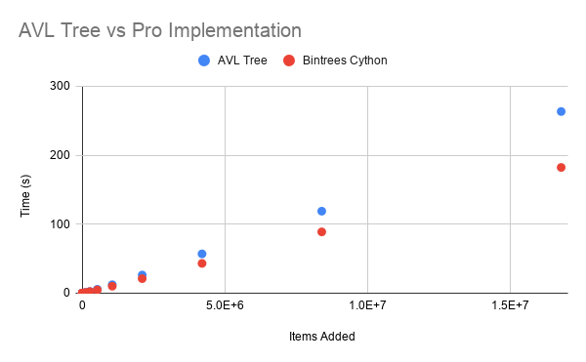
Time vs n Items
AVL Tree vs Bintrees Cython Tree.
Create and add 2^n items for five minutes.

Slide 3
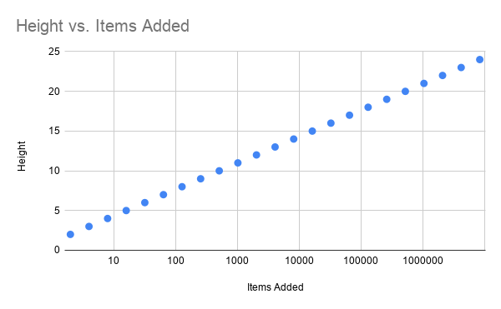
Height vs n Items
Height for custom AVL Tree implementation.
Create and add 2^n items for five minutes.
(Log Scale)

Slide 4
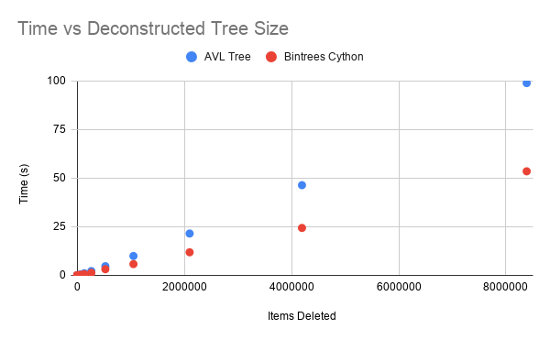
Deconstruction Time
Time to deconstruct custom and pro.
Create tree size 2^n and then deconstruct it.

Slide 5
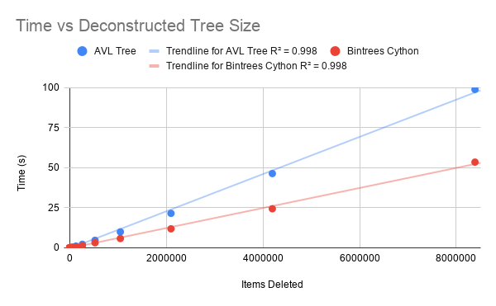
Deconstruction Complexity
Time complexity for custom and pro is O(n).
This is supported by a Linear Regression Analysis.
Since both implementations have an R^2 of 0.998, O(n) describes their time complexity very well.

