Slide 1
Hash Map
Computer Programming III / Tristan Goodell

Slide 2
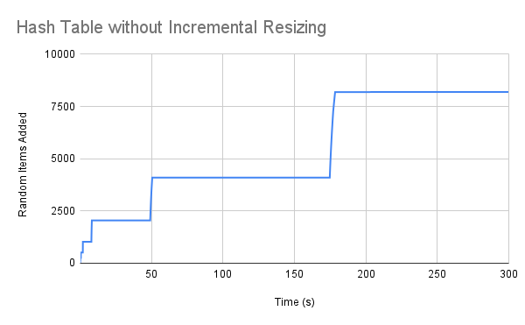
Without Incremental Resizing
Adding 2^i random items and stopping at five minutes.
8192 items.

Slide 3
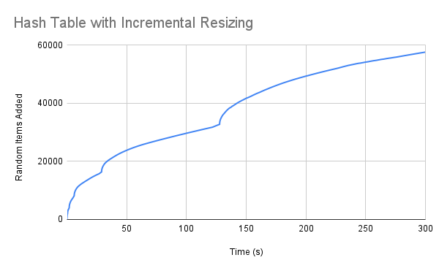
With Incremental Resizing
Adding 2^i random items and stopping at five minutes.
  When resizing, 3 items were transferred each turn.
57628 items.

Slide 4
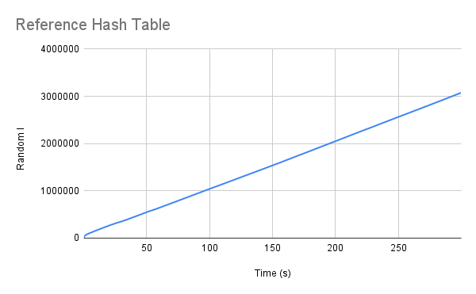
Reference Hash Table
Adding 2^i random items and stopping at five minutes. Built by Amorpheous.
3076740 items.

Slide 5
General Observations
The pro solution performed the best, effectively adding items O(n).
  Added over 57 times more items than with incremental resizing.
Hash with IR allowed items to keep being added while it is resized.
  This allowed it to add 7 times more items without IR.
Hash without IR performed the worst because it had to wait increasingly long periods of time while the Hash Table was resized before it could resume adding.

