Slide 1
Assignment5 / {Seams}
Graphics Programming / Tristan Goodell

Slide 2
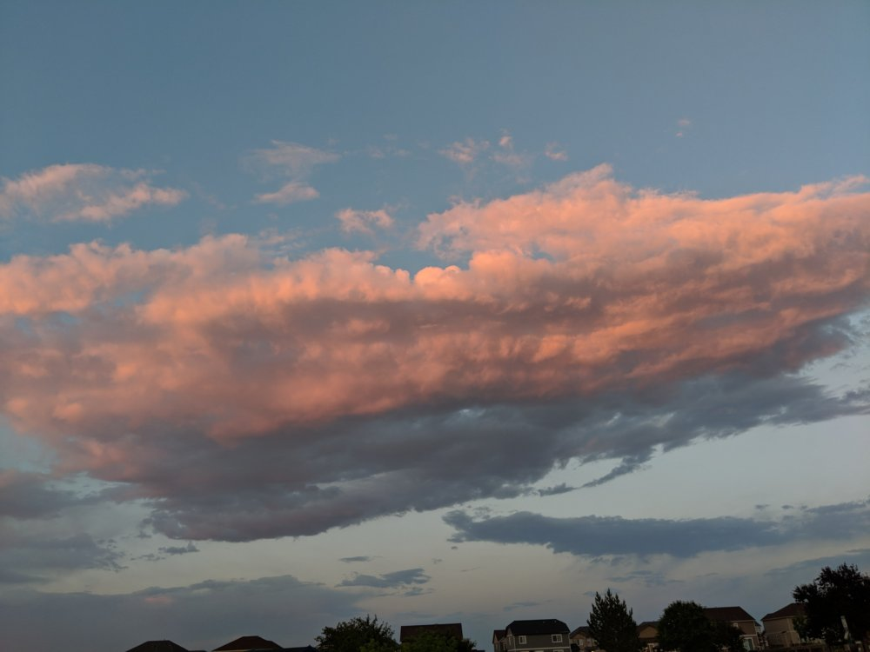
Source Image
image1.jpg

Slide 3
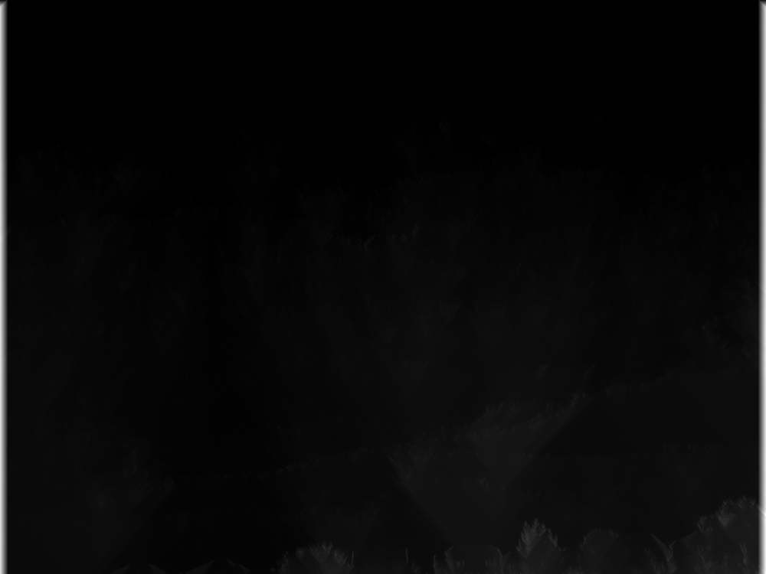
Energy Map
def getEnergyMap(img,repulseMask=None,attractMask=None): edges=getEdgeImage(img) if attractMask is not None: edges[attractMask==1]=-10 kernel=np.ones(3,np.float64) for i in range(1,len(edges)): minAbove=cv2.erode(edges[i-1],kernel).T[0] edges[i]+=minAbove return edges
energyMap.png

Slide 4
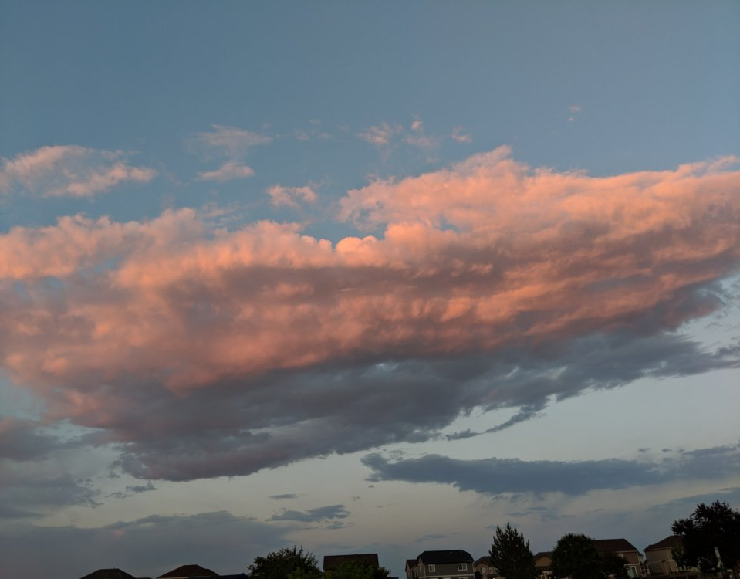
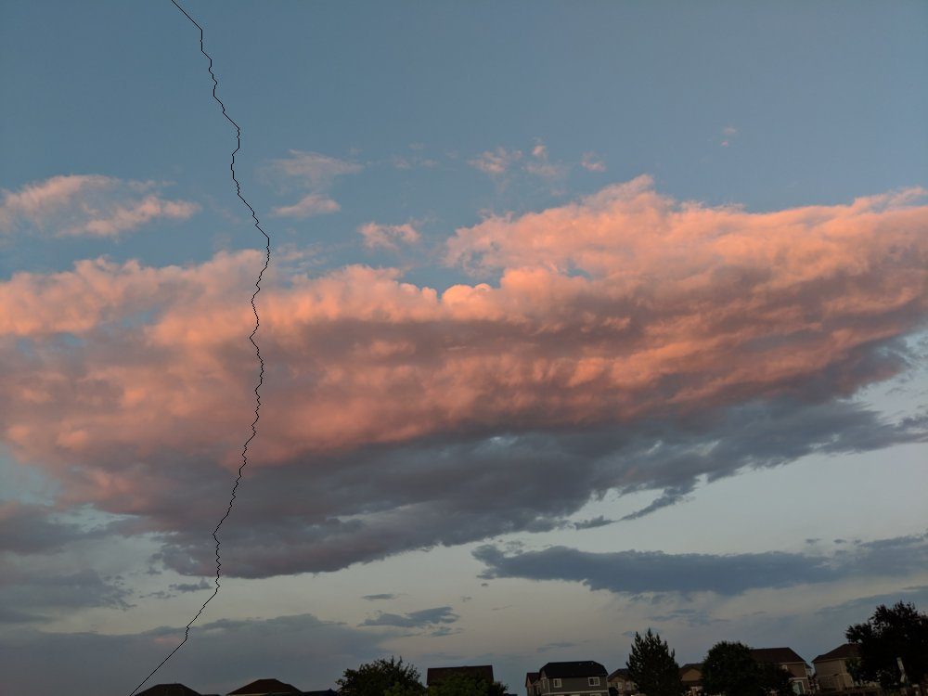
Vertical Seaming
image1.jpg
seams40.png
highlightedSeam.png

Slide 5
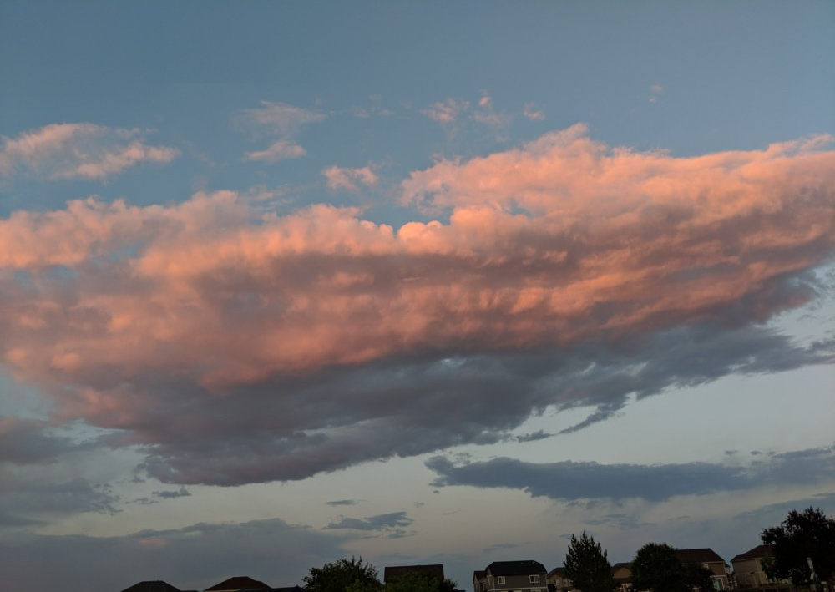

Horizontal Seaming
image1.jpg
horizontalSeams40.png
horizontalHighlightedSeam.png

Slide 6
Retarget
def retarget(img,w,h): seams40=reHoriz(img,w) seams40=reVert(seams40,h) return seams40
def reHoriz(img,w): ih, iw, = img.shape[:2] n = 0 seams40 = img gs40 = cv2.cvtColor(img, cv2.COLOR_BGR2GRAY) attractMask = gs40 * 0 attractMask[690:810, 100:200] = 1 while n < np.abs(iw - w): seam = getSeam(gs40, attractMask=attractMask) gs40 = removeSeam(gs40, seam) seams40 = removeSeam(seams40, seam) attractMask = removeSeam(attractMask, seam) n += 1 return seams40
def reVert(img,h): ih, iw, = img.shape[:2] seams40 = img gs40 = cv2.cvtColor(img, cv2.COLOR_BGR2GRAY) gs40 = cv2.rotate(gs40, cv2.ROTATE_90_COUNTERCLOCKWISE) seams40 = cv2.rotate(seams40, cv2.ROTATE_90_COUNTERCLOCKWISE) attractMask = gs40 * 0 attractMask[690:810, 100:200] = 1 n = 0 while n < np.abs(ih - h): seam = getSeam(gs40, attractMask=attractMask) gs40 = removeSeam(gs40, seam) seams40 = removeSeam(seams40, seam) attractMask = removeSeam(attractMask, seam) n += 1 seams40 = cv2.rotate(seams40, cv2.ROTATE_90_CLOCKWISE) return seams40
def retarget(img,w,h): seams40=reHoriz(img,w) seams40=reVert(seams40,h) return seams40
def reHoriz(img,w): ih, iw, = img.shape[:2] n = 0 seams40 = img gs40 = cv2.cvtColor(img, cv2.COLOR_BGR2GRAY) attractMask = gs40 * 0 attractMask[690:810, 100:200] = 1 while n < np.abs(iw - w): seam = getSeam(gs40, attractMask=attractMask) gs40 = removeSeam(gs40, seam) seams40 = removeSeam(seams40, seam) attractMask = removeSeam(attractMask, seam) n += 1 return seams40

Slide 7
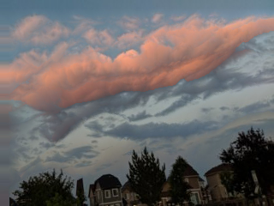
Retarget - 320x240

Slide 8
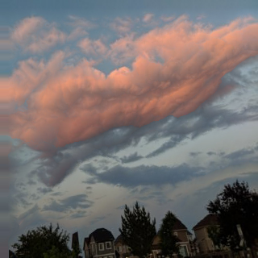
Retarget - 320x320

Slide 9
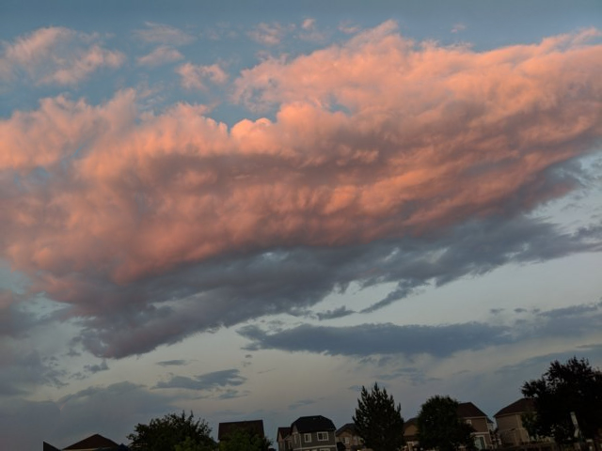
Retarget - 640x480

Slide 10
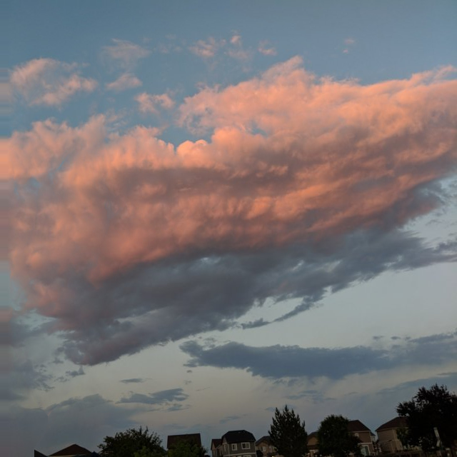
Retarget - 640x640

