Slide 1
Assignment6 / {WebCamBooth}
Graphics Programming / Tristan Goodell

Slide 2
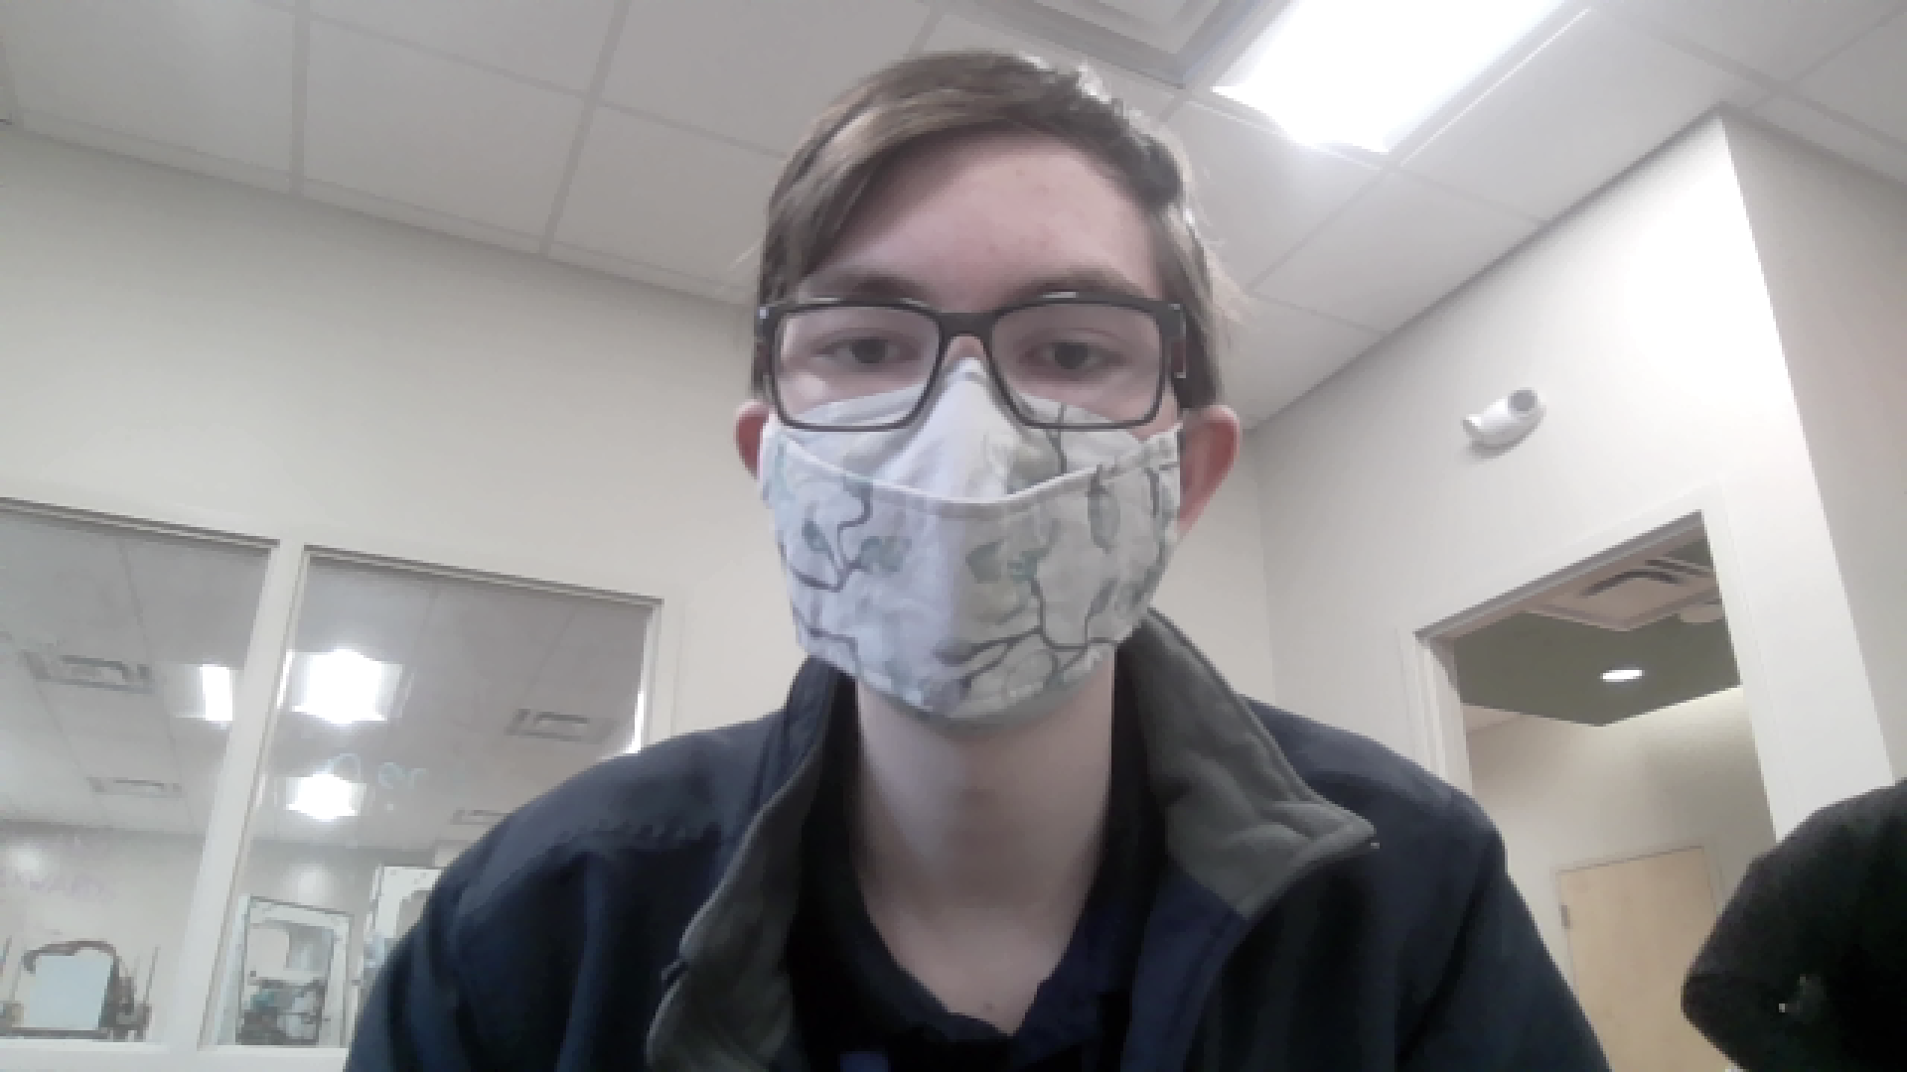
Filter 1

Slide 3
Filter 1 - {code}
def desaturate(img): desat = 1*np.double(img[:, :, :]) greyImg = greyscale(img) # Actual math behind desat desat[:, :, :] = (desat[:, :, :] *(1 - 0.5)) + (greyImg[:,:,None] * 0.5) # Overflow Check desat[desat > 255] = 255 desat[desat < 0] = 0 return desat

Slide 4
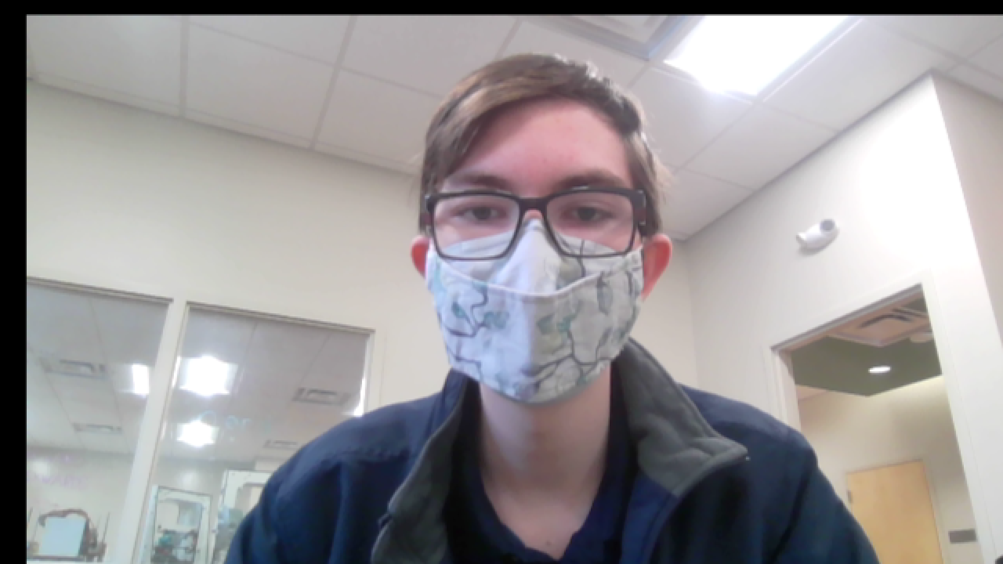
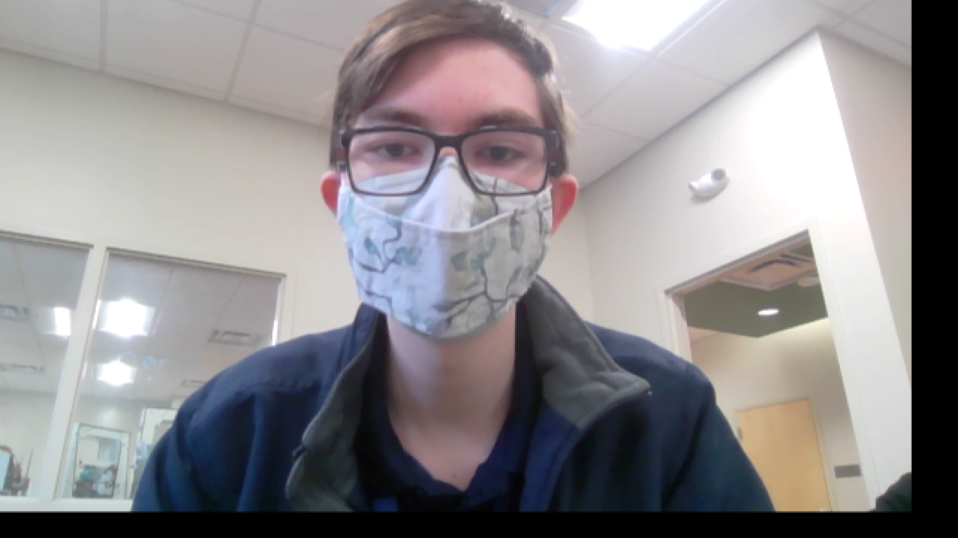
Filter 2

Slide 5
Filter 2 - {code}
if warp==True: angle = np.pi * t / 1000 + np.pi / 3 * np.cos(t * .05)*2 T1 = np.float64([[1, 0, w/3*np.cos(angle)], [0, 1, h/3*np.cos(angle)], [0, 0, 1]]) frame = cv2.warpPerspective(frame, T1, (w, h))

Slide 6
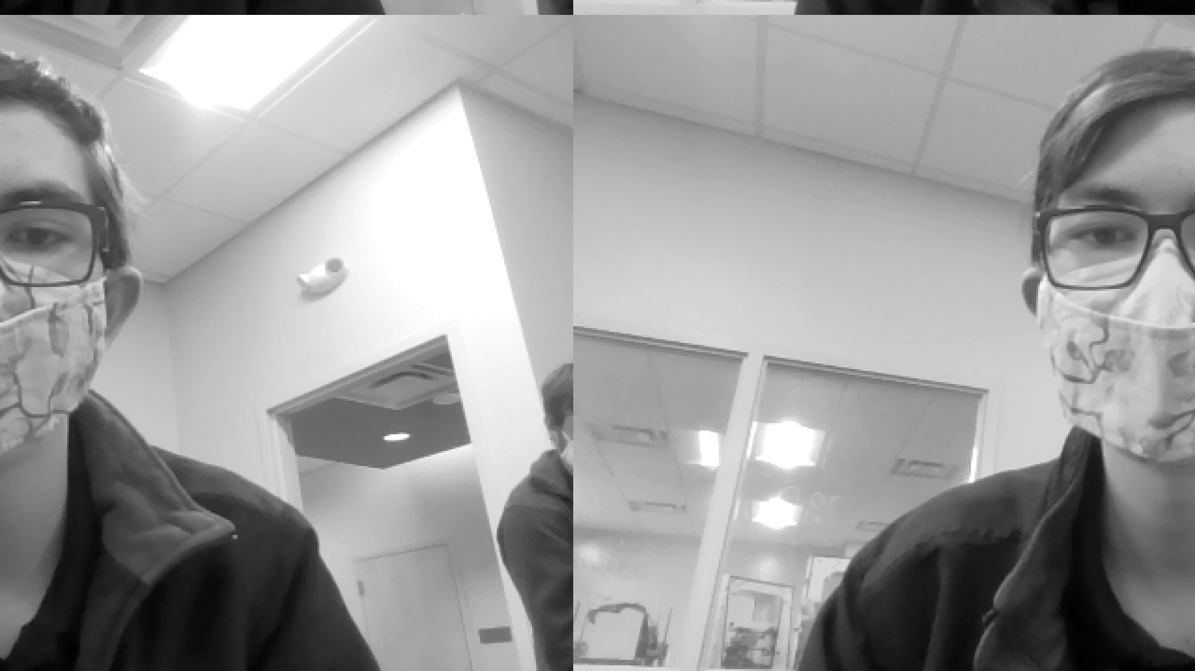
Filter 3
if nonlinear==True: frame=cv2.remap(frame,(x+dx*t)%(w-1),(y+dy*np.sin(np.pi*t/180))%(h-1),cv2.INTER_CUBIC) frame=normalize(greyscale(frame))

Slide 7
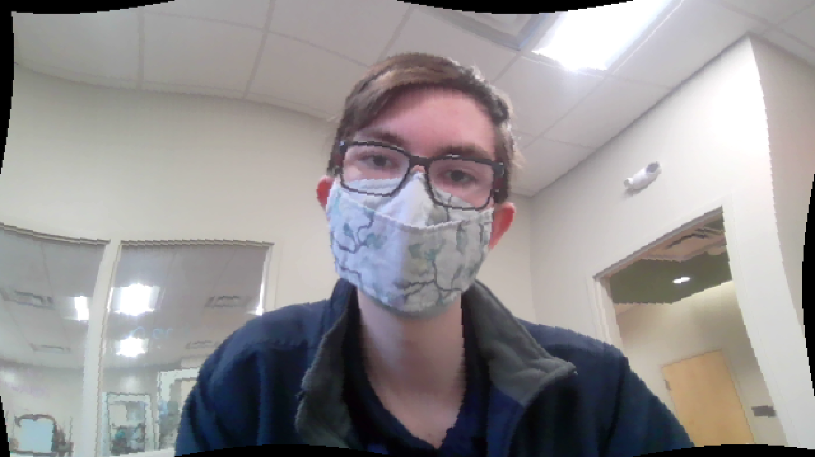
Filter 4

Slide 8
Filter 4 - {code}
if matrix==True: M = np.float32([[1, 0, np.sin(2*t+10)], [0, 1, np.sin(2*t+10)], [0, 0, 1]]) frame = cv2.warpPerspective(frame, M, (w,h)) frame = cv2.remap(frame, x + dx * np.sin(np.pi * (y + t)/180),y + dy * np.sin(np.pi * (x + t)/180), 0)

Slide 9
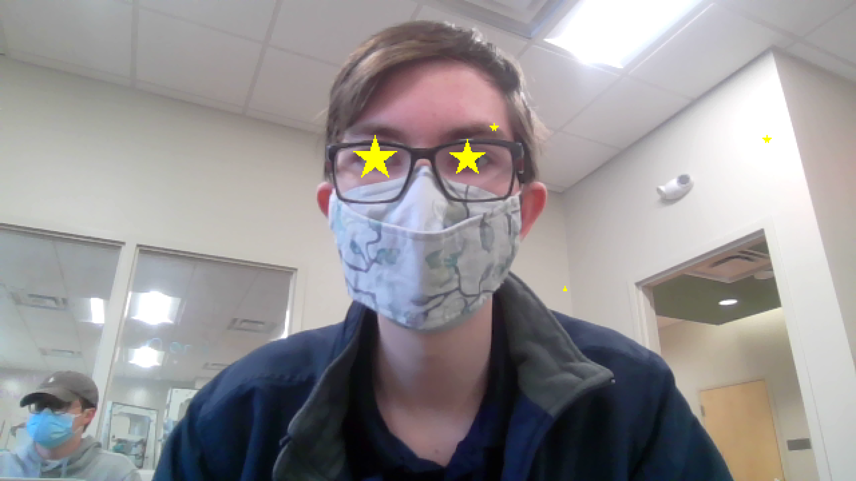
Filter 5

Slide 10
Filter 5 - {code}
if eyez==True: ret, frame = cap.read() eyes = eyecacade.detectMultiScale(frame[:, :, 1], scaleFactor=1.2, minNeighbors=5) # cv2.rectangle(frame,(x,y),(x+w,y+h),(0,0,255),5) yellow = (0, 255, 255) for (x, y, w, h) in eyes: star(frame,w//2,(x+w//2,y+h//2),color=yellow) c=0 while c<3: star(frame, random.randint(1,5), (random.randint(0,640), random.randint(0,360)), color=yellow) c+=1

Slide 11
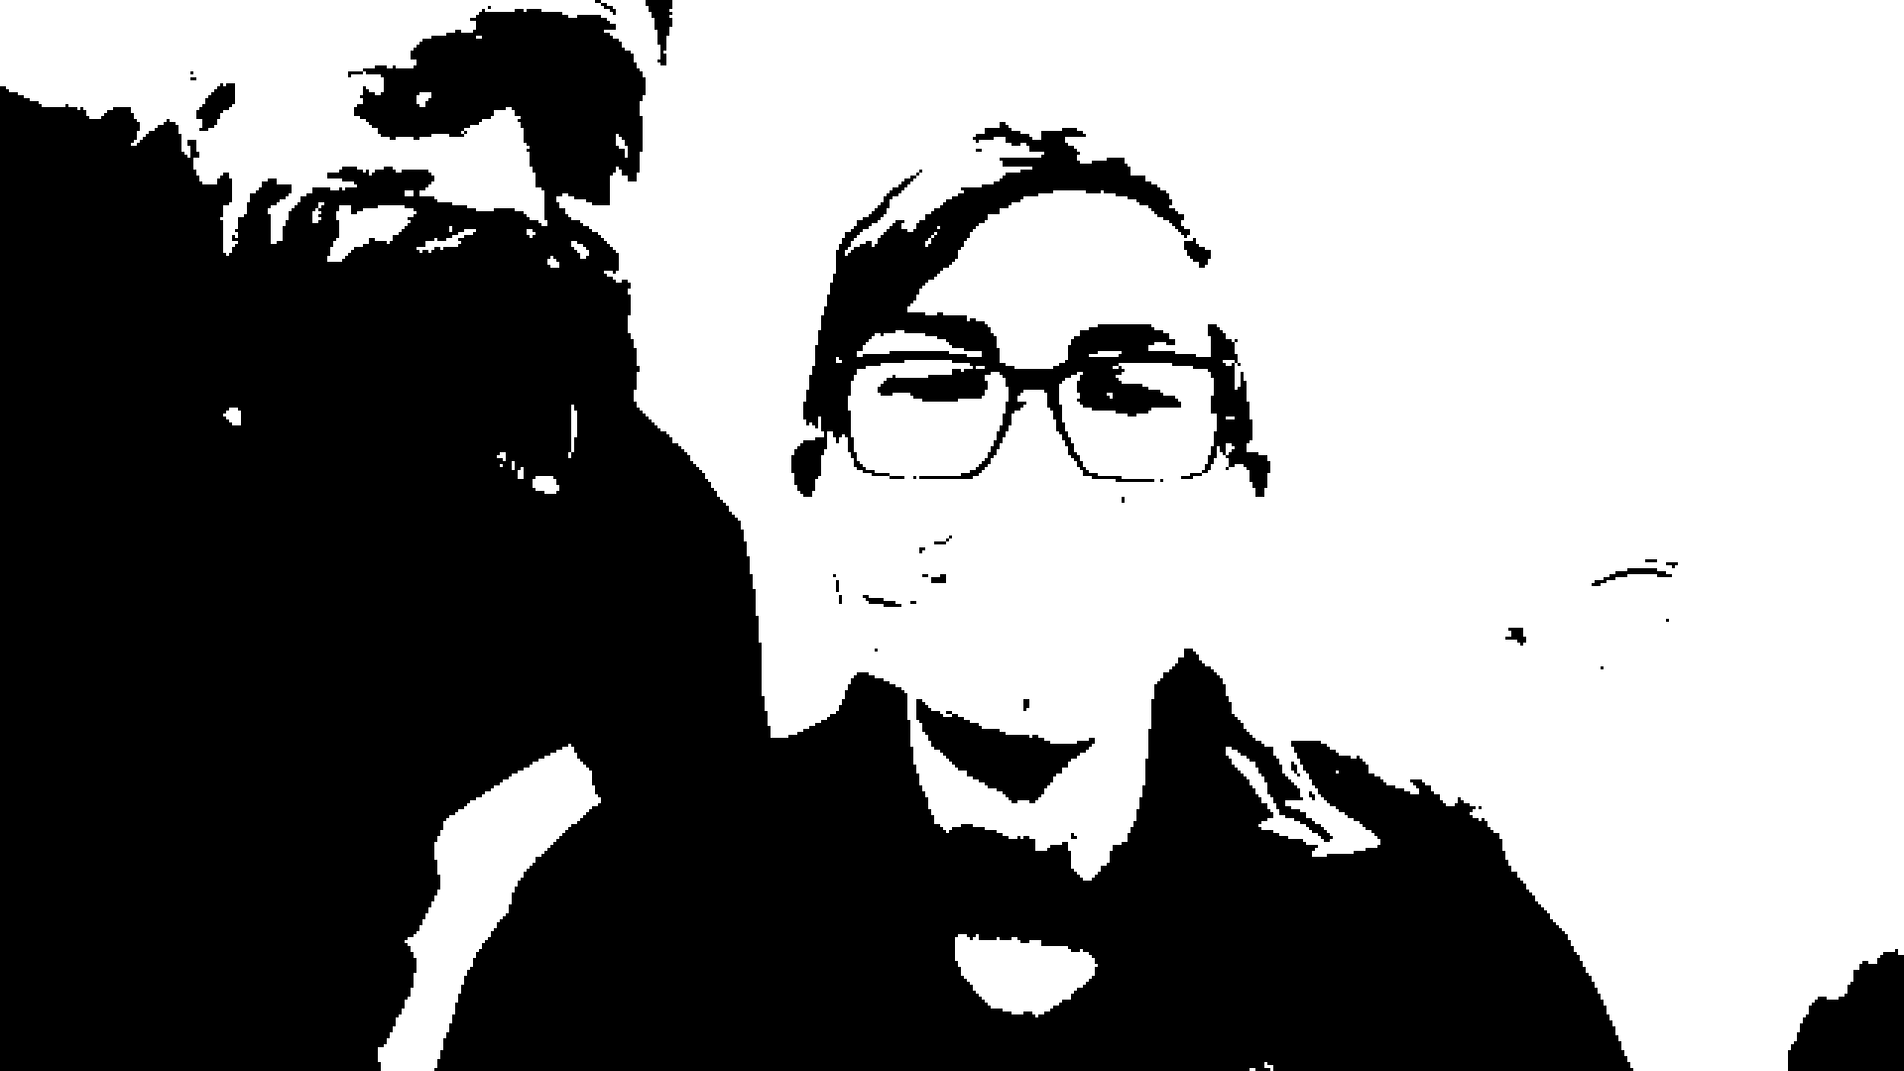
Filter 6

Slide 12
Filter 5 - {code}
def blackWhite(img, threshold): bw = 1*greyscale(img) bw[np.uint8(bw) < threshold] = 0 bw[np.uint8(bw) > threshold] = 255 return bw

