Slide 1
Assignment8 / {XKCompressionD}
Graphics Programming / Tristan Goodell

Slide 2
Methodology
To compress an XKCD comic, the image is converted to black and white. Then, a String of 1s (white pixels) and 0s (black pixels) is constructed.
From there, an array is created that goes through the String and counts the number of black and white pixels in a row. If there are more than 255 pixels of the same color in a row, the the array places a 0 in the next index and then resumes in the index after that.
The array is then converted to binary and then added to output.tzg.
To decompress an image, the process is the exact opposite.

Slide 3
BW, writeHeaders, & getPixelCount
def blackWhite(img, threshold): bw = cv2.cvtColor(img,cv2.COLOR_BGR2GRAY) bw[np.uint8(bw) < threshold] = 0 bw[np.uint8(bw) > threshold] = 255 return bw def writeHeaders(w,h,f): f.write(b"TZG") aSeriesOfBytes = struct.pack("<2I", w, h) f.write(aSeriesOfBytes)
def getPixelCount(pixels,startIndex,count=0): counter=count index=startIndex val=pixels[index] while counter<255 and index<len(pixels)-1 and pixels[index]==val: index+=1 counter+=1 return counter

Slide 4
save
def save(img,filename): w,h=img.shape f=open(filename+".tzg","wb") writeHeaders(w,h,f) pixels="" for row in img: for pixel in row: if pixel==255: pixels+="1" else: pixels+="0" pixelsSize=len(pixels) index=0 turn=0 npixels=[]
while index<pixelsSize-1: if turn%2==0 and pixels[index]=="0": num=getPixelCount(pixels,index,0) npixels.append(num) index+=num elif turn%2==1 and pixels[index]=="1": num = getPixelCount(pixels,index,0) npixels.append(num) index+=num turn+=1 npixels.append(1) bnpixels=[] for pixel in npixels: bnpixels.append(bin(pixel)) f.write(struct.pack("<B", pixel)) f.close()

Slide 5
read
def read(filename): f = open("%s.tzg" % filename, "rb") x = f.read(3) if x != b"TZG": print("invalid file") w, h = struct.unpack("<2I", f.read(8)) pixels = [] while 1: b = f.read(1) if not b: break pixels.append(struct.unpack("<B", b)) npixels=[] index=0
while index<len(pixels)-1: npixels.append(int(pixels[index][0])) index+=1 npixels.append(1) spixels="" turn=0 index=0 while index<len(pixels)-1: if turn%2==1: spixels+=npixels[index]*"0" elif turn%2==0: spixels+=npixels[index]*"1" turn+=1 index+=1 spixels+="0" m = np.array(list(spixels)) img = np.uint8(np.reshape(m[:w * h], (w, h)) == "1") * 255 return img

Slide 6
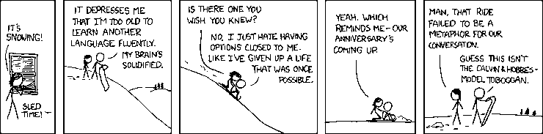
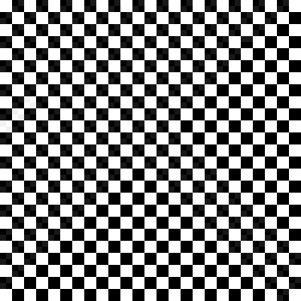

Case 1: #529
Black_and_White.png - 11.2 KB
Compressed.tzg
13.9 KB
0.82 bits/pixel
Uncompressed.png - 11.1 KB

Slide 7
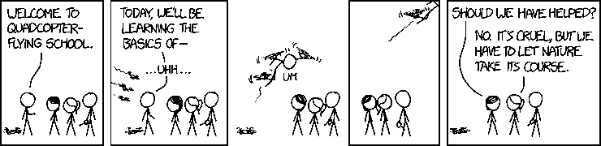
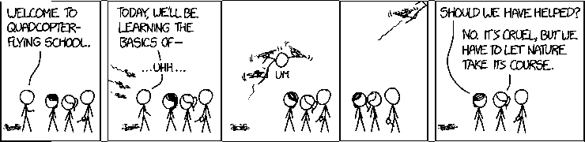
Case 2: #1630
Black_and_White.png - 10.6 KB
Compressed.tzg
11.7 KB
0.7 bits/pixel
Uncompressed.png - 10.6 KB

Slide 8
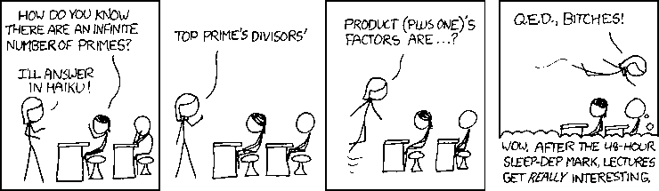
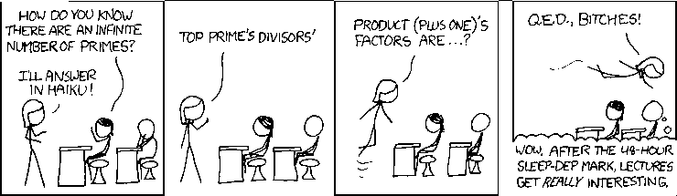
Case 3: #622
Black_and_White.png - 11.6 KB
Compressed.tzg
12.6 KB
0.63 bits/pixel
Uncompressed.png - 11.5 KB

