Slide 1
CompSci 230 S2 2017 Programming Techniques
Arrays

Slide 2
Agenda & Reading
Topics:
Introduction
Primitive Types vs. Reference Types
Arrays
Multidimensional Arrays
Arrays of Objects
Reading
Java how to program Late objects version (D & D)
Chapter 6
The Java Tutorial
Arrays
https://docs.oracle.com/javase/tutorial/java/nutsandbolts/arrays.html
http://www.tutorialspoint.com/java/java_arrays.htm

Slide 3
1.Introduction
Data structures — collections of related data items.
Array objects — data structures consisting of related data items of the same type.
Make it convenient to process related groups of values.
Remain the same length once they’re created.
Enhanced for statement : allows a program to access the data in an array more easily than does the counter-controlled for statement.
Use variable-length argument lists to create methods that can be called with varying numbers of arguments.
Demonstrate how to process command-line arguments in method main.
static methods of class Arrays from the java.util package.
ArrayLists are similar to arrays but provide additional functionality,

Slide 4
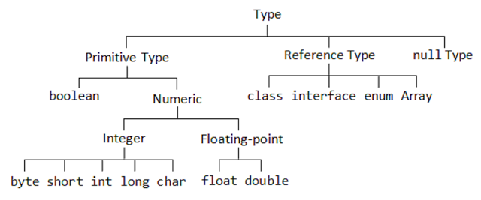
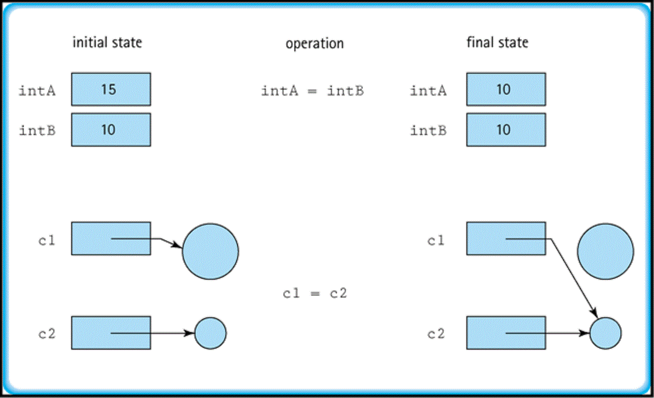
2.Primitive Types vs. Reference Types
Java is a strongly typed language.
Java requires all variables to have a type.
Java’s types are divided into primitive types and reference types.
Primitive types:
boolean, byte, char, short, int, long, float and double.
A variable of a primitive type is directly associated with a memory location storing the value of the variable.
int intA = 15;
int intB = 10;

Slide 5
2.Primitive Types vs. Reference Types
Reference Types:
Any data type that is not a primitive type is a reference type
Programs use variables of reference types (normally called references) to store the addresses of objects in the computer’s memory.
Such a variable is said to refer to an object in the program.
If a variable is not initialized explicitly, the variable is given the special value null.
Point b = new Point( 10, 20);
b: Point
x =10
y =20

Slide 6
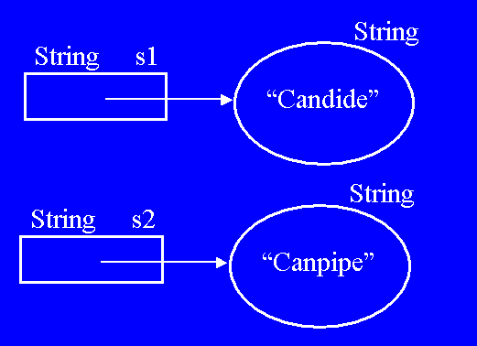
2.Primitive Types vs. Reference Types
To call an object’s methods, you need a reference to the object.
If an object’s method requires additional data to perform its task, then you’d pass arguments in the method call.
Primitive-type variables do not refer to objects, so such variables cannot be used to invoke methods.
String s1 = new String("candide");
String s2 = s1.replace('d', 'p');

Slide 7
3.Arrays
int[] ages = new int[10];
String[] names = new String[10];
An array is a group of variables (called elements) containing values that all have the same type.
The type of an array is determined by its element type, which is specified when the array is instantiated.
Arrays are objects and thus are of a reference type.
Elements can be either primitive types or reference types.
Default values: (int:0; String: null; boolean:false)
The length of an array can be obtained from the array object’s length variable
An array’s length is fixed when it is created (determines the amount of memory allocated) and cannot be changed unless the array is redeclared.
System.out.println(courseMarks.length);

Slide 8
3.Arrays
0
1
2 | 95
3
Array Name
Index
Value
courseMaks[2]= 95;
Each element is accessed in constant time using an index position of the particular element in square brackets ([]).
The index:
must be an int (non-negative), or an expression that evaluates to an int
uses zero-numbering (indexes go from 0 to length-1)
Array names follow the same conventions as other variable names.
Value (element of the array) can be accessed and modified in constant time using its index.

Slide 9

3.Arrays Declaring & Creating Arrays
The three steps for creating an array are
Declaring an Array
Syntax:
No memory space allocated
No length specified
The array has not been initialized
Creating a New Array
Syntax:
specify the type of the array elements and the number of elements as part of an array-creation expression that uses keyword new.
returns a reference that can be stored in an array variable.
Note: memory space allocated, length specified, initialized to default values
Creating & Initializing elements
create an array and initialize its elements with an array initializer — a comma-separated list of expressions enclosed in braces.
i.e. counts the number of initializers in the list to determine the size of the array
Syntax:
int courseMarks[];
String[] args;
<type><name>[]; //or
<type>[] <name>;
int[4] courseMarks;
Specify the size in array declaration is a syntax error
<name> = new <type>[Length];
courseMarks = new int[10];
courseMarks = new int[]{26,73,55,97};
<name> = new <type> { values };

Slide 10
3.Arrays Creating Arrays
Combine declaration and creation
The first two steps of creating an array can be combined as one:
Combine declaration & initialization
Array elements can be initialized in the declaration statement by putting a comma-separated list in braces
The length of an array is automatically determined when the values are explicitly initialized in the declaration
The memory space of an array can be allocated dynamically during the run-time of the program.
If the size is -1, it will lead to a run-time error
Note: The Java compiler will NOT indicate that something is wrong.
int[] courseMarks = new int[10];
int[] courseMarks = new int[4]{26,73,55,97};
double[] reading = {5.1, 3.02, 9.65};
int[] courseMarks = new int[-1];

Slide 11
3.Arrays Using Arrays
Array processing is easily done in a loop
A for loop is commonly used to initialize array elements and print out all values
Initialization
Note:
The loop counter/array index goes from 0 to length-1
It counts through length=5 iterations using the zero-numbering of the array index
Printing
Using an index larger than length-1 causes a run time (not a compiler) error
An ArrayIndexOutOfBoundsException is thrown
int[] reading = new int[5];
for (int i=0; i<reading.length; i++) {
reading[i] = i;
}
for (int i=0; i<reading.length; i++) {
System.out.println(reading[i]);
}
Outside the valid range
System.out.println(reading[5]);

Slide 12
3.Arrays Example 1
L06Code.java
Example 1:
creates a 10-element array and assigns to each element one of the even integers from 2 to 20 (2, 4, 6, …, 20).
ARRAY_LENGTH: is a constant.
Constant variables must be initialized before they’re used and cannot be modified thereafter.
final int ARRAY_LENGTH = 5;
int[] array = new int[ARRAY_LENGTH];
for (int counter=0; counter<array.length; counter++)
array[counter] = 2 + 2 * counter;
for (int counter=0; counter<array.length; counter++)
System.out.printf("%5d%8d%n", counter, array[counter]);
0 2
1 4
2 6
3 8
4 10

Slide 13
3.Arrays Enhanced for Statement
Iterates through the elements of an array without using a counter, thus avoiding the possibility of “stepping outside” the array.
Syntax:
where parameter has a type and an identifier, and arrayName is the array through which to iterate.
It can be used only to obtain array elements—it cannot be used to modify elements.
Note: No error message generated, the values are simply unchanged
If you need to modify elements, use the standard for loop
for (parameter : arrayName) statement
2
4
6
8
10
for (int value: array)
value += 2;
for (int value: array)
System.out.printf("%5d%n", value);

Slide 14
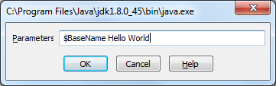
3.Arrays Arguments for the method main
L06Code.java
The heading for the main method shows a parameter that is an array of Strings:
When you run a program from the command line, all words after the class name will be passed to the main method in the args array.
The following main method in the class TestArray will print out the first two arguments it receives:
public static void main(String[] args) {
...
}
>java TestArray Hello World
public static void main(String[] args) {
for (int i=0; i<args.length; i++)
System.out.println(args[i]);
}
Output:
Hello
World

Slide 15
3.Arrays Testing for Equality
The following example creates two arrays of ints.
Comparison “==”
Compares references, not values. The use of == with array/object references is generally limited to if two references are to the same object
Variables a and b are both 3-element arrays of ints
The output of this example is "Not Equal" because the addresses of the arrays are not equal.
int[] a = new int[] {1, 2, 3};
int[] b = new int[] {1, 2, 3};
 | a
0 | 0
1 | 1
2 | 2
 | b
0 | 0
1 | 1
2 | 2
if (b == a)
System.out.println("Equal");
else
System.out.println("Not Equal");
Not Equal

Slide 16
3.Arrays Copying Arrays
Note: assigning one array to another only changes the references. No actual copying is performed.
To perform copying, use the
void arraycopy(Object src, int srcPos, Object dest, int destPos, int length)
Copies an array from the specified source array, beginning at the specified position, to the specified position of the destination array.
Note:
It is useful when copying parts of an array
The copy array must be first created.
int[] src = {1,2,3};
int[] copy = new int[3];
System.arraycopy(src,0, copy, 0, 2);
for (int i=0; i<copy.length; i++)
System.out.println(copy[i]);
 | src
0 | 1
1 | 2
2 | 3
 | copy
0 | 1
1 | 2
2 | 0
if (copy == src) //checking reference
System.out.println("Equal");
else
System.out.println("Not Equal");
Not Equal

Slide 17
3.Arrays Cloning Arrays
To copy the entire array, use the clone method
Object clone()
Creates and returns a copy of this object
int[] src = {1,2,3};
int[] copy = src.clone();
Must create an object first
 | src
0 | 1
1 | 2
2 | 3
0 | 1
1 | 2
2 | 3
 | copy
if (copy == src) //checking reference
System.out.println("Equal");
else
System.out.println("Not Equal");
Not Equal

Slide 18
Exercise 1
What is the output of the following code fragment?
What is the output of the following code fragment?
What is the output of the following code fragment?
int[] array = {0, 2, 4};
for (int value: array)
value += 2;
System.out.println(Arrays.toString(array));
!
!
int[] array = {0, 2, 4};
for (int counter=0; counter<array.length; counter++)
array[counter] += 2;
System.out.println(Arrays.toString(array));
int[] array = {0, 2, 4};
for (int value: array) {
value += 2;
}
System.out.println(Arrays.toString(array));
!

Slide 19
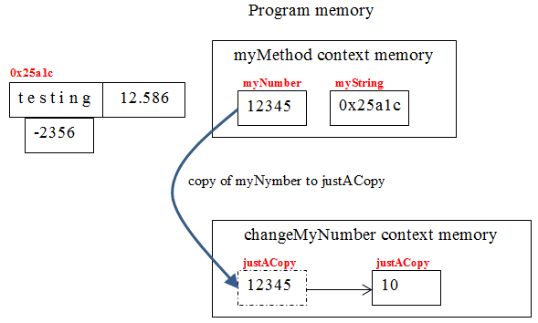
3.Arrays Pass-by-value
L06Code02.java
All arguments are passed by value in method calls in Java.
A method call can pass TWO types of values to a method—copies of primitive values and copies of references to objects.
Objects themselves cannot be passed to methods.
Case 1: primitive types: (int, double, float.. etc)
a copy of the argument’s value is passed to the called method.
changes to the called method’s copy do not affect the original variable’s value in the caller.
public static void changeMyNumber(int justACopy){
justACopy = 10;
System.out.println("justACopy = "+justACopy);
}
public static void myMethod() {
int myNumber = 12345;
String myString = "testing";
System.out.println("myNumber before call = "+myNumber);
changeMyNumber(myNumber);
System.out.println("myNumber after call = "+myNumber);
}
myNumber before call = 12345
justACopy = 10
myNumber after call = 12345

Slide 20
3.Arrays Pass-By-Value
L06Code02.java
Case 2: Reference Types (StringBuffer, array… etc)
i.e. a copy the object’s reference is passed to the called method
an object’s reference is passed by value, a method can still interact with the referenced object by calling its public methods using the copy of the object’s reference.
The parameter in the called method and the argument in the calling method refer to the same object in memory.
We can modify the object and have the changes reflected in the outer scope.
public static void changeMyString(StringBuffer justACopy) {
justACopy.append("++");
System.out.println("justACopy = "+ justACopy);
}
++
myString
myNumber
0x25a1c
12345
public static void myMethod2() {
int myNumber = 12345;
StringBuffer myString = new StringBuffer("testing");
System.out.println("myString before call = "+myString);
changeMyString(myString);
System.out.println("myString after call = "+myString);
}
copy of the object’s reference to justACopy
changeMyString
0x25a1c
myString before call = testing
justACopy = testing++
myString after call = testing++

Slide 21
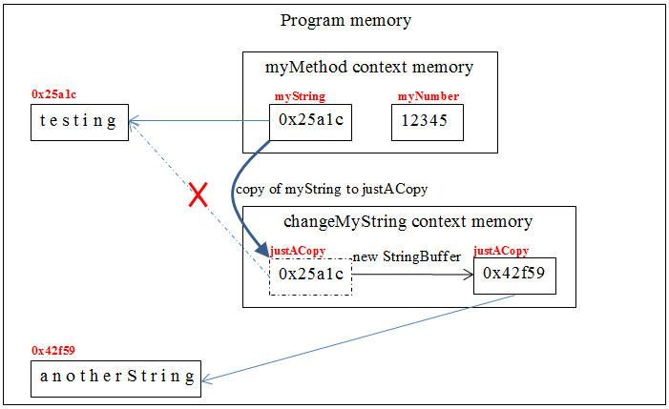
3.Arrays Pass-By-Value
L06Code02.java
Case 3: Reference Types (StringBuffer, array… etc)
i.e. a copy the object’s reference is passed to the called method
If you modify a reference-type parameter so that it refers to another object, only the parameter refers to the new one.
changes to the called method’s copy do not affect the original variable’s value in the caller.
public static void makeNewString(StringBuffer justACopy) {
justACopy = new StringBuffer("another String");
System.out.println("justACopy = "+justACopy);
}
public static void myMethod3() {
int myNumber = 12345;
StringBuffer myString = new StringBuffer("testing");
System.out.println("myString before call = "+myString);
makeNewString(myString);
System.out.println("myString after call = "+myString);
}
myString before call = testing
justACopy = another String
myString after call = testing

Slide 22
3.Arrays Passing Arrays to Methods
L06Code02.java
To pass an array argument to a method, specify the name of the array without any brackets.
the method’s parameter list must specify an array parameter.
the called method receives a copy of the object’s reference.
i.e. they both refer to the same object
We can modify the object and have the changes reflected in the outer scope.
modifyArray(origArray);
public static void modifyArray(int[] myArray) { ... }
public static void modifyArray(int[] myArray) {
myArray[0] += 10;
}
origArray before call = 3
origArray after call = 13
int[] origArray = {3,5,7};
System.out.println("origArray[0] before call = "+origArray[0]);
modifyArray(origArray);
System.out.println("origArray[0] after call = "+origArray[0]);

Slide 23
3.Arrays Passing Array elements to Methods
L06Code02.java
To pass an individual array element of a primitive type to a method, specify the name of the array and the index.
the called method receives a copy of the element’s value.
Modifying the copy in the called method does not affect the original value of that element in the calling method’s array.
changeMyNumber(origArray[2]);
public static void changeMyNumber(int justACopy){
justACopy = 10;
System.out.println("justACopy = "+justACopy);
}
origArray[2] before call = 7
justACopy = 10
origArray[2] after call = 7
int[] origArray = {3,5,7};
System.out.println("origArray[2] before call = "+origArray[2]);
changeMyNumber(origArray[2]);
System.out.println("origArray[2] after call = "+origArray[2]);

Slide 24
3.Arrays Variable-Length Argument Lists
L06Code02.java
With variable-length argument lists, you can create methods that receive an unspecified number of arguments.
Syntax: A type followed by an ellipsis (...) in a method’s parameter list
e.g. double… numbers
Note: it can occur only once in a parameter list, and must be placed at the end of the parameter list.
Java treats the variable-length argument list as an array whose elements are all of the same type.
public static double average(double... numbers) {
double total = 0;
for (double d: numbers)
total += d;
return total/numbers.length;
}
Average 15.0
Average 20.0
System.out.printf("Average %.1f%n", average(d1, d2));
System.out.printf("Average %.1f%n", average(d1, d2, d3));

Slide 25
4.Multidimensional Arrays
Multidimensional Arrays - Arrays with more than one index
number of dimensions = number of indexes
Multidimensional arrays with two dimensions are often used to represent tables of values with data arranged in rows and columns.
To identify a particular table element, you specify two indices—the first identifies the element’s row and the second its column.
Multidimensional arrays can have more than two dimensions.
Java does not support multidimensional arrays directly, but it allows you to specify one-dimensional arrays whose elements are also one-dimensional arrays, thus achieving the same effect.
int[][][] threeD = new int [2][3][4];
int[][][][] fourD = new int [2][3][768][1024];
int[][] x = new int[5][7];
7 columns:
5 rows

Slide 26
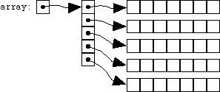
4.Multidimensional Arrays 2-Dimensional Arrays
Declaration & Initialization 2-D arrays
Syntax for 2-D arrays is similar to 1-D arrays
<type>[][] <name> = new <type>[rows][columns];
Example 1:
The array should have five rows and seven columns
The real picture:
Example 2:
The array has 4 rows.
2-D Array Initializer
You can also initialize at declaration with 2D array literal
Use nested comma separated lists, enclosed in {}’s
int[][] x = new int[5][7];
int[][] x = new int [4][];
1 | 2 | 3
4 | 5 | 6
Compiler determine the number of rows and determine the number of columns in each row
int[][] y = { {1,2,3}, {4,5,6}};

Slide 27
4.Multidimensional Arrays Creating Multidimensional Arrays
We can use existing arrays for initialization
a3 does not store copies of a1 and a2 in Array3[0] and a3[1] respectively
Instead it stores reference to a1 and a2
If we change the value of a1[1], we also change the value of a3[0][1]
To create copies of an existing 1-dimensional arrays, we can use the clone method
 | a1
0 | 10
1 | 12
2 | 14
int[] a1 = {10,12,14};
int[] a2 = {20,22,24};
int[][] a3 = {a1, a2};
0
1
 | a2
0 | 20
1 | 22
2 | 24
 | a3
a1[1] = 0;
System.out.println(a3[0][1]);
 | a1
0 | 10
1 | 12
2 | 14
int[][] a4={a1.clone(), a2.clone()};
0 | 20
1 | 22
2 | 24
0
1
 | a2
 | a4
10 | 12 | 14
20 | 22 | 24

Slide 28
4.Multidimensional Arrays Length Variables
Using the Length Variable:
arrayName.length
returns the number of rows in the array
arrayName[rowToGet].length
returns the number of columns in row "rowToGet"
Note:
If x is a rectangular array, all rows have the same length
int[][] x = new int[5][7];
System.out.println(x.length);
System.out.println(x[0].length);
5
7
System.out.println(x[0].length);
System.out.println(x[1].length);
System.out.println(x[2].length);
7
7
7

Slide 29
4.Multidimensional Arrays Using 2D Arrays
L06Code03.java
Accessing elements
To access elements, we use pretty much the same technique as a 1D array
Initialization & Printing
Nested loops are used to initialize array elements and print out values
Starting from the first row (0th) to the last row (n-1) – outer loop
For each row, starting from the first column (0th) to the last column (m-1) – inner loop
Print out the value
System.out.println(myArr[rowToGet][colToGet]);
Use y.length to navigate the last row
int[][] y = { {1,2,3}, {4,5,6} };
for (int row = 0; row < y.length; row++) {
for (int col = 0; col < y[row].length; col++)
System.out.print(y[row][col] + " ");
System.out.println();
}
Use y[row].length to navigate the last column of each row

Slide 30
4.Multidimensional Arrays Cloning of Multi-D Arrays
It is shallow clone only
Remember that multi-dimensional arrays in Java are arrays of arrays. Cloning only generates a copy of the root array
Note: a5[0] and a5[1] from an 1-dimensional array that store the memory location m0 and m1 of two 1-dimensional arrays. If we clone a5, then we only create a new 1-dimensional array that stores m0 and m1.
int[][] a5 = {{10,12,14}, {20,22,24}};
int[][] a6 = a5.clone();
 | a5
0
1
10 | 12 | 14
20 | 22 | 24
 | a6
0
1

Slide 31
4.Multidimensional Arrays Ragged Arrays
Ragged arrays have rows of unequal length
Each row has a different number of columns, or entries
Declaration & Initialization a ragged array
<type>[][] <name> = new <type>[rows][];
<name>[0] = new <type>[colCountForRow1];
…
Using Array Initializer
int[][] b1 = new int[2][ ]; b1[0] = new int[]{1, 2, 3, 4, 5};
b1[1] = new int[]{1, 2, 3};
 | b
0
1
2
0 | 0
int[][] b;
b = new int[3][];
b[0] = new int[2];
b[1] = new int[3];
b[2] = new int[1];
0 | 0 | 0
0
1
 | b
1 | 2 | 3 | 4 | 5
0
1 | 2 | 3
 | b
0
1
2
int[][] b = {{3,2}, {3,2,1}, {1}};
3 | 2
3 | 2 | 1
1

Slide 32
4.Multidimensional Arrays Using Ragged Arrays
Length Variables:
arrayName.length returns the number of rows in the array
arrayName[rowToGet].length returns the number of columns in row "rowToGet"
Example:
b.length = 3
b[0].length returns 2
b[1].length returns 3
b[2].length returns 1
b[3].length <- ERROR
Initialization & Printing
Nested loops are used to initialize array elements and print out values
Note: You must use y[row].length to get the number of columns in each row. The number may not be the same for all rows.
int[][] y = {{3,2}, {3,2,1}, {1}};
for (int row = 0; row < y.length; row++) {
for (int col = 0; col < y[row].length; col++)
System.out.print(y[row][col] + " ");
System.out.println();
}

Slide 33
4.Multidimensional Arrays Example: Pascal's Triangle
Pascal’s Triangle using a ragged array
The first row has 1 element
The second row has 2 elements
The third row has 3 elements
...
The n row has (n+1) elements
Solution:
Create a n-row array
Fill the first row, create 1 column and fill by 1
For the second to the last row(n), create (n+1) columns
Calculate the value
For the first or last column, value = 1
Else, value[row][col] = value of the previous row and previous col + value of the previous row but the same col
1
1 1
1 2 1
1 3 3 1
1 4 6 4 1

Slide 34
4.Multidimensional Arrays Example: Pascal's Triangle
L06Code03.java
Code:
final int NUM_ROWS = 5;
int triangle[][] = new int[NUM_ROWS][];
triangle[0] = new int[1];
triangle[0][0] = 1;
for (int row = 1; row < NUM_ROWS; row++) {
triangle[row] = new int[row+1];
triangle[row][0] = 1;
triangle[row][row] = 1;
for (int col = 1; col < row; col++)
triangle[row][col] = triangle[row-1][col-1] + triangle[row-1][col];
}
1
1 1
1 2 1
1 3 3 1
1 4 6 4 1

Slide 35

Exercise 2
int[][] grid = { { 3, 5, 6, 9 },{ 2, 6, 9, 4 } };
int len;
What is the output of the following code fragment?
len = grid[0].length;
for(int row=0; row < len; row++) {
for(int col=0; col < len; col++) {
System.out.print(grid[row][col] + " ");
}
System.out.println();
}
!
len = grid.length;
for(int row=0; row < len; row++) {
for(int col=0; col < len; col++) {
System.out.print(grid[row][col] + " ");
}
System.out.println();
}

Slide 36
5.Array of Objects
Apart from arrays of primitive types we can have arrays of reference types (objects)
Creating an array of Point
Syntax:
Create the array
<class>[] <name> = new <class>[Length];
Note: Memory space are allocated for the array
Create the object element
<name>[row] = new <class>();
Note:
In an array of reference types not the objects are stored in the array, but references to the objects.
The objects themselves have to be created and memory space has to be allocated for them separately.
The element are initialized with the null reference.
0
1
2
 | p
x:10
y:20
x:20
y:30
Point[] p = new Point[3];
NULL
p[0] = new Point(10, 20);
p[1] = new Point(20, 30);

Slide 37
5.Array of Objects Using Array of Objects
L06Code04.java
Accessing
To access all components of an array of reference types we can use the same code that we have used for primitive types
A for loop is used to print out values.
You must create the object element before accessing it.
Otherwise, a NullPointerException is thrown.
for (int i=0; i<2; i++)
System.out.println(p[i].toString());
java.awt.Point[x=10,y=20]
java.awt.Point[x=20,y=30]
for (int i=0; i<p.length; i++)
System.out.println("(" + p[i].x + ","+ p[i].y + ")");
(10,20)
(20,30)
Exception in thread "main" java.lang.NullPointerException ...

Slide 38
5.Array of Objects Assignment - Arrays of Objects
L06Code04.java
Reference type:
The variable copy holds a copy of the reference held in the variable p. There is still only one copy of the array.
Thus changing the object pointed to by one of the variables will also cause the contents of the other variable to change (since the same object in memory is being altered).
0
1
2
 | p
x:10 ->100
y:20
Point[] p = new Point[3];
p[0] = new Point(10, 20);
p[1] = new Point(20, 30);
p[2] = new Point(30, 40);
Point[] copy = p;
 | copy
x:20
y:30
x:30
Y:40
copy[0].x = 100;
for (int i=0; i<copy.length; i++)
System.out.println(p[i].toString());
java.awt.Point[x=100,y=20]
java.awt.Point[x=20,y=30]
java.awt.Point[x=30,y=40]

Slide 39
5.Array of Objects Copying Arrays of Objects
L06Code04.java
An array can be copied to reproduce an exact copies (or part) of the original by using the System.arraycopy method
However, if the array elements are reference variables, both source and destination now refer to the same object (pointing to the same physical object in memory)
Thus changing the object pointed to by one of the variables will also cause the contents of the other variable to change (since the same object in memory is being altered).
0
1
2
 | p
x:10 ->100
y:20
Point[] p = new Point[3];
p[0] = new Point(10, 20);
p[1] = new Point(20, 30);
p[2] = new Point(30, 40);
Point[] copy = new Point[2];
System.arraycopy(p,0, copy, 0, 2);
0
1
 | copy
x:20
y:30
x:30
Y:40
copy[0].x = 100;
for (int i=0; i<copy.length; i++)
System.out.println(p[i].toString());
java.awt.Point[x=100,y=20]
java.awt.Point[x=20,y=30]

Slide 40
5.Array of Objects Cloning Arrays of Objects
L06Code04.java
Shallow Clone
An array can be cloned to reproduce an exact copies of the original
It allocates space to hold the same size as the original
It makes copies of the original and has the same problem as before (pointing to the same physical object in memory)
0
1
Point[] p = new Point[2];
p[0] = new Point(10, 20);
p[1] = new Point(20, 30);
Point[] copy = p.clone();
 | p
x:10 ->100
y:20
0
1
 | copy
x:20
y:30
copy[0].x = 100;
System.out.println(p[0].toString());
java.awt.Point[x=100,y=20]

Slide 41
5.Array of Objects Deep Clone
L06Code04.java
A deep copy is copy that contains the complete data of the original object, allowing it to be used independently of the original object
Clone the array
Walk through each element in the new array
Clone the element in the array to produce a new copy
Point[] q = new Point[2];
q[0] = new Point(10, 20);
q[1] = new Point(20, 30);
Point[] dest = q.clone();
for (int i = 0; i < q.length; i++)
dest[i] = (Point)q[i].clone( );
0
1
0
1
 | q
x:10 ->100
y:20
x:10
y:20
 | dest
x:20
y:30
x:20
y:30
dest[0].x = 100;
System.out.println(q[0].toString());
java.awt.Point[x=10,y=20]

Slide 42
Advantages & Disadvantages
Advantages
Easy to specify (declaration, allocation of memory space, initialization can all be done in one line of code)
Direct access to any element via the index
Fast Access
Disadvantages
A potential disadvantage of arrays is the need to know the size at time of allocation
Careful design is required to make sure that the array will be large enough to hold the largest possible group of data

Slide 43

Exercise 3
Write a program that simulates rolling a pair of dice. Each die can have the values of 1 to 6 and the sum of the dice can have values from 2 to 12. Use a one-dimensional array to tally the number of times each possible sum appears. The application should roll the dice 36,000 times. Display the results in a tabular format.
int[] totals = new int[13];
int dice1, dice2;
SecureRandom randomNumbers = new SecureRandom();
for (int roll = 1; roll <= 36000; roll++) {
}
System.out.printf("%3s%12s%12s\n","Sum", "Frequency", "Percentage");
for (int k = 2; k < totals.length; k++){
System.out.printf("%3d%12d%12d%n", k, totals[k], totals[k] / (360));
Sum Frequency Percentage
2 1021 2
3 1919 5
4 3032 8
5 3983 11
6 4944 13
7 6045 16
8 5023 13
9 4051 11
10 2988 8
11 1972 5
12 1022 2

Slide 44

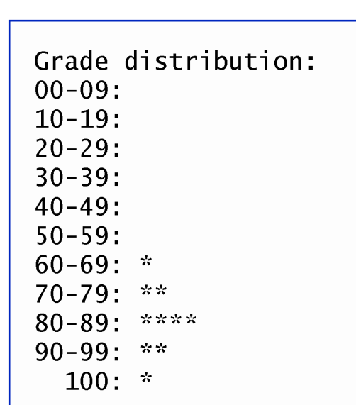
Exercise 4
int[] array = {0,0,0,0,0,0,1,2,4,2,1};
Display the following bar-chart using the array given above:
for (int counter=0; counter<array.length; counter++) {
if (counter == 10)
System.out.print(" 100: ");
else
System.out.printf("%02d-%02d: ________, ___________);
for
System.out.println();
}

