Slide 1
CompSci 230 S2 2017 Programming Techniques
ArrayLists

Slide 2
Agenda & Reading
Topics:
Introduction to Collections and Class ArrayList
ArrayLists
ArrayList with Generics
Wrapper Classes
ArrayLists Vs Arrays
Reading
Java how to program Late objects version (D & D)
Chapter 6
The Java Tutorial
ArrayLists
http://www.tutorialspoint.com/java/java_arraylist_class.htm

Slide 3
1.Introduction
Introduction to Collections and Class ArrayList
Collections provide efficient methods that organize, store and retrieve your data without requiring knowledge of how the data is being stored.
ArrayLists:
Everything stored must be an Object (non-primitive data types)
Objects can be different types
provides methods for adding and removing
keeps track of the list capacity (the length of the allocated array) and list size (the number of elements currently in the list)
Example:
capacity
import java.util.ArrayList;
...
ArrayList list = new ArrayList();
...
size
"Cat"
"Hat"
"Bat"
...
Old version

Slide 4
2.ArrayLists Advantages & Disadvantages
Advantages:
Size is dynamic, rather than fixed.
Disadvantages:
Less efficient than arrays
Lacks familiar [ ] syntax (Java limitation, supported by C++)
Base type must be an object (not primitive) type

Slide 5
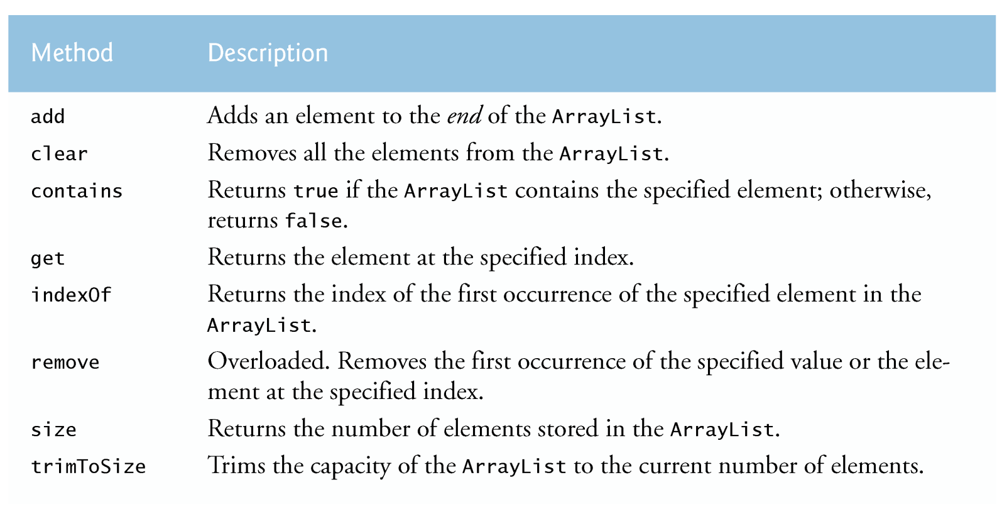
2.ArrayLists Methods

Slide 6
2.ArrayLists Methods to add elements
Only objects can be added to an ArrayList.
public boolean add(Object x)
Adds an object to the end of the list, adjusts the size of the list; returns true
Objects can be added to a specific position in an ArralyList:
public void add(int index, Object o)
Inserts x at position index, sliding elements at position index and higher to the right (adds 1 to their indices) and adjusts size.
Capacity increases if necessary
list.add( "One" );
list.add( "Two" );
list.add( "Three" );
One | Two | Three
list.add( "One" );
list.add( "Two" );
list.add( "Three" );
list.add( 1, "Fred" );
One | Fred | Two | Three

Slide 7
2.ArrayLists Search methods
public boolean contains (Object target )
True if ArrayList contains target; false otherwise.
public int indexOf (Object target )
Returns index of first occurrence of target in ArrayList; -1 otherwise.
public int lastIndexOf (Object target )
Same as above except index of last occurrence is returned.
true
System.out.println(list.contains("Three" ));
int i = list.indexOf("Fred" );
1

Slide 8
2.ArrayLists Size & Capacity
public boolean isEmpty ( )
True if empty; false otherwise.
public int size ( )
Returns number of elements in ArrayList
public void clear ( )
Removes all elements; size() becomes 0
System.out.println(list.isEmpty());
false
System.out.println(list.size());
4
list.clear();

Slide 9
2.ArrayLists Methods to remove elements
Object remove(int index)
where 0<=index<size() (or exception)
Removes element at index; shifts to the left remaining elements at index+1 … size()-1.
boolean remove(Object theElement)
if found then removes the first occurrence of theElement; shifts the remaining elements to the left; size() becomes size()-1; returns true.
if not found then returns false.
One | Fred | Two | Three
Fred | Two | Three
list.remove( 0 );
String s = (String) list.remove( 0 );
System.out.println(s);
One
One | Fred | Two | Three
boolean n = list.remove("Three");
System.out.println(n);
true
One | Fred | Two

Slide 10

2.ArrayLists Array-like methods
public Object set ( int index, Object newElement )
where 0<=index<size() (or exception)
Replaces the element at index with a newElement and returns the element formerly at the specified position.
public Object get ( int index )
where 0<=index<size() (or exception)
Returns the element at index.
One | Fred | Two
System.out.println(list.set(0, "Hello"));
One
Hello | Fred | Two
System.out.println(list.set(4, "Good"));
Exception in thread "main" java.lang.IndexOutOfBoundsException:
Hello | Fred | Two
System.out.println(list.get(0));
Hello
System.out.println(list.get(4));
Exception in thread "main" java.lang.IndexOutOfBoundsException:

Slide 11
2.ArrayLists Methods to print the list
public String toString()
Returns a String which contains all the object in the ArrayList
Using a For loop
Hello | Fred | Two
System.out.println(list.toString());
[Hello, Fred, Two]
Hello
Fred
Two
for( int i=0; i<list.size(); i++ ) {
System.out.println(list.get(i).toString());
}

Slide 12
2.ArrayLists Equality
public boolean equals ( Object other )
True only when both are of the same size, and both have the same elements with the same order.
list.add("Hello");
list.add("Two");
list.add("Fred");
myList2.add("Two");
myList2.add("Hello");
myList2.add("Fred");
System.out.println(list.equals(myList2));
false

Slide 13
2.ArrayLists Different Types
Old version
Stored elements may be of different types
Example: Objects of type Integer, Character and Point could all be stored in ArrayList. (Object is a superclass of Integer, Character and Point. Therefore, all are of type Object)
Need to be concerned about type returned by ArrayList method.
Notice: Return type for get, set and remove are of type Object. If the returned object is to be used with a particular class, it needs to be cast to that class type.
myList2.clear();
myList2.add(new Integer(5));
myList2.add(new Character('c'));
myList2.add(new Point(10,20));
System.out.println(myList2);
[5, c, java.awt.Point[x=10,y=20]]
Integer i = (Integer) myList2.get(0);
System.out.println(i);
Point p = (Point) myList2.get(2);
System.out.println(p);
5
java.awt.Point[x=10,y=20]

Slide 14
Exercise 1
What is the output of the following code fragment?
ArrayList list = new ArrayList();
Point pt1 = new Point(3, 4);
list.add( pt1 );
Point pt2 = (Point) list.get( 0 );
pt2.x = 23;
if ( pt2 == pt1 ) {
System.out.println( "Same object" );
} else {
System.out.println( "Different object" );
}
System.out.println();

Slide 15
3.Generic ArrayLists
Starting with Java 5, ArrayList<T> and other collection classes hold objects of a specified data type.
The T (by convention) is a placeholder—when declaring a new ArrayList, replace it with the type of elements that you want the ArrayList to hold.
Classes with this kind of placeholder that can be used with any type are called generic classes.
The elements’ data type is shown in angle brackets and becomes part of the ArrayList type. For example:
ArrayList<String> appears in the variable declaration and in the class instance creation expression.
Using <> in a class instance creation expression tells the compiler to determine what belongs in the angle brackets.
ArrayList<String> words = new ArrayList<String>();
ArrayList<Integer> nums = new ArrayList<Integer>();

Slide 16
3.Generic ArrayLists Adding elements & for-each loop
L07Code02.java
Adding elements:
Enhanced for Statement
The for-each loop is used to access each successive value in a collection of values.
Syntax:
Example:
[One, Two, Three]
ArrayList<String> words = new ArrayList<String>();
words.add("One");
words.add("Two");
words.add("Three");
System.out.println(words);
for (Base_Type var :Collection_Object)
Statement;
Elements are all in the same type.
Standard for-loop
for (String str : words)
System.out.println(str);
for( int i=0; i<words.size(); i++ )
System.out.println( words.get( i ));

Slide 17
4.Wrapper Classes
Each primitive data type has a corresponding Wrapper class.
Java’s primitive data types (boolean, int, etc.) are not classes.
Wrapper classes are used in situations where objects are required.
The wrapper class can be used to convert a primitive into an object type.
Data Type | Wrapper
boolean | Boolean
char | Character
byte | Byte
short | Short
int | Integer
long | Long
float | Float
double | Double

Slide 18
4.Wrapper Classes Value => Object: Wrapper Object Creation
Wrapper.valueOf() takes a value (or string) and returns an object of that class:
Using object creation:
Integer i1 = Integer.valueOf(42);
Integer i2 = Integer.valueOf("42");
Boolean b1 = Boolean .valueOf(true);
Boolean b2 = Boolean .valueOf("true");
Integer i1 = new Integer(42);
Character cC = new Character('b');
Boolean bB = new Boolean(true);

Slide 19
4.Wrapper Classes Object => Value & String => value
Each wrapper class Type has a method typeValue to obtain the object’s value: intValue(), doubleValue(), charValue() etc
It also has a method parseType() to parse a string representation & return the literal value.
System.out.println(i1.intValue());
System.out.println(c1.charValue());
System.out.println(b1.booleanValue());
42
b
true
Integer.parseInt("42") => 42
Boolean.parseBoolean("true") => true
Double.parseDouble("2.71") => 2.71

Slide 20
4.Wrapper Classes Auto boxing
Since Java 5, conversion from int to Integer and from double to Double is, in most cases, automatic (autoboxing/autounboxing)
ArrayList<Integer> numbers = new ArrayList<Integer>();
numbers.add(12);
numbers.add(5);
int sum = 0;
for (int i : numbers) {
sum += i;
}
System.out.println("Total=" + sum);
autoboxing
autounboxing

Slide 21

Exercise 2
What is the output of the following code fragment?
ArrayList<Integer> x = new ArrayList<Integer>();
x.add(3);
x.add(5);
x.add(8);
x.add(9);
ArrayList<Integer> y = new ArrayList<Integer>();
y.add(6);
y.add(7);
y.add(1);
y.add(2);
for (int i=0; i<x.size(); i++) {
x.set(i, y.get(i));
y.set(i, x.get(i));
}
System.out.println(x);
System.out.println(y);

Slide 22
5.ArrayLists Vs Arrays
Capacity:
Array: Once you set the array size, you cannot change it easily.
ArrayList: It automatically adjusts its capacity as you add and remove elements, without your needing to write any code.
If the internal array is full, the array list automatically creates a bigger array and copies all the objects from the smaller to the bigger array.
Printing the entire array/ArrayList:
Array : print the memory address only
ArrayList: print the entire list
int actualSize = . . .;
Point[] points1 = new Point[actualSize];
Initial capacity = 10
ArrayList<Point> points2 = new ArrayList<Point>();
ArrayList<Point> points2 = new ArrayList<Point>(100);
capacity = 100
System.out.println(points1);
[Ljava.awt.Point;@659e0bfd
System.out.println(points2);
[java.awt.Point[x=1,y=2], java.awt.Point[x=3,y=4]]

Slide 23
5.ArrayLists Vs Arrays Capacity
Distinction between the capacity
array:
If you allocate an array with 100 entries, then the array has 100 slots, ready for use.
ArrayList:
An array list with a capacity of 100 elements has the potential of holding 100 elements (and, in fact, more than 100, at the cost of additional reallocations);
At the beginning, even after its initial construction, an array list holds no elements at all.
Actual number of elements inside the array/ArrayList
array:
returns the actual number of elements in the array
ArrayList:
returns the actual number of elements in the ArrayList
new Point[100]; // size is 100
new ArrayList<Point>(100); // capacity is 100
points1.length
points2.size()

Slide 24
5.ArrayLists Vs Arrays Accessing Elements
To access or change the element:
Array:
Use [] syntax to access or change the element of an array
ArrayList:
Use the get and set methods to access or change the element in the ArrayList
Note: Do not call list.set(i, x) until the size of the ArrayList is larger than i.
Use the add method instead of set to fill up an array, and use set only to replace a previously added element.
To get an element
Array:
ArrayList:
Before Java SE 5.0, there were no generic classes, and the get method of the raw ArrayList class had no choice but to return an Object.
Consequently, callers of get had to cast the returned value to the desired type:
The raw ArrayList is also a bit dangerous. Its add and set methods accept objects of any type and you run into grief only when you retrieve the object of another type and try to cast it.
points1[i] = new Point(1,2);
points2.set(i, new Point(1,2));
Point p = points1[i];
After Java SE 5.0
Point p = points2.get(i);
Point p = (Point) points2.get(i);
Before Java SE 5.0

Slide 25
5.ArrayLists Vs Arrays Converting between Array and ArrayList
Array to ArrayList
Use the asList() method in the Arrays class
Note: The Arrays class provides static methods for common array manipulations. For example:
sort() - for sorting an array
equals() for comparing arrays
fill() for placing values into an array
ArrayList to Array
Use the toArray() method from the ArrayAList class
java.awt.Point[x=1,y=2]
java.awt.Point[x=3,y=4]
Point[] points1 = {new Point(1,2), new Point(3,4)};
ArrayList<Point> points2 = new ArrayList<Point>(Arrays.asList(points1));
for (Point p: points2)
System.out.println(p);
String[] copy = new String[words.size()];
copy = words.toArray(copy);
for (String i: copy)
System.out.println(i);
One
Two
Three

Slide 26

Exercise 3
Write a static method to get distinct elements from an array. The method returns an ArrayList which contains distinct elements.
int[] numbers = {25, 2, 5, 9, 10, 15, 8, 2, 5, 9};
System.out.println(getUnique(numbers));
[25, 2, 5, 9, 10, 15, 8]
public static ArrayList<Integer> getUnique(int[] source) {
//create ...
for (int value: source) {
}
return uniqueList;
}

