Slide 1
11.2 Introduction to Python
NanoDTC Practicals
Thomas Parton
16th October 2018
Notes:
Aim for 30 minutes

Slide 2
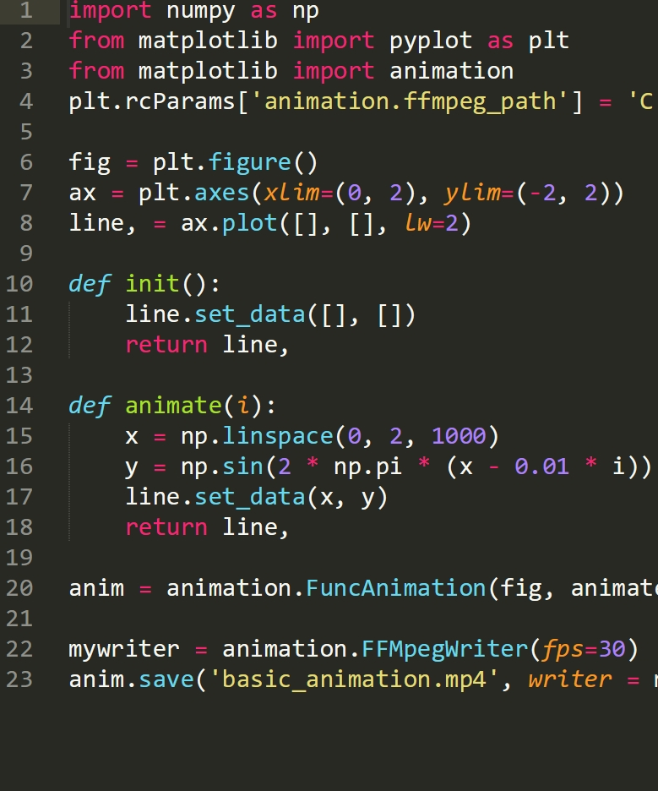
Overview
What is Python?
Why learn Python?
Practical Format
Where to learn more Python
Good coding practices
Solving your Python problems
Notes:
not like that MATLAB lecture
Focus on general details and useful information
Discussion, not lecture (interrupt with qs)

Slide 3
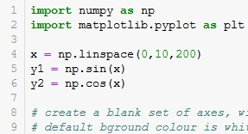
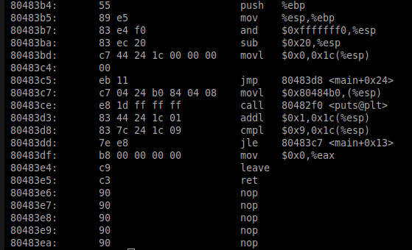
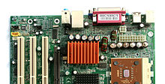

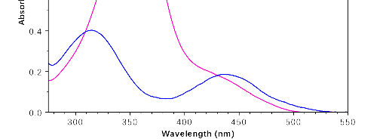
What is Python?
Python script
Machine code
User
Hardware
User
Software
I want to make a plot of my UV-vis data
interpreter
Python output
State readout
Notes:
Programming language
IDE – type text, machine code, get result
Python the interpreter versus the language

Slide 4

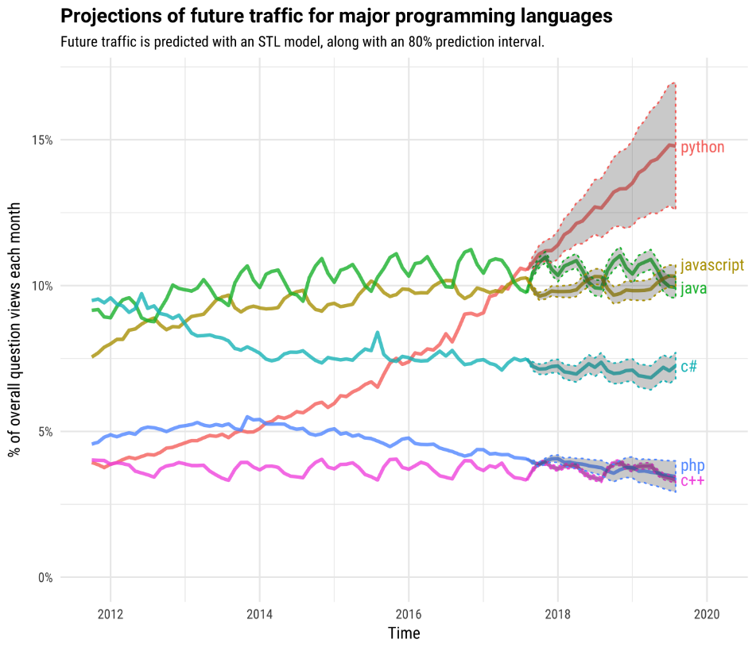
Why Python?
It’s easy to use
Free and open-source
Relatively easy to learn
Readable code (high-level language)
Robust and error-tolerant
It’s powerful
Versatile (multiple programming paradigms)
Extensible (easy to upgrade what it can do)
It’s popular
Active online support community
A lot of other people already use it.
Source:https://bit.ly/2O3Y2AI
Notes:
Job applications – “Python experience”, hours.
Best language to learn, doesn’t means it’s the best for your research tasks.

Slide 5
Why Python???
It’s easy to use
Free and open-source
Relatively easy to learn
Readable code (high-level language)
Robust and error-tolerant
It’s powerful
Versatile (multiple programming paradigms)
Extensible (easy to upgrade what it can do)
It’s popular
Active online support community
A lot of other people already use it.
Lack of quality control and tech support
Good for computer scientists, not us
Need a new package for everything
Other grievances
Non-intuitive user interface
Limited data and plot visualisation
Notes:
Compared to MATLAB, originLab, wolfram mathematica,

Slide 6

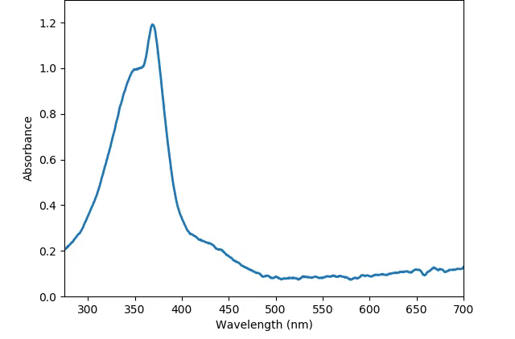
Where Python is best, and where it’s not*
*compared to other research software
Where Python is good, but not the best
Data analysis for research (OriginLab, R)
Image processing (ImageJ)
Modelling (MATLAB, COMSOL)
Advanced maths (MATLAB, Mathematica)
Where Python is the best
Combining multiple tasks (import data, process, plot, save figures)
Automating repetitive tasks
Real-time isomerisation under UV light
Notes:
When compared to other research tools (MATLAB, OriginLab, Excel)
https://bit.ly/2m8GiBd
Based on personal opinion and observation of what other people do
https://uk.mathworks.com/products/matlab/matlab-vs-python.html
However, advantages of combining and automating might make Python the best choice overall

Slide 7
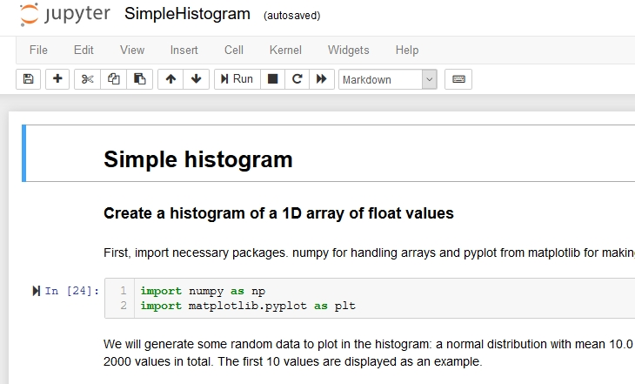



Jupyter notebooks, and other ways to code
Jupyter notebook
Combines text notes with passages of (Python) code.
Good for demonstrating code
Uses .ipynb files (not regular .py files)
Common Python IDEs
IDLE (integrated development and learning environment)
Atom
Spyder
Anaconda (includes Jupyter and Spyder)
Notes:
Jupyter: common, useful, but not ubiquitous.
Show how to export to .py file.

Slide 8
Practical Format
Before the practical:
Install Python and Jupyter notebook
Read through practical prep notebook (not 100% comprehension)
During the practical:
Play with Blocks (functioning units of code)
Use Blocks to attempt Challenges (realistic research problems)
Grading
“Participation and Preparation”

Slide 9
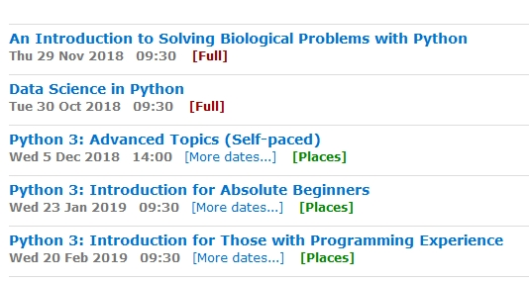
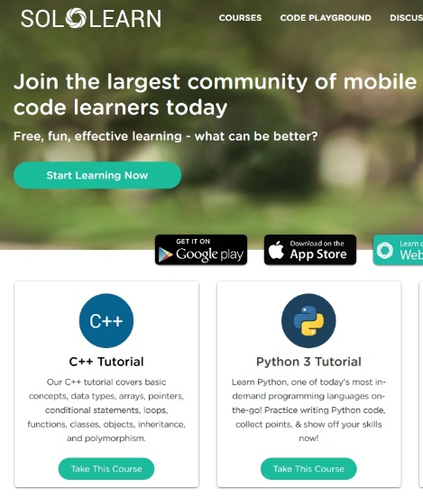
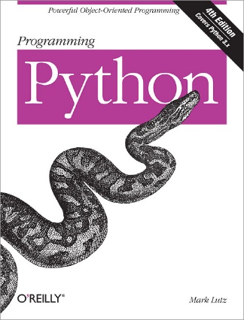
Where to learn more about Python
University of Cambridge courses
Online courses (e.g. Khan Academy, Udemy [£])
Free online guides and manuals (see notes for recommendations)
Books (university, college libraries)
Notes:
Advice – pick a project (e.g. kaggle for machine learning)

Slide 10
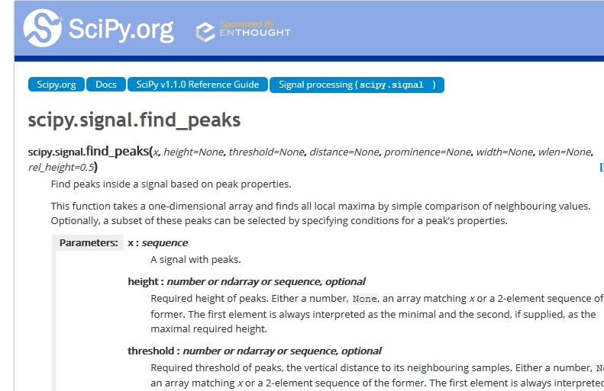
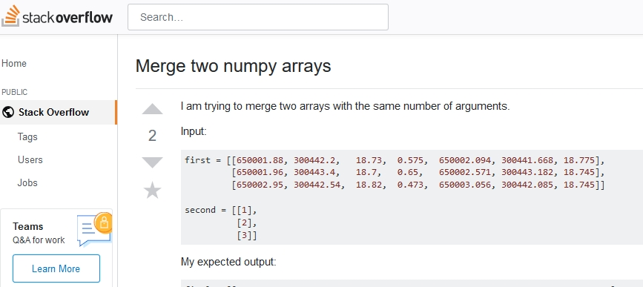
Finding solutions to your problems
Learning resources (previous slide)
Official documentation
Stack Overflow and other online forums
Talking to other people
Notes:
Advice – pick a project (e.g. kaggle for machine learning)

Slide 11
Good habits
Good coding habits | Good lab habits
Make a plan of what the code will do and break it down into individual tasks. | Make a plan of what the experiment will do and break it down into smaller tasks.
Label code objects in an informative and consistent way | Label samples in an informative and consistent way
Add concise, useful comments about what the code does to make the code easier to read | Add concise, useful observations about the experiment to make the lab book easier to read
Don't cram everything onto one line | Don't cram everything onto one line
If things are going wrong, check individual sections of code one at a time | If things are going wrong, check individual components of the equipment one at a time
Notes:
Easiest to show example of code

Slide 12
Questions and Comments
Notes:
Easiest to show example of code

