Slide 1


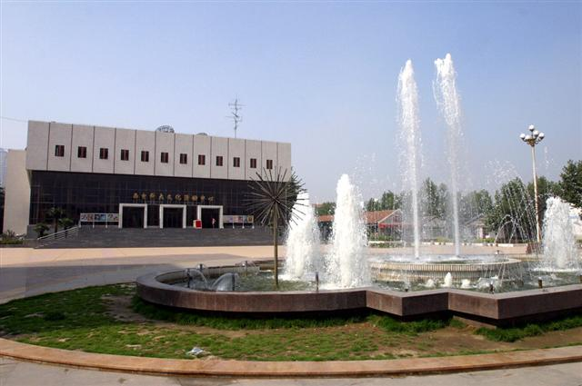
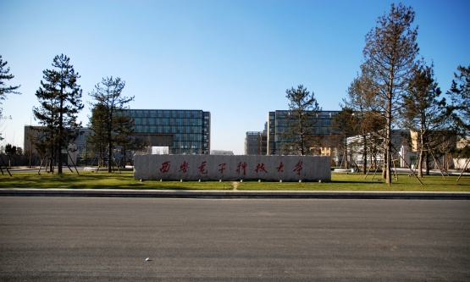
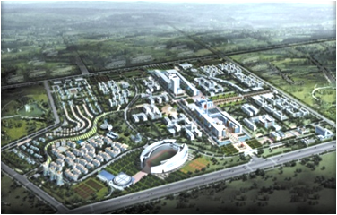


Software School
XIDIAN UNIVERSITY
2017年4月

Slide 2

Chapter Seven
Writing the Programs
Standards for Programming
Guideline for Reuse
Using Design to Frame the Code
Internal and external Documentation

Slide 3


Software Process Modeling(2.2)
Waterfall Model (Royce 1970)
4
Requirements
Analysis
1
8 Steps
5
Waterfall like Sequence
System Design
2
3
6
Program Design
Coding
7
4
Unit &
Integration Test
5
System Test
6
Acceptance Test
7
Product
Operation & Maintenance
8

Slide 4
Definition
Chapter 4
Capture Requirement
Specification
Software
Architecture
Document
(SAD)
Chapter 5
High-Level Architectural Design
Major component
Interact
Chapter 6
How the individual component will be deigned at a modular levels, so that developers can write code that implement the design.
Chapter 7
Most are Advice
It explains some of the software engineering practice that should keep in mind as you write code.

Slide 5
7.1 Programming Standards and Procedures
规范
National Standards
Standard
Standards For You
Standards For Others

Slide 6
7.1 Programming Standards and Procedures
Standards For You
SideBar 7.1
Microsoft’s approach to programming standards
Single physical site
Common language
Common coding style
Standard development tools

Slide 7
7.1 Programming Standards and Procedures
Standards For Others
Block of Comments
*********************************************************************
* Component to Find Intersection of Two Lines
*
* Component Name: FindPT
* Programmer: E. Ellis
* Version 1.0 (February 2001)
*
* Procedure Invocation
* Call FindPT (a1,b1,c1,a2,b2,c2,xs,yx,flag)
*
* Input Parameters
*
*
* Output Parameters
*
*

Slide 8
7.1 Programming Standards and Procedures
Matching Design with Implementation
Match
Chapter 6
Chapter 7
Design the Module
Implementation the Module
Direct Correspondence

Slide 9
7.2 Programming Guidelines
Base
Language
Prog.
Programming involves a great deal of creativity
Control Structure
Regardless of the language
Algorithm
Data Sturcture

Slide 10
7.2 Programming Guidelines
Control Structure
Benefit = minimum
If ( age < 75 ) goto A;
Benefit = maximum
goto C;
If ( age < 65 ) goto B
If ( age < 55) goto C;
A:
…….
B:
……
C:
…….
If (age < 55) benefit = minimum;
elseif ( age <65) benefit = minimum+bonus;
elseif ( age <75) benefit = minimum*1.5+bonus;
else benefit = maximum
Guidelines: Do not have to jump wildly through the code

Slide 11
7.2 Programming Guidelines
Algorithm
Guidelines: Fast code may involve hidden costs
May be more complex and thus take more time to write
May take more time to test, more test case and test data
The cost for users to understand the code
The costs of time to modify the code, if necessary
Guidelines: Must learn how your compiler optimizes your code.

Slide 12
7.2 Programming Guidelines
Data Structures
Guidelines-1: Keeping the Program Simple
Example:
Given the amount of taxable income
For the first $10000 of income, the tax is 10%
For the next $10000 of income above $10000, the tax is 12%
For the next $10000 of income above $20000, the tax is 15%
For the next $10000 of income above $30000, the tax is 18%
For any income above $40000, the tax is 20%

Slide 13
7.2 Programming Guidelines
Algorithm:
Tax = 0
if ( taxable_income == 0 ) goto exit
if ( taxable_income > 10000 ) tax = tax +1000;
else tax = tax + .10*taxable_income
………..

Slide 14
7.2 Programming Guidelines
Table 7.1 Sample Tax Table
Bracket Base Percent
0 0 10
10000 1000 12
20000 2200 15
30000 3700 18
40000 5500 20
for ( int I -2; Level = 1; I <=5; i++)
if ( taxable_income > bracket[i] Level = Level + 1;
tax = base[Level]+percent[Level]*(taxable_income – bracket[Level])

Slide 15
7.2 Programming Guidelines
Data Structures
Guidelines-2: Using Data Structure to Determining a Program Structure
Example:
Recursive Program – Rooted Tree
Removing the Root
A Set of the Root

Slide 16
7.2 Programming Guidelines
General Guideline
1. Localizing Input and output
2. Including Pseudo-Code
Component Parse_Lines
read next eight characters
If this is a continuation of the previous line,
CALL CONTINUE
Else determine command lines
Case of Command_type
P.382

Slide 17
7.2 Programming Guidelines
General Guideline: Pseudo-Code
Paragraph:
Common Functions
First:
……..
……..
Indent(边):
Second
……..
……..
Skip_line:
Third:
……..
……..
P.383
P.384

Slide 18
7.2 Programming Guidelines
General Guideline: Pseudo-Code
Initial:
Code
If ((command_type==INDENT)
||(command_type==LINE_SKIP)
|| (command_type==MARGIN))
……..
Line_Breaks
……..
Individual_Case:
……..
……..
P.384
P.385
Step By Step

Slide 19
7.2 Programming Guidelines
General Guideline
1. Localizing Input and output
2. Including Pseudo-Code
3. Revising and Rewriting, not Patching
Draft
Code
Revising and Rewriting

Slide 20
7.2 Programming Guidelines
General Guideline
1. Localizing Input and output
2. Including Pseudo-Code
3. Revising and Rewriting, not Patching
4. Reuse

Slide 21
7.2 Programming Guidelines
Reuse
Producer Reuse
Consumer Reuse
Components in other project
Components designed to be reused in subsequent application
Lucent
Reuse Standard SideBar7.2

Slide 22
7.3 Program Documentation
Program Documentation
Internal Documentation
External Documentation

Slide 23
7.3 Program Documentation
Internal Documentation
1. Head Comment Block
Program SCAN :
Programmer :
Calling Sequence :
Version :
Revision :
Purpose :
Data Structure :
Algorithm :
1
7

Slide 24
7.3 Program Documentation
Internal Documentation
2. Other Program Comment
i3 = i3 +1 // Increment i3

Slide 25
7.3 Program Documentation
Internal Documentation
3. Meaningful Variable Names and Statement Labels
Weekwage = (hrrate * hours + (.5) *(hrate) * (hours=40)

Slide 26
7.3 Program Documentation
Internal Documentation
3. Meaningful Variable Names and Statement Labels
Weekwage = (hrrate * hours + (.5) *(hrate) * (hours=40)

Slide 27
7.3 Program Documentation
Internal Documentation
4. Formatting to Enhance Understanding
if (xcoord < ycoord ) result = -1;
else if ( ……
void free_store_empty ()
{
}

Slide 28
7.3 Program Documentation
Internal Documentation
4. Formatting to Enhance Understanding
if (xcoord < ycoord ) result = -1;
else if ( ……
void free_store_empty ()
{
}

Slide 29
7.3 Program Documentation
Internal Documentation
5. Documenting Data
Data Map
Branch No.
Meaning

Slide 30
7.3 Program Documentation
External Documentation
Doc
1. Describing The Problem
2. Describing The Algorithm
3. Describing The Data

Slide 31
7.4 Programming Process
1. Understanding the Problem
2. Devising a Plan
3. Carrying out the Plan
4. Looking Back

Slide 32
End Of Chapter Seven

Slide 33
谢 谢 ！

