Slide 1
Chapter 2 Modeling the Process and Life Cycle
In this chapter, we look at :
What we mean by process ?
Software development process
Processes and resources
Several models of the software development process
Tools and techniques for process modeling

Slide 2
Organization
Contents
Section 2.1
Section 2.2
Section 2.3
What’s?
Models
Method
Software
Engineering
Definition (2)
How to use?
Conception
Achievements
Build ?

Slide 3
2.1 The Meaning of Process
Process
A Sequence Of Steps , In the Same Order each time.
Tools
Activities
Constrains
Resources
Techniques
Produce an intended output of same kind

Slide 4
2.1 The Meaning of Process
The Characteristics Process
The process describes all the major process activities.
The process uses the resources, subject to a set of constraints, and produces intermediate and final products.
The process may be composed of sub-processes that that linked in some way.
Each process activity has entry and exit criteria, so that we know when the activity begins and ends .
The activities are organized in a sequence, so that it is clear when one activity is performed relative to the other activity .
Every process has a set of guiding principles that explain the goals of each activity.
Constraints or controls may apply to an activity, resource, or product.

Slide 5
2.1 The Meaning of Process
The Importance of Process
Impose consistency and structure on a set of activities
Guide us to understand, control, examine, and improve the activities
Enable us to capture our experiences and pass them along

Slide 6
2.2 The Meaning of Process
Life Cycle
When the process involves the building of some PORDUCT;
We sometime refer to the process as a Life Cycle.
Software Product
Conception
Implementation
Delivery
Use
Maintenance

Slide 7
2.2 The Meaning of Process
Modeling
Software Engineering Researchers
Model
Contain Key Process Features
Named:
Requirement Analysis……
Defined Sequence
Process Description Techniques -Text, Picture or combination

Slide 8
2.2 The Meaning of Process
Modeling
Model
Contain Key Process Features
Named:
Defined Sequence
Requirement Analysis……

Slide 9
2.2 The Meaning of Process
Modeling
Model
Contain Key Process Features
Named:
Defined Sequence
Requirement Analysis……
Process Description Techniques -Text, Picture or combination

Slide 10
Organization
Contents
Section 2.1
Section 2.2
Section 2.3
What’s?
Models
Method
Software
Engineering
Definition (2)
How to use?
Conception
Achievements
Build ?

Slide 11
2.2 Software Process Modeling
Waterfall Model (Royce 1970)
8 Steps
Requirements Analysis
1
Waterfall like Sequence
System Design
2
Program Design
3
Coding
4
Unit & Integration Test
5
System Test
6
Acceptance Test
7
Operation & Maintenance
8
Product

Slide 12
2.2 Software Process Modeling
Waterfall Model (Royce 1970)
Chapter
Requirements Analysis
4
System Design
5
Program Design
5
Coding
7
Unit & Integration Test
System Test
Acceptance Test
Operation & Maintenance

Slide 13
2.2 Software Process Modeling
Waterfall Model – In Reality
1
Requirements Analysis
1
2
System Design
8
2
3
Program Design
4
Coding
D
5.1
Unit Test
3
6
5.1
Integration Test
6
System Test
4
5.2
7
Acceptance Test
5.1
8
Operation & Maintenance
Delivery

Slide 14
2.2 The Meaning of Process
Characteristics of Waterfall Model
One of the first process development models proposed
Works for well understood problems with minimal or no changes in the requirements
It presents
  a very high-level view of the development process
  sequence of process activities
Each major phase is marked by milestones and deliverables (artifacts 制品 )

Slide 15
2.2 Software Process Modeling
Drawbacks of The Waterfall Model
Provides no guidance how to handle changes to products and activities during development (assumes requirements can be frozen)
Views software development as manufacturing process rather than as creative process
There is no iterative activities that lead to creating a final Product
Long wait before a final product

Slide 16
2.2 Software Process Modeling
Waterfall Model (With Prototyping)
Requirements Analysis
System Design
Program Design
Coding
Unit & Integration Test
Prototyping
Validation
Implemented
?
Verification
Correctly
Customer
Operation & Maintenance

Slide 17
2.2 Software Process Modeling
Characteristics of Waterfall Model With Prototype
A prototype is a partially developed product Prototyping helps developers assess alternative design strategies (design prototype)
Users understand what the system will be like (user interface prototype)
Prototyping is useful for verification and validation

Slide 18
2.2 Software Process Modeling
V Model ( German Ministry of Defense 1992)
Operation & Maintenance
Validate Req.
Requirements Analysis
Acceptance Testing
Validate Design
System Design
System Testing
Unit & Integration Test
Program Design
Coding

Slide 19
2.2 Software Process Modeling
Characteristics of V Model
A variation of the waterfall model
Uses unit testing to verify procedural design
Uses integration testing to verify architectural (system) design
Uses acceptance testing to validate the requirements
If problems are found during verification and validation, the left side of the V can be re-executed before testing on the right side is re-enacted

Slide 20
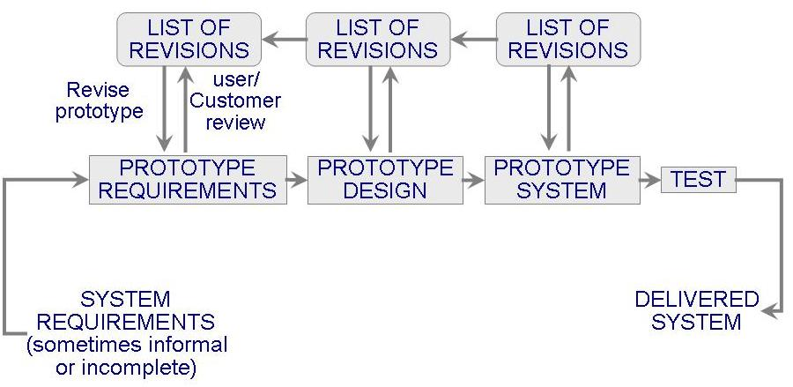
2.2 Software Process Modeling
Prototyping Model

Slide 21
2.2 Software Process Modeling
Characteristics of Prototype Model
Allows repeated investigation of the requirements
or design
Reduces risk and uncertainty in the development

Slide 22
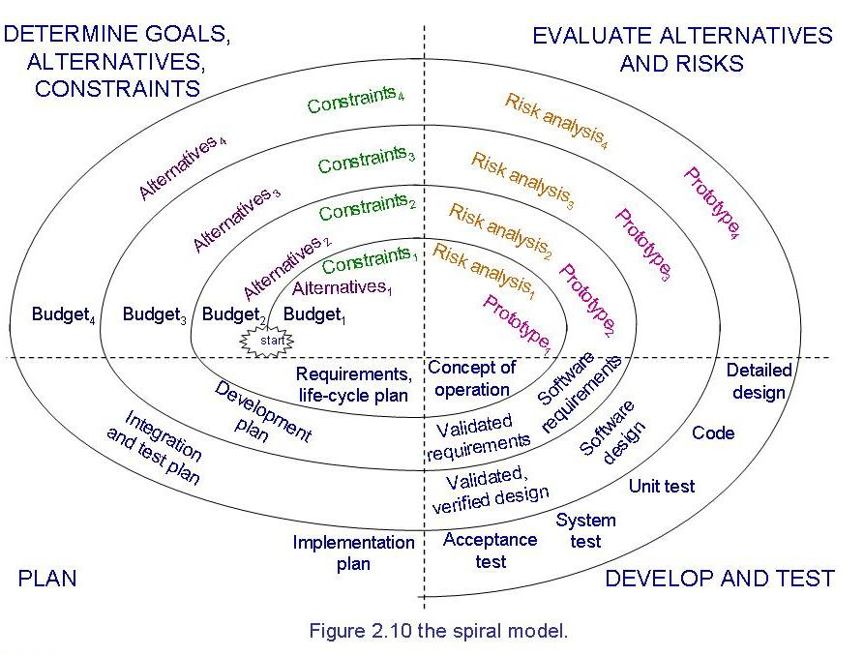
2.2 Software Process Modeling
Spiral Model (Boehm 1988)

Slide 23
2.2 Software Process Modeling
Characteristics of Spiral Model
Combines development activities with risk management to minimize and control risks
The model is presented as a spiral in which each iteration is represented by a circuit around four major activities
  Plan
  Determine goals, alternatives, and constraints
  Evaluate alternatives and risks
  Develop and test

Slide 24
2.2 The Meaning of Process
Reasons for Modeling a Process
To form a common understanding
To find inconsistencies, redundancies, omissions
To find and evaluate appropriate activities for reaching process goals
To tailor a general process for a particular situation in which it will be used

Slide 25
2.3 Tools and Techniques for Process Modeling
Software Development
Choice Model
Textual – Express Process as Functions
Graphical – Depicts Process hierarchies of boxes and arrows
Presentations
Or Combinations
Tools and Techniques
Later Chapters

Slide 26
What This Chapter Means for You
Software Development Process involves activities. Resources, and products.
A process model is useful for guiding you behavior when you are working with
a group. Detailed process models tell you how to coordinate and collaborate with
you colleagues as you design and build a system.

Slide 27
What this chapter Means for Your Development Team
A good model shows each team member which activities occur when, and by
whom, so that the division of duties is clear. In addition, the project manager
can use process tools to enact the process, simulating activities and tracking
resources to determine the best mix of people and activities in order to meet
the project’s budget and schedule.

Slide 28
What This Chapter Means for Research
Process Notations: How to write down the process in a way that is
understandable by those who must carry it out.
Process Models: How to depict the process, using an appropriate
set of activities , resources, products and tools.
Process Modeling Support tools: How to enact or simulate a process
model, so resources availability, usage, and performance can be assessed.

Slide 29
Exercise
For Reading and Translating
WaterFall Model P48-P50
For Doing
Exercise No.2 P.76

Slide 30
The End Of Chapter 2

