Slide 1


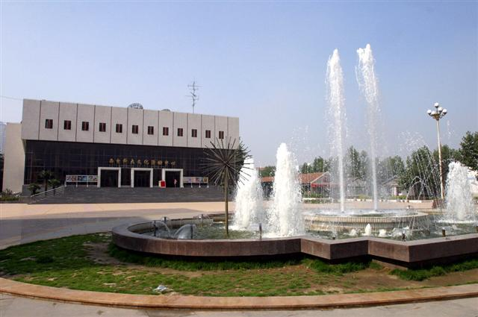
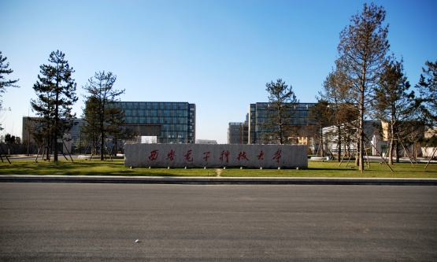
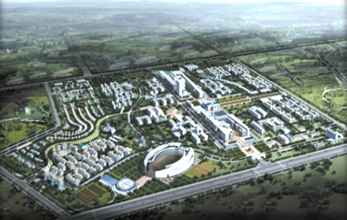


Software School
XIDIAN UNIVERSITY
2018年3月

Slide 2


Chapter Five
Design The Architecture
Views of Software Architecture
Common Architecture Patterns
Criteria for Evaluating and comparing Design Alternatives
Software Architecture Documentation

Slide 3
5.1 The Design Process
Definition
Design is the creative process of transforming the problem into a solution, the description of the solution is call the DESIGN.
Chapter Three
Chapter Four
Spec.
Logical Presentation

Slide 4
5.1 The Design Process
Definition (Architecture Garlan & Shaw)
软件体系结构={构件，连接件，约束}
约束：对象的连接规则.。
连接件：可以是过程调用，管道，远程调用等，用于表示构建之间的相互作用。
构件：可以是一组代码，如程序模块，也可以是一个独立运行的程序，如数据库服务器。

Slide 5
5.1 The Design Process
Definition (Architecture Garlan & Shaw)
Software Design
Architecture Design
Module Design
This Chapter
Next Chapter

Slide 6


5.1 The Design Process
Definition (Architecture Garlan & Shaw)
Software Design
Next Chapter
Architecture Design
Plumbing
Heating Cooling
Electrical
This Chapter
Site Plan
Room
Prototypes
Layouts

Slide 7
5.1 The Design Process
Each Design Decisions Address
the system’s Architecture.
How the units relate to one another
5
Explain how to
decompose into units
Describing any external visible properties of each units
6
Design Decision Address
How to implement the individual units

Slide 8


5.1 The Design Process
Component
Data Store
Symbol Table
Data Fetch/Store
Control flow
Lexical Analyzer
Parser
Semantic Analyzer
Optimizer
Code
Generator
Attributed Parse Tree
Reference Model for Compiler

Slide 9
5.1 The Design Process
Source of Design Advice (Creative Process)
Similar System
Experience
Reference Models
Design
Design Principle
Architectural Style
Cha.5
Design Convention
Design Pattern
Cha.6

Slide 10

5.1 The Design Process
Design Process Model
Modeling
Analysis
Documentation
Review
Software
Architecture
Document
(SAD)
Assessing
Preliminary
Architecture
Recording
Architecture
Decisions
Checking
Satisfies
Requirement
Experimenting with possible decomposition

Slide 11
5.1 The Design Process
Design Process Model
Software
Architecture
Document
(SAD)
Final Outcome of the software architecture process.
System-Level Decisions.
High-Level overview of the system’s design.

Slide 12
5.1 The Design Process
Cases Study
Case 1 Windows 2000 的体系结构设计
Case 2 邮政金融稽查系统的体系结构设计
Case 3 邮政加盟网点的体系结构设计
Separate Slide or Files

Slide 13
5.2 Modeling Architecture
Six Ways (Garlan 2000)
Why?
To understand the system: what it will do and how it will do it
To determine how much of the system will reuse elements…
To provide a blueprint for constructing the system,…
To reason about how the system might evolve,…
To analyze the dependences and select most appropriate design,
To support management decision and understand risks,….

Slide 14

5.2 Modeling Architecture
Modeling Architecture
Exist
Modeling Requirement
Mature
Method &
Tect.
Unlike
Modeling Architecture
Almost No
?
Strategies
&
Styles

Slide 15

5.3 Decomposition and Views
Decomposition
Large Problem
Top-Down
Decomposing
Sub-Problem
Sub-Problem

Slide 16
5.3 Decomposition and Views
Decomposition
Large Problem
Top Level
Decomposing
Top-Down
Sub-Problem

Slide 17
5.3 Decomposition and Views
Decomposition
Large Problem
1
Functional Decomposition
Design Methods
2
Future-oriented Decomposition
Decomposing
3
Data-oriented Decomposition
Top-Down
4
Process-oriented Decomposition
Sub-Problem
5
Event-oriented Decomposition
6
Object-oriented Decomposition

Slide 18

5.3 Decomposition and Views
Decomposition
Software Unit
Large Problem
Any Method
1
Component
Decomposing
2
subsystem
Top-Down
3
Runtime process
4
module
Sub-Problem
5
class
6
Package
7
Library
8
procedure

Slide 19

5.3 Decomposition and Views
Different Views
Architecture Views
Sub-Problem
Different System
1
Decomposition
Decomposing
2
Dependence
Top-Down
3
Generalization
Software Unit
4
Execution
5
Implementation
6
Deployment
Constituent Programmable Unit
7
Work-assignment

Slide 20
5.4 Architecture Styles and Strategies
Exist System
Coning(克隆）
Other System
Reference Model
Particular
Domain
Generic
Design
Solution
Architecture Style

Slide 21
5.4 Architecture Styles and Strategies
Architecture Style
1
Piper-and-Filter
2
Client-Server
3
Peer-to-Peer
4
Publish-Subscribe
5
Repositories
6
Laying

Slide 22
5.4 Architecture Styles and Strategies
Architecture Style
Piper-and-Filter
1
Pipe
Filter
Connector: Transmit data form one filter to then next
Independent function (Operation, Transformation)
Unix Shell Program

Slide 23
5.4 Architecture Styles and Strategies
Architecture Style
Client-Server
2
Database
Server
Request
Reply
Server
Application
Server
Client
Web Browser
Web Browser
Desktop
Application
Code Separate

Slide 24
5.4 Architecture Styles and Strategies
Architecture Style
Peer-to-Peer
3
Peer
Peer
Peer
Peer
Request
Service
Peer
1
Peer
3
It scale up well
2
Service
Each component has an interface
Request
Each Component execute as its own process
And act as both a client and a server to other peer
File-Sharing System

Slide 25

5.4 Architecture Styles and Strategies
Architecture Style
Publish-Subscribe(公布调用）
4
Implicit Invocation(隐式调用）
Broadcasting
Event-Bus
Process
Process
Process
Debugger-Editor

Slide 26
5.4 Architecture Styles and Strategies
Architecture Style
Repositories(信息库）
5
Knowledge
Source
Know. 1
Blackboard
Know. 6
Know. 2
Blackboard
Read/Write
Know. 3
Know. 5
Know. 4
Central Data Store
Component
Dada-accessing
Rule-Based System

Slide 27
5.4 Architecture Styles and Strategies
Architecture Style
6
Laying(分层）
Layer
Send (my file)
Procedure Call
Application
Send (my data)
Physical cable
Presentation
Data Flow
OSI model for network communication

Slide 28
5.4 Architecture Styles and Strategies
Combination
Enterprise
Information
System
Application Database
Application Database
Application Server
Application Server
Business Logic
Server
Server-Side
Presentation
Client Application
And Presentation
Client
Client
Client

Slide 29
×
5.5 Archiving Quality Attributes
×
5.6 Collaboration Design
×
5.6 Architecture Evaluation and Refinement
5.8 Documenting Software Architectures

Slide 30
5.1 The Design Process
Design Process Model
Modeling
Analysis
Documentation
Review
Software
Architecture
Document
(SAD)
Assessing
Preliminary
Architecture
Recording
Architecture
Decisions
Checking
Satisfies
Requirement
Experimenting with possible decomposition

Slide 31


5.8 Documenting Software Architecture
Goal
Service as a repository for information about
The architecture design , and
Help to communicate this vision to the various
members of the development team.
Software
Architecture
Document
(SAD)
Reader
Customer will be looking for natural language
Description of what the system will do
Designer will be looking for precise specification
Of the software unit to be developed.
Performance analyst will want enough information
about the software design (speed, load )
Content
System View
Software Unit
Standard
Analysis data and results
Design rational
Definitions, glossary, acronyms

Slide 32
End Of Chapter Five

Slide 33
谢 谢 ！

