Slide 1


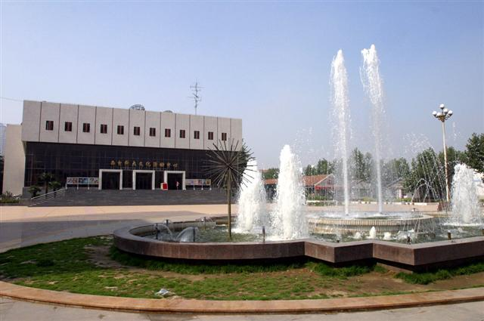
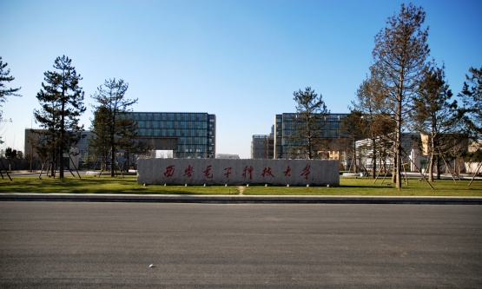
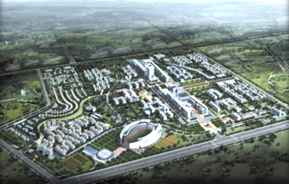


Software School
XIDIAN UNIVERSITY
2018年4月

Slide 2

Chapter Eight
Testing The Program
Types of faults and how to classify then
The Purpose of Testing
Unit Testing
Integrating Test Strategies
Test Planning

Slide 3


Software Process Modeling(2.2)
Waterfall Model (Royce 1970)
8 Steps
4
Requirements
Analysis
1
5
Waterfall like Sequence
System Design
2
6
Program Design
3
Programming
7
4
Unit& Integration Test
5
8
System Test
6
Acceptance Test
7
Product
Operation & Maintenance
8

Slide 4
Definition
Chapter 4
Capture Requirement
Specification
Software
Architecture
Document
(SAD)
Chapter 5
High-Level Architectural Design
Major component
Interact
Chapter 6
How the individual component will be deigned at a modular levels, so that developers can write code that implement the design.
Chapter 7
Most are Advice
It explains some of the software engineering practice that should keep in mind as you write code.

Slide 5
Unit Test
Chapter 8
Test components individually
Integration Test
Test Interface

Slide 6
8.1 Software Faults and Failures
Fault(P.6):
A fault occurs when a human makes a mistake,
call an error, in performing some software activity.
A fault is an inside view of the system,
as seen by the eye of the developer.

Slide 7
8.1 Software Faults and Failures
Failure(P.6):
A failure is a departure from the system’s
required behavior.
A failure is an outside view of the system, as seen by the eye of the user.

Slide 8
8.1 Software Faults and Failures
Causes:
1. Specification may be wrong.
2. Specification may contain impossible to implement
3. The system design may contain faults
4. The Program design may contain faults
5. The Program code may contain faults
Every Step !

Slide 9
8.1 Software Faults and Failures
Solve:
Fault Identification
Fault Correction
Removal

Slide 10
8.1 Software Faults and Failures
Types of Faults:
1
Algorithm Faults
Faults
Syntax Faults
11
Computation Faults
Documentation Faults
Stress or Overload Faults
Capacity or Boundary Faults
Timing Faults
8
Throughput Faults

Slide 11
8.1 Software Faults and Failures
Types of Faults:
Faults
9
Recovery Faults
Hardware and System Software Faults
11
Standard and Procedure Faults
Every Where

Slide 12
8.2 Test issues (相关事宜，基本概念)
1. Test Stages
Chapter 8
1
2
Unit Test
Tested Component
Integrated
Module
Integration
Test
Unit Test
Code
Component
Design
Specification

Slide 13
8.2 Test issues (相关事宜，基本概念)
1. Test Stages
Chapter 9
3
4
Functioning
System
Function
Test
Performance
Test
Verified,
Validated
Software
System
Functional
Requirements
Other
Software
Requirements

Slide 14
8.2 Test issues (相关事宜，基本概念)
1. Test Stages
Chapter 9
5
6
Accepted
System
System
In Use!
Acceptance
Test
Installation
Test
Custom
Requirements
Specification
User
Environment

Slide 15
8.2 Test issues (相关事宜，基本概念)
2. Attitude Toward Testing
Test Code not Coder
1
Egoless Programming
2

Slide 16
8.2 Test issues (相关事宜，基本概念)
3. Who Perform Test
Independent
Test Team

Slide 17
8.2 Test issues (相关事宜，基本概念)
4. Views of the Test Objects
Closed Box
Test
Component
Open Box
Tester

Slide 18
8.2 Test issues (相关事宜，基本概念)
4. Views of the Test Objects
Closed Box
Test
Component
1. Contents are unknown
Tester
2. Feeds Input, Note Output
Every Kind
Of Input ?

Slide 19
8.2 Test issues (相关事宜，基本概念)
4. Views of the Test Objects
Closed Box
Test
Component
Every Kind
Of Input ?
Tester
2
AX + BX + C = 0 Every Triple ( A,B,C)
How to solve ?
Clear Box

Slide 20
8.2 Test issues (相关事宜，基本概念)
4. Views of the Test Objects
Clear Box
Test
Component
Tester
1. Execute all the statements
2. Execute all the Control Path

Slide 21
8.2 Test issues (相关事宜，基本概念)
4. Views of the Test Objects
I = J =1
Perform A
No
I < N ?
Perform C
Yes
P411
Logic Structure

Slide 22
8.3 Unit Test
Test Object: Component
Test Step:
1
Examine code by reading through
Find algorithm, data, syntax
Tester
2
Complier the code
Find remaining syntax faults
3
Develop Test Case
Find desired faults

Slide 23
8.3 Unit Test
Test Methods
Examining The Code
Code Walkthroughs
Code Inspection
Proving Code Correct
Test Program Component

Slide 24
8.3 Unit Test
Test Methods
Examining The Code
Code Walkthroughs
1. Present code and documentation
to test team
2. Team comments their correctness

Slide 25
8.3 Unit Test
Test Methods
Formal
Examining The Code
Code Inspection
Prepared list of concern
Step1: Meet the group: goals
Step2: Individually second goal
Step3: Inspect the code
Step4: Group meeting:report

Slide 26
8.3 Unit Test
Test Methods
Test Program Component
According different Test Objectives we select different Test Case
A particular choice of input data to be used in testing a program

Slide 27
8.3 Unit Test
Test Methods
Test Program Component
According different Test Objectives we select different Test Case
Positive Input Value
A very larger positive integer
Zero
A positive integer
A negative number
A positive, fix-point decimal
A nonnumeric character
A number great than 0 but less 1

Slide 28
8.3 Unit Test
Test Methods
Test Program Component
According different Test Objectives we select different Test Case
Program’s Internal Structure
Statement testing
Test Thoroughness
Branch Testing
Path Testing

Slide 29
Appendix PPT

Slide 30
8.4 Integration Test
Bottom-up Integration
A
B
C
D
G
E
F
Component Hierarchy

Slide 31
8.4 Integration Test
Bottom-up Integration
A
B
C
D
G
E
F
Component Hierarchy

Slide 32
8.4 Integration Test
Bottom-up Integration
A
B
C
D
Interface
E
F
Driver
G

Slide 33
8.4 Integration Test
Top-Down Integration
A
B
C
D
E
F
Stub
Simulate
G

Slide 34
8.5 Test Object-Oriented System
8.6 Test Plan
Real Test Plan Document

Slide 35
End Of Chapter Eight

Slide 36
谢 谢 ！

