Slide 1

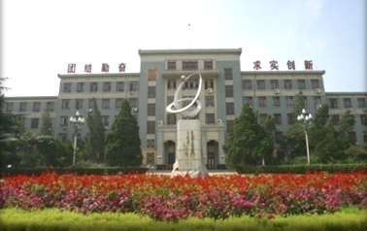
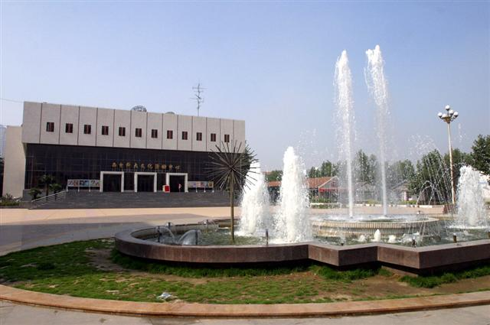
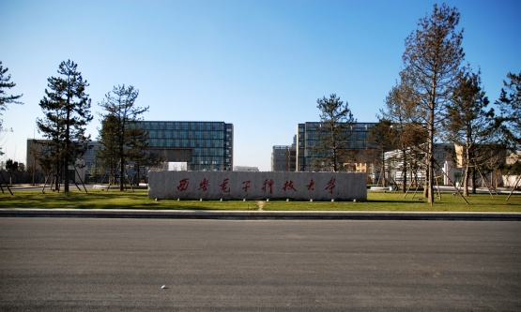
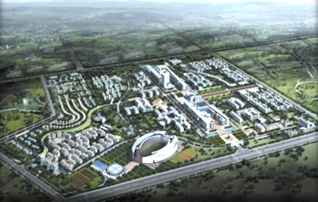


Software School
XIDIAN UNIVERSITY
2018年3月

Slide 2


Chapter Four
Capturing The Requirements
Eliciting Requirements form our customers
Modeling Requirements
Reviewing Requirements to ensure quality
Documenting Requirements

Slide 3
4.1 The Requirement Process
Definition
An Expression of desired Behavior
Process
Elicitation
Analysis
Speci.
Validation
Software
Requirement
Specification
Collecting
User’s
Requirement
Understanding and modeling desired Behavior
Documenting
Checking

Slide 4
4.2 The Requirement Elicitation
Who?
Clients : who are paying for develop
Customers : who buy the software
Users : who use the future system
Stakeholder
Domain Expert : who are familiar with the
Problem
Market Researchers : have conducted
surveys
Lawyers or auditors : Governments
Software engineers : Governments

Slide 5
4.2 The Requirement Elicitation
Volere Model (1999)
Stakeholder’s need
Current Organization
And system
Domain models
Elicit
Existing
Documents
Current Situation
model
Suggested types
Reusable Req.

Slide 6
4.3 Types of Requirements
Functional
Non-Functional
Types
Table 4.2
Design Constraint
Process Constraint

Slide 7


4.3 Types of Requirements
1
Functional Requirements
Functionality
Data
1 What will the system do?
2 When will the system do it?
3 Are there several modes of operation ?
4 What kinds of computations or data transformations must be performed?
5 What are the appropriate reactions to possible stimuli?

Slide 8

4.3 Types of Requirements
1
Functional Requirements
Functionality
Data
1 For both input and output ,what should be the format of the data?
2 Must any data be retained for any period of time ?

Slide 9

4.3 Types of Requirements
Design Constraints
2
Physical Env.
Interfaces
Users
1 Where the equipment to be located ?
2 Is there one location or several ?
3 Are there any env. restrictions such as temperature humidity magnetic
4 Are there any constraints on the size of the system ?
5 Are there any constrains on power, heating, or air conditioning ?
6 Are there any constrains on programming language because of existing
software component ?

Slide 10
4.3 Types of Requirements
Design Constraints
2
Physical Env.
Interfaces
Users
1 Is input coming from one or more other system ?
2 Is output going to one or more other system?
3 Is there a prescribed way in which input/output data must be
formatted ?
4 Is there a prescribed medium that the data must use ?

Slide 11

4.3 Types of Requirements
Design Constraints
2
Physical Env.
Interfaces
Users
1 Who will use the system ?
2 Will there be the several type of users?
3 What the skill level of each user ?

Slide 12
4.3 Types of Requirements
Process Constraints
3
Resources
Documentation
Standards
1 What materials. personnel, or other resources are needed
to build the system ?
2 What the skill the developers have ?

Slide 13

4.3 Types of Requirements
Process Constraints
3
Resources
Documentation
Standards
1 How much the documentation is required ?
2 Should it be on line ?
3 To what audience should each type of documentation be addressed?

Slide 14
4.3 Types of Requirements
Performance
4
Usability and
Human Factors
Security
Quality (Non-functional)
Reliability and
Availability
Maintainability
Maintainability
Maintainability

Slide 15
4.3 Types of Requirements
Requirement Documents
Definition
Specification
Definition: Complete listing of everything the customer wants
to achieve.
Writer: Jointly by the client and requirement analyst (term)
Reader: Business audience ( client, customers, users)

Slide 16

4.3 Types of Requirements
Requirement Documents
Definition
Specification
Definition: How the proposed system shall have.
Writer: Requirement analyst (Term)
Reader: Software developer

Slide 17

4.3 Types of Requirements
Requirement Documents
Definition
Specification
▲ Restate
▲ Direct correspondence

Slide 18
4.4 The Characteristics of Requirement
Correct
Consistent
Unambiguous
Quality(8)
Complete
Feasible
Relevant
Testable
Traceable

Slide 19
4.5 Modeling Notation
Requirement Presentation
Data
Entity-Relationship Diagram
Modeling
Function
Data-Flow Diagrams
Behavior
State Machine

Slide 20
4.5 Modeling Notation
Entity-Relationship Diagram (Chen 1976)
Three core constructs
  An entity:
  Depicted as a rectangle, represents a collection of real-
  world objects that have common properties and behaviors
  A relationship:
  Depicted as an edge between two entities, with diamond
  in the middle of the edge specifying the type of relationship
  An attribute:
  An annotation(注释) on an entity that describes data or
  properties associated with the entity

Slide 21
4.5 Modeling Notation
Entity-Relation Method （Review)
1. 数据建模方法。软件系统中数据成千上万，如何组织？呈现？
实体
联系（1:1,1:n,m:n）
属性
实体、属性及关系的连接

Slide 22
4.5 Modeling Notation
2. 举例。
学号
姓名
课号
课时
m
n
选课
专业
学生
课程
类别
年级
学分
学生和课程之间的E-R模型

Slide 23
4.5 Modeling Notation
Examples ：Turnstile(绕杆，旋转门)（Jackson and Zave 1995）
m
m
1
Owns
Insert
Coins
CoinSlot
1
Visitor
Price of admission
1
Enters
Barrier
Locked
学生和课程之间的E-R模型

Slide 24
4.5 Modeling Notation
UML (Unified Modeling Language OMG 2003)
1. 类图符号
类名
属性
方法

Slide 25
4.5 Modeling Notation
Example Library Problem（Class Diagram）
0..1
Borrows
0..*
Patron
Publication
Patron ID
Call Number
Check-fines()
Loan
buy()
Due date
Book
Periodical
Calduedate()
Author
Patron ID
Check-fines()

Slide 26
4.5 Modeling Notation
Summary（需求分析之任务）
建立
完整、准确的逻辑（数据）模型
待开发系统
表述
Researcher
Achievements
建模方法
（表述方法）
文档

Slide 27
4.5 Modeling Notation
Data-Flow Diagram （DFD)
1. 功能建模方法。描述数据处理过程的一种图形工具。
数据的源点或终点
加工（数据处理）
数据存储
数据流

Slide 28
4.5 Modeling Notation
Data-Flow Diagram （DFD)
1. 举例
人事部门
考勤、业绩
工资条
职工
工资
计算
系统
煤气、水电
银行
后勤部门
存银行单
内
数据的来源和去向
外
数据的来源和去向
工资计算系统的顶层（0层）数据流图

Slide 29
4.5 Modeling Notation
Data-Flow Diagram （DFD)
1. 举例
帐务系统
考勤、业绩
计算
1
2
人事
打印
职工
工资条
后勤
煤气、水电
转存
3
实发工资
银行
转存清单
外
数据的来源
内
数据去向
工资计算系统的第1层数据流图

Slide 30
4.5 Modeling Notation
Summary（需求分析之任务）
建立逻辑模型
结构化方法
L0
F1
F2
S
L1
F1
F2
1
3
2
系统加工
S
Top-Down
Refine by Step
Fi
子系统加工

Slide 31
4.5 Modeling Notation
DFG of the Library
Reserve
Reserve Record
Request to put
Items on reserve
Put on Reserve
Librarian
Layout and contents
Borrow
Usage Trends
Borrowed
Borrowed
Return
Loan Record
Returned
Title, subject,
authors
Returned
Due Date
Returned
Over Due Fine
Fine
Patron
Patron’sFine`
Outstanding fine

Slide 32
4.5 Modeling Notation
UML Use Case of the Library
Larger Box
System Boundary
Human
Stick Figure
Actor
System
Oval
Case (Functionality)
Line
Actor participate the case

Slide 33
4.5 Modeling Notation
UML Use Case of the Library
<<Include>>
Pay Fine
Borrow Item
<<Extend>>
<<Include>>
Find Item
Borrow Item
Return Item
Patron
<<Extend>>
Librarian
Reserve Item
Recall Item
Un-reserve
Librarian

Slide 34
4.5 Modeling Notation
State Machine
Node
State
Edge
Transition

Slide 35
4.5 Modeling Notation
State Machine (Turnstile Problem)
Slug/Buzz
Coin
Unlocked
Locked
Rotated
Rotating
Push
Finite-Machine Model

Slide 36
4.3 Types of Requirements
Decision Table(判定表)
▲ Background 数据流图的补充表示法，用以表示加工的一种描述方法。
Case
当某一个加工的实现同时需要依赖多个逻辑条件的取值时
Format
条件列表
条件组合
动作列表
对应的动作

Slide 37
4.3 Types of Requirements
Example(职务津贴计算)
助工
奖金基数350
职称
工程师
奖金基数400
奖金基数500
条件
高工
动作
上浮20%
X<10
上浮30%
工龄
上浮35%
10<X<20
上浮40%
20>X

Slide 38
4.3 Types of Requirements
Example(职务津贴计算)
组合
1
2
3
4
5
6
7
8
9
职称
助工
工程师
高工
助工
工程师
高工
助工
工程师
高工
条件
工龄
<10
<10
<10
10-20
10-20
10-20
>20
>20
>20
350
∨
∨
∨
400
∨
∨
∨
动作
∨
∨
∨
500
20%
∨
∨
30%
∨
∨
35%
∨
40%
∨

Slide 39
4.3 Types of Requirements
Example(职务津贴计算)-判定树
<10年，基数为350
助工
10-20年，基数为350，上浮20%
>20年，基数为350，上浮30%
津贴计算
工程师
高工

Slide 40
4.5 Modeling Notation
Requirement Presentation
Data
Entity-Relationship Diagram
Modeling
Function
Data-Flow Diagrams
Decision Table (Tree)
Behavior
State Machine

Slide 41
4.7 Prototype Requirement
Customer Uncertain
Reasons
1
Options
2
3
Uncertain for realization
Types
Throw-Away Prototype
Types:
1
2
Evolutionary Prototype

Slide 42
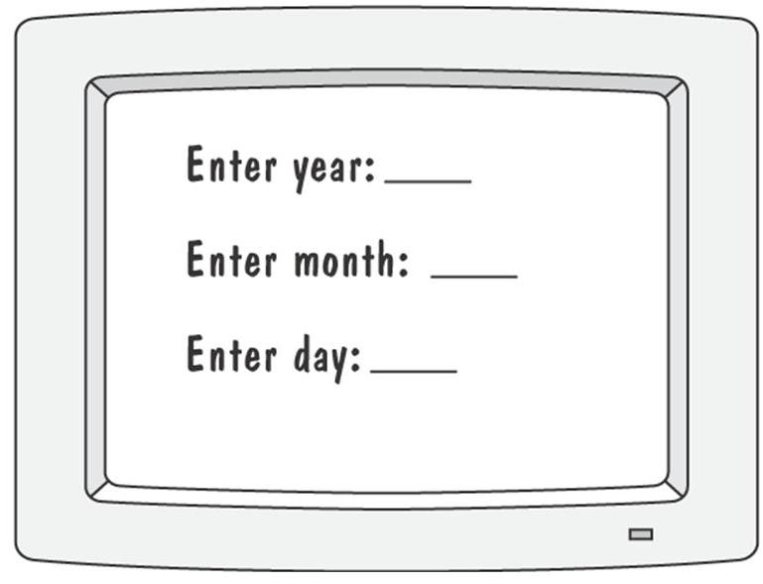
4.7Prototype Requirements
Example:
User Exercise Tracker
First Interface Prototype

Slide 43
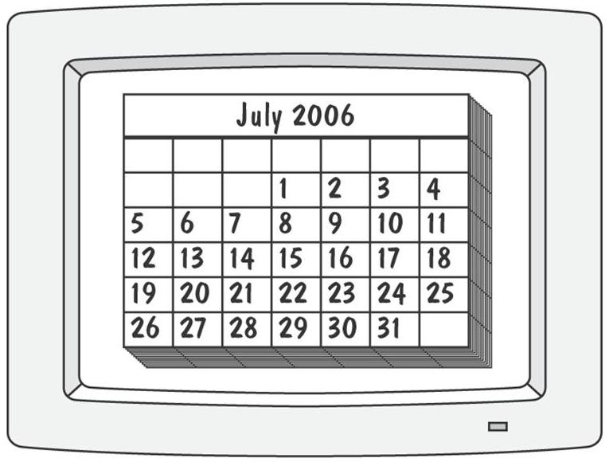
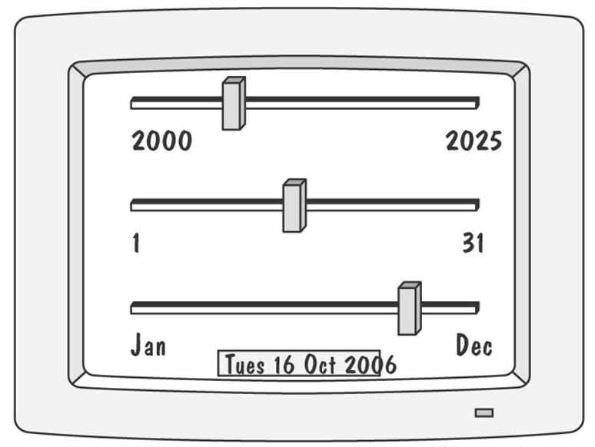
4.7 Prototype Requirements
Example:
User Exercise Tracker
Second: Calendar
Third: Three Slide Bar

Slide 44
4.8 Requirements Documentation
Requirements Definition Document
For Customer
Outline the general purpose of the system.
Describe the background and objectives of system development.
Outline a description of the approach.
Describe the detailed characteristics of the proposed system.
Discuss the environment.
Requirements Specification Document
For Developer

Slide 45
4.8 Requirements Documentation
Requirement Definition Document
For Customer
4.1.3.1 Initiate Track On Image.
Logical processing shall be done to INITIATE TRACK ON IMAGE. This shall have as ……
ALPHA: INITIATE_TRACK_ON_IMAGE
INPUTS: HANDOVER_DATA
OUTPUTS: HOIQ, STATE_DATA, IMAGE_ID
……
Requirements Specification Document
For Developer

Slide 46
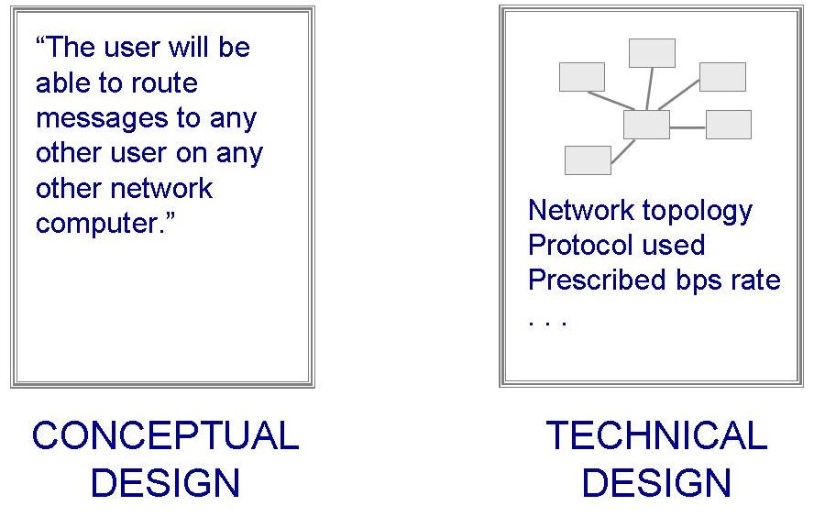
4.8 Requirements Documentation
Requirement Definition
Requirement Specification
For Customer
For Developer

Slide 47
4.9 Requirements Validation
In requirements validation, we check that our requirements definition accurately reflects the customer's needs.
In verification, we check that one document or artifact conforms to another.
Verification ensures that we build the system right,
whereas validation ensures that we build the right system.

Slide 48
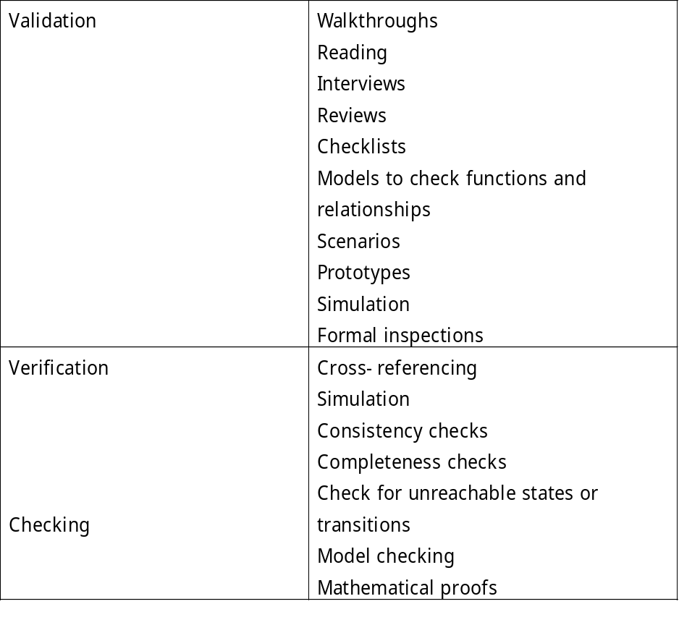
4.9 Requirements Validation
List of techniques to validate requirements.

Slide 49
4.9 Requirements Validation
Requirements Review
Review the stated goals and objectives of the system
Compare the requirements with the goals and objectives
Review the environment in which the system is to operate
Review the information flow and proposed functions
Assess and document the risk, discuss and compare alternatives
Testing the system: how the requirements will be revalidated as the requirements grow and change

Slide 50
End Of Chapter Four

Slide 51
谢 谢 ！

