Slide 1
Database Management
Tomasz Grabusiński

Slide 2

Scope of the course
Data recovery
Checking data integrity
Index fragmentation
Statistics update

Slide 3

Why is database management important
Potential risks:
Data loss
Disk runs out of space
Ineffective indexes
Suboptimal execution plans

Slide 4
How to mitigate risks
Schedule
Plan
Test
Deploy
Monitor

Slide 5

Maintenance tasks
Full, Differential, Log Backups
Check integrity
Index Rebuild and Reorganize
Statistics Update
File shrink
Custom Scripts
Clean up

Slide 6
Data recovery

Slide 7
Scope
Data and Transaction Log files
Backup types
Recovery models
Restore Sequence
Recovery examples
Recovery strategy planning

Slide 8
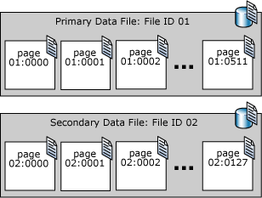
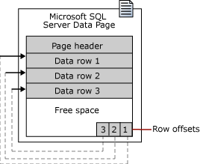
Data file

Slide 9
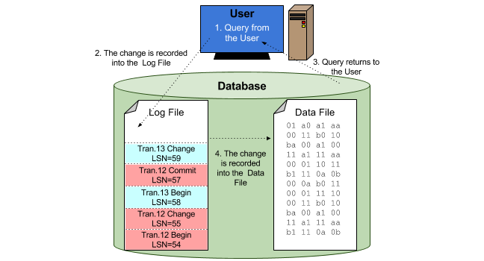
Transaction Log File

Slide 10
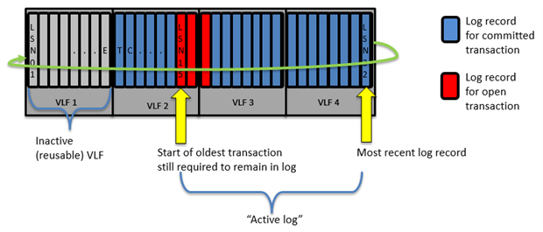
Transaction Log Structure

Slide 11
Log Record (Demo 1)
Log Sequence Number
Transaction Id
Pointer to Previous LSN
Bitmap before and Bitmap after

Slide 12
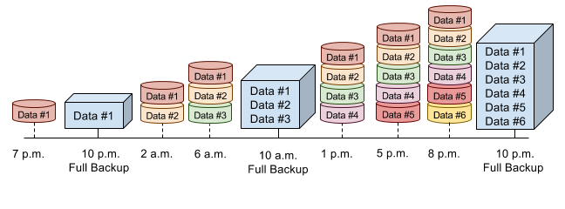
Backup types – Full Backup

Slide 13
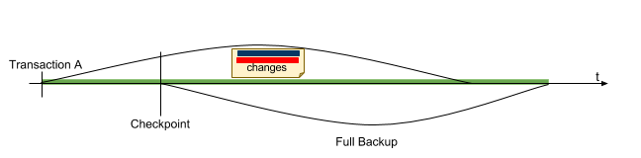
Backup types – Full Backup (2)

Slide 14
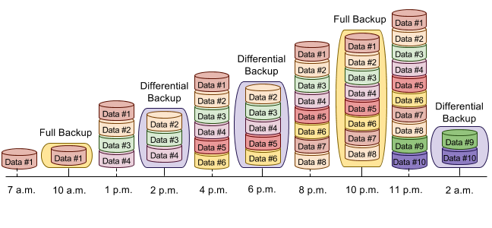
Backup types – Differential Backup

Slide 15
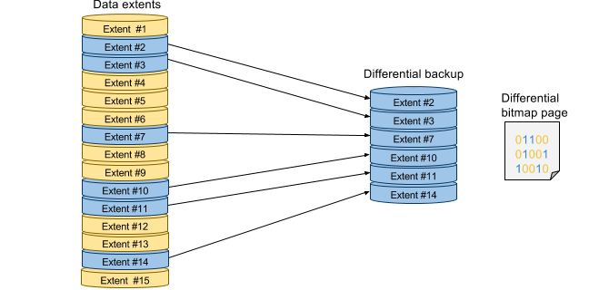
Backup types – Differential Backup (2)

Slide 16
Backup types – Transaction Log Backup
Checkpoint
LSN 10
Checkpoint
LSN 6
Tran. 3 Insert
LSN 9
Tran. 2 Insert
LSN 5
Tran. 3 Begin
LSN 8
Tran. 2 Begin
LSN 4
Tran. 2 Commit
LSN 7
Tran. 1 Commit
LSN 3
Tran. 1 Commit
LSN 3
Checkpoint
LSN 6
Checkpoint
LSN 6
Checkpoint
LSN 10
Tran. 1 Update
LSN 2
Tran. 1 Update
LSN 2
Tran. 2 Insert
LSN 5
Tran. 2 Insert
LSN 5
Tran. 3 Insert
LSN 9
Tran. 1 Begin
LSN 1
Tran. 1 Begin
LSN 1
Tran. 2 Begin
LSN 4
Tran. 2 Begin
LSN 4
Tran. 3 Begin
LSN 8
t
00:01
00:02
Transaction Log Backup
LSN 1-6
00:04
00:05
Transaction Log Backup
LSN 7-10
00:07

Slide 17
Recovery models
SIMPLE recovery model
FULL recovery model
BULK_LOGGED recovery model

Slide 18
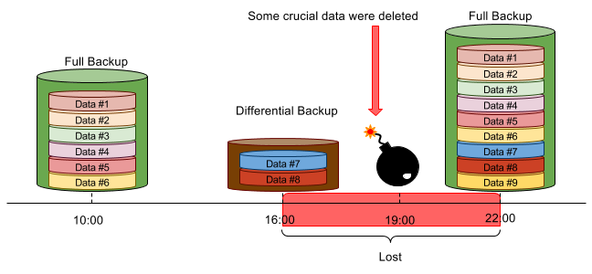
Simple Recovery Model

Slide 19
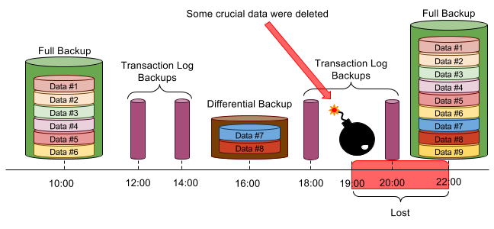
Full Recovery Model

Slide 20
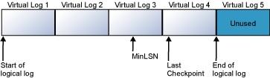
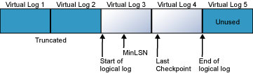
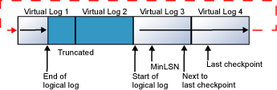
Transaction Log Truncation (Demo )

Slide 21
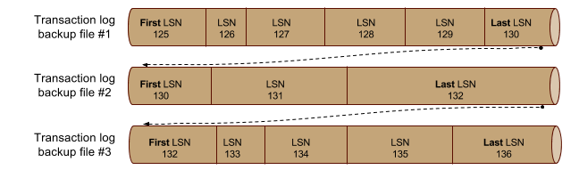
Transaction Log Backup Chain

Slide 22
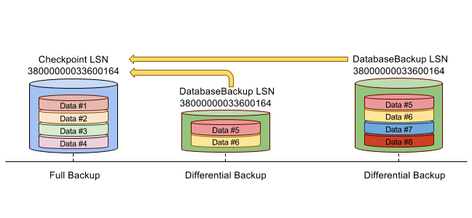
Restore Sequence

Slide 23
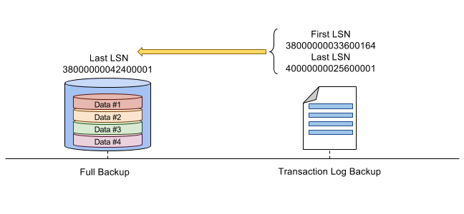
Restore Sequence (2)

Slide 24
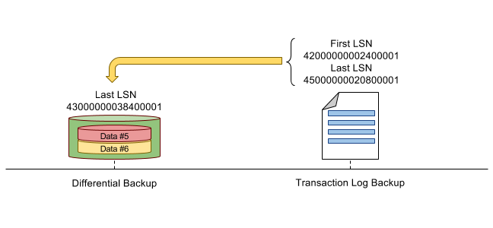
Restore Sequence (3)

Slide 25
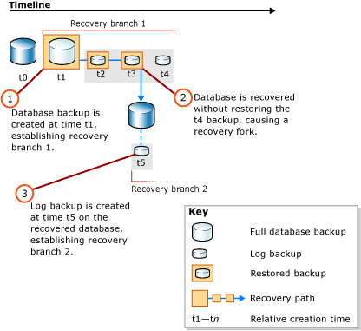
Restore paths

Slide 26
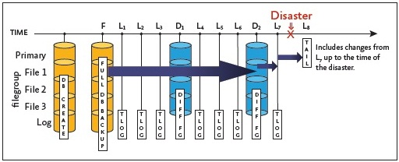
Recovery from Tail Log Backup (Demo)

Slide 27
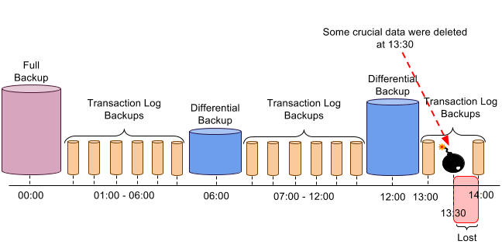
Point in Time Recovery (Demo)

Slide 28
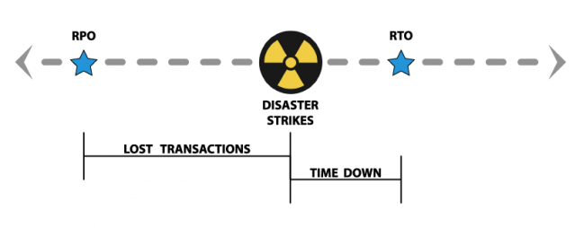
How to plan recovery strategy
Consider RPO and RTO

Slide 29
Full Backups Strategy
FULL
FULL
FULL
t

Slide 30
Full + Differential Backups Strategy
FULL
DIFF
DIFF
DIFF
FULL
DIFF
DIFF
DIFF
FULL
t

Slide 31
Full + Differential + Log Backups Strategy
FULL
Log
Log
DIFF
Log
Log
FULL
Log
Log
DIFF
Log
Log
FULL
t

Slide 32


Slide 33
How to increase availability
Backups localization
Backups validation
Setup database mirroring, database replication

Slide 34
No covered
Bulk_Logged Recovery Model
How to deal with damaged Transaction Log File
How to deal with fragmented VLFs
How to deal with damaged log backups

