Slide 1
Data corruption

Slide 2
Overview
causes of corruption
detecting corruption methods
what is consistency check
how to repair errors

Slide 3
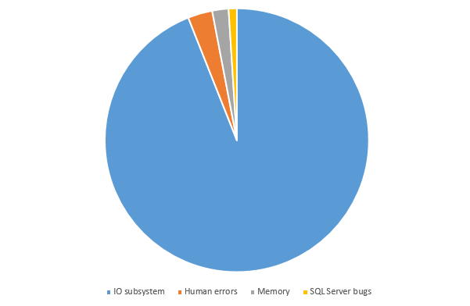
Causes of corruption

Slide 4
Detecting corruption
CHECKSUM
Consistency check
Scope:
CHECKSUM
IO errors
Memory errors
CONSISTENCY CHECK

Slide 5
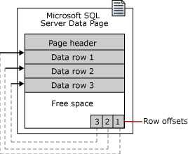
CHECKSUM (Demo)

Slide 6
Consistency Check
DBCC CHECKALLOC
(checks allocation structures)
DBCC CHECKDB
DBCC CHECKTABLE
(checks tables and indexes)
DBCC CHECKCATALOG
(checks system tables data)

Slide 7
Consistency check (2)
DBCC CHECKCONSTRAINTS – checks constraints
DBCC CHECKIDENT – checks identity value

Slide 8
Repair techniques
Restore
DBCC CHECKDB WITH REPAIR
Export data
Manual repairs

Slide 9
How does DBCHECK Repair work
GOAL: keep database structurally consistent
CHECKDB WITH REPAIR:
1. Find errors and rank them
2. Repair errors starting with the highest rank
* No guarantee everything will be repaired

Slide 10
Repair options
REPAIR_REBUILD
REPAIR_ALLOW_DATA_LOSS

Slide 11
Repair approach (Demos)
CHECKDB
CHECKDB WITH REPAIR
CHECKDB
CHECKCONSTRAINTS
BACKUP OR BEGIN TRAN

Slide 12
Emergency Mode
allows bypass recovery
allows access database
allows export data
allows run repair

Slide 13
How does Emergency Repair work
1. Redo/undo valid log records
2. Build new transaction log
3. Runs DBCC CHECKDB WITH REPAIR_ALLOW_DATA_LOSS
4. Tries to bring database online

