Slide 1
Index Management
Tomasz Grabusiński

Slide 2
Overview
Index structure
What is index fragmentation
Detecting index fragmentation
Removing index fragmentation
Avoiding index fragmentation

Slide 3
How is data arranged in table

Slide 4
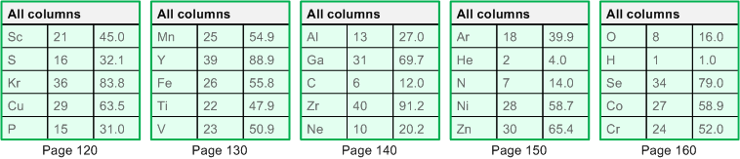
Heap table

Slide 5
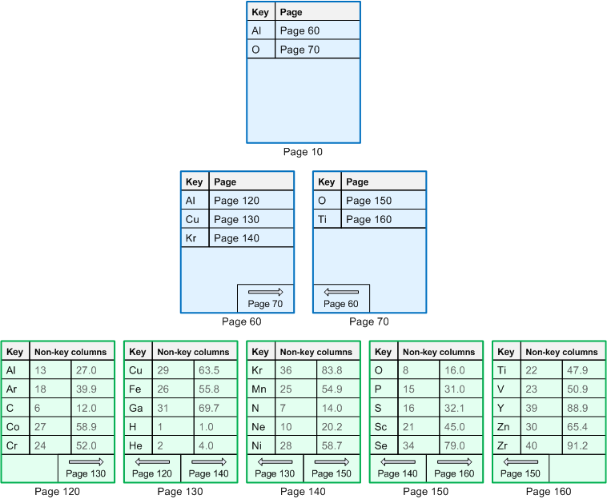
Clustered table
Index pages
Data pages

Slide 6
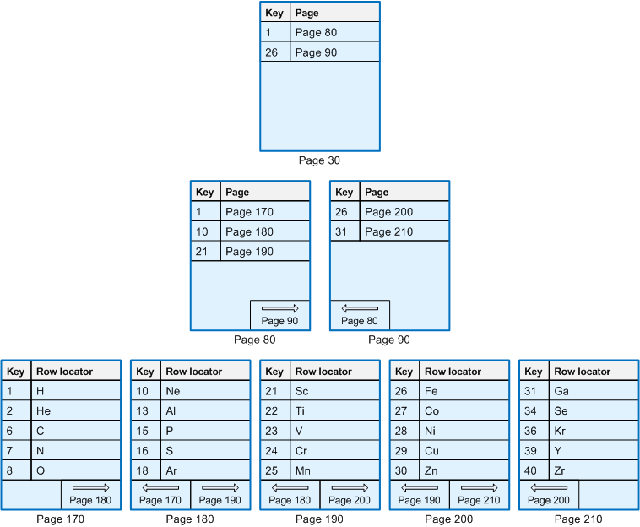
Non clustered index for clustered table
Index pages

Slide 7
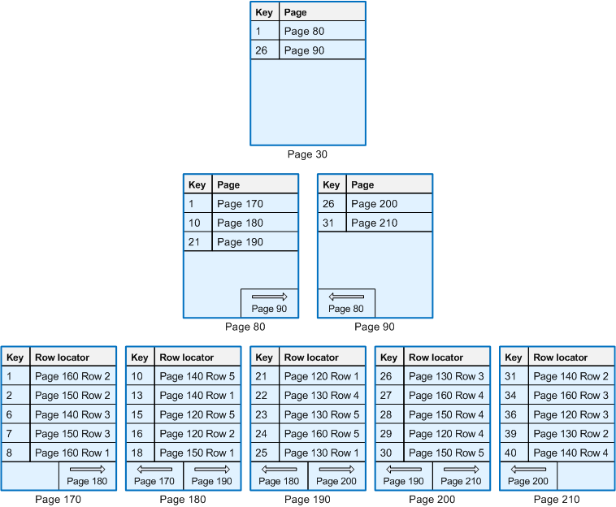
Non clustered index for heap table
Index pages

Slide 8
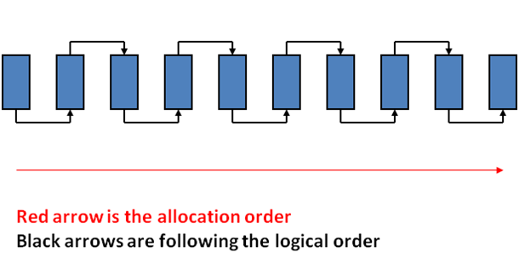
Index fragmentation

Slide 9
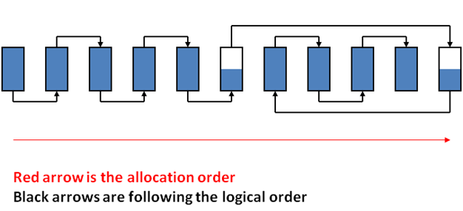
Index fragmentation

Slide 10
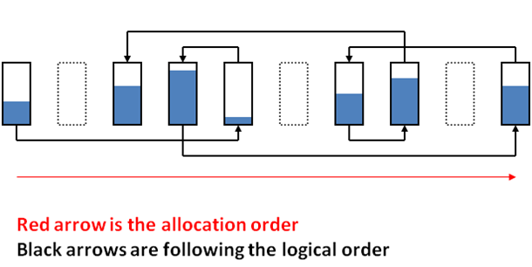
Index fragmentation

Slide 11
Consequences of index fragmentation
DEMO

Slide 12
Detecting index fragmentation
DEMO

Slide 13
Removing index fragmentation
Rebuild ALTER INDEX Name ON Table REBUILD;
Reorganize ALTER INDEX Name ON Table REORGANIZE;

Slide 14
Reorganize - Compaction Phase

Slide 15
Reorganize - Compaction Phase

Slide 16
Reorganize - Compaction Phase

Slide 17
Reorganize - Compaction Phase

Slide 18
Reorganize – Reorder Phase
5
1
3
6
2
4
1
2
3

Slide 19
Reorganize – Reorder Phase
5
1
3
6
2
4
1
2
3
500

Slide 20
Reorganize – Reorder Phase
1
3
5
2
4
6
1
2
3
500

Slide 21
Reorganize – Reorder Phase
1
3
5
2
4
6
1
2
3
500

Slide 22
Reorganize – Reorder Phase
1
3
5
2
4
6
1
2
3
500

Slide 23
Rebuild or Reorganize
Reference Values (in %) | Action
avg_fragmentation_in_percent > 5 AND < 30 | Reorganize Index
avg_fragmentation_in_percent > 30 | Rebuild Index

Slide 24
Avoiding index fragmentation
Insert records with sequential key value
Use index fill factors

Slide 25
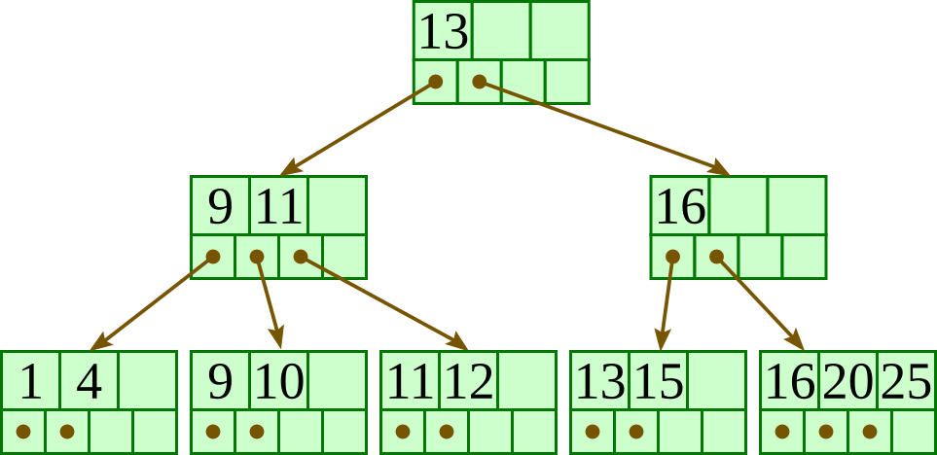
Appendix: B+tree
Every node has at most m children.
Every non-leaf node (except root) has at least ⌈m/2⌉ children.
The root has at least two children if it is not a leaf node.
A non-leaf node with k children contains k−1 keys.
All leaves appear in the same level
Search/Insert/Delete require O(logmn) operations
B+Tree Interactive

