Slide 1
SQL SERVER
STATISTICS
Grabusiński
Tomasz

Slide 2
Scope
What are statistics used for?
What data do the statistics contain?
When and which data does the optimizer utilize?
How to deal with stale statistics?

Slide 3
Query Execution Pipeline
PARSE
QUERY TREE
COST BASED OPTIMIZATION
COMPILATION
EXECUTION

Slide 4
Cost Based Optimization
P1
P2
...
Pn
What can influence the plan generation?
Indexes
Data selectivity
Query
Database settings
Candidate Plans
C1
C2
...
Cn
Costs
Pick minimum cost one
Notes:
Rozsądny podzbiór potencjalnych algorytmów które zwrócą nasze dane. Na wybór algorytmu ma wpływ kilka czynników tj. samo zapytanie, joiny, indeksy, statystyki

Slide 5
Data Selectivity
SELECT * FROM dbo.Addresses
WHERE Country = 'Tonga'
SELECT * FROM dbo.Addresses
WHERE Country = 'Barbados'
SELECT * FROM dbo.Addresses
WHERE Country = 'Ghana'
Notes:
The SQL Server query optimizer uses distribution statistics when creating a query plan. The statistics provide information about the distribution of column values across participating rows, helping the optimizer better estimate the number of rows, or cardinality, of the query results.
The statistics provide the optimizer with clues on the best ways to process the query and consequently maximize performance. For example, the statistics might lead the optimizer to choose an index seek over an index scan, a potentially more resource-intensive operation. Without statics, it would be difficult for the optimizer to determine the best processing strategy in advance.

Slide 6


Definition of Data Selectivity
$$Selectivity= \frac{\# of matched rows}{total rows}$$
$$0 < Selectivity ≤ 1$$

Slide 7
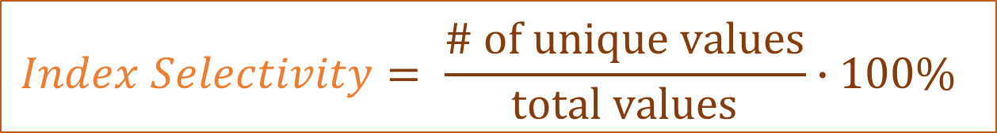
Definition of Index Selectivity
$$Index Selectivity= \frac{\# of unique values}{total values}∙100\%$$
$$0 <Index Selectivity ≤ 1$$

Slide 8
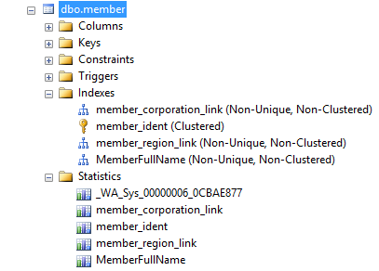
Statistics Object
CREATE INDEX
AUTO_CREATE_STATISTICS
CREATE STATISTICS
Notes:
The SQL Server query optimizer uses distribution statistics when creating a query plan. The statistics provide information about the distribution of column values across participating rows, helping the optimizer better estimate the number of rows, or cardinality, of the query results.
The statistics provide the optimizer with clues on the best ways to process the query and consequently maximize performance. For example, the statistics might lead the optimizer to choose an index seek over an index scan, a potentially more resource-intensive operation. Without statics, it would be difficult for the optimizer to determine the best processing strategy in advance.

Slide 9
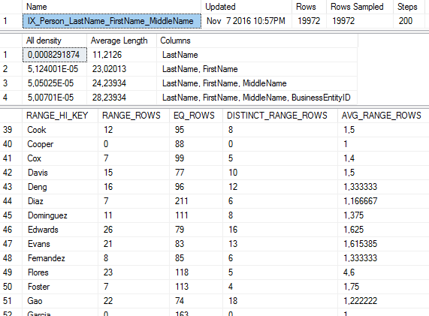
DBCC SHOW_STATISTICS
CREATE INDEX IX_Person_LastName_FirstName_MiddleName
ON Person(LastName, FirstName, MiddleName);
Header
Density Vector
Histogram
Notes:
The SQL Server query optimizer uses distribution statistics when creating a query plan. The statistics provide information about the distribution of column values across participating rows, helping the optimizer better estimate the number of rows, or cardinality, of the query results.
The statistics provide the optimizer with clues on the best ways to process the query and consequently maximize performance. For example, the statistics might lead the optimizer to choose an index seek over an index scan, a potentially more resource-intensive operation. Without statics, it would be difficult for the optimizer to determine the best processing strategy in advance.

Slide 10
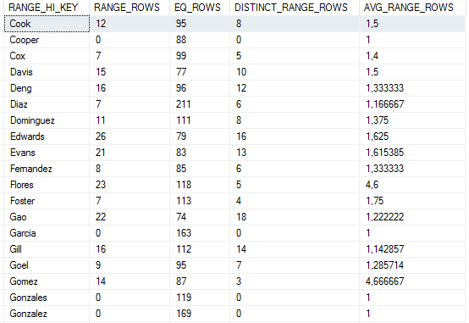
Histogram
RANGE_HI_KEY – the histogram step
RANGE_ROWS – the estimated number of rows within the range
DISTINCT_RANGE_ROWS – the estimated number of distinct rows within the range
EQ_ROWS – the estimated number of rows whose value equals the histogram step
AVG_RANGE_ROWS – the average number of rows with duplicate values within the range

Slide 11
Density Vector
Name | Updated | Rows | Rows Sampled | Steps
IX_Person_LastName_FirstName_MiddleName | Nov 7 2016 10:57PM | 19972 | 19972 | 200
All density | Average Length | Columns
0,000829187 | 11,2126 | LastName
5,124001E-05 | 23,02013 | LastName, FirstName
5,05025E-05 | 24,23934 | LastName, FirstName, MiddleName
5,00701E-05 | 28,23934 | LastName, FirstName, MiddleName, BusinessEntityID

Slide 12



Definition of Density
$$Density= \frac{1}{\# of unique values}$$
$$\overline{Duplicates}=Density ∙rows$$
$$0 <Density ≤ 1$$

Slide 13
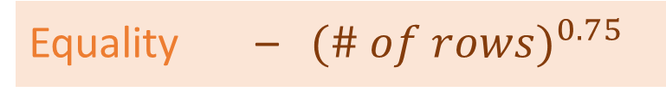
Rule Based Estimation
Equality – ${ (\# of rows)}^{0.75}$
Inequality – 30%
Between – 9%

Slide 14
Demo
Equality with and without a known value
Inequality with and without a known value

Slide 15
Updating Statistics
UPDATE STATISTICS NAME WITH FULLSCAN | SAMPLE
AUTO_UPDATE_STATISTICS
0 rows
less than 500 rows and there is atleast 500 rows modified
over 500 rows and there is atleast 500 + 20% of rows modified

Slide 16
Demo
Stale statistics
Updating statistics

Slide 17
github.com/tgrabus/ sql-server-maintenance
REF SZKOLENIA: 98

