Slide 1

From Short-Term Actions to Long-Term Patterns: Exploring Temporal Dependencies in Activity Recognition with Wearable Sensor Data
Tuğrahan Karakadıoğlu
Ozyegin University

Slide 2
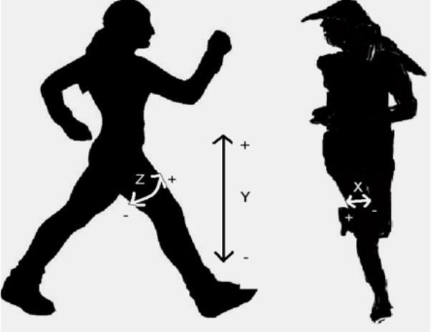
Introduction
Human Activity Recognition (HAR) is a critical research area with applications in healthcare, fitness tracking, smart environments, and human-computer interaction. By leveraging wearable sensors like accelerometers, HAR systems aim to classify activities such as walking, jogging, sitting, and climbing stairs.

Slide 3
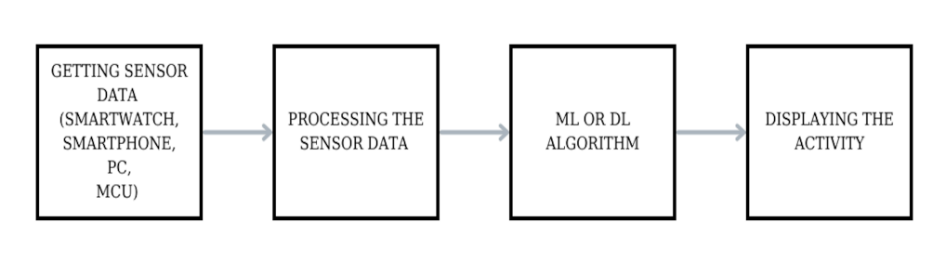
What is HAR ?
Human Activity Recognition (HAR) is an engineering field dedicated to developing systems and methods that identify and classify human activities, using data from videos, images, and sensors to recognize and understand body movements.

Slide 4
Objectives - Challenges
Temporal Dependencies: The choice of time-window size directly impacts the system’s ability to recognize short-term transitions (e.g., sitting to standing) and long-term repetitive activities (e.g., jogging or walking).
Imbalanced Datasets: Activities like "Walking" often dominate datasets, making it difficult to classify underrepresented activities such as "Standing" or "Downstairs.”
Model Selection: Traditional feature-based models (e.g., Random Forest) lack temporal awareness, while sequence models (e.g., LSTM-CNN) require careful parameter tuning to avoid overfitting.
Investigate the impact of time-window sizes on activity recognition using wearable sensor data.
Analyze short-term and long-term temporal patterns to optimize recognition performance.

Slide 5
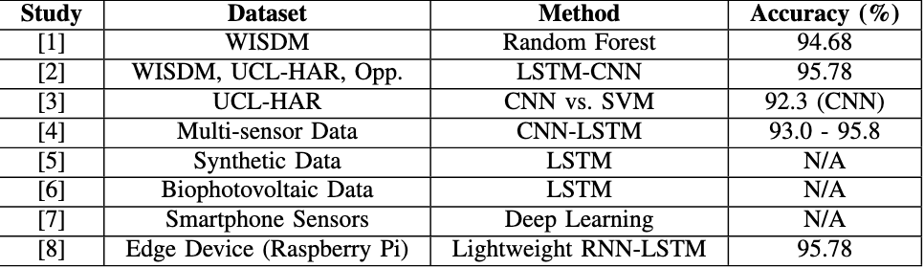
Related Literature
Extensive research has been conducted on Human Activity Recognition (HAR) systems, demonstrating high accuracy rates with traditional classifiers and CNN-based algorithms [Seelwal et al., 2023][Ordóñez and Roggen, 2016].
• Recent studies focus on lightweight models that can be deployed on resource-constrained devices while maintaining high accuracy [Agarwal and Alam, 2020].

Slide 6
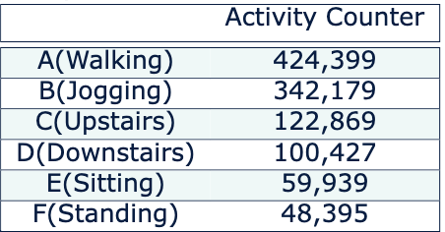
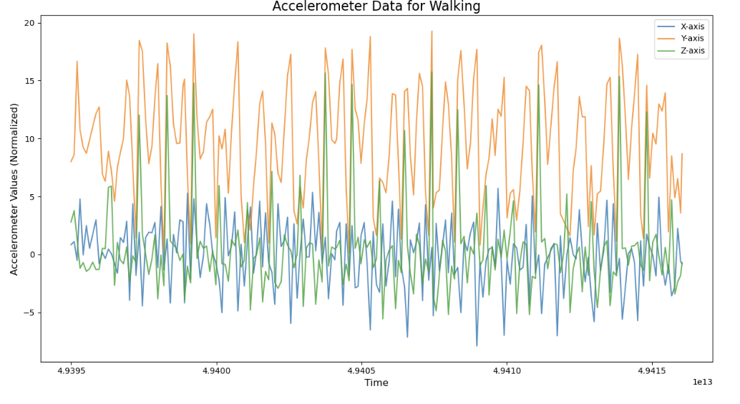
WISDM Dataset
A publicly available dataset collected from smartphone accelerometers.
Primarily designed for research in Human Activity Recognition (HAR).
Data is sampled at 20 Hz (20 readings per second).
Sensor: Smartphone accelerometer placed in the participant’s pocket.
Activities: Six labeled activities:
Walking, Jogging, Sitting, Standing, Upstairs, and Downstairs.
Features:
Three Axes: X, Y, Z readings (acceleration in three dimensions).
Timestamp: Each reading is associated with a time index.
Activity Label: Specifies the activity being performed.

Slide 7
Dataset Challenges
Imbalanced Classes:
Activities like Walking and Jogging dominate the dataset.
Underrepresented classes like Sitting and Standing make classification harder.
Temporal Dependencies:
Activities vary in duration, requiring dynamic or optimized time-window sizes.
Noisy Sensor Data:
Raw accelerometer readings can contain noise due to movement variations and external factors.

Slide 8
Methodology
1. Data Preprocessing:
Dataset: WISDM dataset containing accelerometer readings for six activities:
Walking, Jogging, Sitting, Standing, Upstairs, Downstairs.
Segmenting Time-Series Data:
Divided data into fixed time-windows with overlaps (3s, 5s, and 10s).
Allowed comparison of short-term vs. long-term temporal dependencies.
Normalization:
Applied Z-score standardization to normalize sensor readings (X, Y, Z axes).

Slide 9
Methodology
2. Feature Extraction
Random Forest:
Extracted statistical features (mean, std, min, max, skewness, kurtosis, RMS, zero-crossing rate) for each window.
LSTM-CNN:
Used raw segmented windows as input to capture both spatial and temporal dependencies.

Slide 10
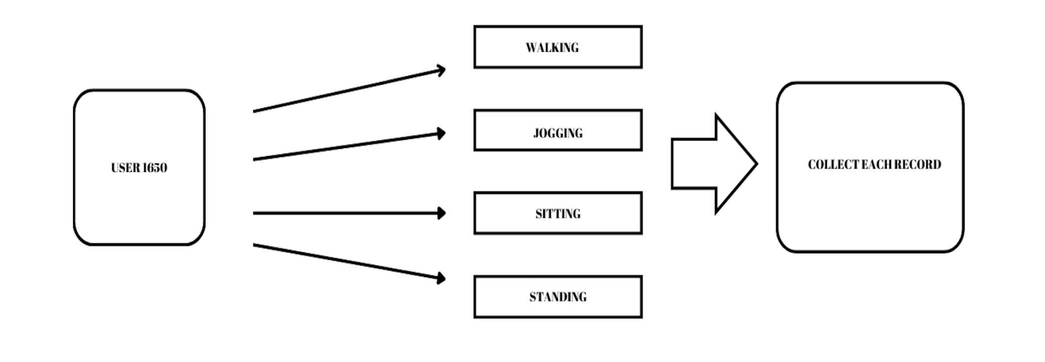
Segmentation Techniques 1- Fixed-Window Size For Each User

Slide 11
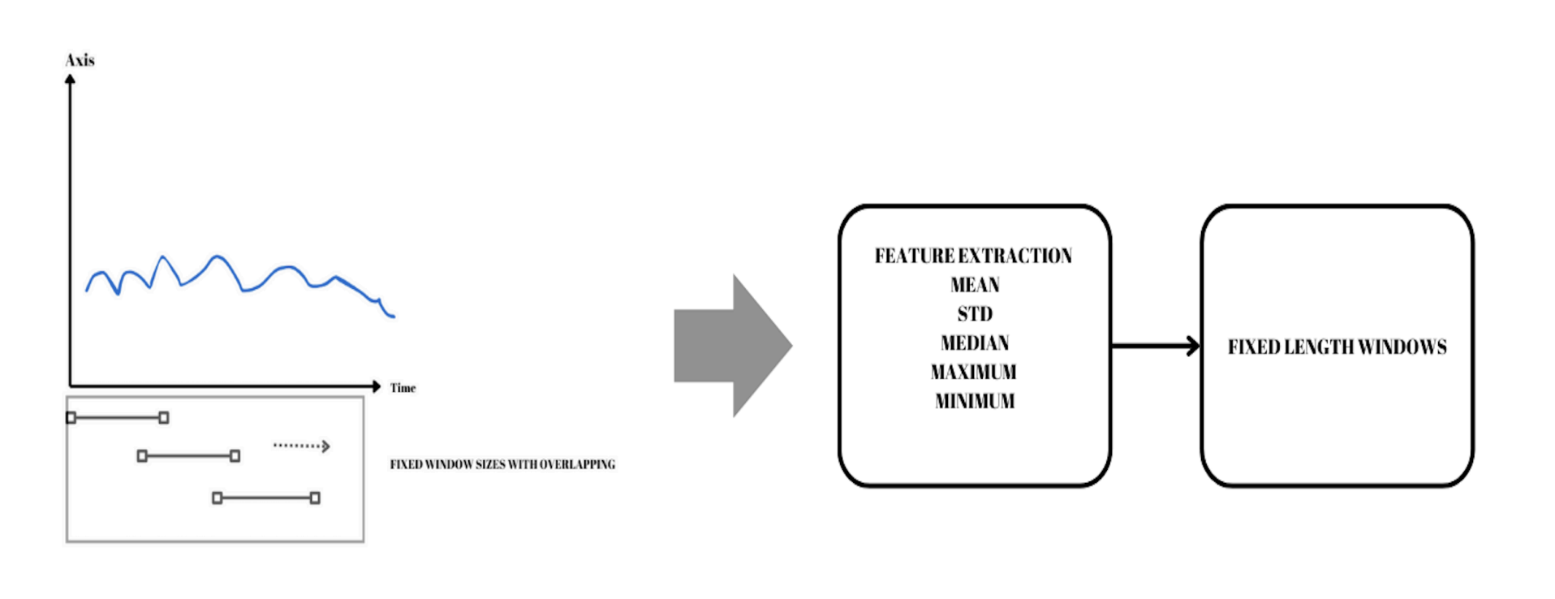
Segmentation Techniques 2- Fixed Window Size with Feature Extraction

Slide 12
Methodology
3. Handling Class Imbalance
SMOTE (Synthetic Minority Oversampling Technique):
Balanced training data by generating synthetic samples for minority classes (e.g., Sitting, Standing).
Improved recall and F1-score for underrepresented activities.

Slide 13
Methodology Model Training
Random Forest: (best parameters with Grid Search)
Hyperparameters:
n_estimators: 200
max_depth: 30
min_samples_split: 10
Trained on extracted features.
LSTM-CNN:
Architecture:
Conv1D: Captured spatial features across X, Y, Z axes.
LSTM: Modeled temporal dependencies for sequence analysis.
Linear Perceptron: Final prediction layer.
Optimized using Adam optimizer and cross-entropy loss.
Data Split:
Training Set: 70% of the data
Test Set: 15% of the data
Validation Set: 15% of the data

Slide 14
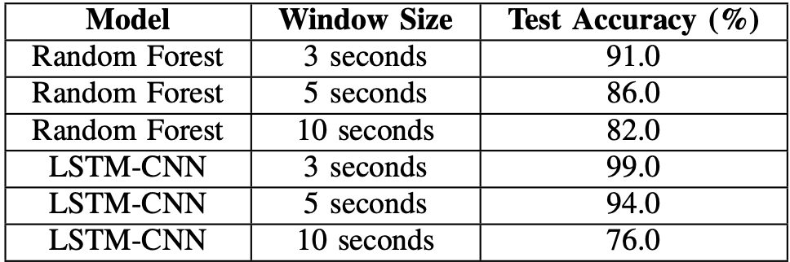
Results Impact of Time-Window Sizes

Slide 15
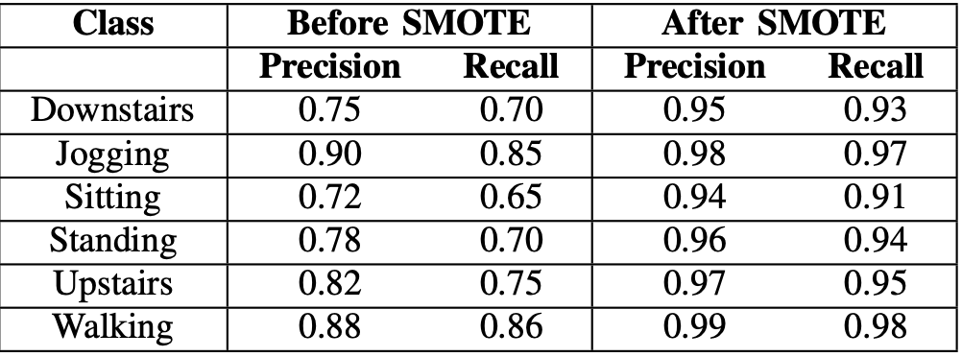
Results Impact of SMOTE

Slide 16
Conclusion
This study investigated the impact of time-window sizes on activity recognition using the WISDM dataset. By comparing Random Forest and LSTM-CNN models across 3s, 5s, and 10s windows, we derived the following conclusions:
Optimal Window Size:
3-second windows provided the best balance between responsiveness and recognition accuracy.
Larger windows (e.g., 10 seconds) captured repetitive patterns but reduced model performance, especially for LSTM-CNN, due to overfitting.
Model Performance:
Random Forest: Performed well with statistical features, achieving 91% test accuracy with 3-second windows. However, it struggled to model long-term dependencies.
LSTM-CNN: Outperformed Random Forest by modeling both spatial and temporal dependencies, achieving 99% test accuracy with SMOTE and 3-second windows.
Class Imbalance:
Applying SMOTE significantly improved recall and F1-scores for minority activities such as "Sitting" and "Standing."

Slide 17
Future Directions
Edge Device Deployment:
Investigate lightweight LSTM-CNN architectures for real-time HAR systems on microcontrollers or IoT devices.
Multimodal Data:
Extend the analysis to include additional sensors like gyroscopes and magnetometers for improved activity recognition.

Slide 18
References
[1] Ya Min, Yin Yin Htay, and Khin Khin Oo. Comparing the performance of machine learning algorithms for human activities recognition using wisdm dataset. International Journal of Computer (IJC), 38(1):61–72, 2020.
[2] Kun Xia, Jianguang Huang, and Hanyu Wang. Lstm-cnn architecture for human activity recognition. IEEE Access, 8:56855–56866, 2020.
[3] Pardeep Seelwal, Chetana Srinivas, VS Rekha, et al. Human activity recognition using wisdm datasets. Journal of Online Engineering Education, 14(1s):88–94, 2023.
[4] Francisco Javier Ordóñez and Daniel Roggen. Deep convolutional and lstm recurrent neural networks for multimodal wearable activity recognition. Sensors, 16(1):115, 2016.
[5] Yuxiu Hua, Zhifeng Zhao, Rongpeng Li, Xianfu Chen, Zhiming Liu, and Honggang Zhang. Deep learning with long short-term memory for time series prediction. IEEE Communications Magazine, 57(6):114–119, 2019.
[6] Tonny I Okedi and Adrian C Fisher. Time series analysis and long short term memory (lstm) network prediction of bpv current density. Energy Environmental Science, 14(4):2408–2418, 2021.
[7] Mohammadreza Heydarian and Thomas E Doyle. rwisdm: Repaired wisdm, a public dataset for human activity recognition. arXiv preprint arXiv:2305.10222, 2023.
[8] Preeti Agarwal and Mansaf Alam. A lightweight deep learning model for human activity recognition on edge devices. Procedia Computer Science, 167:2364–2373, 2020.

