Slide 1

Predicting Survival Times for Neuroblastoma Patients using RNA-Seq Expression Profiles
CAMDA: Neuroblastoma Data Integration Challenge
Tyler Grimes, Alejandro R. Walker, Susmita Datta, Somnath Datta Department of Biostatistics, University of Florida

Slide 2
Contents
Background
Accelerated Failure Time (AFT) Model
Imputation for Right Censoring
Dimension Reduction
- Regularization, Filtering Data
Bagging and Rank Aggregation
Results
- Prediction, Pathway Analysis, Prognosis
Conclusions

Slide 3
Contents
Background
Accelerated Failure Time (AFT) Model
Imputation for Right Censoring
Dimension Reduction
- Regularization, Filtering Data
Bagging and Rank Aggregation
Results
- Prediction, Pathway Analysis, Prognosis
Conclusions

Slide 4
1. Background
Neuroblastoma:
5% of all Pediatric cancers
10% of all Pediatric oncological deaths
Highly heterogeneous disease
Prognosis is hard for High Risk groups

Slide 5
1. Background
Neuroblastoma:
5% of all Pediatric cancers
10% of all Pediatric oncological deaths
Highly heterogeneous disease
Prognosis is hard for High Risk groups
Clinical Variables:
Age group, sex, MYCN status
Overall survival time, Event free survival time
INSS stage, High risk, favorable

Slide 6
1. Background
Neuroblastoma:
5% of all Pediatric cancers
10% of all Pediatric oncological deaths
Highly heterogeneous disease
Prognosis is hard for High Risk groups
Clinical Variables:
Age group, sex, MYCN status
Overall survival time, Event free survival time
INSS stage, High risk, favorable
RNA-Seq data:
28k NCBI genes, 217k NCBI transcripts, 340k introns

Slide 7
1. Background
INSS Stage – 1, 2, 3, 4, 4S
Has the cancer spread? How successful was surgery?
High Risk
Patients with stage 4 disease >18 months at diagnosis,
or any age and stage with MYCN-amplified tumors
Unfavorable
Patient died from disease despite chemotherapy

Slide 8
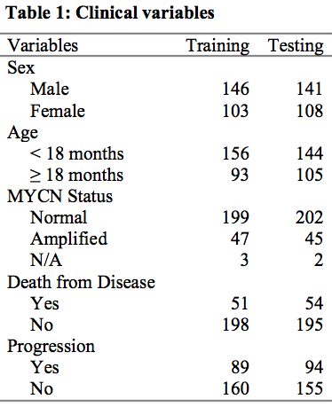
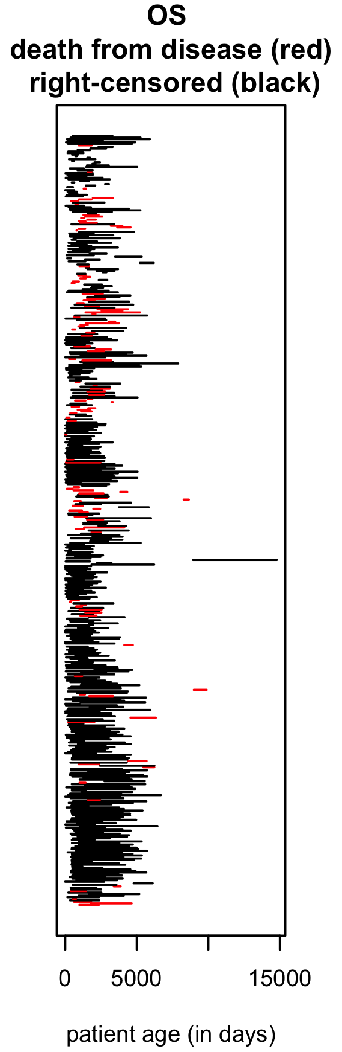
1. Background

Slide 9
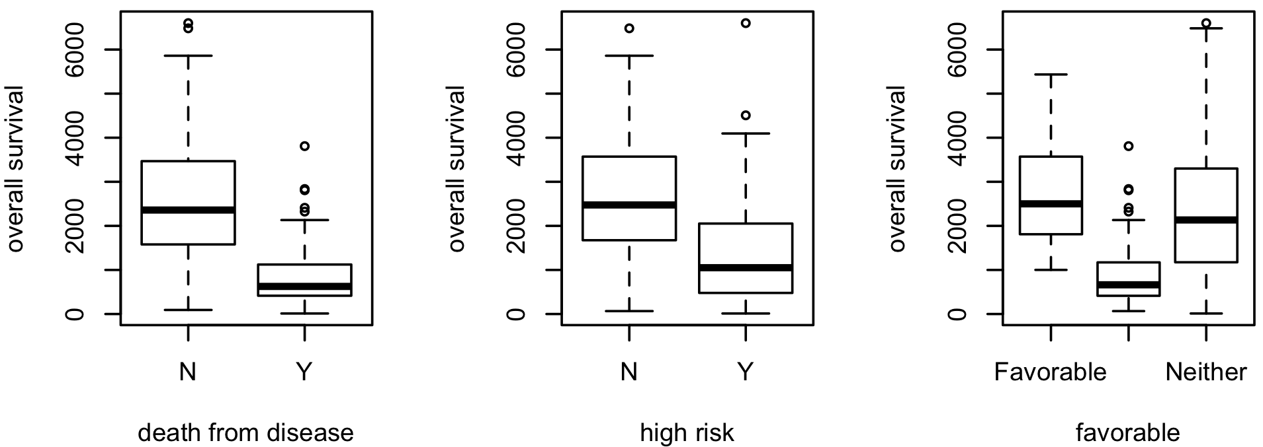
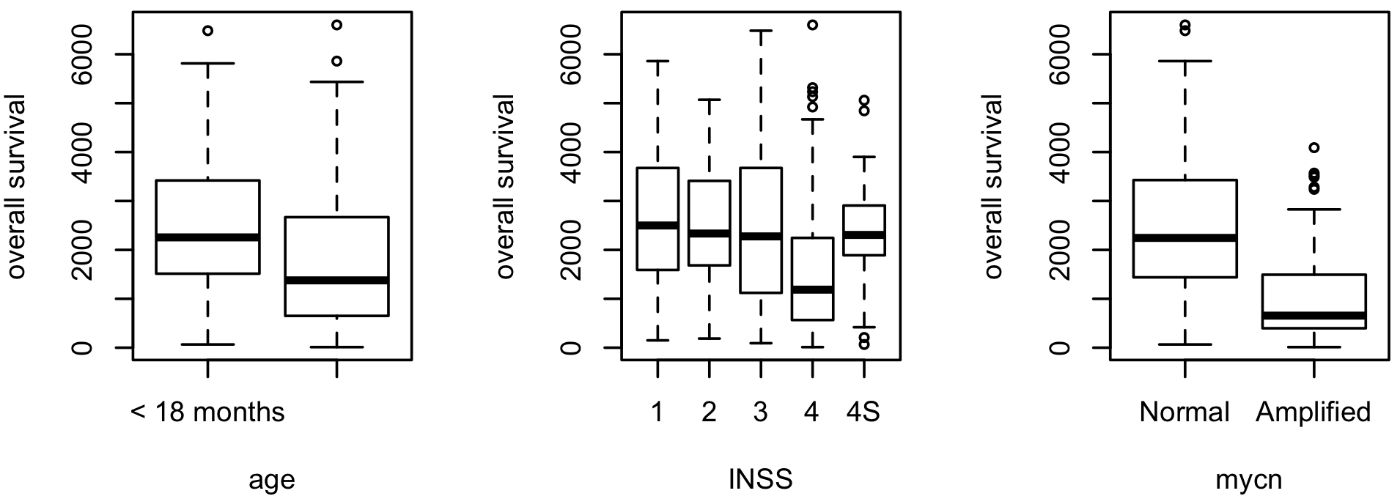
1. Background

Slide 10
Contents
Background
Accelerated Failure Time (AFT) Model
Imputation for Right Censoring
Dimension Reduction
- Regularization, Filtering Data
Bagging and Rank Aggregation
Results
- Prediction, Pathway Analysis, Prognosis
Conclusions

Slide 11
2. Accelerated Failure Time (AFT) Model
Training
n = 249
Testing
n = 249

Slide 12
2. Accelerated Failure Time (AFT) Model

Slide 13
2. Accelerated Failure Time (AFT) Model

Slide 14
Contents
Background
Accelerated Failure Time (AFT) Model
Imputation for Right Censoring
Dimension Reduction
- Regularization, Filtering Data
Bagging and Rank Aggregation
Results
- Prediction, Pathway Analysis, Prognosis
Conclusions

Slide 15
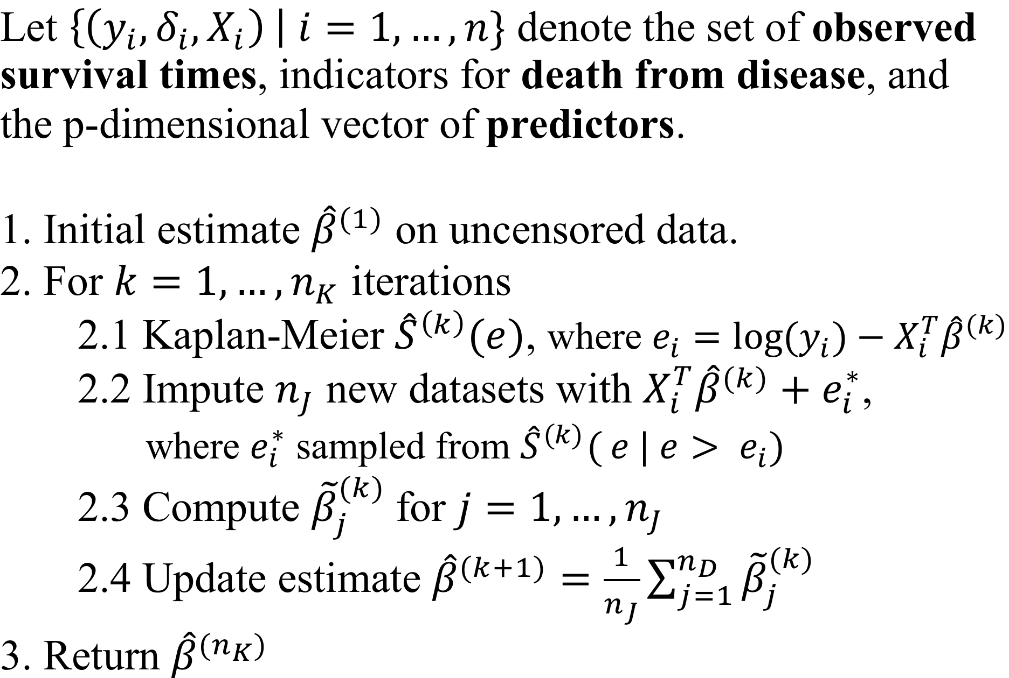
3. Imputation for Right Censoring
Mostajabi, F., Datta, S. and Datta, S., 2013. Predicting patient survival from proteomic profile using mass spectrometry data: an empirical study. Communications in Statistics-Simulation and Computation, 42(3), pp.485-498.

Slide 16
Contents
Background
Accelerated Failure Time (AFT) Model
Imputation for Right Censoring
Dimension Reduction
- Regularization, Filtering Data
Bagging and Rank Aggregation
Results
- Prediction, Pathway Analysis, Prognosis
Conclusions

Slide 17
4. Dimension Reduction

Slide 18
4. Dimension Reduction

Slide 19
4. Dimension Reduction
Genes
Transcripts
Introns

Slide 20
4. Dimension Reduction
Genes
Transcripts
Introns
28,239
217,392
340,270
Remove columns with > 80% zeroes

Slide 21
4. Dimension Reduction
Genes
Transcripts
Introns
28,239
217,392
340,270
Remove columns with > 80% zeroes
24,236
197,910
Filter by Gene Cards

Slide 22
4. Dimension Reduction
Genes
Transcripts
Introns
28,239
217,392
340,270
Remove columns with > 80% zeroes
24,236
197,910
Filter by Gene Cards
340,270
3,389
47,276
Order p-values from individual Cox PH

Slide 23
4. Dimension Reduction
Genes
Transcripts
Introns
28,239
217,392
340,270
Remove columns with > 80% zeroes
24,236
197,910
Filter by Gene Cards
340,270
3,389
47,276
Order p-values from individual Cox PH
2,000
2,000
2,000

Slide 24
4. Dimension Reduction
We consider 5 sets of predictors:
Clinical predictors only (Age, Sex, MYCN)
Genes
Transcripts
Introns
Transcripts + Introns

Slide 25
4. Dimension Reduction
We consider 5 sets of predictors:
Clinical predictors only (Age, Sex, MYCN)
Genes
Transcripts
Introns
Transcripts + Introns
For 21 total models
Plus 1 more….

Slide 26
Contents
Background
Accelerated Failure Time (AFT) Model
Imputation for Right Censoring
Dimension Reduction
- Regularization, Filtering Data
Bagging and Rank Aggregation
Results
- Prediction, Pathway Analysis, Prognosis
Conclusions

Slide 27
5. Bagging and Rank Aggregation
1. Fit several models
2. Compute performance measure(s) for each
3. Choose the overall best performing model
4. Repeat

Slide 28
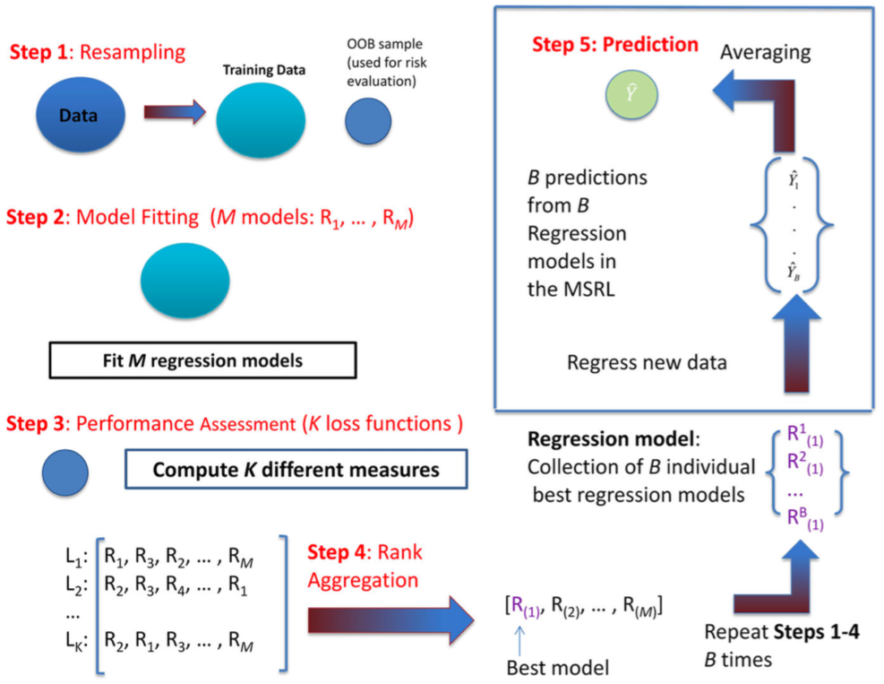
5. Bagging and Rank Aggregation
Bag Training
OOB Testing
Training
n = 249
Shah, J., Datta, S. and Datta, S., 2014. A multi-loss super regression learner (MSRL) with application to survival prediction using proteomics. Computational Statistics, 29(6), pp.1749-1767.
Notes:
Rank Aggregation (RankAggreg package in R). L_i is a point in M dimensional space.
Choose L which minimizes Phi(L) = sum( w_i d(L, L_i))
d(L, Li) is weighted Spearman footrule distance
(see Shah, Datta, & Datta. 2014)

Slide 29
5. Bagging and Rank Aggregation

Slide 30
Contents
Background
Accelerated Failure Time (AFT) Model
Imputation for Right Censoring
Dimension Reduction
- Regularization, Filtering Data
Bagging and Rank Aggregation
Results
- Prediction, Pathway Analysis, Prognosis
Conclusions

Slide 31
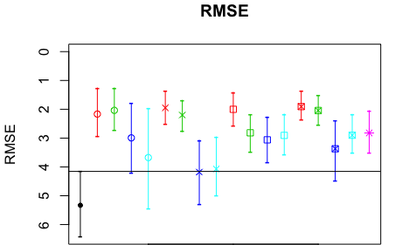
6. Results – Predicting Survival times

Slide 32
6. Results – Predicting Survival times
Genes

Slide 33
6. Results – Predicting Survival times
Transcripts

Slide 34
6. Results – Predicting Survival times
Introns

Slide 35
6. Results – Predicting Survival times
Transcripts
and Introns

Slide 36
6. Results – Predicting Survival times

Slide 37
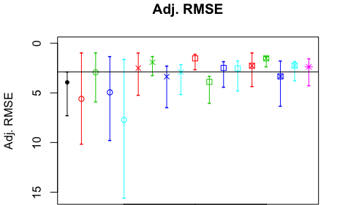
6. Results – Predicting Survival times

Slide 38
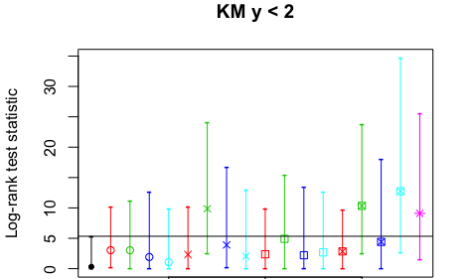
6. Results – Predicting Survival times

Slide 39
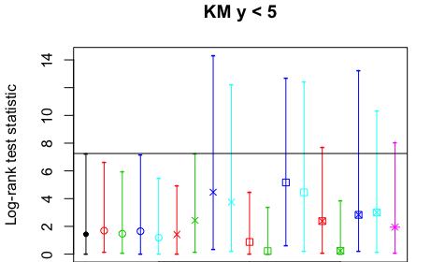
6. Results – Predicting Survival times

Slide 40
6. Results – Pathway Analysis
Genes with elnet
- 185 gene with non-zero coefficients
- Pathways (4): Ras, PI3k-Akt, TGF-β, cell cycle
Transcripts with elnet
- 404 transcripts with non-zero coefficients
- Pathways (5): Ras, PI3k-Akt, Jak-STAT, MAPK, cell cycle
Notes:
But pre-filtered with gene-cards, so is this still relevant? i.e. all genes relevant regardless.
Yes – just order pathways

Slide 41
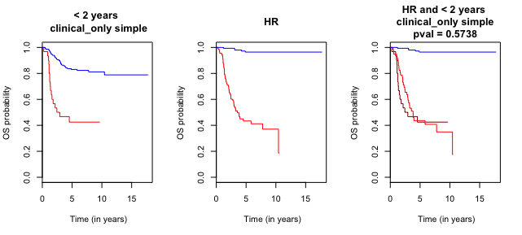
6. Results – High Risk Stratification
High Risk Group

Slide 42
6. Results – High Risk Stratification
Model Predicted Survival Time < 2 years
Age, Sex, MYCN status

Slide 43
6. Results – High Risk Stratification
Model + HR
Age, Sex, MYCN status

Slide 44
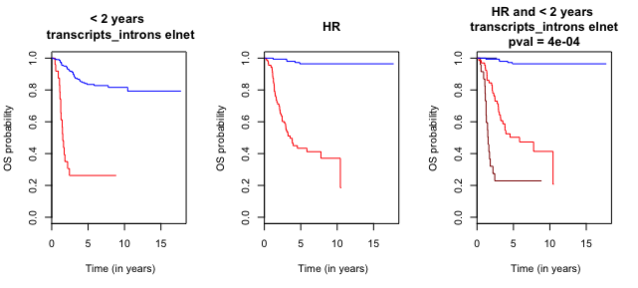
6. Results – High Risk Stratification

Slide 45
6. Results – High Risk Stratification
Transcripts and Introns

Slide 46
6. Results – High Risk Stratification
Transcripts and Introns

Slide 47
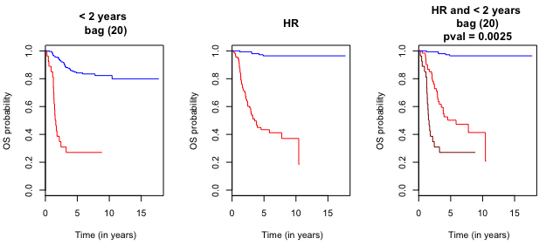
6. Results – High Risk Stratification
Bagging + Rank Aggregation

Slide 48
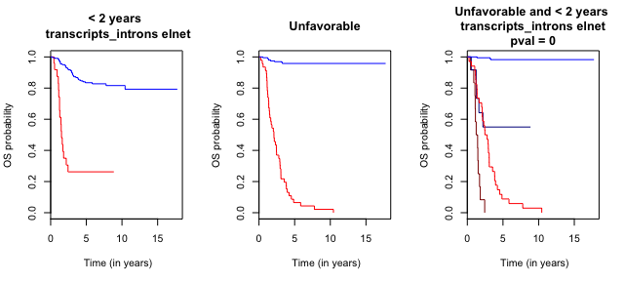
6. Results – High Risk Stratification

Slide 49
6. Results – High Risk Stratification
Transcripts and Introns

Slide 50
Contents
Background
Accelerated Failure Time (AFT) Model
Imputation for Right Censoring
Dimension Reduction
- Regularization, Filtering Data
Bagging and Rank Aggregation
Results
- Prediction, Pathway Analysis, Prognosis
Conclusions

Slide 51
7. Conclusions
1. Difficult to predict exact survival times
- High censoring rate
- Parametric model may improve performance

Slide 52
7. Conclusions
1. Difficult to predict exact survival times
- High censoring rate
- Parametric model may improve performance
2. Using AFT for stratification works well
- with Transcripts & Introns
- and can divide HR and Unfavorable

Slide 53
7. Conclusions
1. Difficult to predict exact survival times
- High censoring rate
- Parametric model may improve performance
2. Using AFT for stratification works well
- with Transcripts & Introns
- and can divide HR and Unfavorable
3. Bagging + Rank Aggregation is comparable to the best individual model.

Slide 54


Acknowledgements
Somnath Datta
Susmita Datta
Alejandro Walker
Funding provided by CAMDA Travel Fellowship (2017) and travel award from the Department of Biostatistics, University of Florida
Thank you!

Slide 55
References
Bosse, K.R. et al., 2016. Advances in the translational genomics of neuroblastoma: From improving risk stratification and revealing novel biology to identifying actionable genomic alterations. Cancer, 122(1), pp.20-33.
Formicola, D., et al., 2016. An 18 gene expression-based score classifier predicts the clinical outcome in stage 4 neuroblastoma. Journal of translational medicine, 14(1), p.142.
Tan, Q., et al., 2008. Gene selection for predicting survival outcomes of cancer patients in microarray studies. Advances in Computer and Information Sciences and Engineering, pp.405-409.
Su, Z., et al., 2014. An investigation of biomarkers derived from legacy microarray data for their utility in the RNA-seq era. Genome biology, 15(12), p.523.
Zhang, W., et al., 2015. Comparison of RNA-seq and microarray-based models for clinical endpoint prediction. Genome biology, 16(1), p.133.
Safran, M., et al., 2010. GeneCards Version 3: the human gene integrator. Database, 2010, p.baq020.
Boulesteix, A.L., et al., 2007. Partial least squares: a versatile tool for the analysis of high-dimensional genomic data. Briefings in bioinformatics, 8(1), pp.32-44.
Chun, H., et al.., 2010. Sparse partial least squares regression for simultaneous dimension reduction and variable selection. Journal of the Royal Statistical Society: Series B (Statistical Methodology), 72(1), pp.3-25.
Tibshirani, R., 1996. Regression shrinkage and selection via the lasso. Journal of the Royal Statistical Society. Series B (Mehodological), pp.267-288.
Friedman, J., et al., 2010. Regularization paths for generalized linear models via coordinate descent. Journal of statistical software, 33(1), p.1.
Zou, H. and Hastie, T., 2005. Regularization and variable selection via the elastic net. Journal of the Royal Statistical Society: Series B (Statistical Methodology), 67(2), pp.301-320.
Mostajabi F., et al., 2013. Predicting patient survival from proteomic profile using mass spectrometry data: an empirical study. Communications in Statistics-Simulation and Computation, 42(3), pp.485-498.
Vogelstein, B., et al., 2013. Cancer genome landscapes. science, 339(6127), pp.1546-1558.

