Slide 1

An exploratory approach for identifying novel biomarkers in subgroups of cancer patients from RNA-seq data
CAMDA: Cancer data integration challenge
Tyler Grimes and Somnath Datta
Department of Biostatistics, University of Florida

Slide 2
Contents
Datasets
Reactome Pathways
Association measure
Differential network analysis
Survival analysis with AFT
Overview
Results

Slide 3
Goal: find genes/pathways that have
functional differences between groups
clinical relevance

Slide 4
Goal: find genes/pathways that have
functional differences between groups
- Differences in association with other genes
from gene expression profile
clinical relevance
- Predictive ability in survival model

Slide 5
1. Datasets
Neuroblastoma dataset (n = 498)
RNA-seq of tumor samples
Overall survival times
Clinical covariates including age, INSS, HR
INSS stages: 1, 2, 3, 4, and 4S
Breast cancer dataset (n = 1906)
RNA-seq of tumor samples
Overall survival times
Clinical covariates and subtypes
Claudin: LumA (679), LumB (461), Her2 (220), …
IntClust: 1, 2, 3, 4ER+, 4ER-, 5, …, 10

Slide 6
2. Reactome pathways
1466 Pathways with between 10 and 100 genes
Only using gene sets from these pathways
Example pathway:
“TP53 Regulates Transcription of Genes Involved in G2 Cell Cycle Arrest”
18 Genes
PRMT1
GADD45A
EP300
RBL1
RBL2
TP53
SFN
BAX
…

Slide 7
3. Association measure

Slide 8
Neuroblastoma by INSS stages Association networks by partial correlations TP53 Regulates Transcription of Genes Involved in G2 Cell Cycle Arrest
1
2
3
4
4S

Slide 9
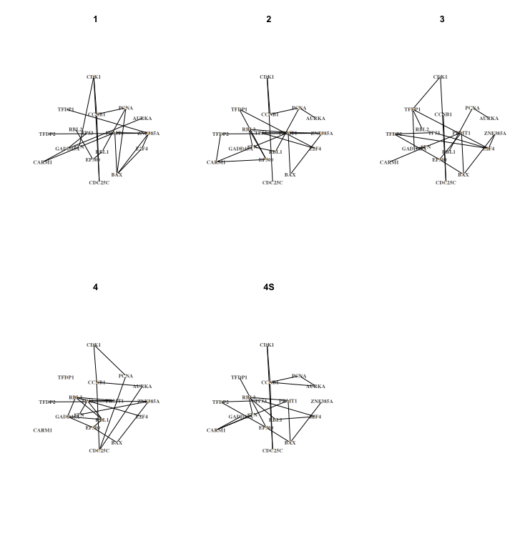
Neuroblastoma by INSS stages Association networks by partial correlations TP53 Regulates Transcription of Genes Involved in G2 Cell Cycle Arrest
1
2
3
4
4S

Slide 10
Neuroblastoma by INSS stages Association networks by partial correlations TP53 Regulates Transcription of Genes Involved in G2 Cell Cycle Arrest
1
2
3
4
4S

Slide 11
Neuroblastoma by INSS stages Association networks by partial correlations TP53 Regulates Transcription of Genes Involved in G2 Cell Cycle Arrest
1
2
3
4
4S

Slide 12
4. Differential network analysis
1
2

Slide 13
4. Differential network analysis

Slide 14
4. Differential network analysis

Slide 15
4. Differential network analysis

Slide 16
4. Differential network analysis

Slide 17
Neuroblastoma by INSS stages Association networks by partial correlations TP53 Regulates Transcription of Genes Involved in G2 Cell Cycle Arrest
1
2
3
4
4S

Slide 18
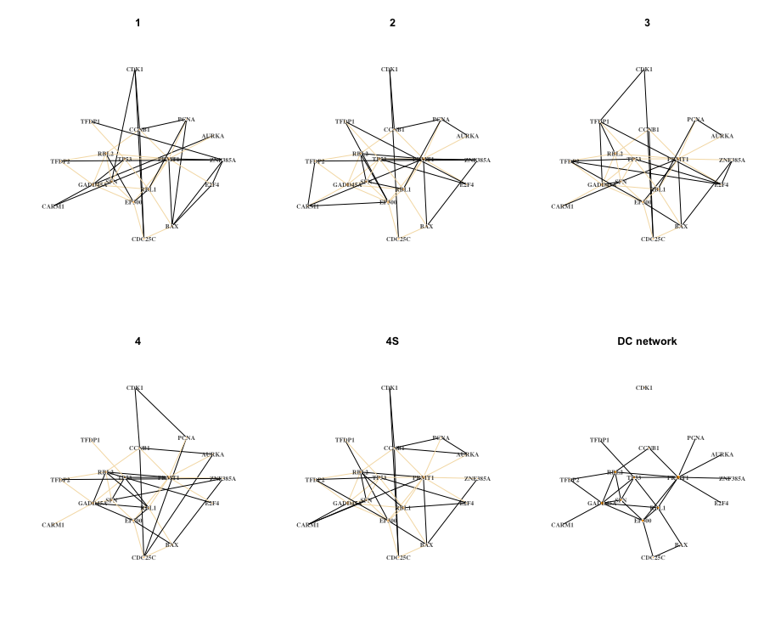
Neuroblastoma by INSS stages Association networks by partial correlations TP53 Regulates Transcription of Genes Involved in G2 Cell Cycle Arrest
1
2
3
4
4S
DC network

Slide 19
Neuroblastoma by INSS stages DC Network TP53 Regulates Transcription of Genes Involved in G2 Cell Cycle Arrest

Slide 20
Neuroblastoma by INSS stages DC Network TP53 Regulates Transcription of Genes Involved in G2 Cell Cycle Arrest
V*, E*

Slide 21
5. Survival analysis with AFT

Slide 22
5. Survival analysis with AFT
How good is the fit?
Likelihood
MSE
C-index
Are interaction terms significant?
Likelihood ratio test
AIC
BIC

Slide 23
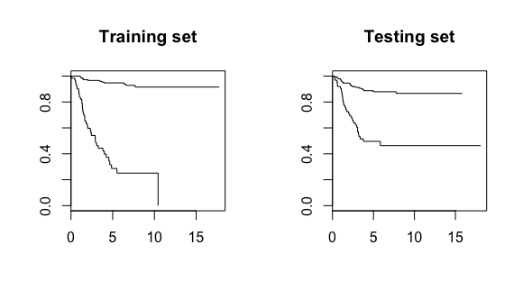
Neuroblastoma DC Network Thresholding predicted times TP53 Regulates Transcription of Genes Involved in G2 Cell Cycle Arrest

Slide 24
6. Heuristic
Goal: find perturbed genes/pathways with functional and clinical relevance
For each pathway
Estimate individual networks
From these, estimate the differential network
Fit the AFT model
Log-rank test using thresholded predicted times
Sort pathways based results

Slide 25
6. Heuristic
Goal: find perturbed genes/pathways with functional and clinical relevance
For each pathway
Estimate individual networks
From these, estimate the differential network
Fit the AFT model
Log-rank test using thresholded predicted times
Sort pathways based on …

Slide 26
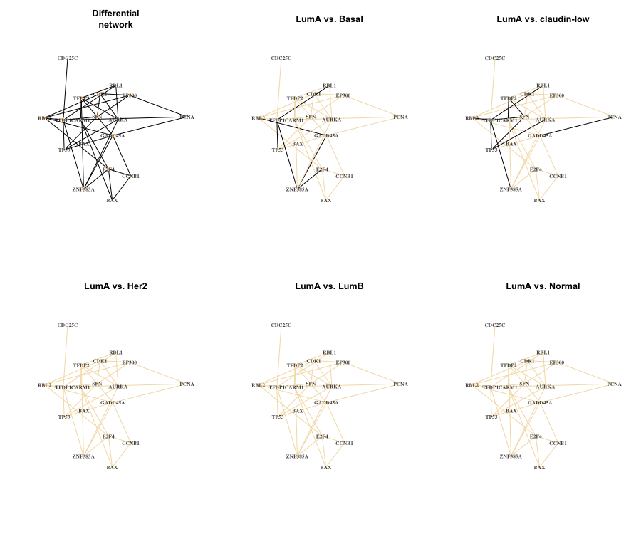
Breast cancer by Claudin subtypes DC Network TP53 Regulates Transcription of Genes Involved in G2 Cell Cycle Arrest
DC network
LumA vs. Basal
LumA vs. Claudin-low
LumA vs. Her2
LumA vs. LumB
LumA vs. Normal

Slide 27
Breast cancer by Claudin subtypes DC Network TP53 Regulates Transcription of Genes Involved in G2 Cell Cycle Arrest
DC network
LumA vs. Basal
LumA vs. Claudin-low
LumA vs. Her2
LumA vs. LumB
LumA vs. Normal

Slide 28
Breast cancer by Claudin subtypes DC Network TP53 Regulates Transcription of Genes Involved in G2 Cell Cycle Arrest
DC network
LumA vs. Basal
LumA vs. Claudin-low
LumA vs. Her2
LumA vs. LumB
LumA vs. Normal

Slide 29
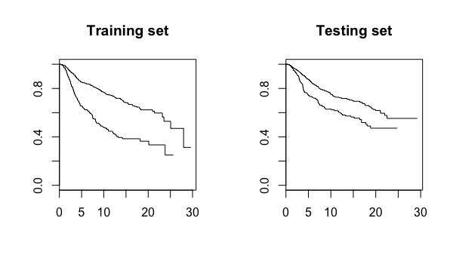
Breast cancer by Claudin subtypes Thresholding predicted times TP53 Regulates Transcription of Genes Involved in G2 Cell Cycle Arrest

Slide 30
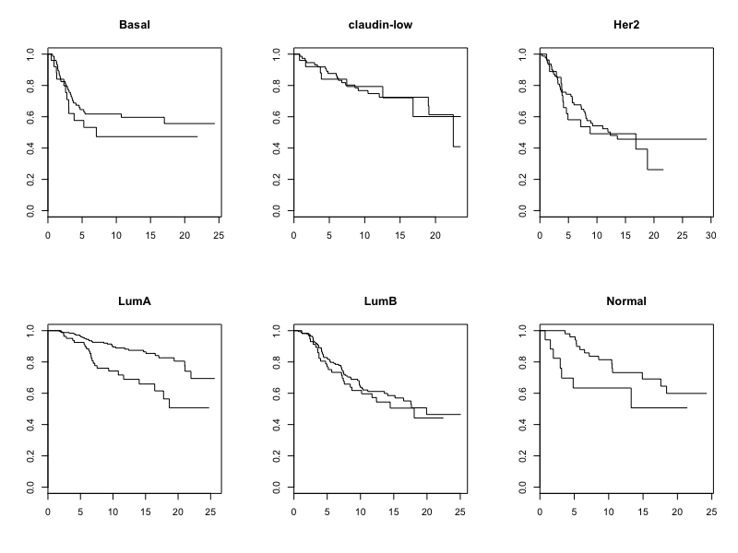
Breast cancer by Claudin subtypes Thresholding predicted times TP53 Regulates Transcription of Genes Involved in G2 Cell Cycle Arrest

Slide 31
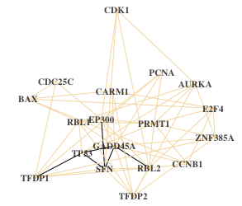
Neuroblastoma and Breast cancer
Overlap of DC network
TP53 Regulates Transcription of Genes Involved in G2 Cell Cycle Arrest
DC genes
GADD45A (3)
SFN (3)
TP53 (3)
EP300 (1)
RBL2 (1)
TFDP1 (1)

Slide 32
Neuroblastoma and Breast cancer
Overlap of DC network
TP53 Regulates Transcription of Genes Involved in G2 Cell Cycle Arrest
DC genes
GADD45A (3)
SFN (3)
TP53 (3)
EP300 (1)
RBL2 (1)
TFDP1 (1)
Engeland, K., 2018. Cell cycle arrest through indirect transcriptional repression by p53: I have a DREAM. Cell death and differentiation, 25(1), p.114.

Slide 33

Thank you!
Questions?
Tyler Grimes and Somnath Datta
Department of Biostatistics, University of Florida

Slide 34
References
Bosse, K.R. et al., 2016. Advances in the translational genomics of neuroblastoma: From improving risk stratification and revealing novel biology to identifying actionable genomic alterations. Cancer, 122(1), pp.20-33.
Formicola, D., et al., 2016. An 18 gene expression-based score classifier predicts the clinical outcome in stage 4 neuroblastoma. Journal of translational medicine, 14(1), p.142.
Tan, Q., et al., 2008. Gene selection for predicting survival outcomes of cancer patients in microarray studies. Advances in Computer and Information Sciences and Engineering, pp.405-409.
Su, Z., et al., 2014. An investigation of biomarkers derived from legacy microarray data for their utility in the RNA-seq era. Genome biology, 15(12), p.523.
Zhang, W., et al., 2015. Comparison of RNA-seq and microarray-based models for clinical endpoint prediction. Genome biology, 16(1), p.133.
Safran, M., et al., 2010. GeneCards Version 3: the human gene integrator. Database, 2010, p.baq020.
Boulesteix, A.L., et al., 2007. Partial least squares: a versatile tool for the analysis of high-dimensional genomic data. Briefings in bioinformatics, 8(1), pp.32-44.
Chun, H., et al.., 2010. Sparse partial least squares regression for simultaneous dimension reduction and variable selection. Journal of the Royal Statistical Society: Series B (Statistical Methodology), 72(1), pp.3-25.
Tibshirani, R., 1996. Regression shrinkage and selection via the lasso. Journal of the Royal Statistical Society. Series B (Mehodological), pp.267-288.
Friedman, J., et al., 2010. Regularization paths for generalized linear models via coordinate descent. Journal of statistical software, 33(1), p.1.
Zou, H. and Hastie, T., 2005. Regularization and variable selection via the elastic net. Journal of the Royal Statistical Society: Series B (Statistical Methodology), 67(2), pp.301-320.
Mostajabi F., et al., 2013. Predicting patient survival from proteomic profile using mass spectrometry data: an empirical study. Communications in Statistics-Simulation and Computation, 42(3), pp.485-498.
Vogelstein, B., et al., 2013. Cancer genome landscapes. science, 339(6127), pp.1546-1558.

