Slide 1


King Coder
A Journey To Discover the Most Influential Programmer on Github

Slide 2




Data From Github Repos:
scikit-learn
pandas
django
tensorflow
keras
tidyverse
ggplot2
linux
ipython
node
spark
Using GraphQL a data query language for APIs to extract data in .json format.

Slide 3
Main Area of Interest is Github Commits.
One Record of Data Contained:
Commit Date
Commit Author
Commit Title / Header
Commit Message / Description
Comments Made on Commit
Comment Author
Date of Comment
Reactions / Emojis on Commit
Reaction Author
Date of Reaction
….Shout out to Douglas Crockford Creator of .json format
For each Repo 100 Commits and all corresponding bits of info relating to Commit was Collected.
Ranging between date-X and date-Y

Slide 4
Quick & Dirty Repo Exploration
To Help Explain A Few Things
Number of unique contributors for each Repo
scikit-learn: 48
linux: 26
ipython: 16
node: 49
django: 32
tensorflow: 46
tidyverse: 10
ggplot2: 31
keras: 21
spark: 46
pandas: 38
Programmers who contribute to more than one repo
minho42: [ipython, django]
hadley: [tidyverse, ggplot2]
batpigandme: [tidyverse, ggplot2]
karawoo: [tidyverse, ggplot2]
topepo: [tidyverse, ggplot2]
Top two contributors to each Repo
scikit-learn: [NicolasHug: 12, thomasjpfan: 9]
linux: [AlexGhiti: 14, liu-song-6: 13]
ipython: [Carreau: 77, terrdavis: 6]
node: [addaleax: 18, ronag: 12]
django: [felixxm: 30, carltongibson: 11]
tensorflow: [tensorflower-gardener: 28, bmzhao, 7]
tidyverse: [hadley: 27, batpigandme: 22]
ggplot2: [paleolimbot: 29, thomasp85, 23]
keras: [fchollet: 67, pavithrasv, 11]
spark: [dongjoon-hyun: 11, HeartSaVioR, 8]
pandas: [jbrockmendel: 36, jorisvandenbossche: 6]

Slide 5
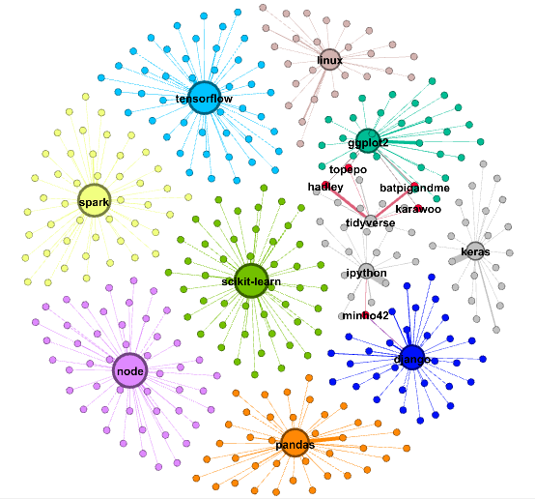
Characteristics:
Not Connected
Bipartite Network
Distinct Repo Communities
Few Bridge Nodes
Things to note:
Red nodes act as bridge between two networks. These are people who contributed to more than one repo.
Nodes with thick edges have higher contribution rate.

Slide 6

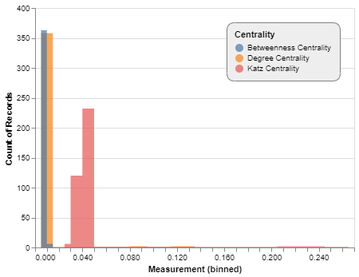
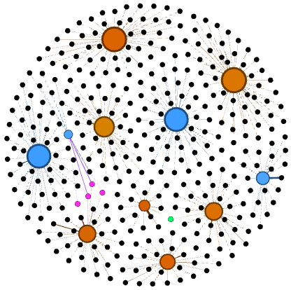
Betweenness Centrality
Histogram of different Centrality Measures for Github Network

Slide 7


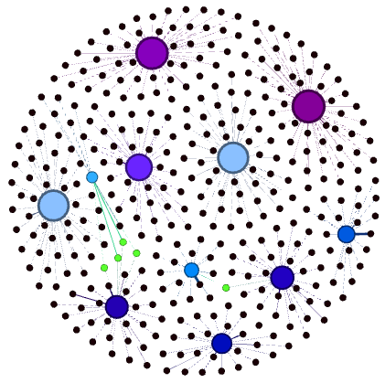
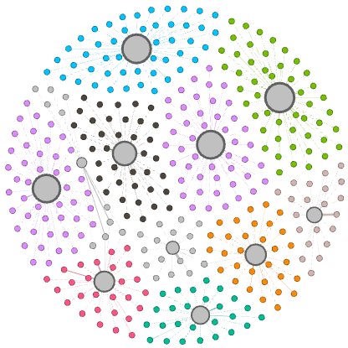
Degree Centrality
Katz Centrality

Slide 8
TOPIC & SENTIMENT ANALYSIS

Slide 9
ANYTHING ELSE

Slide 10
SUMMARY

