Slide 1

Stefan Candea, network guide
[ RCIJ / Scoop / ICIJ / Occrp / The Sponge / The Black Sea / Nieman /
PhD research ]

Slide 2
About EIC
Our primary purpose is the joint reporting and publication of investigative journalism with a focus on European topics to understand how power structures affect European communities.
We partner on in-depth reporting at source.
Notes:
Define "at source” as boots on the ground, local expertise.

Slide 3

About EIC
Notes:
+ Dagens Nyheter, Malta Today, The Intercept, ANCIR

Slide 4

Reveals murky financial transactions in the world of European professional football and exposes the tax tricks employed by some of the Continent's biggest stars.
The data includes 1.9 Terabytes of information and a total of 18.6 million documents including original contracts with secret subsidiary agreements, emails, Word documents, Excel spreadsheets, WhatsApp messages and photos. The data set extends into the year 2016.
Over 60 journalists in 12 countries worked for over seven months to reveal corruption among top officials, clubs, agents and players.
Notes:
-add a slide with clips from the actual
-show other projects (as screenshots of websites)

Slide 5
How we work
PRE-PROJECT Legacy Networking Tools stack ready from past projects
PRE-PUBLICATION (or pre-production) Refining the Idea, Network, Tools Idea and Network Workflow and Tools Drafting Stories
PUBLICATION (or production) Confrontation, Legal issues, Embargoes and publication dates
INVESTIGATIVE PLATFORM Socio-tech in cross-border IJ

Slide 6
1· Pre-project
Legacy Networking
12 media and between 40 to 100 journalists reporting in +13 languages,
including info-designers and a dozen technologists
Tools stack ready from past projects
Hoover (https://hoover.crji.org/ + https://github.com/hoover/): index & Search:
Pads in Intertwinkles (https://intertwinkles.org/): Communication

Slide 7
2 · Pre-publication
Refining the Idea, Network, Tools / Idea and Network
Workflow
Search and post findings
Alert others in dedicated rooms,
Create wikis
Meet once a week online + every 3 months face-to-face
Closer to publication:
Share bullet points in English + drafts in local language

Slide 8
2 · Software tools
Platforms
Hoover (https://hoover.crji.org/) : platform that runs search engine
Sandstorm (https://sandstorm.io/): platform that runs the communication apps
Apps
Rocket (https://rocket.chat/): daily communication (similar to Slack)
Etherpad (http://etherpad.org/): collaborative editing, meeting notes
Davros (https://github.com/mnutt/davros): file sharing
Wekan (https://wekan.io/): project management
Gitlab (https://about.gitlab.com/): filing “findings” [aka issues]
Dokuwiki (https://www.dokuwiki.org/dokuwiki): knowledge base
Bridge: https://hypothes.is/

Slide 9
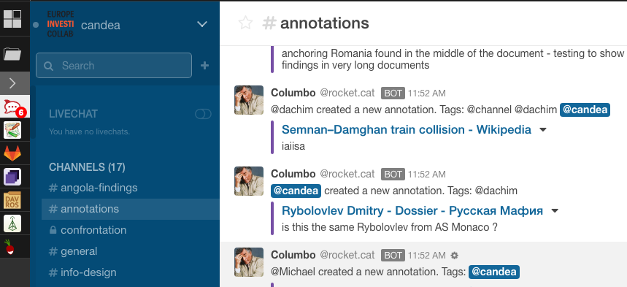
Experimenting with Hypothes.is
Engage directly on source documents
Marking findings, translation or other context directly on the search platform
Bridging between platforms
Columbo (https://github.com/hoover/hypothesis-misc): A bot feeding a dedicated chat channel with latest annotations on the search platform

Slide 10
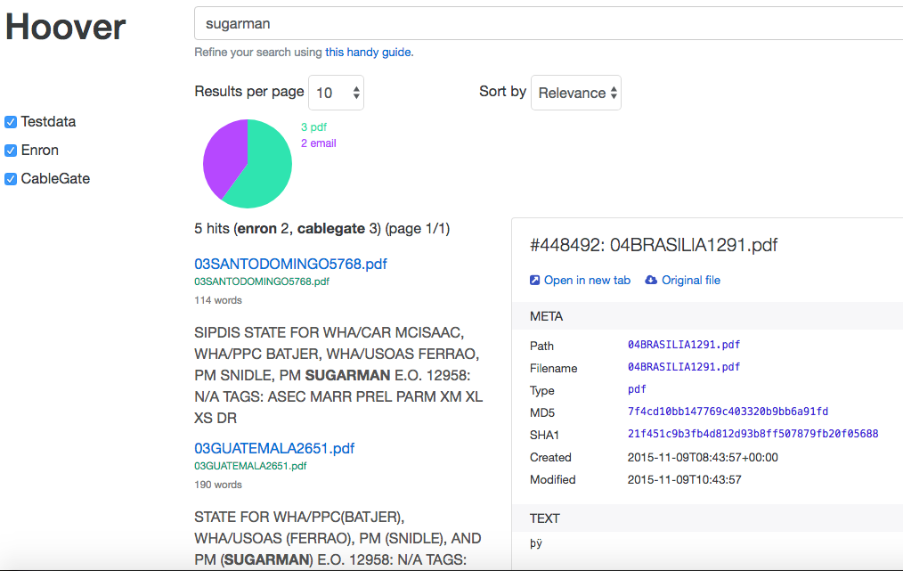
Experimenting with Hypothes.is
Automating investigative tasks
Browser extension to automatically feed Timeline, Footnotes to wiki pages;
to open new investigative pages;
to target search further
Developed by Jon Udell based on our feedback

Slide 11
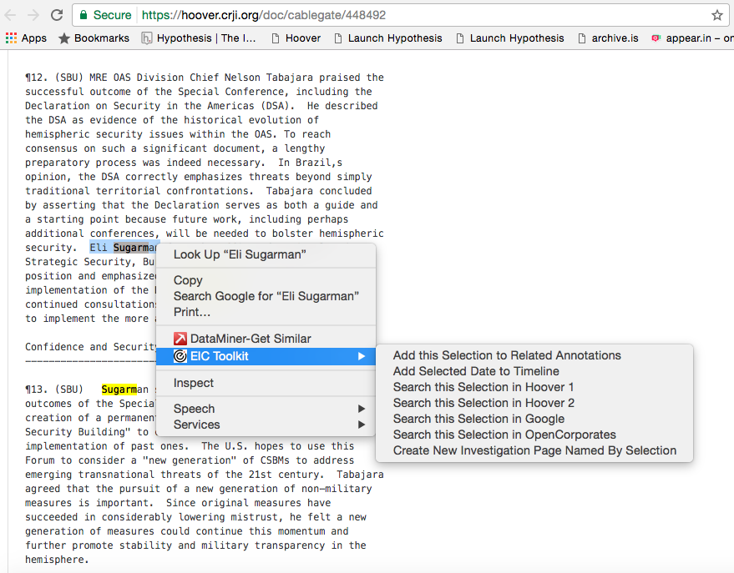
Experimenting with Hypothes.is

Slide 12
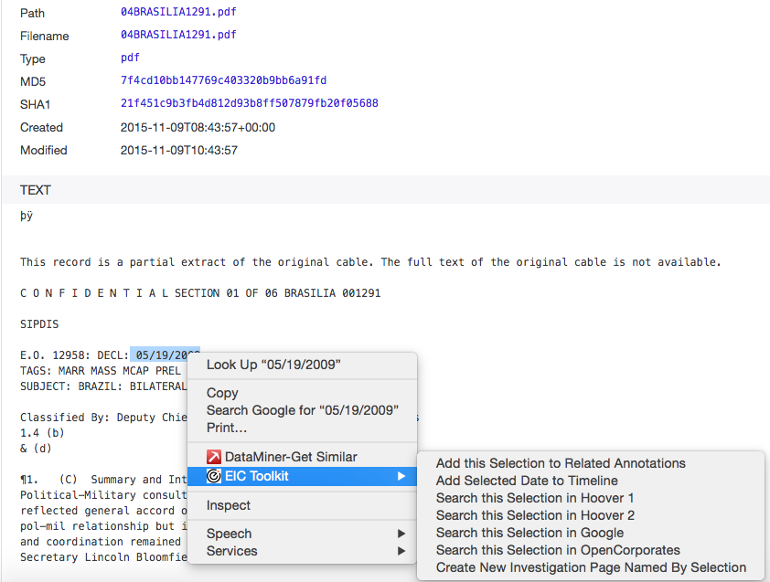
Experimenting with Hypothes.is

Slide 13
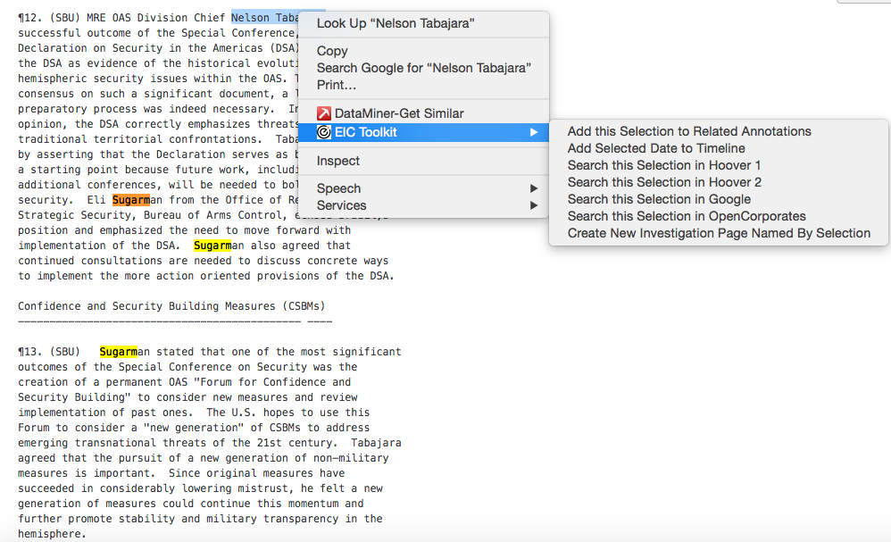
Experimenting with Hypothes.is

Slide 14
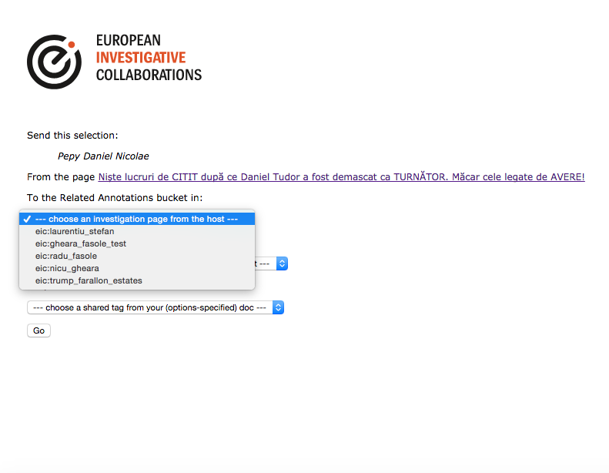
Experimenting with Hypothes.is
Automating investigative tasks
Browser extension to automatically feed Timeline, Footnotes to wiki pages;
to open new investigative pages;
to target search further

Slide 15

Liquid Investigations
Liquid Investigations:
Search & Annotations in a (ARM) Box
https://youtu.be/K7-LhBAyxzw
implementation and video by RCIJ, co-founding partner of EIC.network (Alex Morega and Gabriel Vijiala)
Project funded by Google Innovation Fund - Digital News Initiative

Slide 16
Goal
Build and implement an open toolkit to facilitate collaborative investigations
between journalists, activists, NGO’s - for a variety of use cases.
Empower journalists and other investigators to collaborate more fluidly and securely on public and private documents and spaces in order to increase the potential of journalism to serve its citizenry.

Slide 17
Liquid Investigations
Romanian Center for Investigative Journalism | Crji.org
Stichting Hypothes.is– digital annotations technology
EIC.network
Journalismfund.eu – promoting in-depth and cross-border research for investigative journalists
Investigative journalists and security specialists: Sebastian Mondial, Michael Kröemmer and Pit Schultz
European Research Area Chair: Christopher Csikszentmihályi

Slide 18
Liquid Investigations
Right now, journalists don’t have effective tools to collaborate. Too often systems are proprietary and siloed from each other.
Creating a powerful open source set of tools can dramatically increase the potential of journalists and others to work more easily together, in a secure environment.
A ‘Liquid investigations’ software bundle with the following functionalities:
Search [Hoover] // Annotations [Hypothes.is] // Chat // Wiki // Pads // File sharing

Slide 19
Liquid Investigations
We are currently evaluating multiple federation technologies for both approaches
Our Holy Grail is to find a decentralized way for boxes to discover and talk to each-other, and synchronize data between them.

Slide 20
3 · Publication
Confronting investigated entities
Different practices create conflict
Including internships
Legal issues
National and across jurisdictions injunctions.
Embargoes and publication dates
Conflict of interests create clash within network

Slide 21
4 · Investigative platform
Socio-tech in cross-border IJ
Starbucks model – one central model fits all
Silicon Valley Platform: control the tools (Google) & interactions (capture users and sell them to others - Airbnb, Uber, FB)
Gig economy: hundreds of unpaid journalists working a year long vs. NGO management level 100k – 500k salary

Slide 22
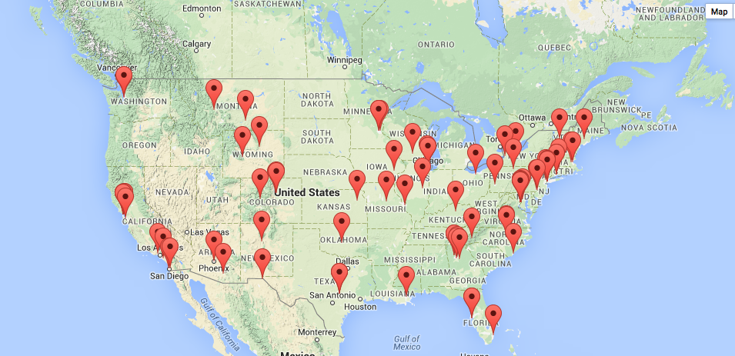
4 · Investigative platform
Fortune 1000 architecture is 10 times less clustered (American corporate elite, 1982–2001)
USA: 100 organizations with 1.000+ Board of Directors;
one person part of 15 Boards, in direct contact with over 150 Board Members;
less then 20% of Board Members have more then 80% of connections;
keeping the Network together, resistant to change and fragile to attacks.

Slide 23
4 · Investigative platform
Socio-tech in cross-border IJ
Growing network, who owns the enriched data, who has access ?
What type of data is gathered and analyzed in the collaborative process ?
What are the responsibilities and obligations for journos and platform owners ?
Centralization versus distributed journalism, or both
Different threats scenarios, maintenance, updates, further dev, consequence

Slide 24
Directions
Decentralized, distributed, working with existing credible initiatives (Journalism Fund / Data Harvest, Academia, Awards)
Break the tools dependency (from US)
Break the institutional and organizational dependency
Test presence at hyper local level (Hacker Village) in conjunction with regional, national and European – boots on the ground & established amplifiers
Invest in people (fellowships, grants)

Slide 25
4 · Investigative platform
More about EIC Projects: https://eic.network/projects/
More about European Investigative Collaborations: https://eic.network/blog/making-a-network
Stefan Candea, candea@eic.network, +40740309073
@EICnetwork

