Slide 1



Modernization of AIX MALLOC DEBUG TOOL
Sowmya Gangishetty
Suman Yadav
Syed Afser
Venkateshwar Yerravalli

Slide 2
Why Modernization?
Unavailability of Purify on AIX
High cost involved in licensing; product sold to unicom
known users of Purify – HACMP, RSCT, VIOS teams
Valgrind not supported on AIX
Only memory debugger available on AIX is malloc debug tool
Its only supported on Linux platforms
This makes the customer/developer rely on MALLOC DEBUG tool

Slide 3
What is covered in hackathon
1. Study of the other memory debugger tools
2. Comparison between PURIFY vs valgrind vs MALLOC DEBUG
3. Extending the ‘functionset’ feature of MALLOC DEBUG to report allocations
4. Implementation of get_malloc_log_live() routine
5. Fixing known issues with ‘validate_ptrs’ feature of MALLOC DEBUG

Slide 4
Memory DEBUGGER tools
Memory RELATED issues like leaks/buffer overflows are the common in the programming world.
Efficient MEMORY debugger helps the developer to find them and fix
them in the early stages of software engineering cycle.
Popular memory debugger tools in unix/linux area like purify, valgrind
are taken for study in this hackathon.

Slide 5
Purify vs valgrind vs malloc debug
1. A detailed study of the above tools is to understand why other tools are more efficient and what is missing in MALLOC DEBUG
2. Comparison chart is made and uploaded in the box folder:
https://ibm.ent.box.com/folder/126815227431

Slide 6
‘Functionset’ Feature
1. For larger applications, ‘functionset’ feature of MALLOC DEBUG tool helps the developer to debug the portion of the program.
Ex: If user wants to fix the memory issues related to his own code, rather the libraries used, He can use this option to specify the interested functions list for the malloc debug tool to track only issues related to those functions.
2. Currently this feature in AIX is only implemented for memory buffer overflows. But it doesn’t work for the memory leaks.
Ex. If user wants to understand the leaks in his own implemented functions, current implementation doesn’t support it.
3. With this hackathon, functionset feature is extended to memory leaks.

Slide 7
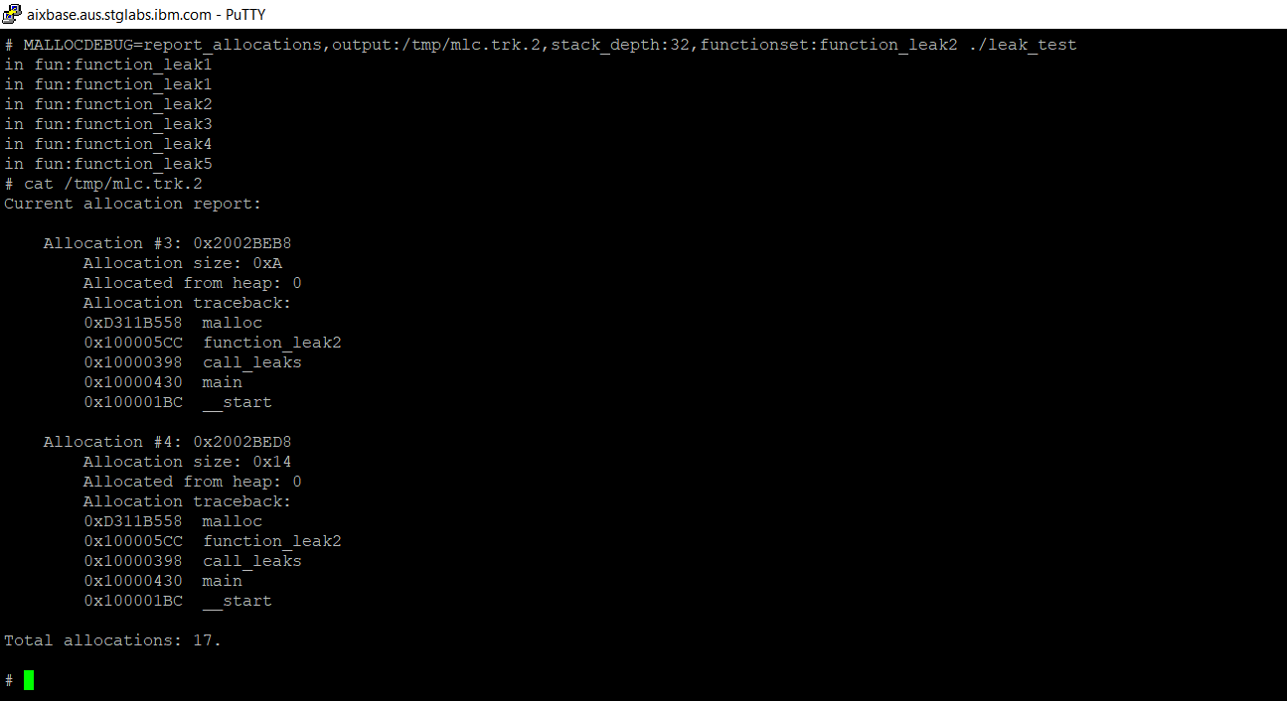
‘Results of functionset for memory leaks
Note: Leaks are reported only in selected functions, though application has more memory leaks

Slide 8
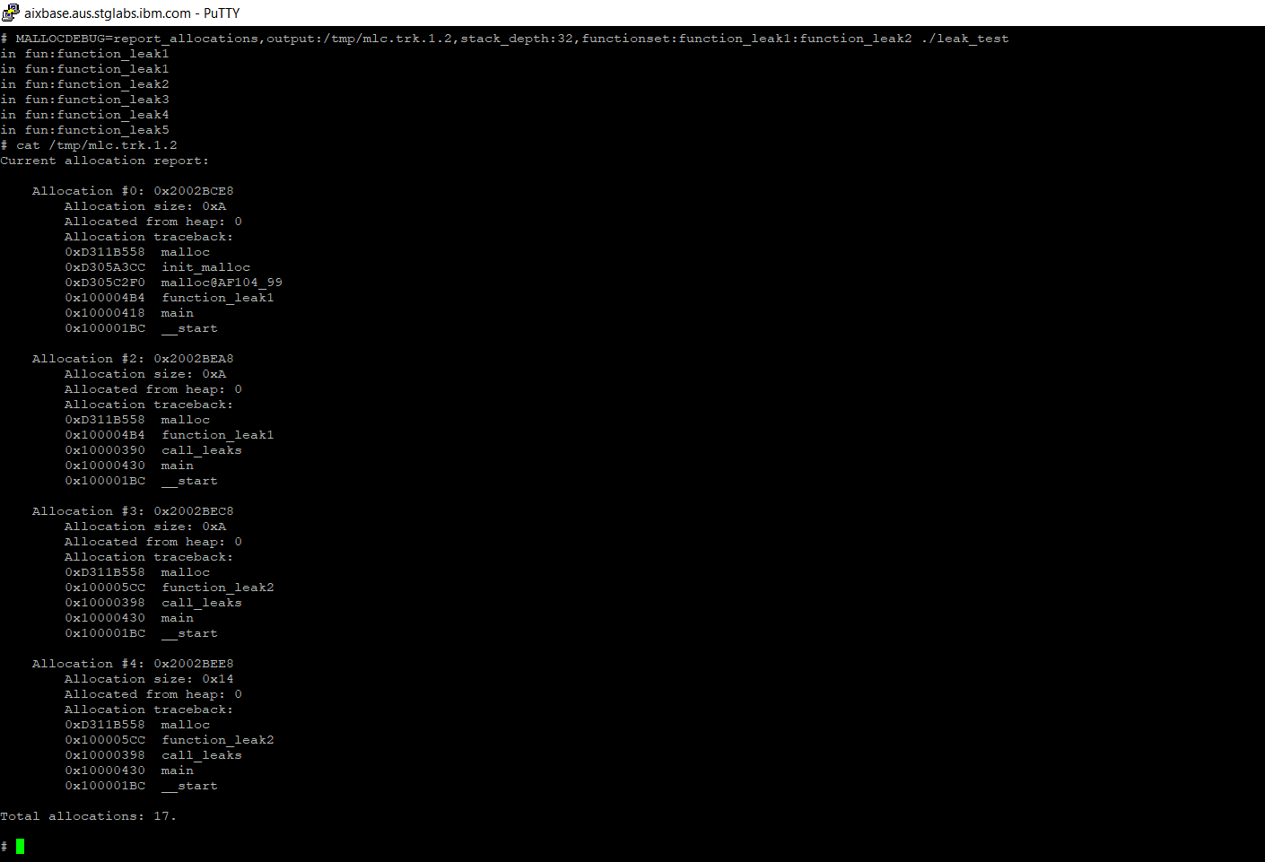
‘Contd..
Note: Leaks are reported only in selected functions, though application has more memory leaks

Slide 9
‘get_malloc_log_live’
1. This API is to provide the current active allocations made by the application. This api is documented in the knowledge centre(KC) but was never implemented in AIX.
https://www.ibm.com/support/knowledgecenter/en/ssw_aix_72/g_bostechref/get_malloc_log_live.html
2. With this hackathon, we have implemented this api as per the documentation.
3. This helps the user to understand how the memory usage is at a specific point of time or to figure out
unexpected heap growths or to understand the heap patterns.

Slide 10
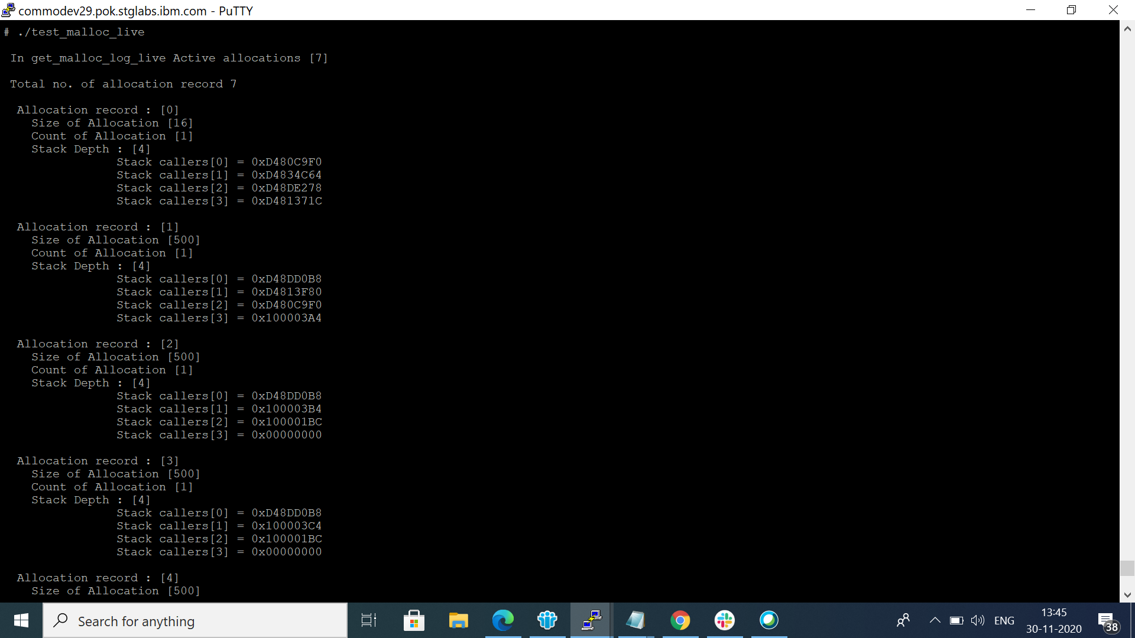
‘Results of get_malloc_LOG_live
Note: User gets a array of allocation records.

Slide 11
‘Validate_PTRs’
‘validate_ptrs’ is an existing option of malloc debug tool which is used to figure out If any invalid pointers are passed to free, realloc calls.
But it doesn’t work as expected as there were known bugs, like it doesn’t cover all scenarios of Corruption like prefix, heap no for reallocs.
With this hackathon those known bugs were fixed. And now it detects any invalid pointers passed to realloc/free calls

Slide 12
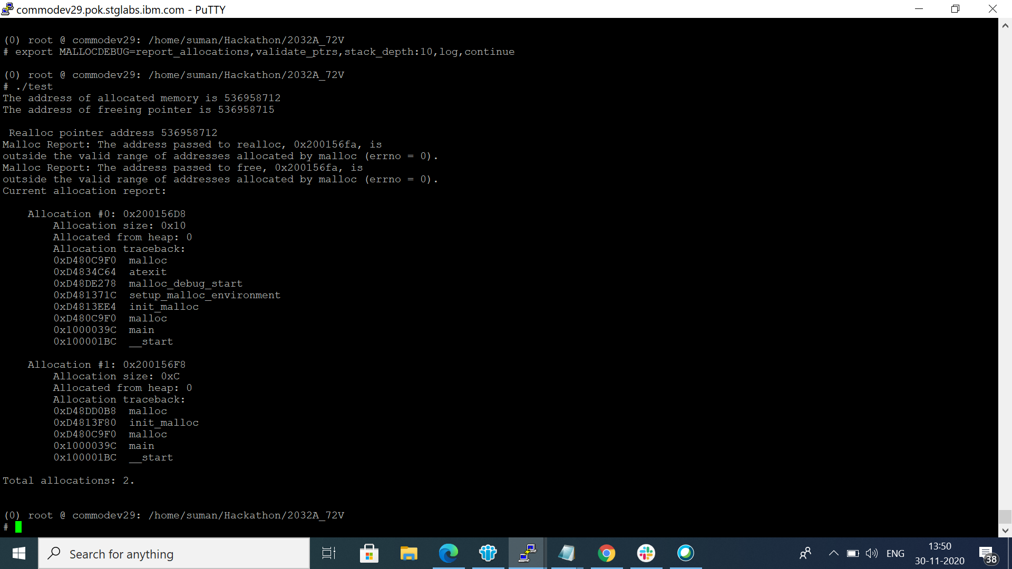
‘Results of validate_ptrs
Note: Prints information about invalid pointers.

Slide 13
Recommendations for MALLOC DEBUG
Based on the hackathon study, we suggest the implementation of the below features as a future LI/ENHANCEMENT to malloc debug which helps the customer in absence of purify tool
1. Detecting the unintialized memory access/Reads. This option is provided by purify and valgring tools. And this is important because we have gone through CMVC defects opened based on the purify testing, and found good no.of defects defects on UMRS in HACMP/RSCT testing.
2. Line no. information and file name information has to be provided with the memory leaks which helps the user to easily figure out the leak with larger applications. This is not supported by current malloc debug tool

Slide 14
Refernces
https://www.ibm.com/support/knowledgecenter/ssw_aix_71/generalprogramming/debug_malloc.html
https://valgrind.org/docs/manual/mc-manual.html#mc-manual.overview
Purify User GUIDE

