Slide 1
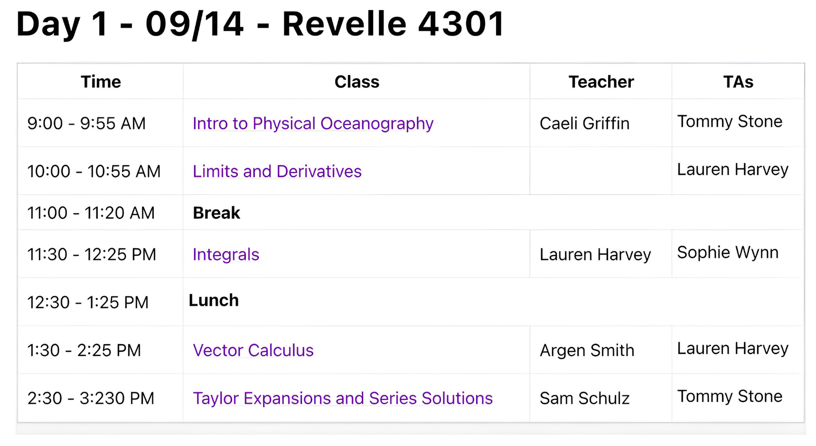
Welcome!

Slide 2
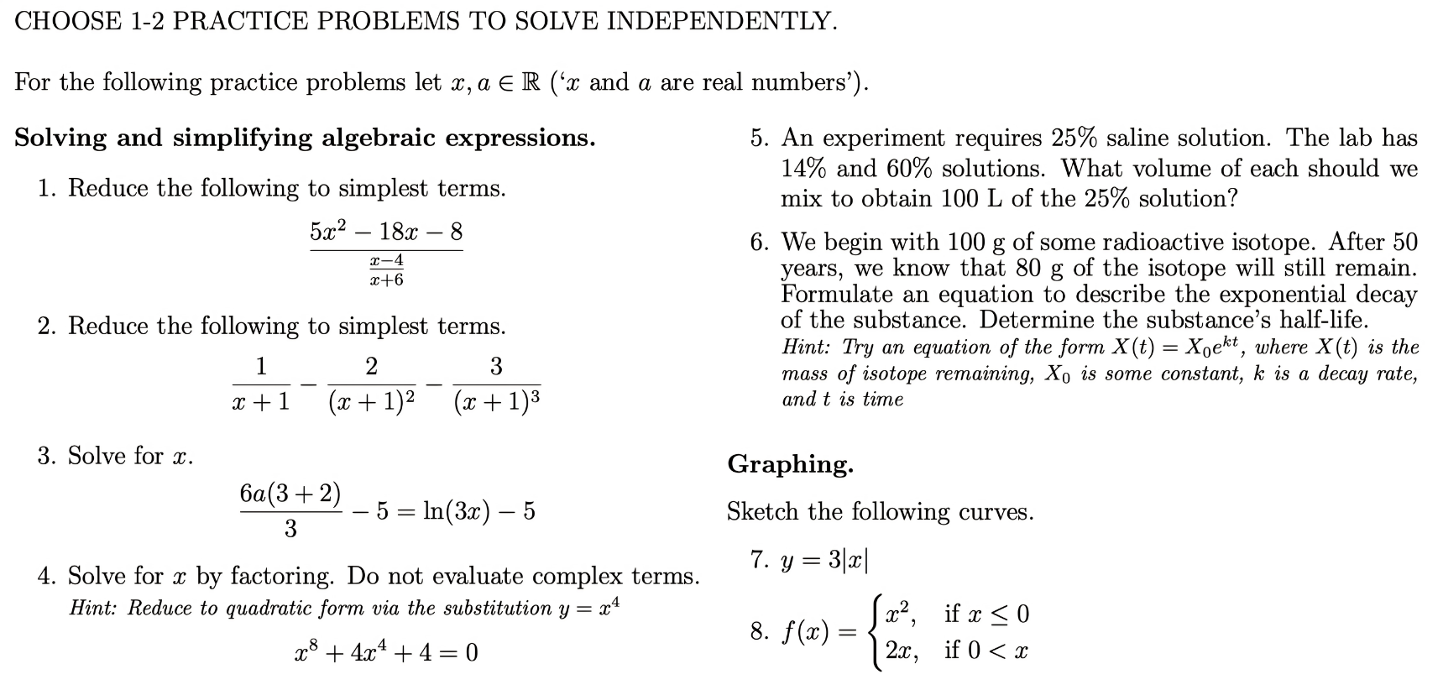

Algebra Warm-Up
Partial solutions:

Slide 3
In groups of 2-3, brainstorm a 60 second science elevator pitch. You could describe the research you’re planning to do, previous work, or anything else ‘science-y’.
But! You have to pretend like you’re explaining to a group of first graders…

Slide 4






Slide 5
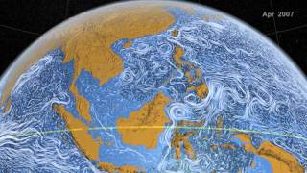
What’s Physical Oceanography?
https://www.youtube.com/watch?v=CCmTY0PKGDs

Slide 6
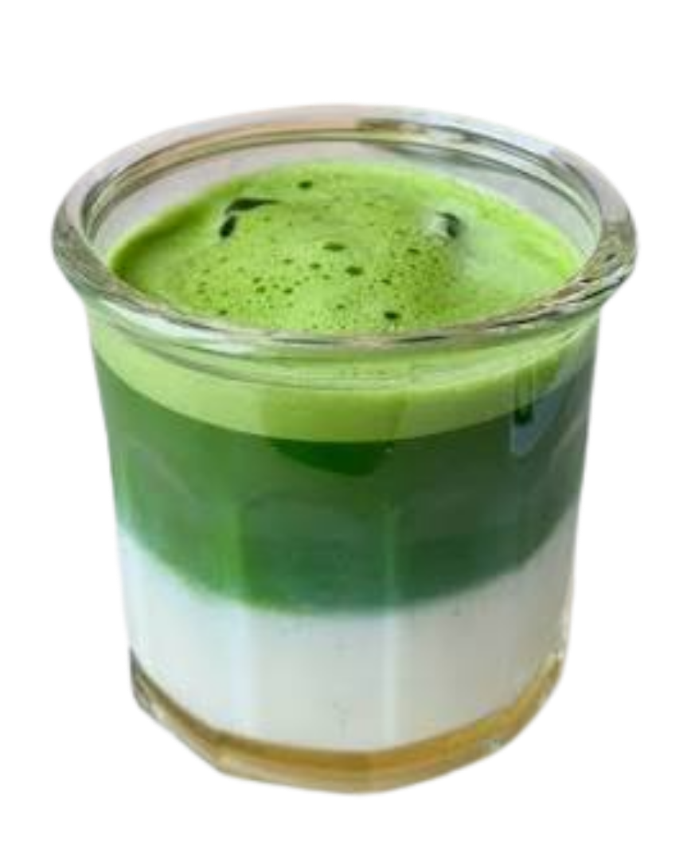
The Ocean as a Stratified Fluid
The ocean is a stratified (i.e. layered) fluid. This means:
The depth of each ocean layer is determined by its density; denser seawater lives deeper in the ocean, and less dense seawater exists closer to the surface
Seawater density is determined by its temperature, salinity, and pressure
In general, colder and saltier water is denser than warmer and fresher water
Ocean = fancy matcha drink!
Fig credit:
https://www.instagram.com/p/DJOkuoRoWr2/

Slide 7
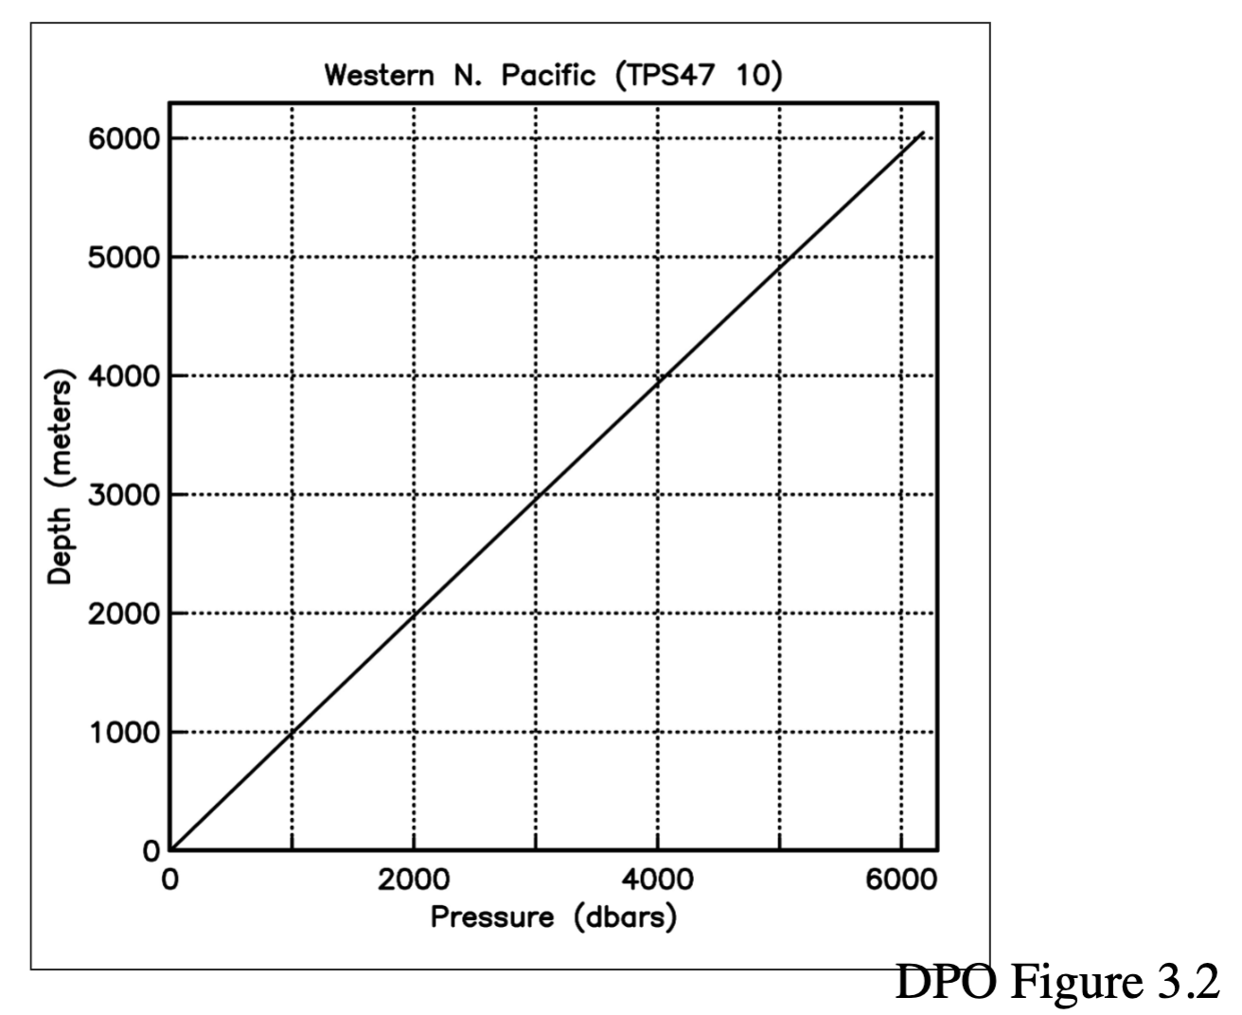
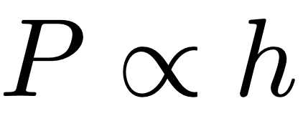
EX. Dimensional Analysis
Question: How many decibars (dbars) of pressure are equivalent to 1 meter of ocean depth?
Qualitatively
Linear
Hypothesis:

Slide 8
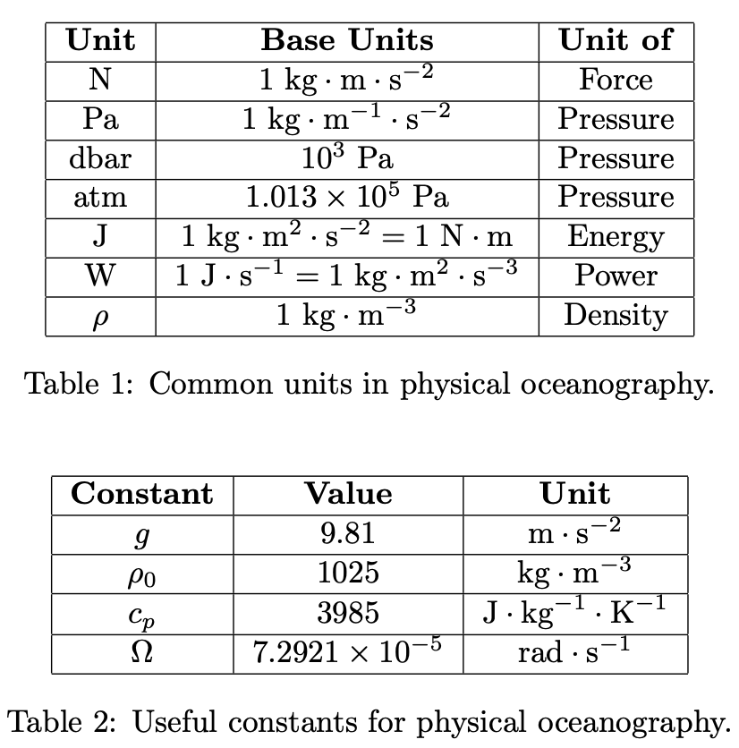
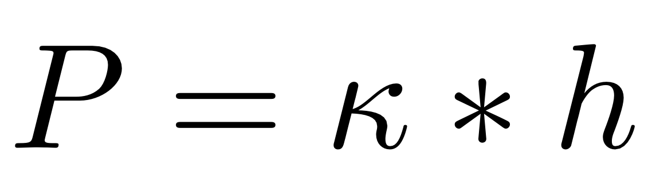
EX. Dimensional Analysis
Question: How many decibars (dbars) of pressure are equivalent to 1 meter of ocean depth?
Qualitatively Linear
Hypothesis:
Hint: Write the units for P and h. What units must κ have (see: Table 1)? Can you build the right κ from constants in Table 2?

Slide 9
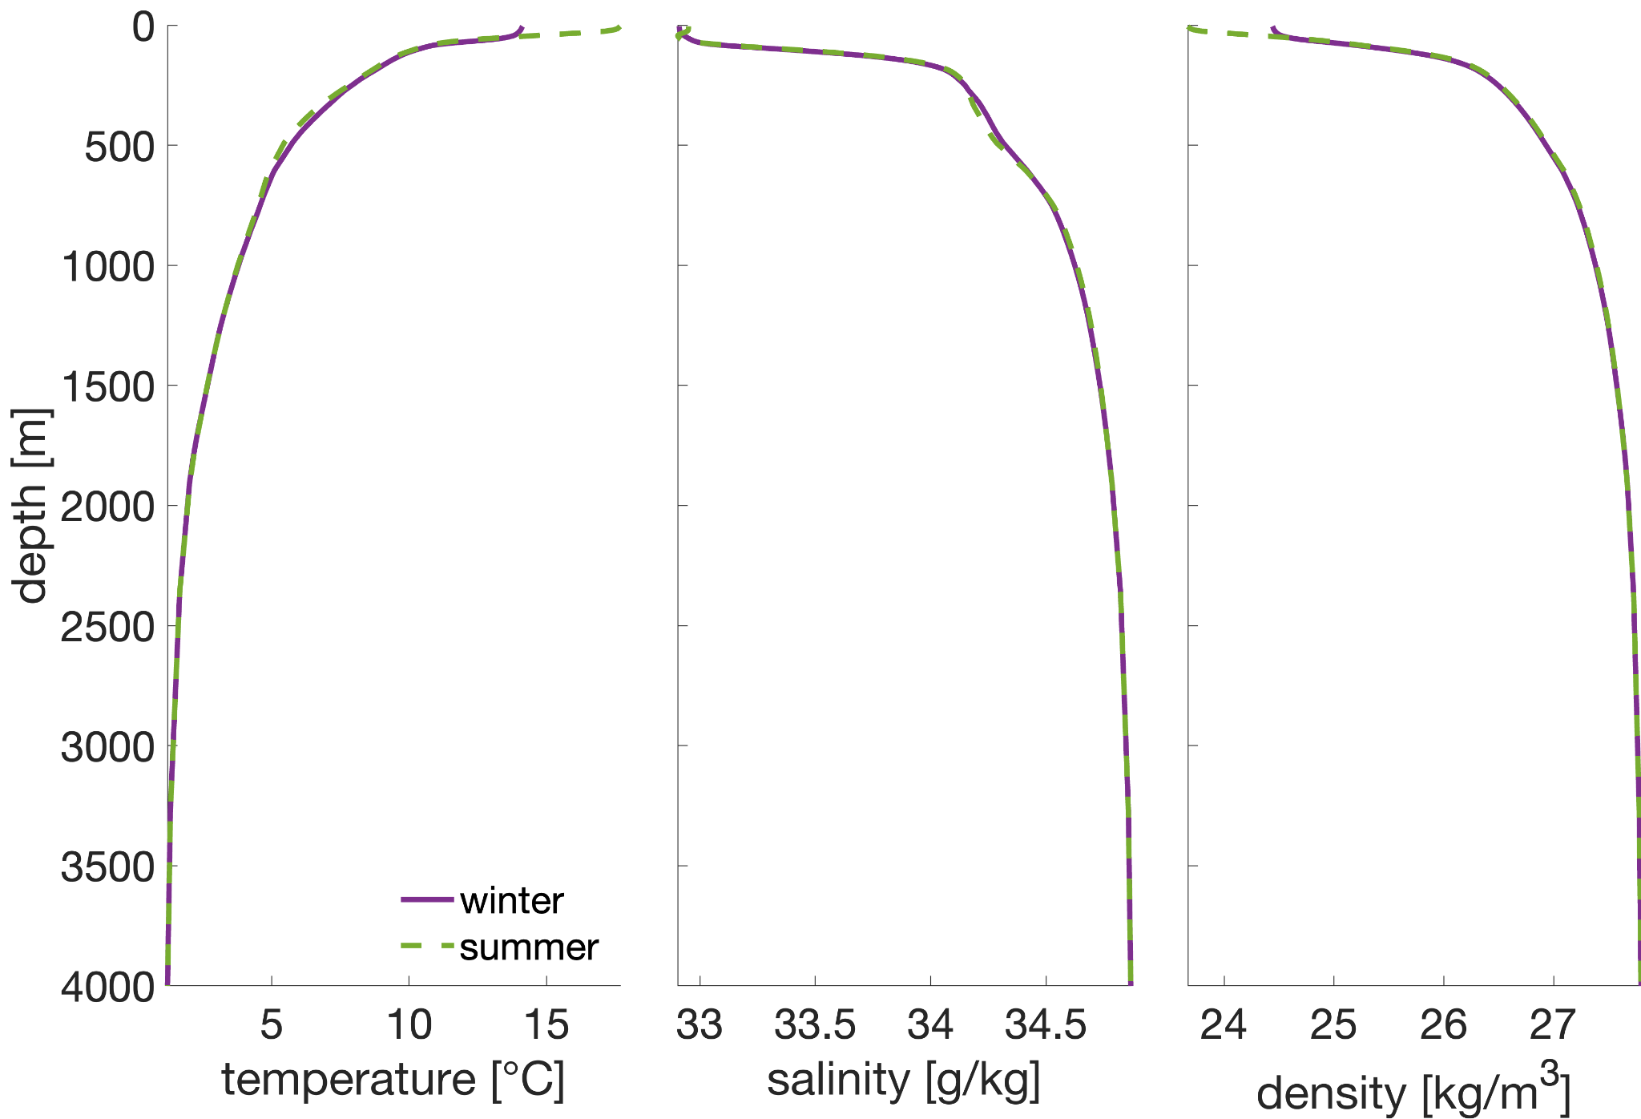
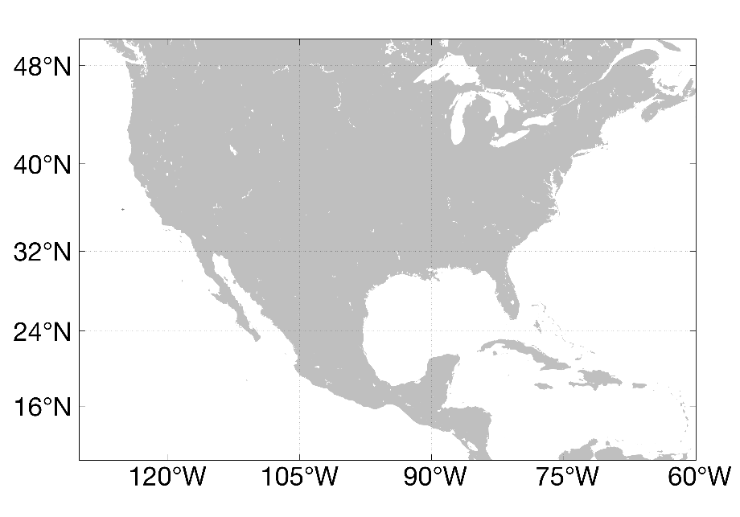
Anatomy of a Vertical Profile
These profiles are seasonal climatologies from in-situ measurements
‘Climatology’ means averaged over some period of time
‘In-situ’ means measured in the ocean
X

Slide 10
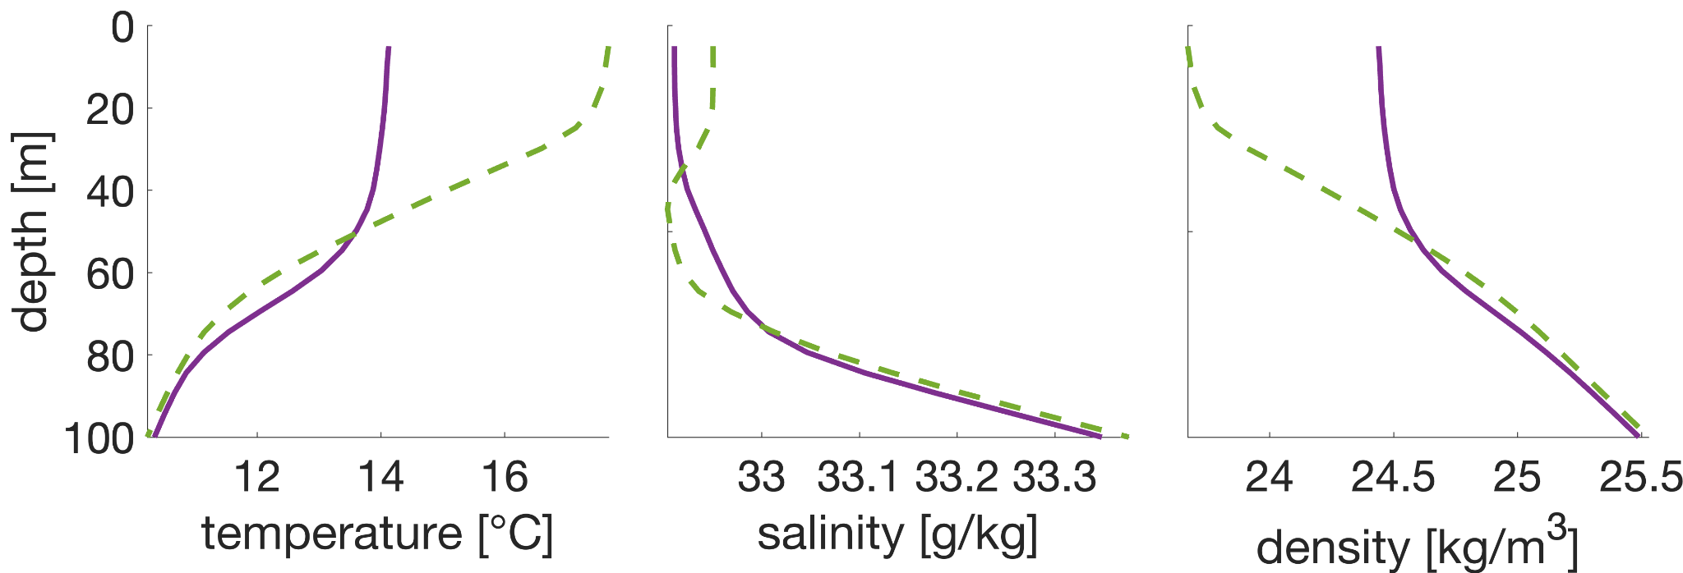
Anatomy of a Vertical Profile
Mixed Layer
Mixed Layer
The mixed layer (~10-100 m) is homogenous in salinity and temperature
The suffix ‘cline’ means region of change
What differences do you notice between the summer and winter profiles?
Thermocline
Thermocline

Slide 11
Anatomy of a Vertical Profile
?
The prefix ‘halo’ means relating to salinity
The prefix ‘pycno’ means relating to density
The suffix ‘stad’ means not changing
What differences do you notice between the summer and winter profiles?
Halostad
?

Slide 12
Anatomy of a Vertical Profile
Pycnocline
The prefix ‘halo’ means relating to salinity
The prefix ‘pycno’ means relating to density
The suffix ‘stad’ means not changing
What differences do you notice between the summer and winter profiles?
Mixed Layer
Mixed Layer
Halostad
Halocline

Slide 13
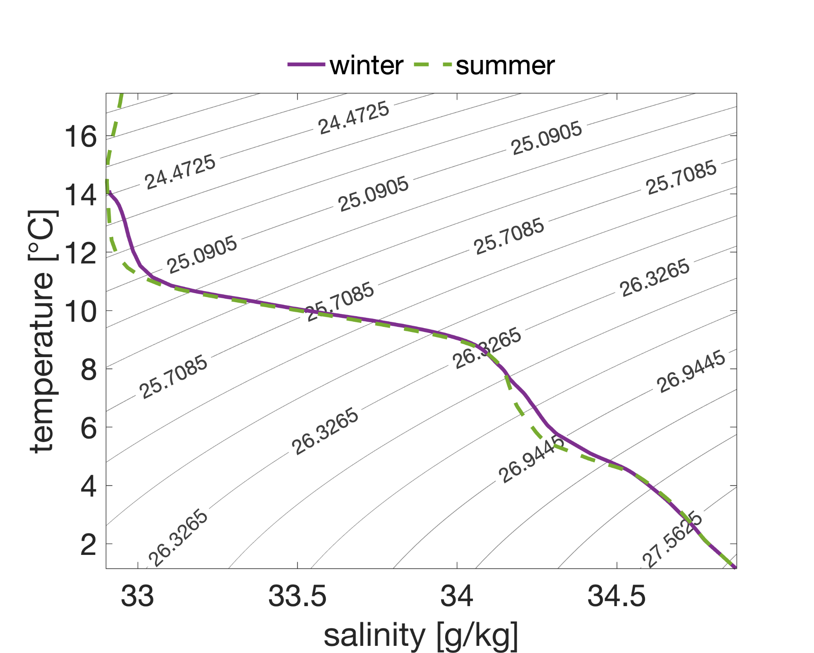
T/S Diagrams - Water Mass Fingerprints
‘Isopycnal’ means same density
‘Water masses’ with similar T/S characteristics can share formation histories
Water mass identification offers clues to general ocean circulation
Same salinity…different flavor of water!

Slide 14

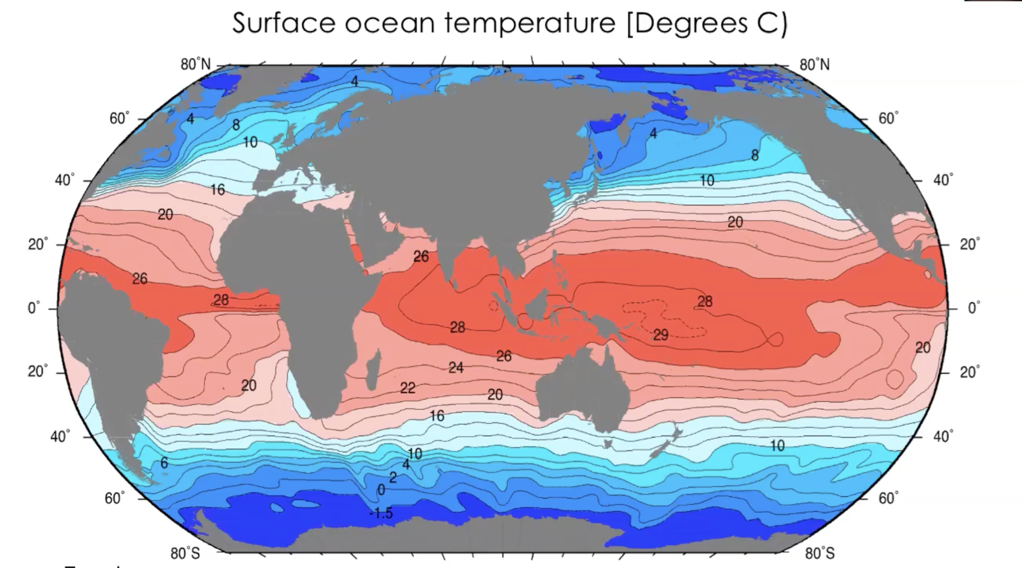
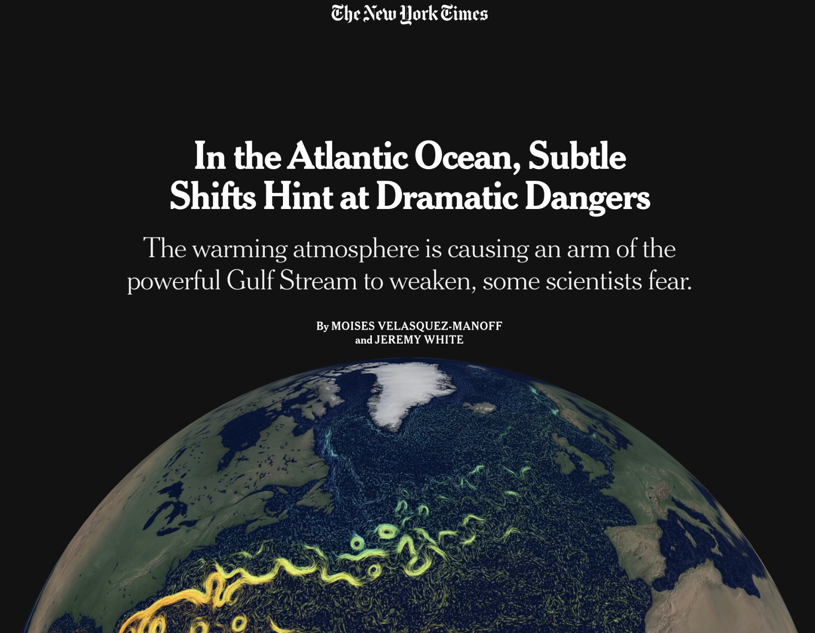
Aside: Ocean Circulation
Zonal
Meridional
Fig credit: SIO210 ‘Properties of Seawater I’
Fig credit: https://www.nytimes.com/interactive/2021/03/02/climate/atlantic-ocean-climate-change.html

Slide 15
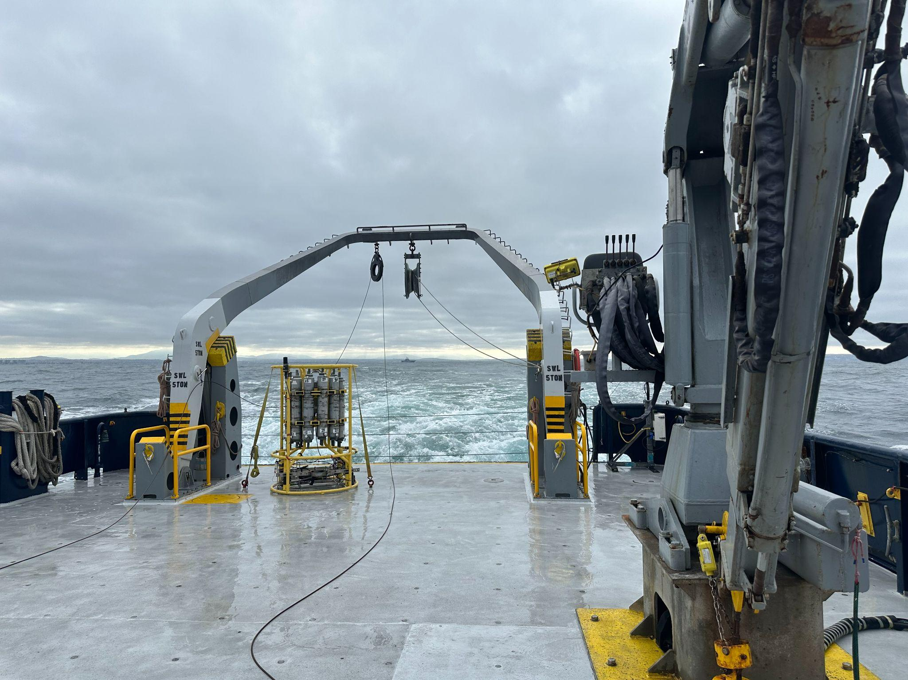
EX. Water Masses Mixing
Two water masses meet and mix. You measure a sample of water with a temperature of 6°C and a salinity of 35.05 PSU. You know that the two water masses that mixed to form this sample have the following properties:
Water Mass A: T = 4°C, S = 34.90 PSU
Water Mass B: T = 12°C, S = 35.50 PSU
Question: What fraction of the sample came from water mass A?
CTD Rosette and Niskin Bottles
Fig credit:
Tommy Stone

Slide 16
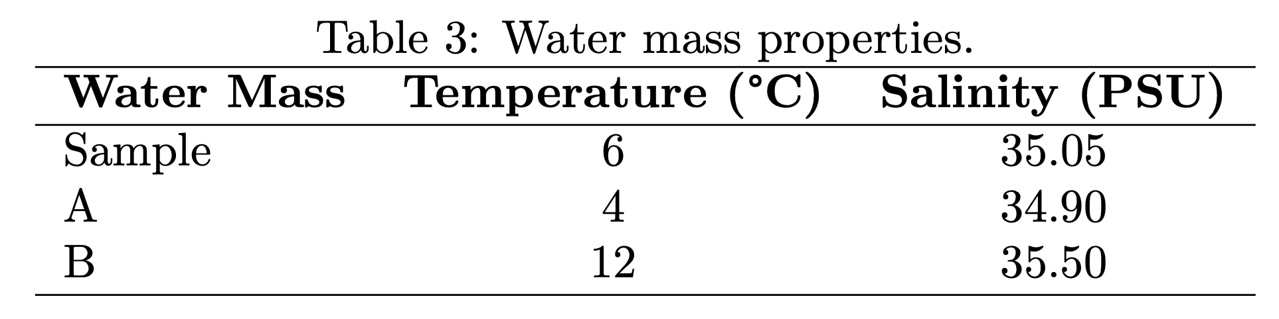
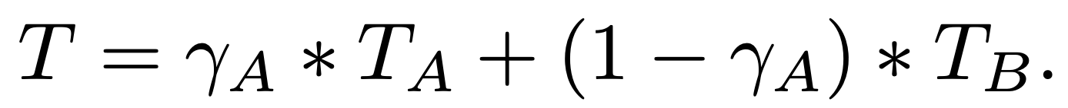
EX. Water Masses Mixing
Question: What fraction of the sample came from water mass A?
Hint: If a fraction 𝛾_{A} came from water mass A, then:
You can write an analogous equation for S (but don't need to, for the purposes of this problem)!

Slide 17
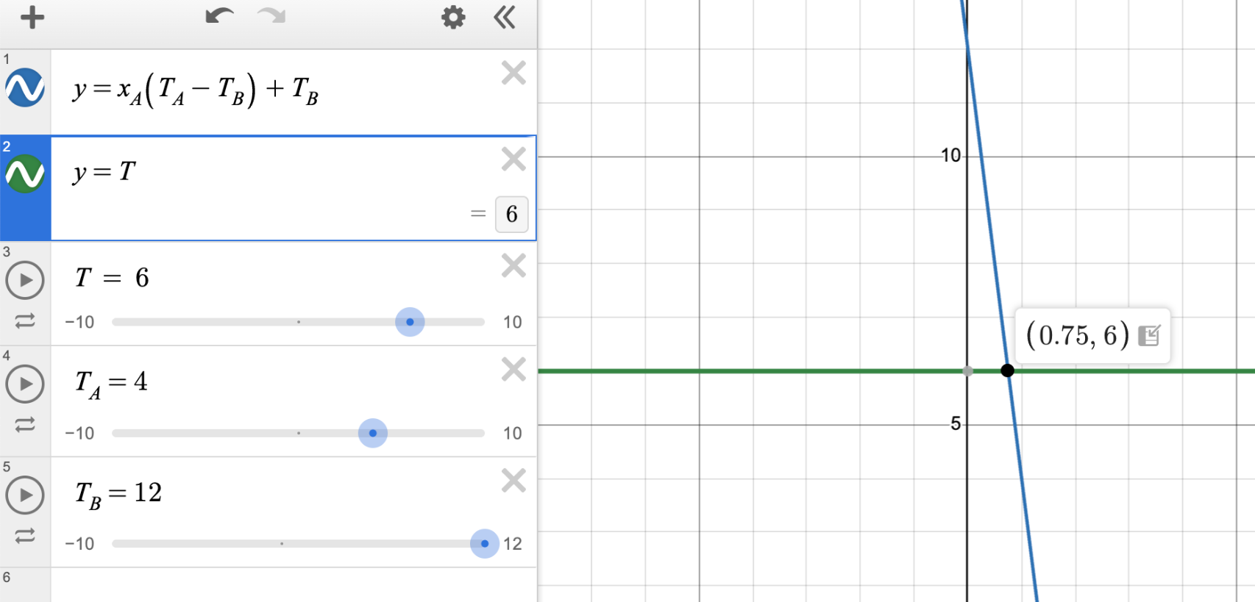
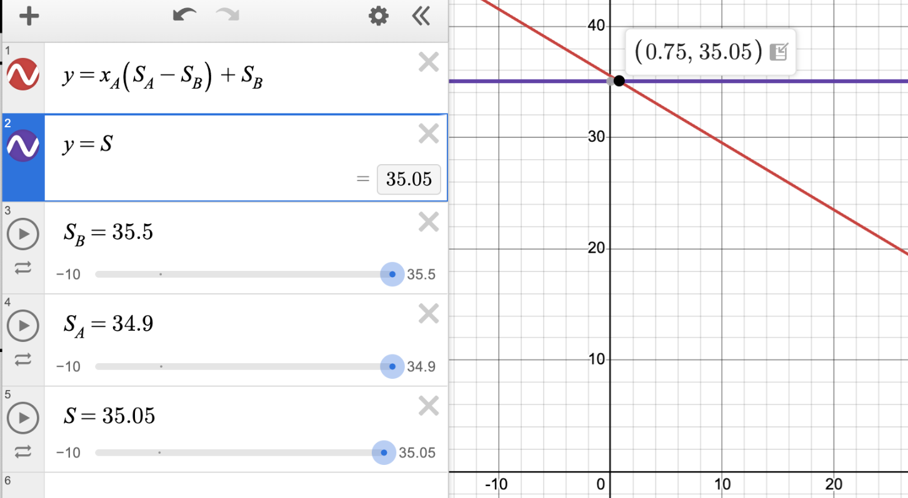
EX. Water Masses Mixing
Question: What fraction of the sample came from water mass A?
Graphical solutions confirm that this problem is over constrained (i.e. two equations, but only one unknown), but exactly determined (i.e. solving both equations yields the same solution)

