Slide 1
BUILT WITH NEURALSEEK
Call Transcript
Analyzer
Turn raw call transcripts into actionable insights —
sentiment, empathy scores, coaching, and highlights.
NeuralSeek · Node.js · AI-Powered Call Intelligence

Slide 2
WHAT IS THE CALL TRANSCRIPT ANALYZER?
📞
🧠
📋
Transcript Parser
AI Analysis Engine
Actionable Output
Upload a JSON call transcript and the agent instantly parses it — identifying speakers, emotions, and key moments throughout the call.
NeuralSeek's Maistro orchestration layer processes the transcript and generates structured intelligence: empathy scores, sentiment arcs, and personas.
The agent surfaces coaching suggestions, call highlights, and emotion timelines that managers can use to improve agent performance.
From raw transcript to structured insight — in seconds.

Slide 3
How It Works
A 4-step intelligent pipeline from file upload to insight
1
2
3
4
Upload JSON
Parse & Index
NeuralSeek AI
Deliver Insights
User uploads a call transcript JSON file via the browser interface.
The agent parses speakers, timestamps, dialogue, and sentiment metadata.
Maistro analyzes tone, empathy, emotion arc, customer persona, and key moments.
Results are rendered as a structured dashboard: scores, timeline, coaching tips, highlights.

Slide 4
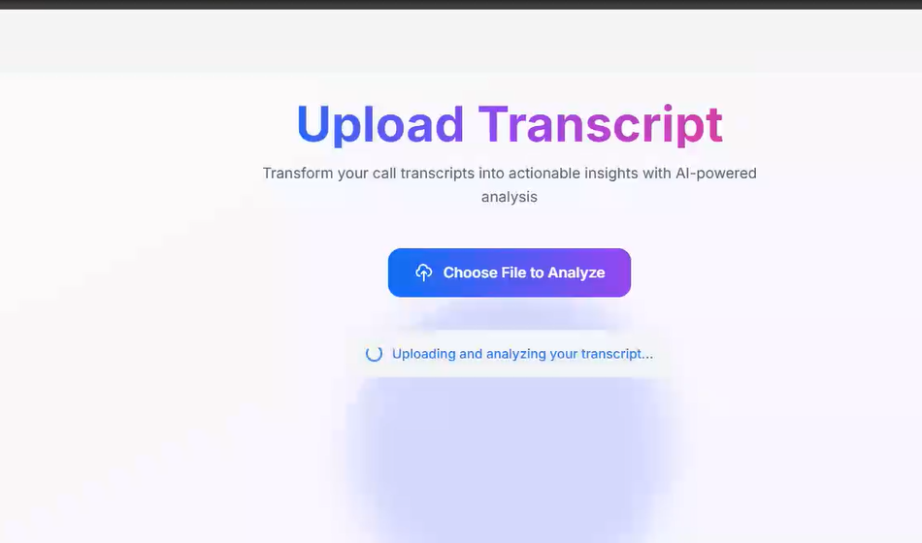
THE UPLOAD INTERFACE
Drop in any JSON call transcript → AI analysis begins immediately

Slide 5
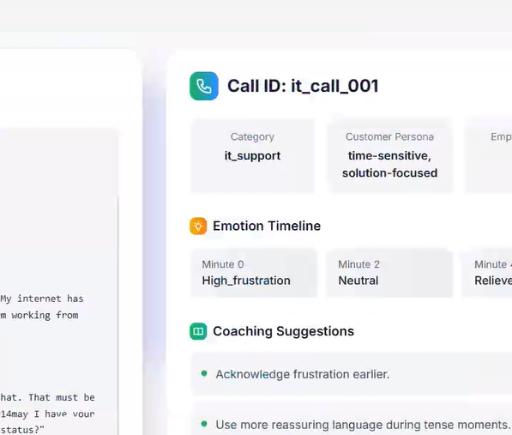
COMPLETE ANALYSIS OUTPUT — it_call_001
IT Support
EMPATHY SCORE
8.5 / 10
START EMOTION
High Frustration
END EMOTION
Relieved
PERSONA
Time-Sensitive,
Solution-Focused

Slide 6
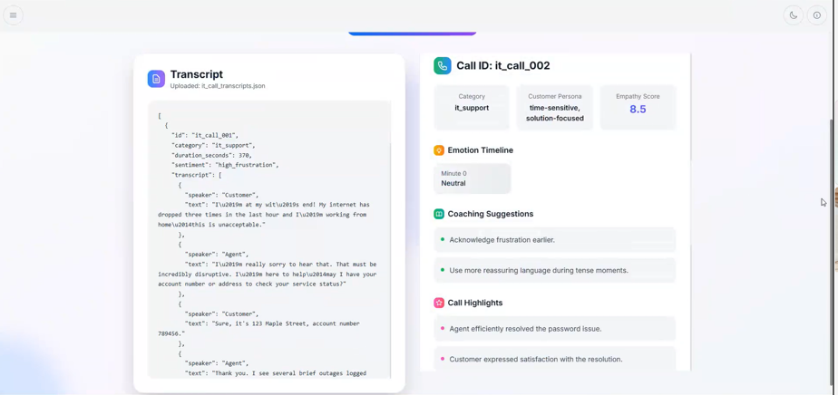
COMPLETE ANALYSIS OUTPUT — it_call_002
IT Support

Slide 7
WHAT THE AGENT OUTPUTS
🆔
Call Metadata
😊
Empathy Score
🎭
Customer Persona
Call ID, category, duration, and overall initial sentiment are extracted and displayed as headers for every analysis.
A numerical score from 0–10 reflects how empathetic the agent was, based on language and responsiveness throughout the call.
The AI infers the customer's behavioral archetype (e.g. time-sensitive, solution-focused) to help agents tailor their approach.
📈
Emotion Timeline
🏋️
Coaching Suggestions
✨
Call Highlights
Tracks how the customer's emotional state evolved minute-by-minute — from frustration to neutral to relief.
Personalized, actionable coaching recommendations for the agent — specific to the dynamics of that call.
Key moments in the conversation are surfaced automatically — competitor mentions, resolutions, customer satisfaction signals.

Slide 8
Technology Stack
What powers the Call Transcript Analyzer
🧠
NeuralSeek / Maistro
📄
JSON Transcript Input
AI ENGINE
DATA FORMAT
NeuralSeek's Maistro orchestration layer performs all natural language analysis — sentiment, empathy scoring, persona detection, and coaching generation.
The agent ingests structured JSON call transcripts containing speaker turns, timestamps, and initial sentiment metadata — enabling instant analysis.
⚙️
Node.js Backend
🖥️
Web Frontend
RUNTIME
UI LAYER
Node.js handles file ingestion, parsing, and API routing to NeuralSeek, delivering low-latency responses back to the frontend.
A clean browser-based interface with file upload, real-time loading indicators, and a structured results dashboard — no installation needed.

Slide 9
USE CASES
Call Center QA
Automatically score every call for empathy and coaching opportunities — replacing manual review for supervisors.
Sales Teams
Surface competitor mentions and objection patterns from customer calls to refine sales strategy and training.
Customer Success
Identify at-risk customers by detecting frustration signals early across support call transcripts.
Training & L&D
Build coaching libraries from real annotated calls — highlight best practices and identify skill gaps automatically.
Operations / Mgmt
Gain call-level intelligence at scale — aggregate empathy trends, emotional patterns, and resolution rates.

Slide 10
Every call tells
a story.
The Call Transcript Analyzer listens to all of them —
transforming raw dialogue into insight that makes every agent better.
Built with NeuralSeek + Node.js

