Slide 1
BUILT WITH NEURALSEEK
Email Tone Agent
Transform your emails with the perfect tone,
context, and persona — powered by AI
NeuralSeek · Node.js · AI-Powered Communication

Slide 2
WHAT IS THE EMAIL TONE AGENT?
✉️
🎭
📋
Tone Rewriter
Persona-Aware
Context-Sensitive
Takes any raw email message and rewrites it to match a specified tone — friendly, formal, assertive, and more.
Adapts the language and style to reflect a chosen sender persona (e.g. project manager, executive, sales rep).
Understands the communication context — team, client, partner — to ensure the right register is used every time.
Built to eliminate tone guesswork in professional communication.

Slide 3
How It Works
A simple 4-step pipeline powered by NeuralSeek
1
2
3
4
Input Email
Set Parameters
NeuralSeek Analysis
Result + Explanation
User pastes or types their raw email message into the agent interface.
User selects the Intended Tone, Communication Context, and Persona Type.
NeuralSeek processes the email using AI, rewriting it to match all selected parameters.
The agent returns the rewritten email alongside a detailed explanation of the changes made.

Slide 4
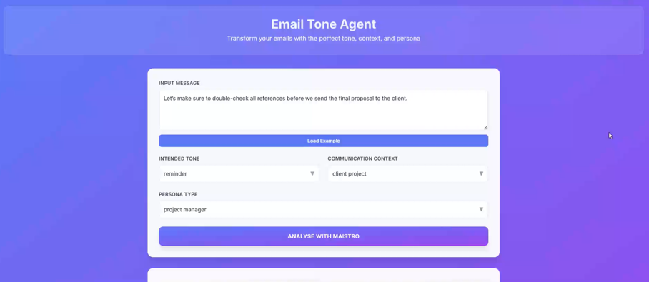
THE AGENT INTERFACE
Input Message
Paste your raw email or use the Load Example button to try a sample.
Intended Tone
Choose from tones like reminder, formal, friendly, assertive, and more.
Communication Context
Set the context: internal team, client project, partner outreach, etc.
Persona Type
Define the sender's role (e.g. project manager) so the AI matches their voice.

Slide 5
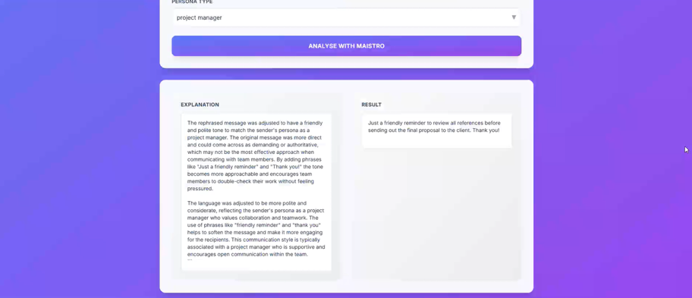
Agent in Action
Input → Analysis → Rephrased Output
INPUT
"Let's make sure to double-check all references before we send the final proposal to the client."
Tone: reminder
→
Context: client project
Persona: project manager

Slide 6
TECHNOLOGY STACK
🧠
NeuralSeek
⚙️
Node.js
AI ENGINE
BACKEND
NeuralSeek handles all natural language understanding, tone analysis, and message rephrasing via its Maistro orchestration layer.
Node.js powers the backend logic, routing API calls to NeuralSeek and processing requests and responses efficiently.
🖥️
Web Frontend
🔗
REST API
UI LAYER
INTEGRATION
A clean, responsive web interface built to enable users to interact with the agent seamlessly via browser.
The agent exposes RESTful endpoints, making it embeddable into any workflow, email client, or enterprise tool.

Slide 7
Key Features
🎯
Multi-dimensional Control
📝
Explanation Panel
⚡
One-Click Examples
Simultaneously adjust tone, communication context, and persona for surgical precision in every message.
Every rewrite comes with a full explanation of why specific changes were made — building communication skills over time.
Load pre-built example inputs instantly to see the agent in action without any manual setup.
🔄
Iterative Refinement
🌐
Browser-Based
🔌
Embeddable
Easily tweak parameters and re-analyze until the tone is exactly right for your audience.
No installation required. Runs entirely in the browser, accessible to any user on any device.
Designed to be integrated into existing tools — email clients, CRMs, or internal communication platforms.

Slide 8
USE CASES
Sales Teams
Craft follow-up emails that strike exactly the right balance between persistence and professionalism.
Project Managers
Send team reminders and client updates that are firm but collaborative in tone.
Executives
Draft high-stakes communications with precise language befitting senior leadership.
Customer Support
Transform terse responses into empathetic, on-brand messages that resolve issues gracefully.
HR & People Ops
Write sensitive communications — performance feedback, policy updates — with the right tone every time.

Slide 9
The right words,
every time.
The Email Tone Agent brings AI-powered communication intelligence
to every message you send — at scale, across any role, any context.
Built with NeuralSeek + Node.js

Slide 10
How to Run It
Get the Email Tone Agent running locally in under 5 minutes
1
2
3
4
Clone the repo
Set your API key
Start the backend
Start the frontend
git clone github.com/
your-username/ToneAgent
NEURALSEEK_API_KEY=
your_key_here
npm install
node server.js
cd email-tone-ui
npm install && npm run dev
Available on GitHub
Add to a .env file in root
Runs on port 3001
Open localhost:5173
github.com/your-username/ToneAgent

Slide 11
BUILT BY
Talha Gulzar
Babson College · November 2025
POWERED BY
STACK
NeuralSeek / Maistro
Node.js · React 19 · Vite
neuralseek.com
Hosted on Replit · Open source on GitHub
Thank you

