Slide 1
HealthConnect Rwanda - Healthcare Predictive Analytics
Week 6 | Data Science Track | Takudzwa Jeffrey Gumbo (TJ)
Population health intelligence, forecasting and predictive analytics
Synthetic educational healthcare data only
Responsible-use focus: evidence, limitations, privacy and human oversight
AnalystLab Africa Experience Lab | Synthetic healthcare data | Not clinical advice

Slide 2
Business problem & methodology
Integrate clinical, operational, financial and experience data
Audit relationships before modelling
Engineer transparent analytical features
Run EDA + statistics + forecasting + predictive models + clustering
Do not invent missing facility mappings or overstate weak models
AnalystLab Africa Experience Lab | Synthetic healthcare data | Not clinical advice

Slide 3
Data landscape & quality constraints
20,000 patients | 60,000 diagnoses | 60,000 bills
5,000 detailed appointments vs 60,809 enterprise annual appointments
Health Facilities master missing: facility names/ownership/geography unavailable
Only 5.1% of appointment DepartmentID-FacilityID pairs match department master
All 2,000 supplied beds are marked Available
AnalystLab Africa Experience Lab | Synthetic healthcare data | Not clinical advice

Slide 4
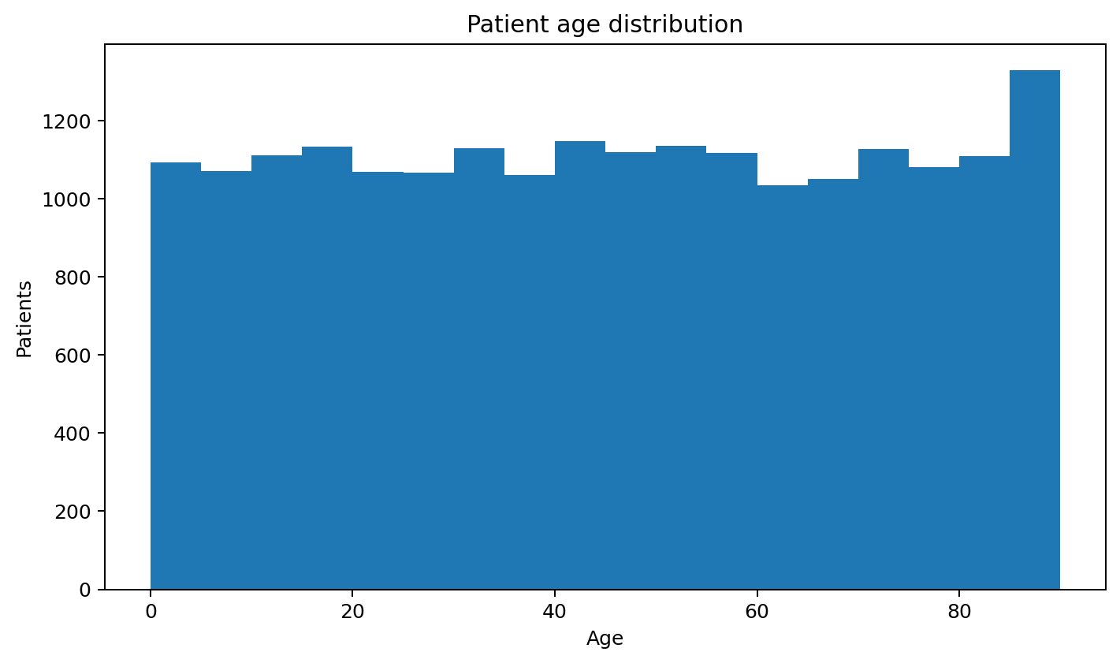
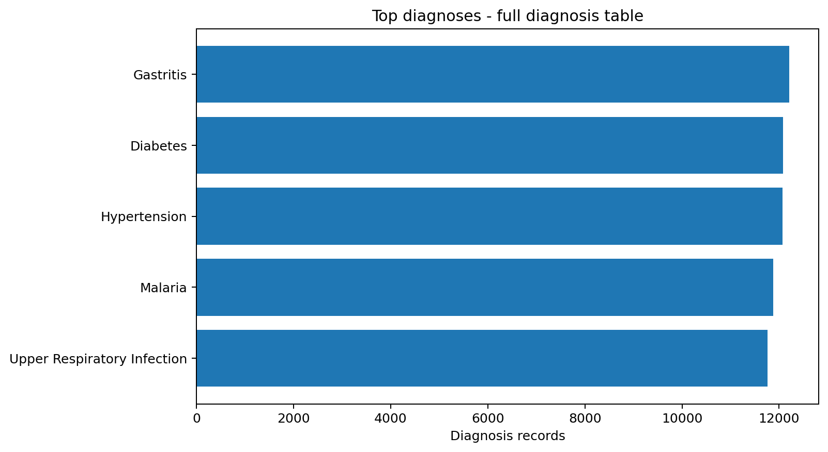
Population & clinical profile
AnalystLab Africa Experience Lab | Synthetic healthcare data | Not clinical advice

Slide 5
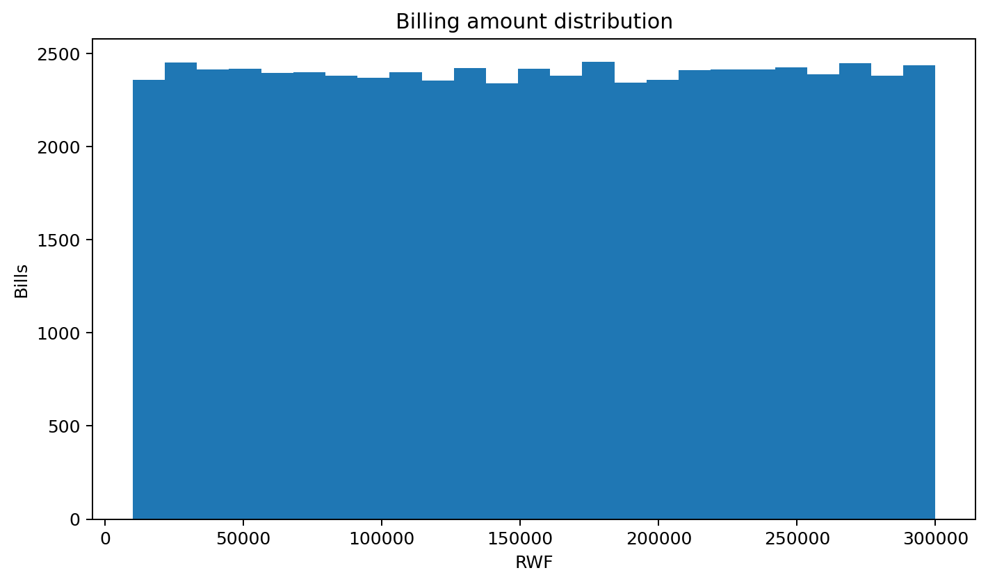
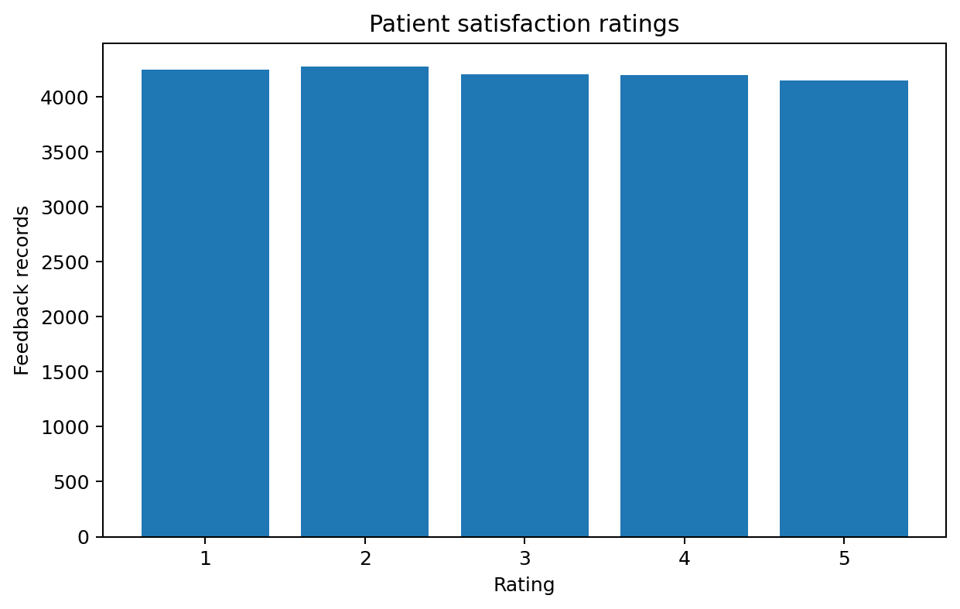
Financial & patient experience profile
AnalystLab Africa Experience Lab | Synthetic healthcare data | Not clinical advice

Slide 6
Statistical evidence
Satisfaction across FacilityIDs: p=0.7952 - no significant difference
Admission status vs age group: p=0.0308 - significant association
Billing by recorded chronic-condition status: p=0.5438 - no significant difference
Associations are synthetic and not clinical causal evidence
AnalystLab Africa Experience Lab | Synthetic healthcare data | Not clinical advice

Slide 7
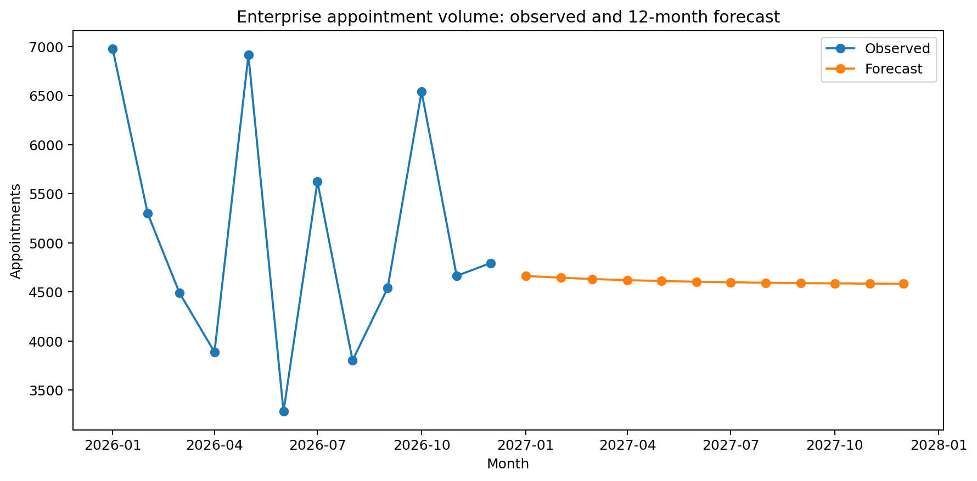
12-month patient-demand forecast
Backtest MAE: 1,299 appointments
Only 12 historical monthly observations - planning illustration, not a staffing commitment
AnalystLab Africa Experience Lab | Synthetic healthcare data | Not clinical advice

Slide 8
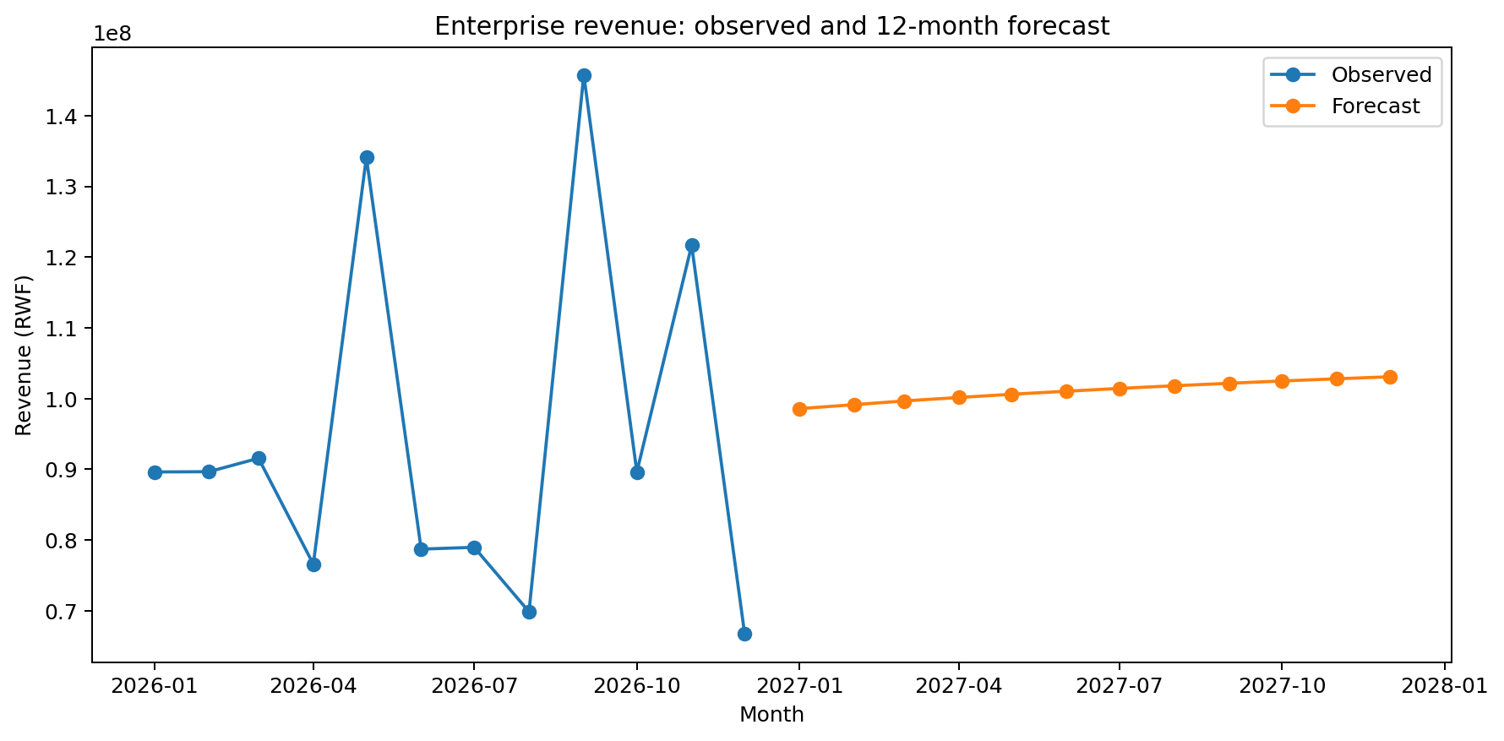
12-month revenue forecast
Backtest MAE: RWF 23,126,582
Forecast uncertainty must remain explicit
AnalystLab Africa Experience Lab | Synthetic healthcare data | Not clinical advice

Slide 9
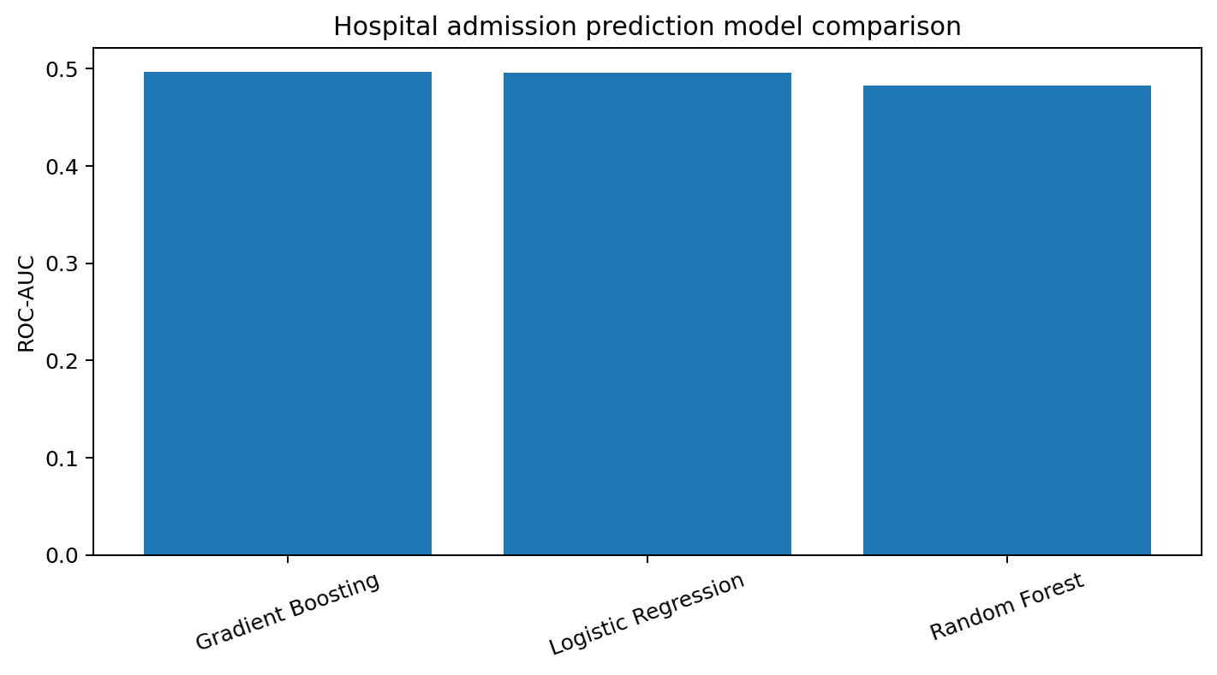
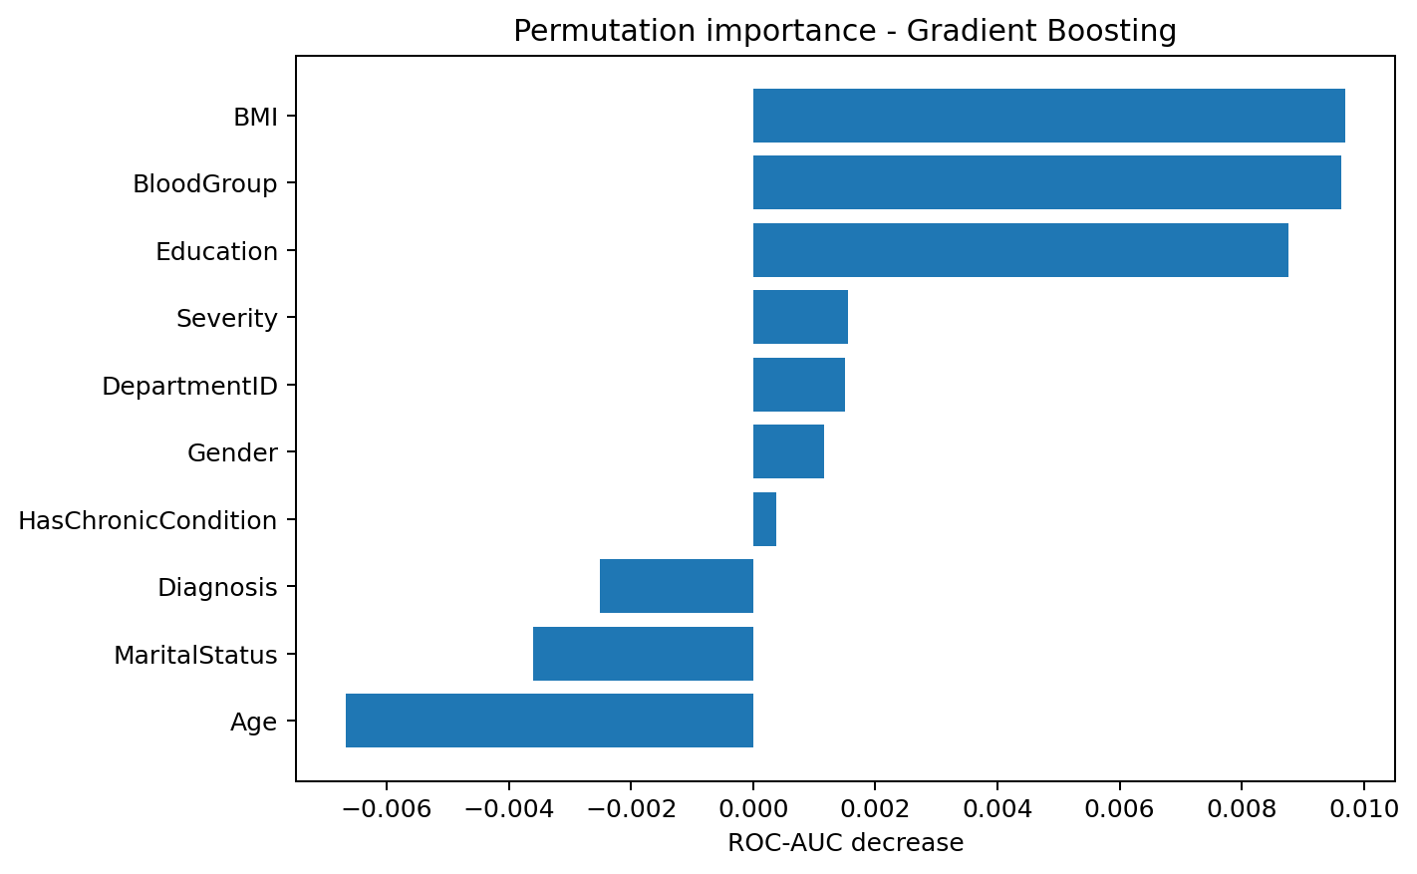
Admission prediction: weak signal
Best ROC-AUC: 0.497 (Gradient Boosting)
Not suitable for clinical deployment
AnalystLab Africa Experience Lab | Synthetic healthcare data | Not clinical advice

Slide 10
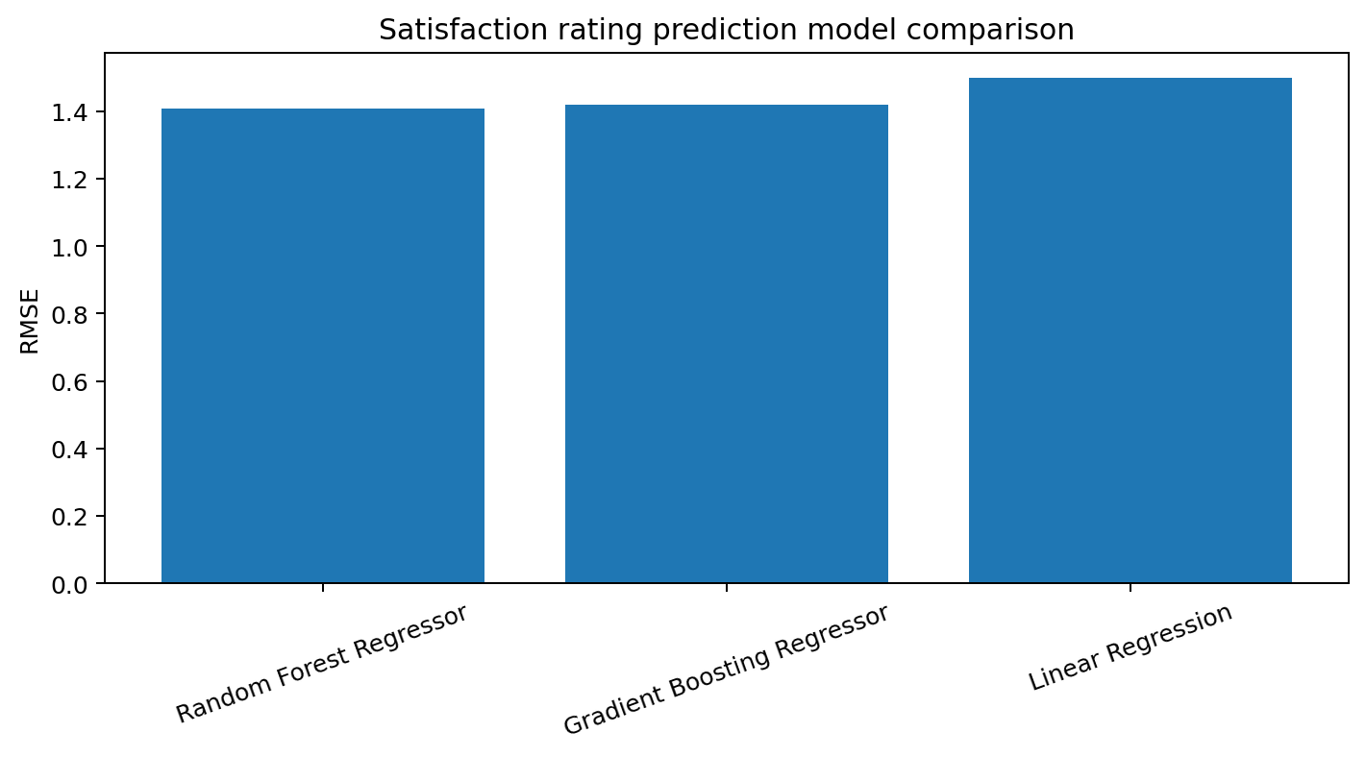
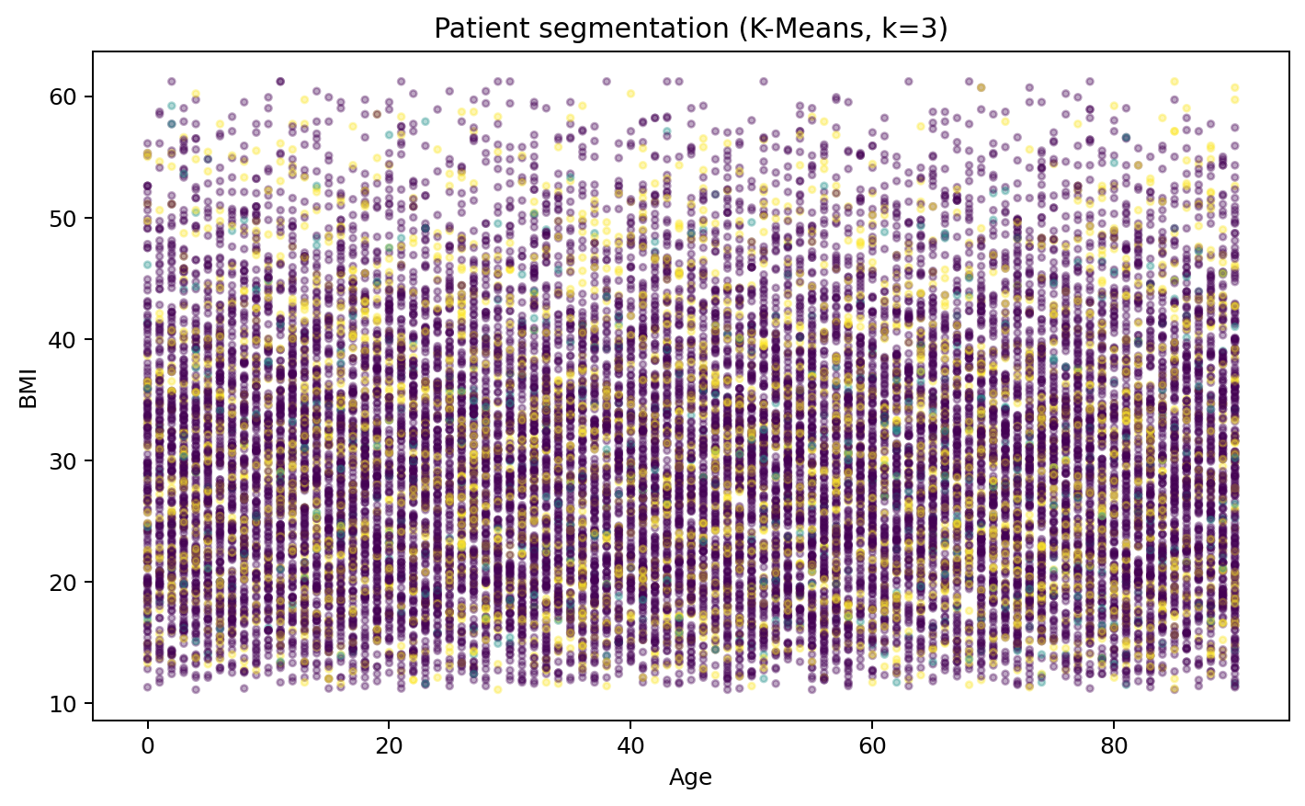
Satisfaction prediction & segmentation
Best satisfaction R2: -0.022
Clusters are descriptive service-planning groups, not clinical phenotypes
AnalystLab Africa Experience Lab | Synthetic healthcare data | Not clinical advice

Slide 11
Recommendations
Collect a complete Health Facilities master with stable FacilityID, name, type, ownership and geographic keys.
Enforce referential integrity between FacilityID and DepartmentID across appointments and staff systems.
Capture true bed occupancy events and timestamps rather than static Available status only.
Preserve complete longitudinal appointment histories with consistent patient, facility, department and clinician keys.
Capture waiting time, triage acuity and discharge outcome fields for operational and admission modelling.
Use the current admission and satisfaction models only as educational baselines; do not deploy them clinically.
Retain forecast uncertainty in capacity planning because only 12 monthly enterprise observations are available.
AnalystLab Africa Experience Lab | Synthetic healthcare data | Not clinical advice

Slide 12
Final takeaway
The strongest result is the data-quality diagnosis, not a high predictive score
Age group is associated with admission occurrence in the synthetic sample, but admission prediction remains weak
Satisfaction is not well explained by the supplied operational/clinical variables
Forecasts are limited by only 12 monthly observations
Next priority: complete facility master + consistent keys + longitudinal outcomes + real capacity measures
Repository: github.com/tgumbo07-ctrl/healthconnect-rwanda-intelligence
AnalystLab Africa Experience Lab | Synthetic healthcare data | Not clinical advice

