Slide 1
HealthConnect Final Data Science Outcome
Week 8 - Final Integration, Presentation & Project Showcase
Takudzwa Jeffrey Gumbo
Data Science Track | AnalystLab Africa Batch E
Final decision
The final documented admission model is reproducible and leakage-safer, but its predictive performance remains close to chance. It is NOT recommended for clinical or operational deployment.

Slide 2
From Week 6 to Week 8
The project evolved from model development to evidence-based final selection.
Week 6
Week 7
Week 8
Advanced development
Testing & refinement
Final integration
Admission candidate ROC-AUC ≈ 0.497
Weaknesses, leakage risk and unstable refinements identified
Final candidate documented; deployment rejected
Week 8 purpose
Select the most defensible final model outcome, integrate validated cross-track findings, document limitations and risks, and communicate the final decision professionally.

Slide 3
Data, target and prediction point
The final modelling question is constrained by what the supplied Rwanda data can actually support.
Integrated records
Admissions
Non-admissions
Attendance target
5,000
586
4,414
Unavailable
appointment-level
11.72% positive
88.28% negative
no no-show field
Actual target
Final prediction point
Hospital admission status (`Admitted`) derived from the Admissions sheet and linked by AppointmentID. The target is actual admission, not a proxy.
Patient arrival / before initial clinical assessment. This prevents the final model from depending on information generated after the decision point.
Key integrity rule: no attendance/no-show target was fabricated.

Slide 4
Cross-track validation changed the model
Data Analytics findings were used as model-design evidence, not just as a discussion record.
Output received from Data Analytics
Data Science action
What changed
• Gender, chronic condition and visit type supported
• Age should be calculated at appointment date
• Facility/department IDs require caveats
• Diagnosis/Severity may leak prediction-time information
• Suggested PriorVisits, month and weekday
• Attendance/no-show cannot be validated
• Fixed prediction point at patient arrival
• Recalculated AgeAtAppointment
• Added time-safe PriorVisits
• Added AppointmentMonth and Weekday
• Removed Diagnosis and Severity
• Excluded unvalidated BMI/demographic variables
• Retained FacilityID/DepartmentID with caveats
Feature governance improved and leakage risk was reduced. The re-test became more operationally defensible, but performance remained too weak for deployment.
Test → Finding → Action → Re-test → Final decision

Slide 5
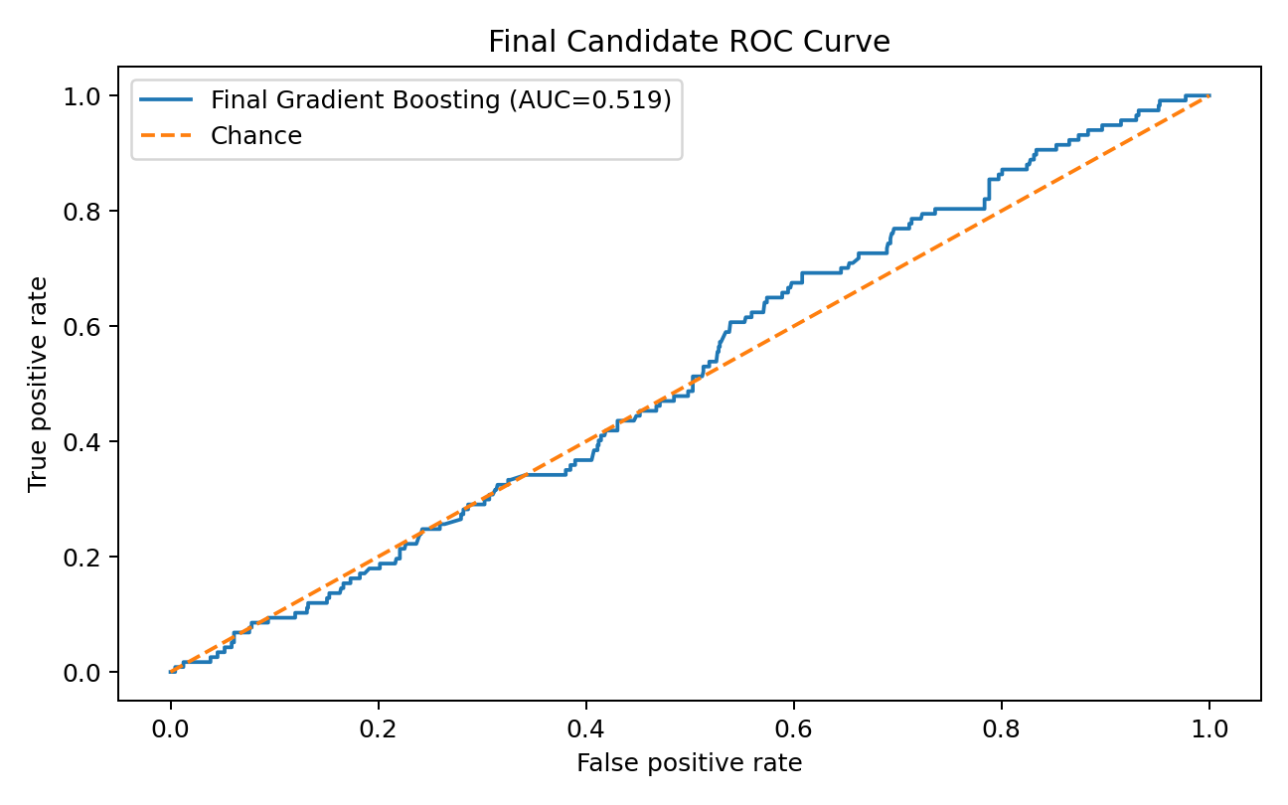
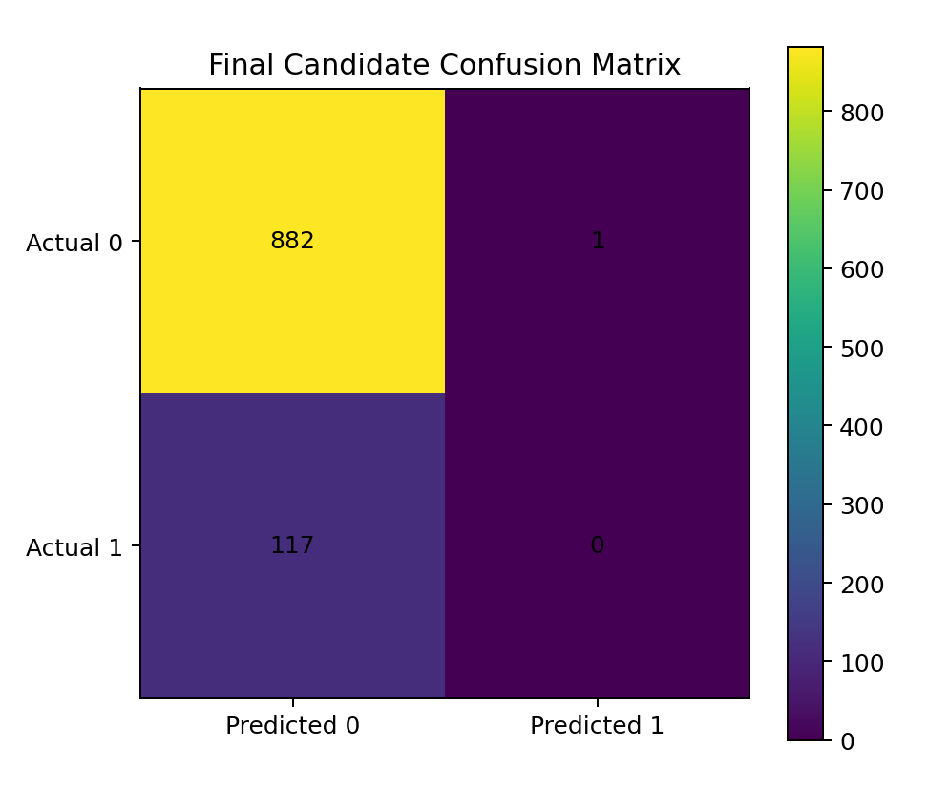
Final model evaluation
Gradient Boosting is the final documented candidate - not a deployment-approved model.
Holdout ROC-AUC
5-fold CV ROC-AUC
Holdout PR-AUC
Recall @ 0.50
Accuracy
0.5189
0.5237
0.1199
0.000
0.882
slightly above chance
± 0.0246
positive rate ≈ 0.117
missed all positives
misleading alone

Slide 6
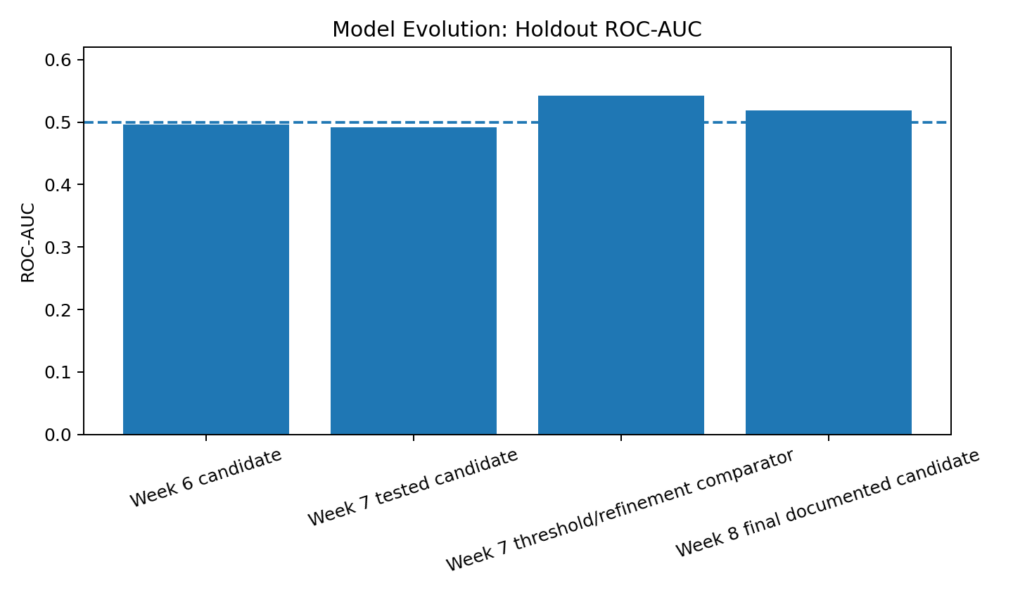
Model evolution and final selection
A better-looking single split was rejected when it did not generalize.
Week 6 candidate
ROC-AUC ≈ 0.497 - near chance.
Week 7 refinement
Holdout ROC-AUC ≈ 0.542 looked better, but 5-fold CV ROC-AUC ≈ 0.487. The apparent gain was rejected as unstable.
Week 8 final documented candidate
Holdout ROC-AUC 0.519; CV ROC-AUC 0.524. Methodologically safer, still not operationally useful.

Slide 7
What the model can - and cannot - do
Final model documentation separates reproducibility value from operational suitability.
Can do
Cannot do
• Reproduce the final feature-engineering and preprocessing workflow
• Demonstrate leakage-aware model validation
• Provide a documented admission-risk experiment
• Support portfolio discussion of responsible model selection
• Provide technical schema requirements for an ML pipeline demonstration
• Reliably predict admission
• Support clinical triage or patient prioritization
• Drive staffing/resource allocation
• Automate patient-level care decisions
• Predict attendance/no-show from the supplied dataset
• Be described as production-ready or clinically validated
Final business decision: DO NOT DEPLOY

Slide 8
How Data Science fits the final HealthConnect solution
The value of the Data Science contribution is the validated decision, not a forced production model.
Data Analytics
Validated findings and feature/timing evidence
Data Science
Tests predictive value, controls leakage, documents model suitability
ML Engineering
Can use schema/preprocessing for technical reproducibility only
Generative AI
Supports administrative interaction within approved knowledge base
Project Management
Coordinates readiness, dependencies and presentation
Integration outcome: the wider solution is protected from relying on an unreliable predictive component.

Slide 9
Recommendations and closing
Responsible Data Science means following the evidence - including negative results.
Collect an explicit attendance/no-show outcome if missed appointments remain the core use case.
Obtain stronger predictors that are genuinely available before clinical assessment.
Freeze a fresh untouched test set before future model selection or threshold tuning.
Define the operational costs of false negatives and false positives before selecting a threshold.
Revisit deployment only after materially stronger and stable out-of-sample performance.
Key takeaway
The final model is not a failed project outcome. The validated do-not-deploy decision prevents weak predictions from becoming part of the HealthConnect workflow.
Evidence > appearance of success
Thank you

