Slide 1
SwiftLog Logistics Analytics & AI Transformation
Week 5 — Supply Chain Intelligence & Feature Engineering for Predictive Logistics
Takudzwa Jeffrey Gumbo (TJ)
Data Science Track | AnalystLab Africa Experience Lab — Batch E
Goal: turn imperfect logistics data into a validated analytical and feature-engineering foundation for future ML.

Slide 2
Business problem & analytical objectives
SwiftLog needs operational visibility before investing in predictive AI.
Integrate customers, orders, products, inventory, shipments, deliveries, warehouses, employees and returns.
Identify delivery, demand, customer-value, product and warehouse patterns.
Run descriptive and inferential statistics — including unsupported hypotheses.
Engineer defensible features for future delay prediction, demand forecasting and return-risk modelling.
Document data gaps instead of fabricating supplier or capacity relationships.
Consulting principle: a missing relationship is a data-quality finding, not permission to invent a join.

Slide 3
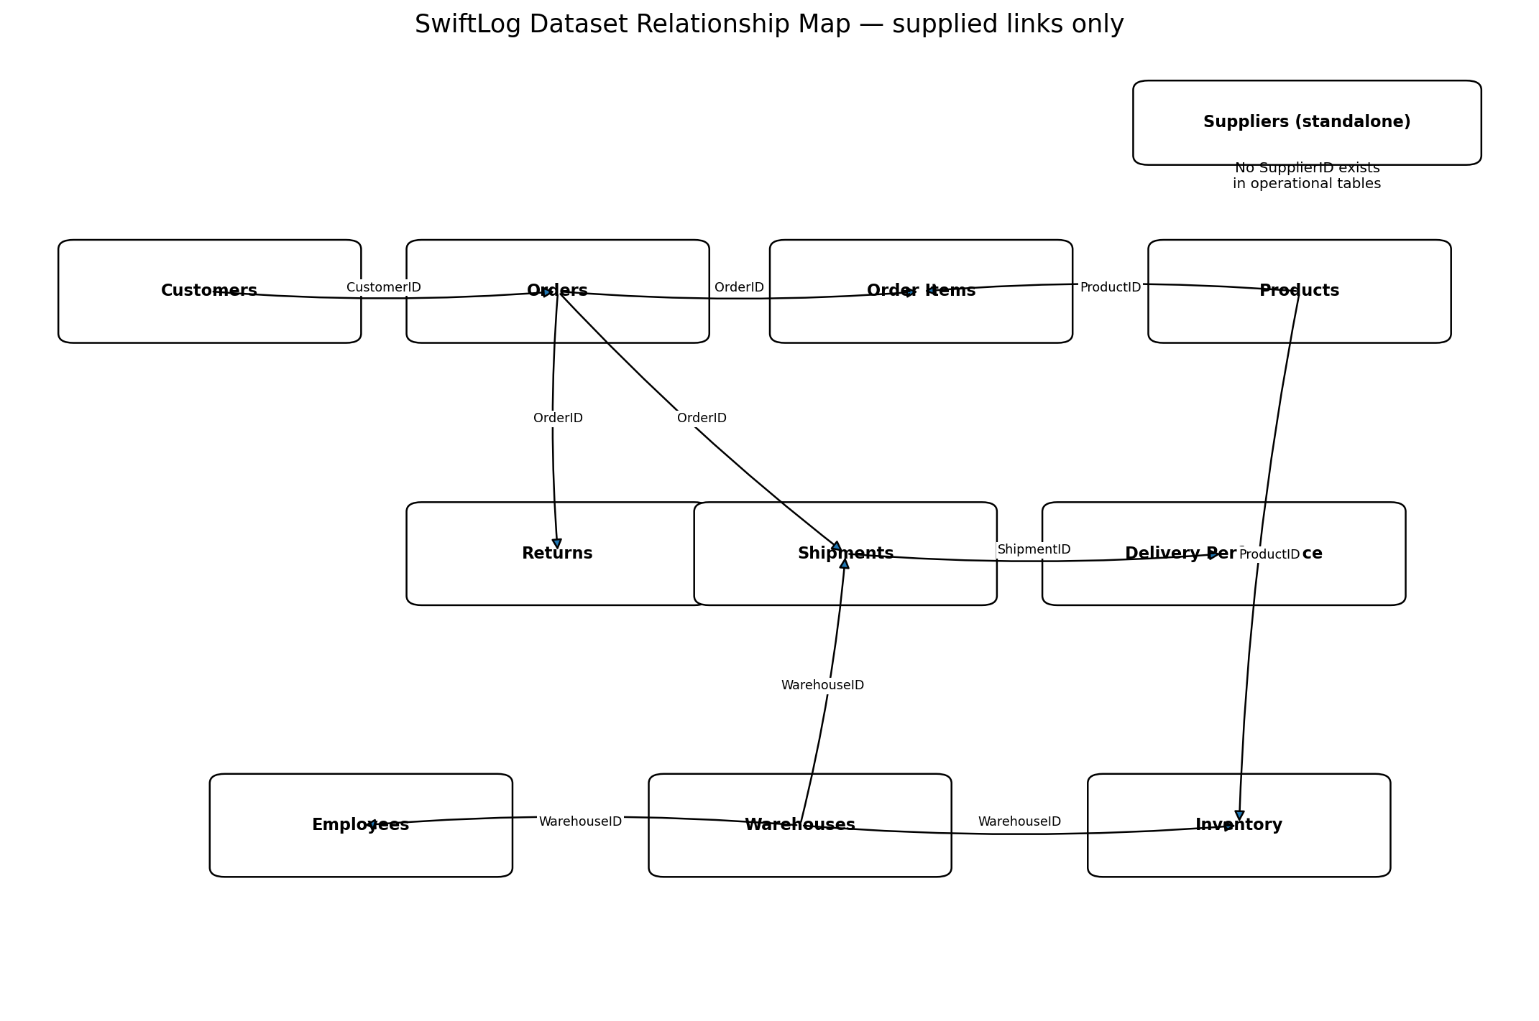
Data landscape & relationship model
12 supplied CSV files; operational links validated with zero unmatched child foreign keys.
5,000 orders and shipments
15,000 order-item rows
1,000 customers; 250 products
15 warehouses; 200 employees
150 suppliers — standalone
500 return records
236 orders have no Order_Items record. They are preserved and explicitly flagged rather than silently dropped.

Slide 4
Data quality decisions & assumptions
Official AnalystLab guidance was applied directly.
Issue | Decision
Supplier link | Keep standalone; no supplier score fabricated.
Warehouse capacity | Use clearly labelled load proxies only.
Inventory repeats | Treat as stock movements; aggregate separately.
Returns grain | Order-level only; no true product return rate.
Data dictionary | Infer cautiously and document assumptions.
Order-item gap | Retain all 5,000 orders; flag 236 without items.
Issue
Decision

Slide 5
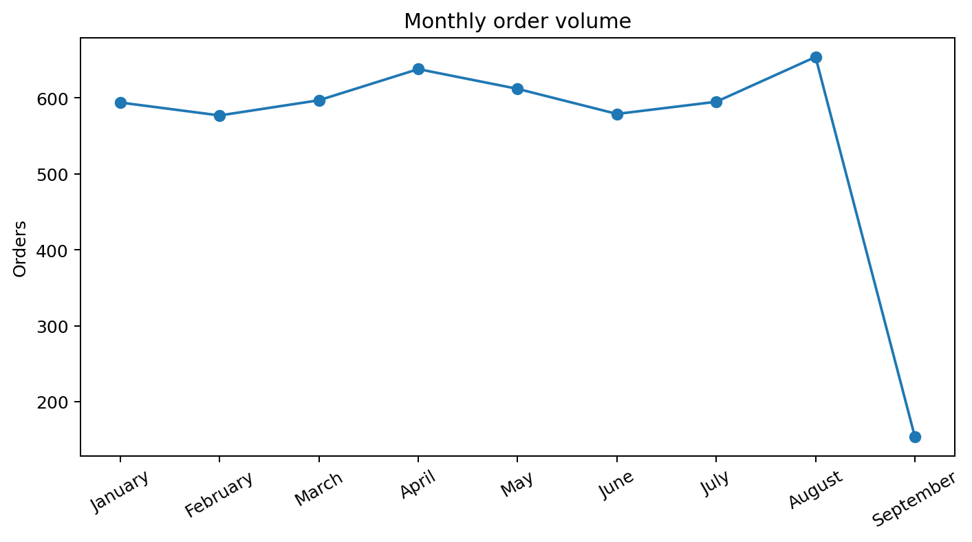
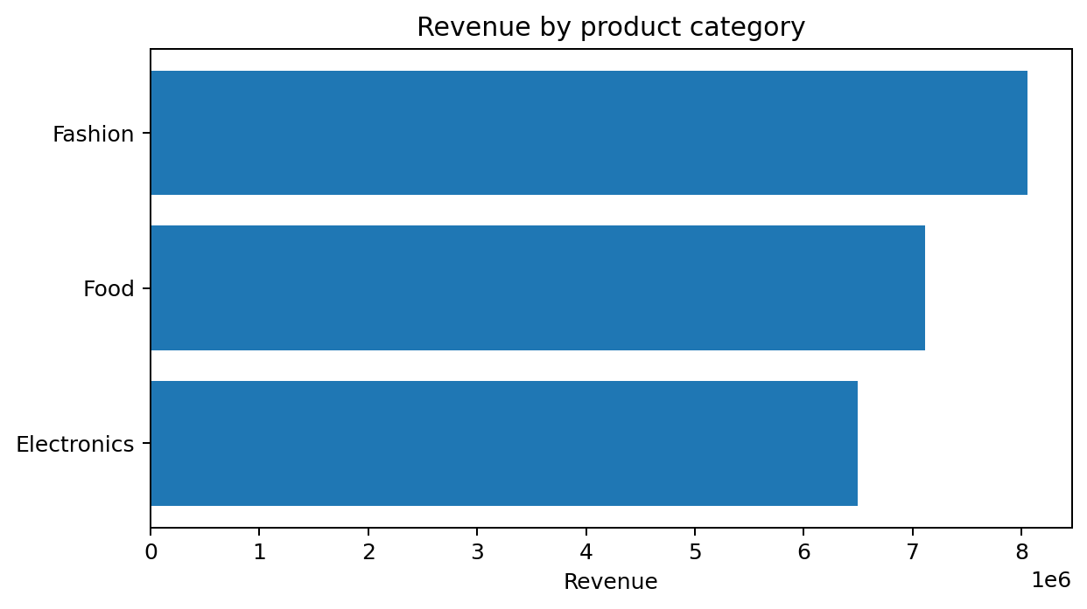
Demand & revenue overview
Observed revenue is calculated only where order-item detail exists.
$21.67m
$4,548
August
Fashion
P040
OBSERVED REVENUE
AVG ORDER VALUE
PEAK MONTH
TOP CATEGORY
TOP PRODUCT
654 orders
$8.06m
$191k

Slide 6
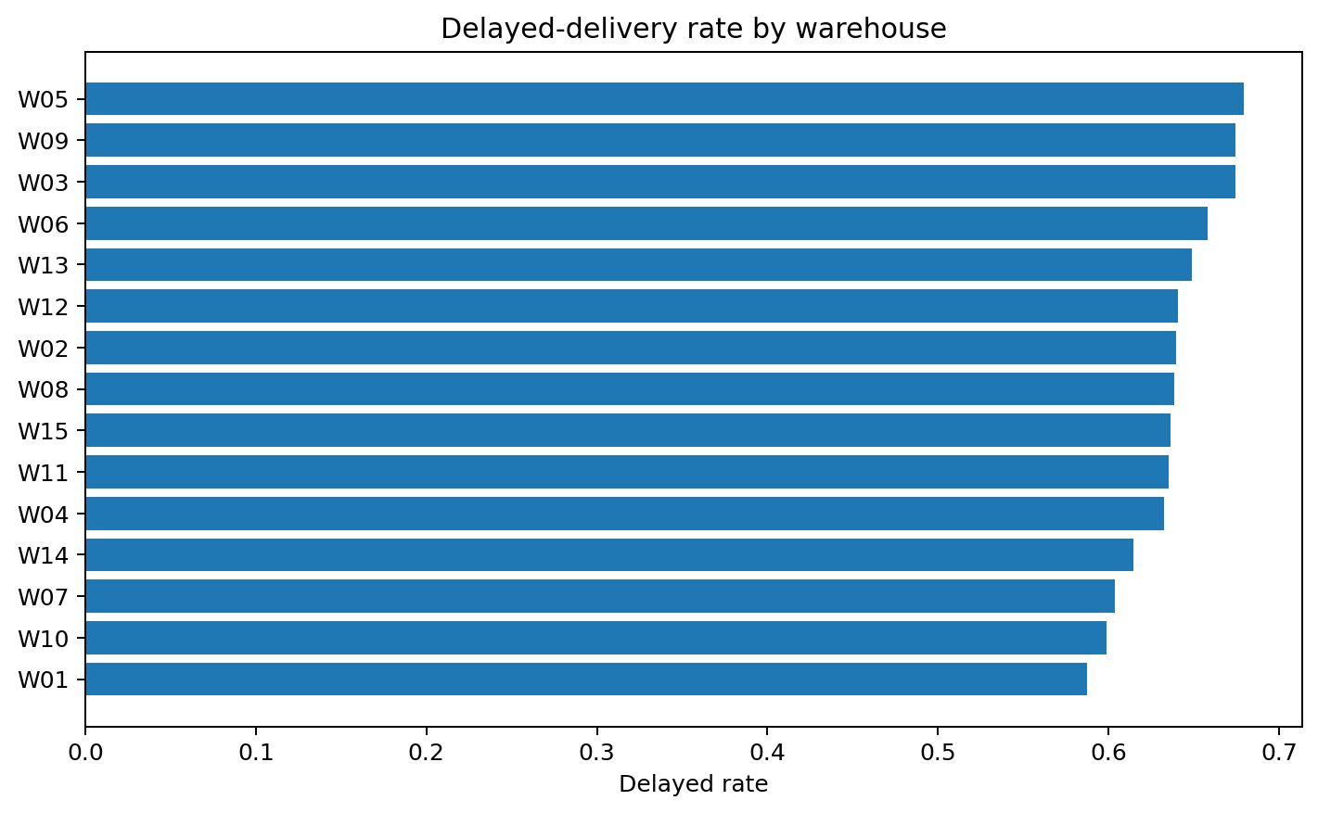
Delivery performance is the main operational signal
Nearly two thirds of shipments are labelled delayed.
63.7%
3.57 days
W01
W05
DELAYED RATE
AVG DELAY
LOWEST OBSERVED
HIGHEST OBSERVED
58.7% delayed
68.0% delayed
Important: the Kruskal-Wallis test finds no statistically significant warehouse delay-distribution difference (p = 0.759). Use warehouse ranking for monitoring, not causal blame.

Slide 7
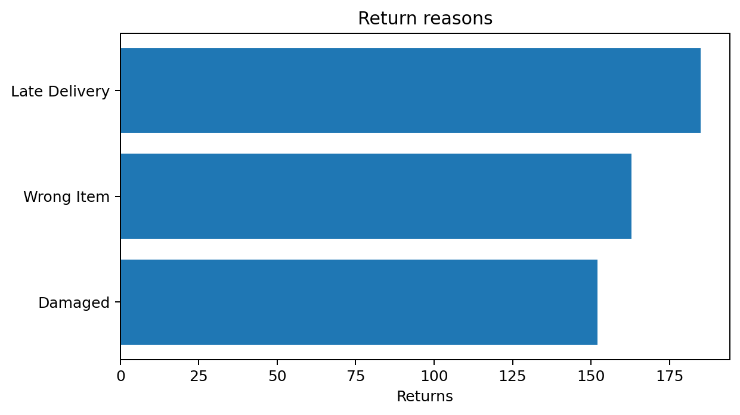
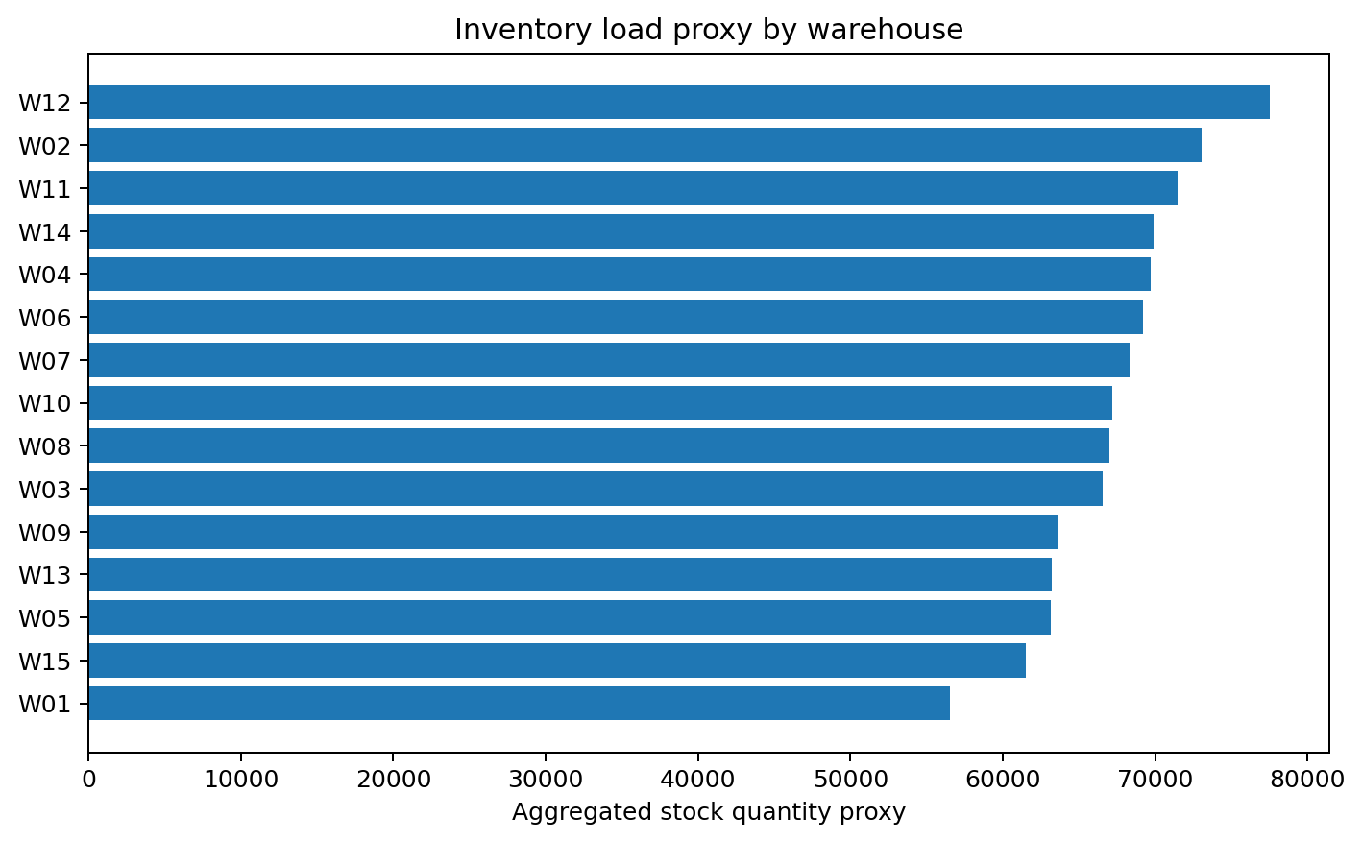
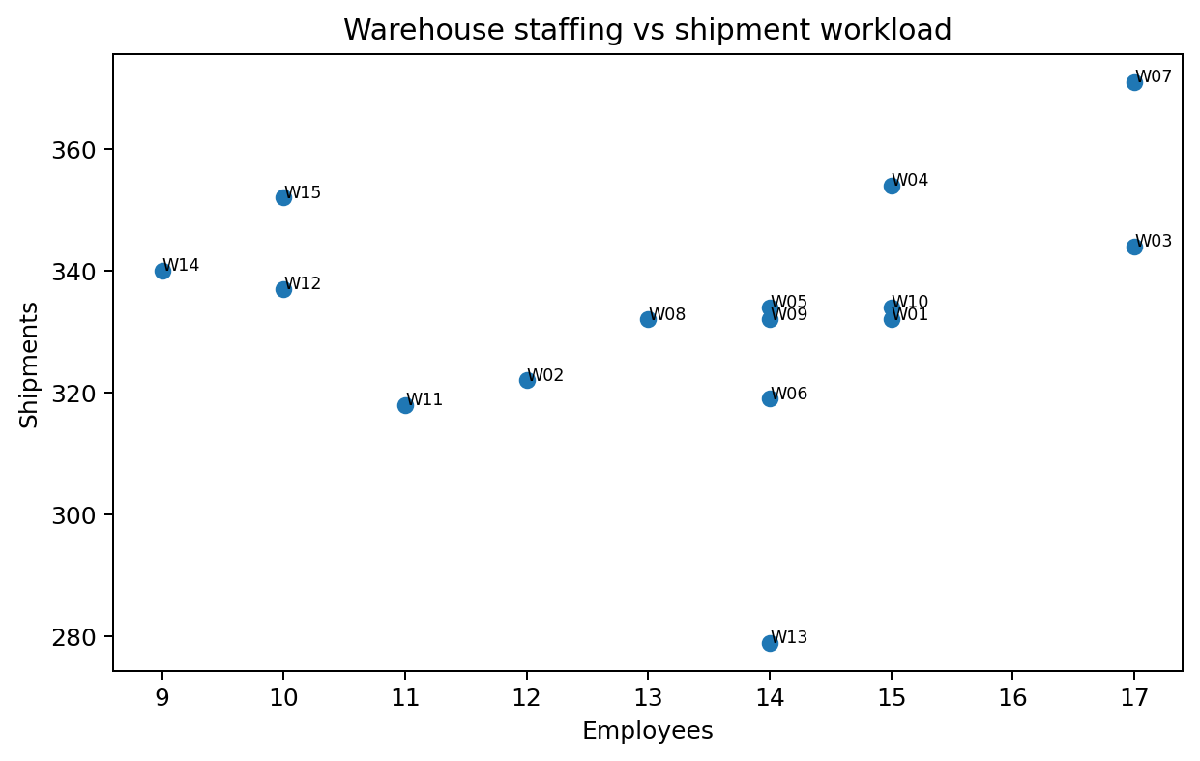
Returns, inventory & workforce patterns
Some requested KPIs can only be approximated because key fields are missing.
Returned-order rate: 9.5%. Late Delivery is the largest stated reason (185 records).
Inventory load is a proxy based on aggregated stock movements — not true capacity utilisation.
True inventory turnover is unavailable without dated inventory/average stock; only a labelled proxy is provided.
Returns lack ProductID/OrderItemID, so true product return rates cannot be calculated.

Slide 8
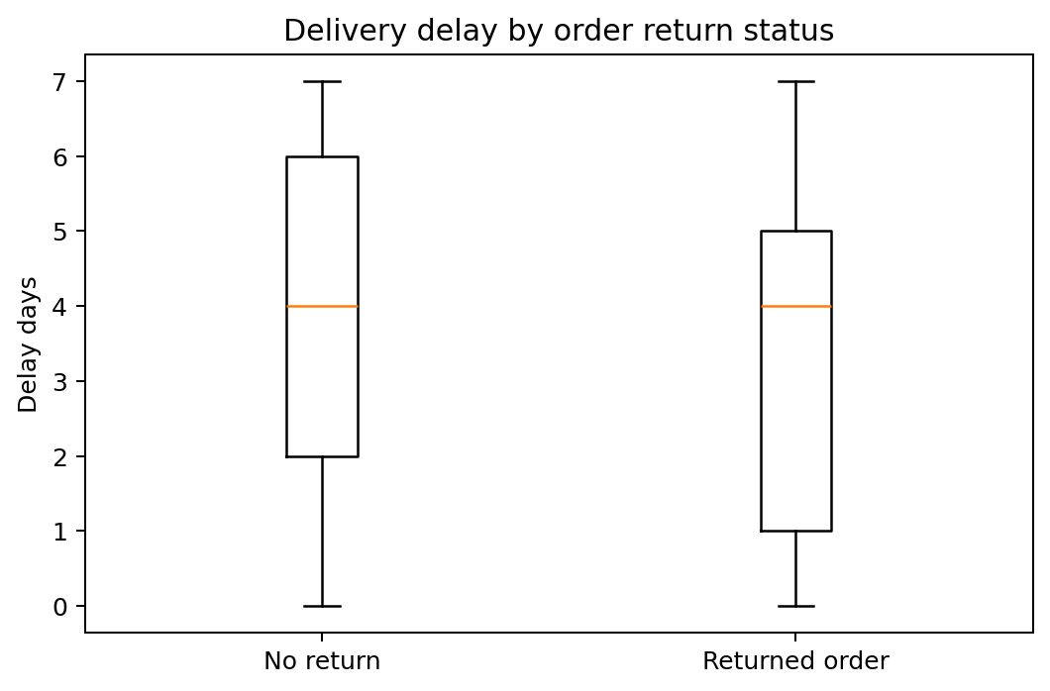
Statistical tests: plausible patterns were not automatically treated as facts
All three pre-defined business hypotheses failed to reject their nulls.
Question | Test | p-value | Conclusion
Delay differs across warehouses | Kruskal-Wallis | 0.759 | Not supported
Returned orders have different delay | Mann-Whitney U | 0.983 | Not supported
Order revenue differs by customer city | Kruskal-Wallis | 0.330 | Not supported
Question
Test
p-value
Conclusion
Null findings are results. They prevent us from overstating descriptive warehouse differences or claiming delay alone explains returns.

Slide 9
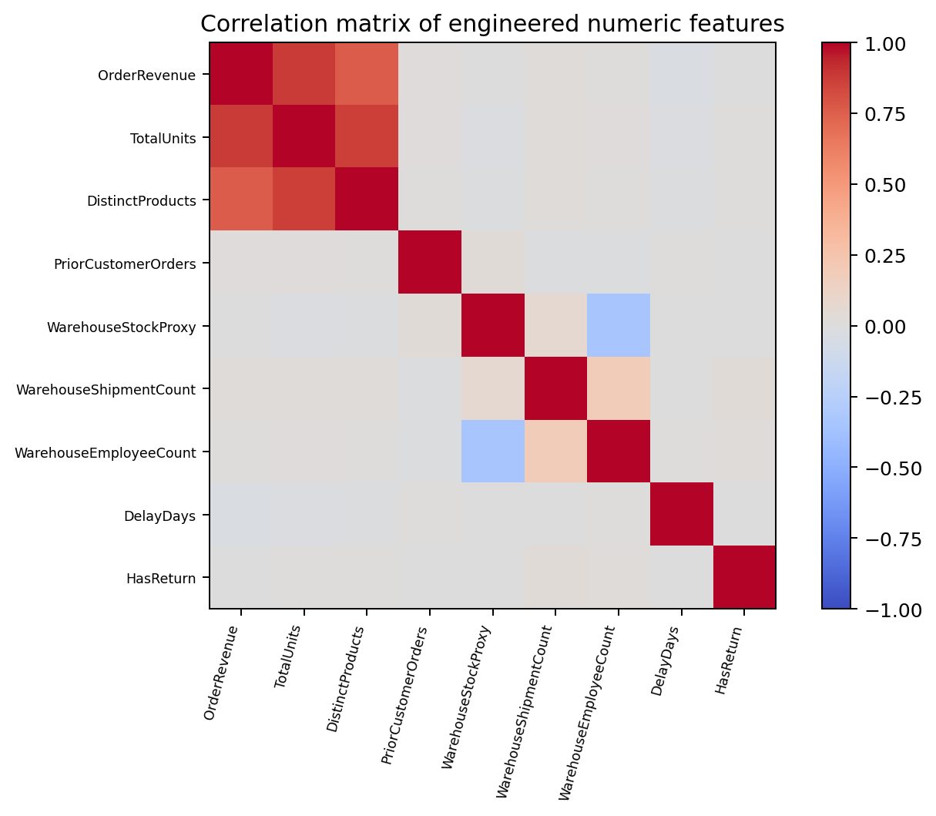
Feature engineering & ML readiness
The final analytical dataset preserves all 5,000 orders.
OrderRevenue, TotalUnits, DistinctProducts, UniqueCategories and DominantCategory.
Strictly prior customer features: PriorCustomerOrders, PriorCustomerSpend and PriorCustomerAvgSpend.
Calendar and demand features: month, quarter, day-of-week, monthly volume and seasonal indicator.
WarehouseStockProxy, product breadth, shipment workload, employee count and OperationalLoadProxy.
Targets/outcomes: DelayDays, IsDelayed, HasReturn. Outcome-derived DeliveryEfficiencyScore is never a delay predictor.
InventoryTurnoverProxy is explicitly labelled because inventory is undated.
Future modelling must re-fit any distribution-based feature inside training data only and exclude outcome-derived fields to avoid leakage.

Slide 10
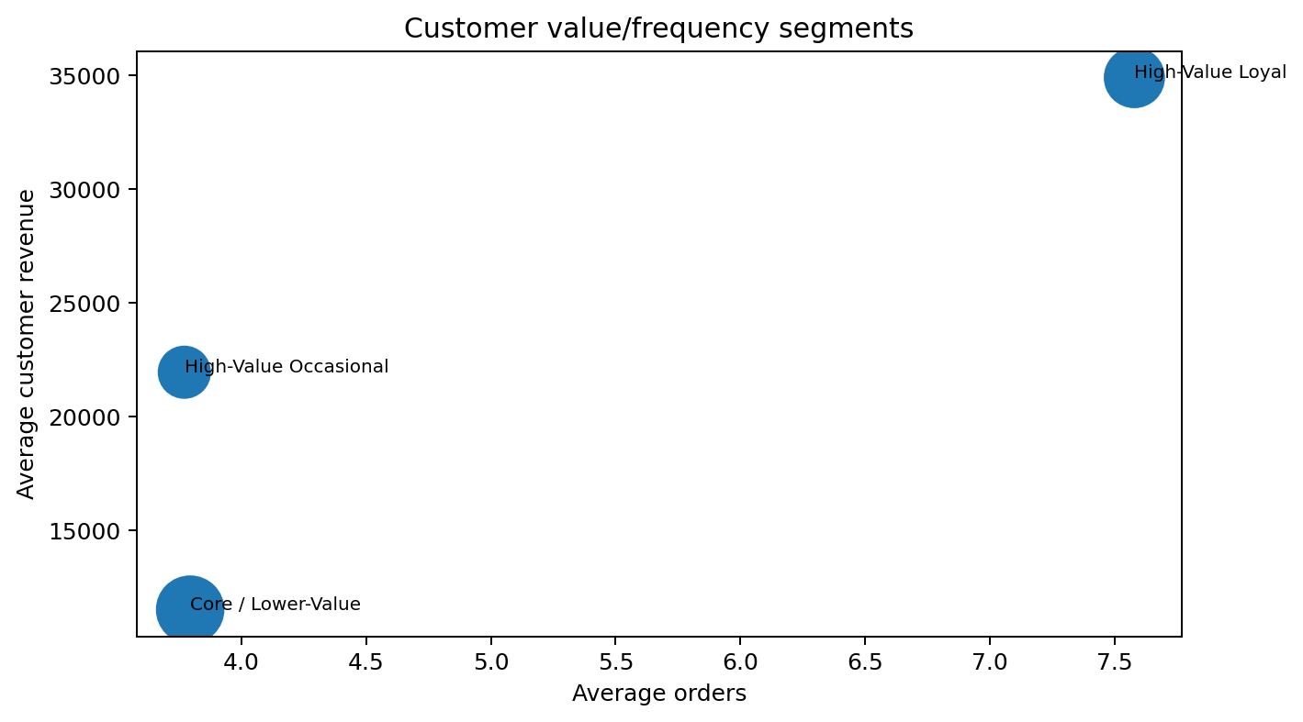
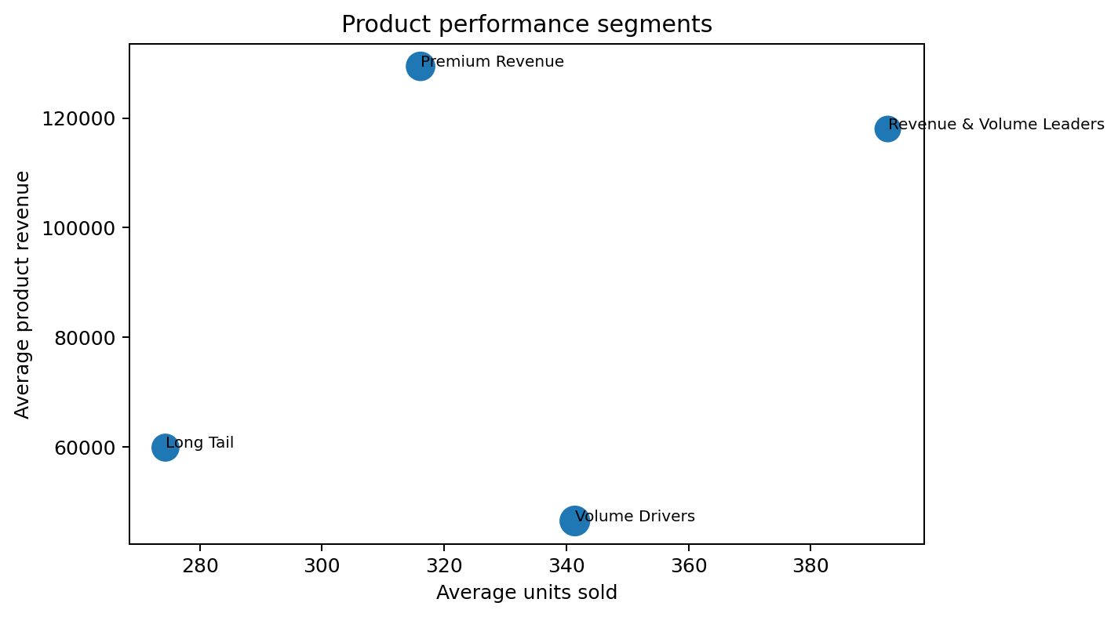
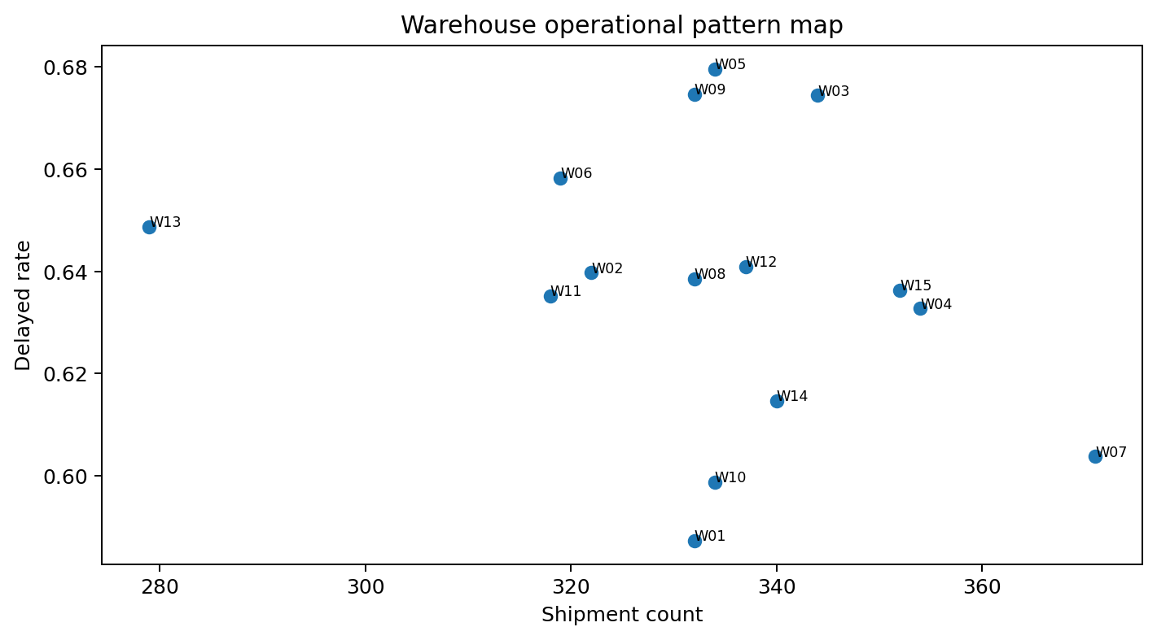
Segmentation & pattern discovery
Exploratory clusters support differentiated management action — not causal claims.
Customer silhouette: 0.360 — clearest segmentation. High-Value Loyal contributes the largest total revenue (~$11.48m).
Product silhouette: 0.330 — useful separation into leaders, premium revenue, volume drivers and long tail.
Warehouse silhouette: 0.301 with only 15 warehouses — interpret cautiously.

Slide 11
Management priorities
Recommendations are tied to observed evidence and documented data limitations.
1. Launch a focused delivery-delay reduction programme; monitor delayed rate and average delay weekly.
2. Review W05/W09/W03 processes first, while treating warehouse ranking as diagnostic rather than causal.
3. Prepare staffing and logistics capacity for August, the peak order and revenue month.
4. Protect High-Value Loyal customers with service-level monitoring and retention activity.
5. Use product segments for replenishment and portfolio prioritisation; protect Fashion availability.
6. Improve returns handling around Late Delivery, Wrong Item and Damaged reasons.
7. Add SupplierID links, true warehouse capacity, dated inventory snapshots and ProductID/OrderItemID on Returns.
8. Resolve the 236 orders missing item detail before product/revenue models are operationalised.

Slide 12
Final takeaway & future ML roadmap
Week 5 delivers the analytical foundation — not an overclaimed predictive solution.
5,000
63.7%
$21.67m
20+
ORDERS PRESERVED
DELAYED RATE
OBSERVED REVENUE
EDA FIGURES
Clean, reproducible order-level feature dataset delivered.
Three formal hypotheses tested and retained honestly as null findings.
Supplier, capacity, inventory-time and return-line gaps documented as priorities for better data collection.
Next ML opportunities: delivery-delay prediction, demand forecasting and return-risk modelling.
Repository and notebook provide the reproducible handoff.
Thank you

