Slide 1
MMA3001 · Individual Project
Predicting Indoor CO2
Concentration
Using recent sensor history and building occupancy
to give a 15-minute early warning for ventilation
Tanmay Gupta · Monash University · 2026
Dataset 2: Monash Smart Infrastructure · Week 5 Regression · Week 6 Integration

Slide 2
The Problem
Why predict CO2 at all?
Most building systems only react AFTER CO2 is already too high.
What we're doing
• Predict CO2 level 15 minutes from now
• Use the last hour of sensor readings
• Include how many people are in the building
• Give ventilation a head start before air goes bad
Why it matters
• CO2 above ~800 ppm makes people less alert
• Proactive ventilation = better air + less energy
• 15 min is enough time for a building system to act
• Regression task — predicting a number, not a category
All four Week 5 regression methods were compared on real data — no single method was assumed to be best.

Slide 3
Prediction Contract — What Success Looks Like
Defined before running any model · Week 5.6 framework
MAE ≤ 10 ppm
R² ≥ 0.25
No data leakage
Below typical reading-to-reading variation.
Useful as a ventilation trend signal.
Explains at least a quarter of variance.
Captures real structure, not just the mean.
Test set must be strictly in the future.
Time-ordered split required — not random.
Key risk: Occupancy data only helps if the sensor is in a monitored room.
Whether it does is answered by the zone-matching analysis — not assumed.
Outcome →
✓ MAE met
✓ R² met (3/4 models)
✓ No leakage
✗ Decision Tree R² = 0.19

Slide 4
Data — Inputs and Outputs
What goes in, what comes out
Current CO2
(ppm)
CO2
15 min ago
1-hr rolling
average
Occupancy
count (0–5)
Time of day
& day of week
CO2 in
15 minutes
→
→
→
→
→
Source: MMA3001 Dataset 2 — Monash Smart Infrastructure. 5 occupancy zones, 5 environmental sensors.
Sensor chosen: 6012002000326
• Longest record of real readings (Sep 2025 – Apr 2026)
• Validated against Bureau of Meteorology:
Temperature: r = +0.84 over 222 days
Humidity: r = +0.65 over 222 days
• Strong evidence it's actually measuring something real
Why the other 4 sensors weren't the main sensor
• 3 sensors: only ever re-send one stale packet
(same time, same value) → no real readings at all
• Sensor 0869: only 3.5 months of real data
• Its usable intervals are tested on slide 10
• None of this was documented in the dataset description

Slide 5
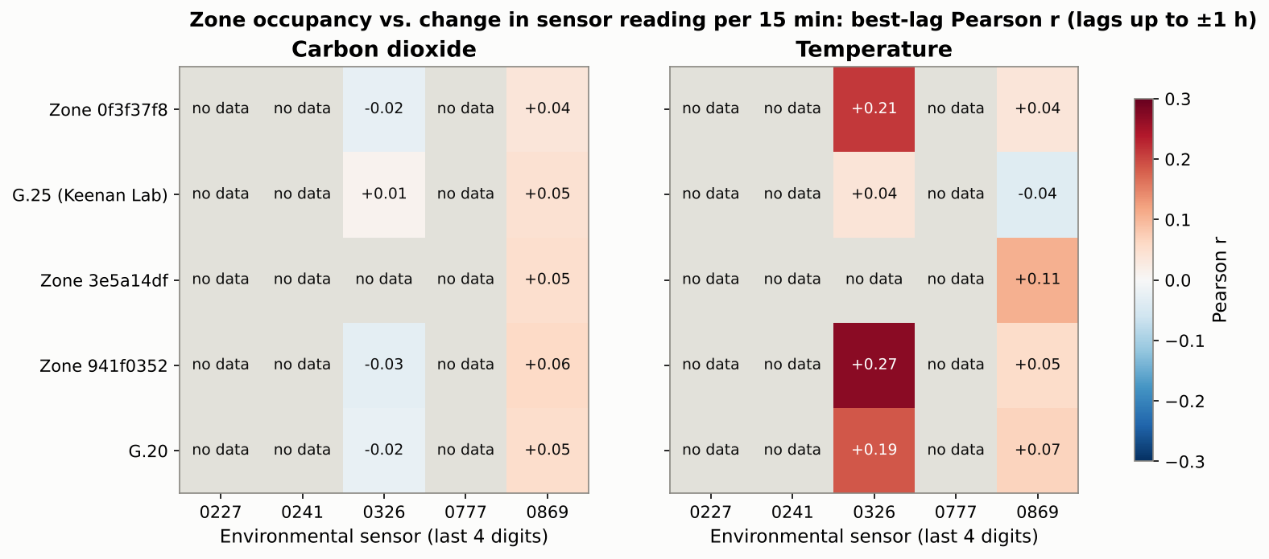
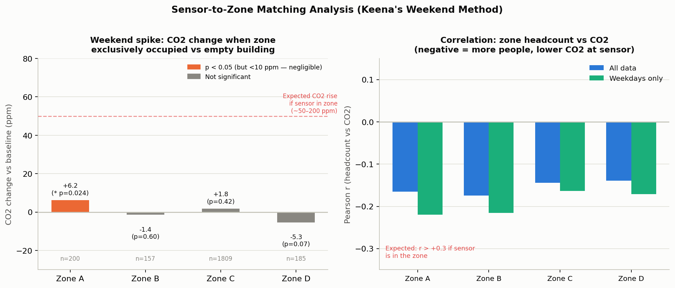
Sensor Matching — Can We Link Sensor to a Room?
Keenan's suggestion: look for the link in the data · lagged correlation · 5 zones × 5 sensors · CO2, temperature, humidity
Method:
1. Resample zones and sensors to 15 min
2. Use change per bin, not level
3. Correlate with occupancy at lags up to ±1 h
4. Keep strongest |r| per pair
✗ CO2: |r| ≤ 0.03 for sensor 0326 against every zone (≤ 0.06 for any sensor) · Temperature up to r = 0.27, but it rises 45–60 min before occupancy → building-wide HVAC, not a shared room

Slide 6
Methods — 4 Regression Models (Week 5)
All four compared — none assumed to be best
Each model runs through the same StandardScaler step so the comparison is fair. Same training data, same test split.
Linear Regression
Decision Tree
SVR (RBF kernel)
Neural Network
Fits a straight line through the data.
Simplest, most interpretable. Good baseline.
Splits into if/else regions (max depth 8).
Can catch combos like 'busy + afternoon'
that a line misses.
Fits a smooth curve, ignores small errors.
C=10, ε=0.5. Good for mild nonlinearity
on a dataset this size.
Two hidden layers (32 + 16 units).
Most flexible but also most likely
to overfit on limited data.
💡 Occupancy was included as something to TEST — not assumed to be useful. Results in next slide.

Slide 7
Results — How Each Model Performed
Chronological split: train up to 11 Mar 2026, test after
17,010 rows · 80% train / 20% test · Split by time — no random shuffling (that would inflate results)
Model
MAE (ppm)
RMSE (ppm)
R²
Linear Regression
9.012
25.579
0.358
Decision Tree
9.353
28.708
0.191
⚠ worst
SVR ← Best
8.350
25.894
0.342
✓ best
Neural Network
9.350
26.015
0.336
8.35 ppm
R² ≈ 0.34
average error — SVR (best model)
explains ~1/3 of variance — moderate result, reported honestly
Decision Tree was the worst — likely memorised the training period's patterns rather than learning something general.

Slide 8
Key Finding — Does Occupancy Actually Help?
Tested with and without for every model
Model
R² with occupancy
R² without
Verdict
Linear Regression
0.3581
0.3579
No difference
Decision Tree
0.1914
0.3305
Gets WORSE ↓
SVR
0.3422
0.3438
No real difference
Neural Network
0.3360
0.3352
No difference
Occupancy does not improve predictions for any model. For Decision Tree it actively made things worse.
Why? The sensor has no documented room location.
• It is not in the official Sensor ID spreadsheet — no way to know which occupancy zone to pair it with.
• A separate correlation check across all 5 zones found max |r| ≤ 0.06 for CO2.
• This is a finding — it was tested properly and reported honestly, not hidden.

Slide 9
Missing Data
What was found and how it was handled
The scale of the gaps
• Longest gap in real readings: ~636 days
• Readings are not evenly spaced
• 84,576 candidate rows in raw data
• Only 17,010 (20%) had all required values
• Rest were dropped — not filled with made-up numbers
How it was handled
• Any row missing lag / rolling average / target → dropped
• No interpolation across the 636-day gap
• Integration step needed a separate fix (slide 11)
• All of this is documented in the report, not hidden
Other data quality issues found along the way:
• Three sensors only ever re-send one stale packet (same timestamp, same value) — no real readings. Found by comparing each reading's own time with the server's receive time.
• The occupancy log file was named "MayToDec2024" but actually covers November 2023 to April 2026. Only found by checking real timestamps.

Slide 10
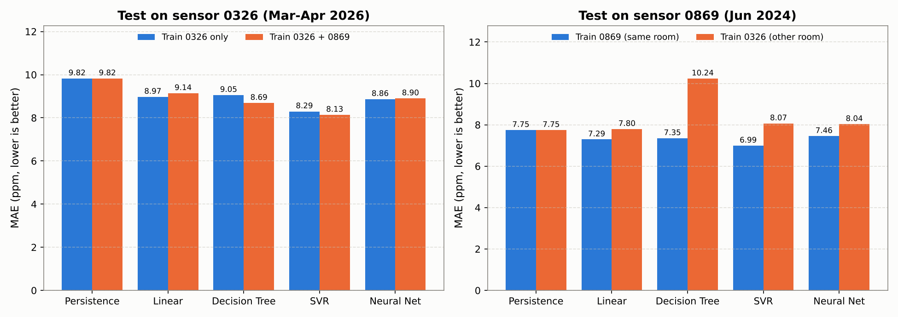
Using Every Sensor's Usable Intervals
Teaching-team suggestion: use valid time intervals from all sensors, not one sensor
Every unbroken interval ≥ 75 min was used, from any sensor: 0326 → 17,317 rows · 0869 → 7,781 rows · other 3 sensors → 0 (stale packets only)
• Pooling 0326 + 0869 (+56% training data): SVR error 8.30 → 8.14 ppm, but not statistically significant for any model (bootstrap 95% CI spans zero).
• Trained on the other room, every model is worse than 'CO2 stays the same'; trained on 0869's own data, SVR reaches 6.99 ppm → train one model per room.

Slide 11
Numerical Integration — Week 6
Calculating total CO2 exposure over time
A sensor gives a snapshot at each moment — but you might want to know total exposure over a day (ppm·hours = area under the curve).
🐛 Bug found during the project
• First version: resampled onto a 15-min grid, dropped missing bins, then integrated.
• Problem: readings either side of the 636-day gap looked like they were 15 minutes apart.
• Result: Simpson's gave ~1.1M ppm·h vs trapezoidal ~9.5M ppm·h. A 9× gap = something is clearly wrong.
✅ Fix: gap-aware trapezoidal rule
• Skips any panel where the two endpoints are more than 2 hours apart.
• Naive estimate: 9,543,357 ppm·h → Gap-aware: 2,305,836 ppm·h (4× difference from bridging alone)
Convergence check on a clean 41-hour gap-free window (1–3 Oct 2025):
Bin size
Trapezoidal (ppm·h)
Simpson (ppm·h)
Agreement
15 min
17,817
17,830
0.07%
30 min
18,020
18,020
0.001%
60 min
17,584
17,572
0.07%

Slide 12
Limitations & What We'd Do Differently
Honest about what worked and what didn't
Sensor has no room location
R² ≈ 0.34 — only partial
Not in the official spreadsheet. Impossible to know which occupancy zone it belongs to — so the occupancy feature was always going to be a stretch.
The model captures about a third of what drives CO2. The rest is things we don't have data on: HVAC events, windows, doors, equipment.
Only 20% of rows usable
Models don't transfer between rooms
The 636-day gap means most of the raw data cannot form a valid training row. Adding a second sensor's usable intervals (+56% data) did not significantly help.
Trained on sensor 0326, every model did worse than 'CO2 stays the same' on sensor 0869. Each room needs its own training data.
If sensor room location were documented → could pick the matching zone, likely improving results.

Slide 13
Summary
What was done, what was found
What was done
• Predicted CO2 15 min ahead using 4 regression models
• Chronological train/test split — no data leakage
• Tested occupancy + usable intervals from all sensors
• Applied Week 6 integration to calculate CO2 exposure
• Found and fixed a real integration bug (gap bridging)
• Validated sensor against Bureau of Meteorology data
What was found
• SVR best model: 8.35 ppm average error
• R² ≈ 0.34 — moderate, reported honestly
• Occupancy does NOT improve CO2 prediction
• Models must be trained per room — they don't transfer
• CO2 driven by ventilation, not individual room counts
• 3 of 5 sensors have no real readings (stale packets)
Best model: SVR · MAE = 8.35 ppm · R² = 0.342
github.com/tgup0010-bot/MMA3001_FINAL · All numbers reproducible from the scripts; results in reports/
Tanmay Gupta · MMA3001 · Monash University · 2026

