Slide 1
Fundamentals in Data Engineering
Thiago de Paiva
p7392@ulusofona.pt
https://github.com/tgvp

Slide 2
Git
Review last class topics on versioning
Initial Setup
Configuration
Practice

Slide 3
SETUP
Install: Git-Install
GitHub: Signup

Slide 4
Config steps
> git config --list
> git config –global user.name “your name"
> git config –global user.email “your_email@email.com”
> git config --global init.defaultBranch main

Slide 5
Three different states
Working directory
podemos fazer alterações em arquivos e diretórios para que possam ser acompanhadas pelo git
Staging area
informamos o que queremos adicionar para que o git mantenha o acompanhamento dos arquivos
Local repository
representa onde os nossos snapshots estão guardados como um histórico do nosso projeto

Slide 6

Practice
We want to create a local repository with a README.md file and a list of students.

Slide 7
Repository
First we create a project directory
The directory is empty - we will initialize it with git
Is it still empty?
> mkdir MyProject
> cd MyProject
> ls
> git init
> ls
> ls -a
> cd .git
> ls

Slide 8
Working Directory
Now let’s create a README.md file
Verify the status – “untracked”?
Send it to staging area – “Changes to be commited”
> touch README.md
> cat README.md
> ls
> git status
> git add README.md
> git status
> git log

Slide 9
Cheatsheet
> mkdir ListaTFC
> cd ListaTFC
> git init
> ls -a
> touch README.md
> git status
> git add README.md
> git status
> git commit –m "Add README.md"
> git log

Slide 10
Commands List
Now add information to the README.md
"Students should open students_tfc_list.txt and add their name and TFC theme."
> git diff
> git add README.md
> git diff
> git diff —staged
> git commit –m "Add instructions"

Slide 11
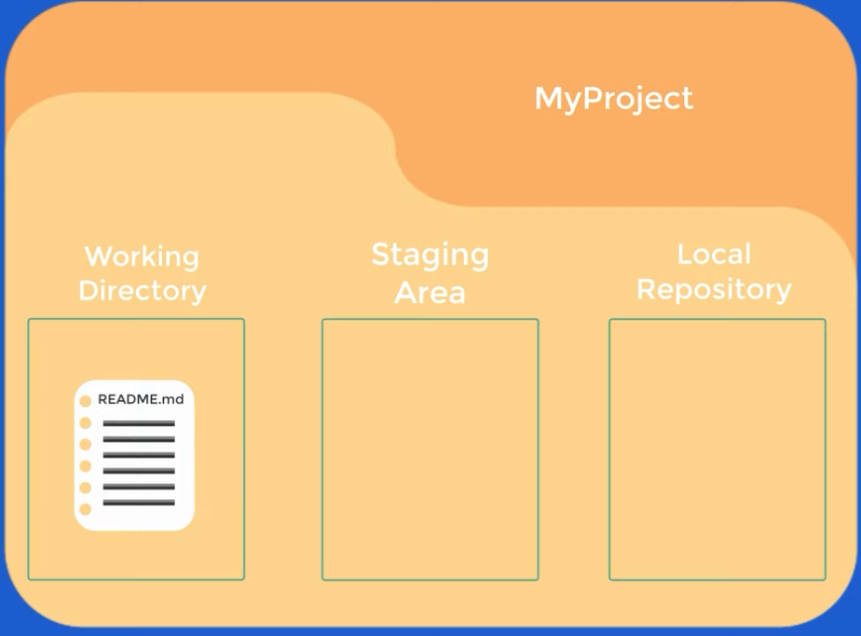

Slide 12
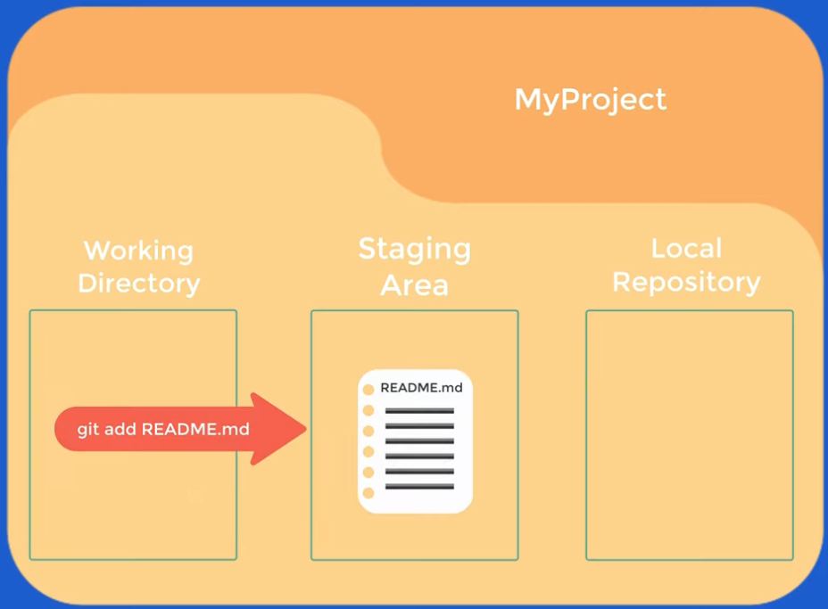

Slide 13
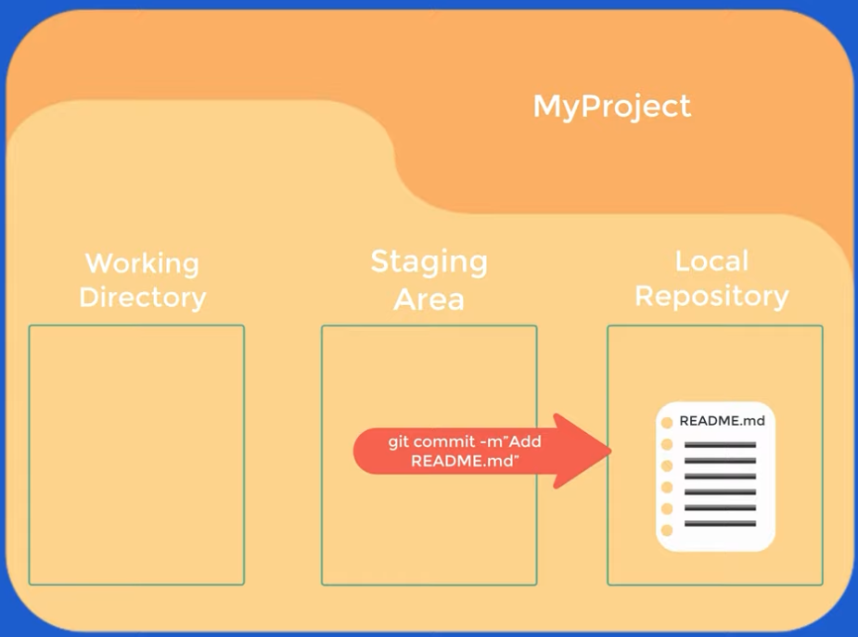

Slide 14
Removing commits made by mistake
First Scenario — Commit hasn’t been sent yet (git push)
To remove the last commit, but keep the files
Removes o commit
Keeps the files in staging area (git add)
It is good to fix the commit message or add more files to be commited
git reset --soft HEAD~1

Slide 15
Removing commits made by mistake
To remove the last commit taking it out of staging area (files still in the directory)
Removes the commit
Removes from staging
Files still in the project
git reset --mixed HEAD~1

Slide 16
Removing commits made by mistake
Second Scenario — Revert the commit safely
To remove the last commit, but also keep the files
Creates a new commit that will undo the previous one
Use git log to find out the hash
git revert <hash_do_commit>

Slide 17
Removing commits made by mistake
If you haven’t pushed yet with git push, you are fine
If you did it already, think twice
Watch out!!!
git reset --hard HEAD~1
git push --force

Slide 18
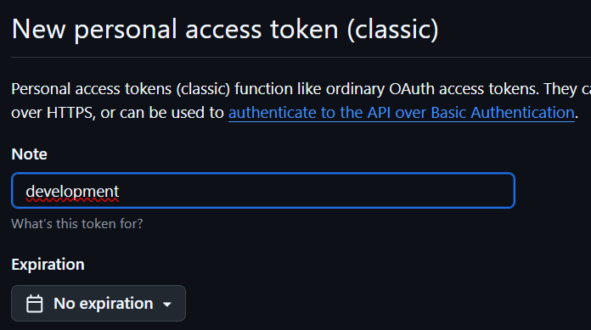
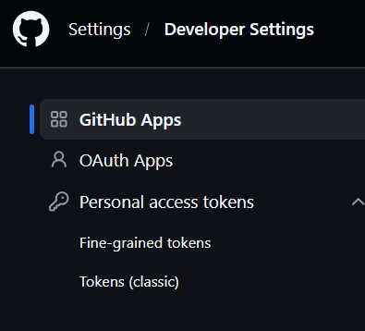

Push to GitHub
> git remote add origin https://github.com/your_user/MyProject.git
Username for 'https://github.com’: your_user
Password for 'https://your_user@github.com’: <Token>
> git branch -M main
> git push -u origin main

Slide 19
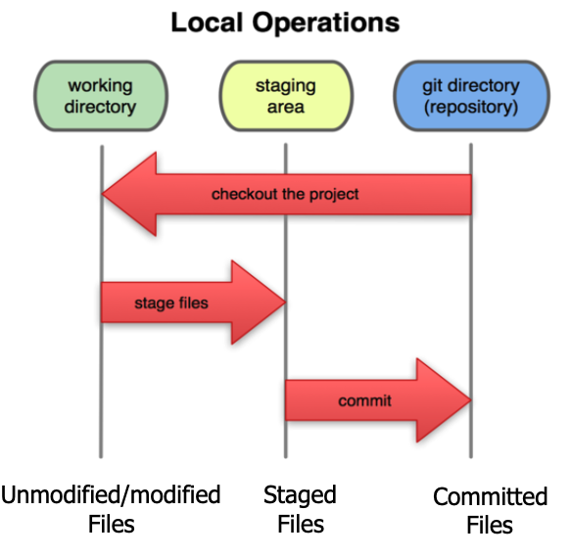
In your local copy of a Git repository, files can be in the following states:
In your local repository (working directory)
Committed
Modified and added to tracking, but not yet committed (staging area)
Working copy
Committed (in the repository)
A commit saves a snapshot of everything that is in the staged state.

Slide 20
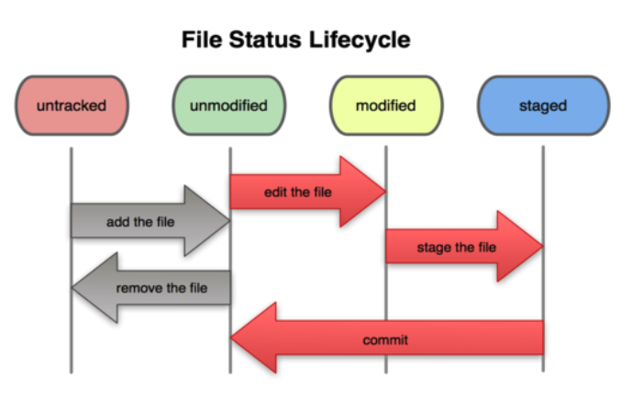
Workflow
Modificar arquivos no seu working directory
Stage arquivos e adicionar snapshots a sua staging area
Commit, que leva os arquivos da staging area e guarda o snapshot no diretório git

Slide 21
Commits
Commits must be short
Commits should represent a logical unit of work.

Slide 22
Commits
Make small commits, not one large commit
Easier to understand, review, merge, and revert
How to make small commits:
Do only one task at a time
Make a commit after each task
If working on multiple tasks in one clone
Commit only a subset of files
Be aware of potential errors
Create a new clone for each simultaneous task
You can have as many as you want
Create a branch for each simultaneous task
In many cases, this is more efficient
However, it can also be more complex and more error-prone

Slide 23
Non diff-able files
Git stores changes (diffs) between versions — not the entire file every time.
Do Not Commit Generated Files
Compiled files Build artifacts Binary filess

Slide 24
Syncing
Pull
Obtain updated version
git pull
Already up to date

Slide 25
Syncing
Fetch Frequently
Avoid falling behind main or your teammates
Push Frequently
Do not destabilize main
Keep changes small and incremental
Running automated tests on every push is a good practice
Reduce the risk of large merge conflicts

Slide 26
Branches and Merging
Branches are simply references (pointers) to a specific commit.
Every time you create a commit:
The branch moves forward
It now points to the new (latest) commit

Slide 27
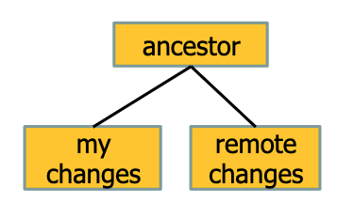
Conflicts
You decide which version to maintain and how to merge
Do not panic!
You can abandon the merge and try again!!!

Slide 28
How to avoid conflicts
Divida o seu trabalho em módulos
Organize the work so that individuals or teams own a module
Communicate Changes That May Cause Conflicts
Inform teammates about major changes
But avoid over-communication — keep it relevant and focused.
Other team members only need to understand the specification
Requires good documentation and tests

Slide 29
Merges
No conflicts - automatic
Changes are in different files
With conflicts - manual
Simultaneous changes in the same line of a file
Or in different lines of the same file
The concept of “no conflict” is textual, not semantic
The code may still be wrong
It may fail to compile
It may break tests
Git cannot decide which version to keep

Slide 30
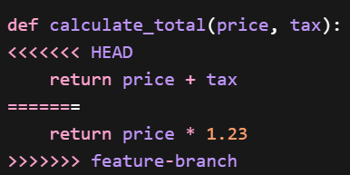
Merges
<<<<<<< HEAD → Your current branch version
======= → Separator
>>>>>>> feature-branch → Incoming branch version

Slide 31
Main
We currently only have the main branch
The * next to main indicates that we are currently on that branch
Any change we commit will be added to the main branch
HEAD points to the most recent commit of the current branch
Useful commands:
> git status
> git show-ref --head
> git log

Slide 32
Branches
http://git-school.github.io/visualizing-git/
> git commit
> git branch new-feature # create a new branch
> git commit # em qual branch foi o commit?
> git checkout new-feature
> git commit

Slide 33
Why create a new branch?
Protect the main
If anything goes wrong, you can safely discard it
> git checkout master
We can switch to diferente branches
>git branch -d new-feature
Implement new features

Slide 34
> git branch add-readme-instructions
> git checkout add-readme-instructions
Add instructions to the README.md file
> git add README.md
> git commit –m “add instructions to README.md”
> git log
> git checkout main
> git log
> git merge add-readme-instructions
> git log
> git branch -d add-readme-instructions
> git branch

Slide 35
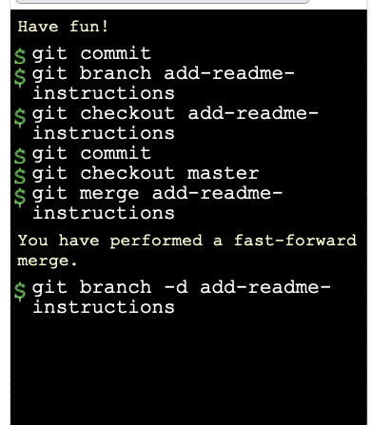

Slide 36
Additional Resources
https://learngitbranching.js.org/
Lab 1 - Git Immersion

Slide 37
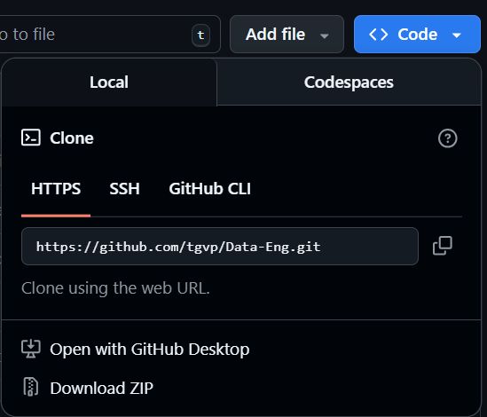
Cloning
Cloning creates a complete copy of a remote repository
> git clone <repository-url>

Slide 38
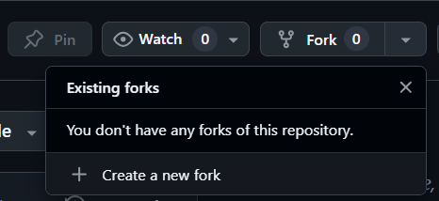
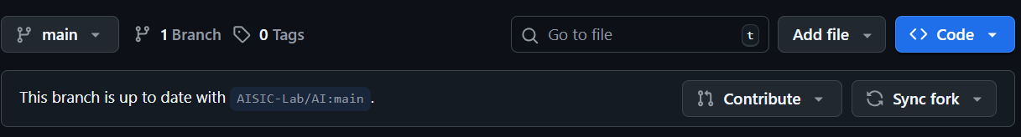
Forking
Creates your own copy of someone else’s repository
Your own independente version
Upstream → original repository
Origin → your fork

Slide 39
Pull Request
Pull Request is a request to merge changes from one branch into another
All diferences are shown
Others can comment
Changes can be approved or requested to modify
Pull Request is not a merge. It is a request to merge.

Slide 40
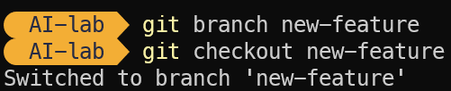
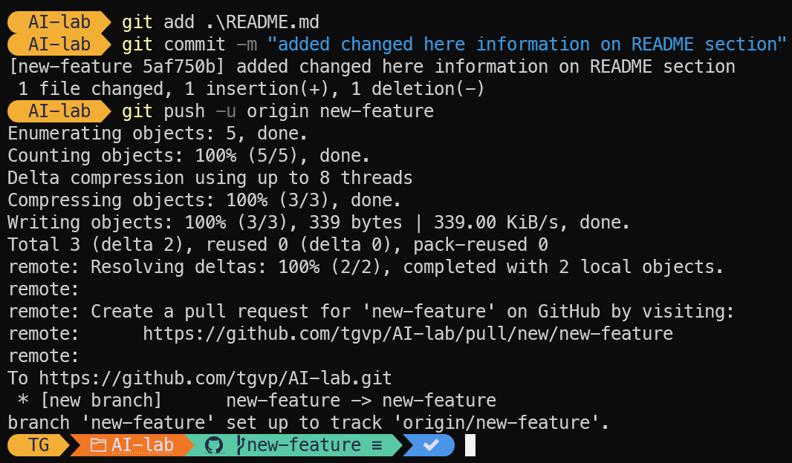
Pull Request

Slide 41
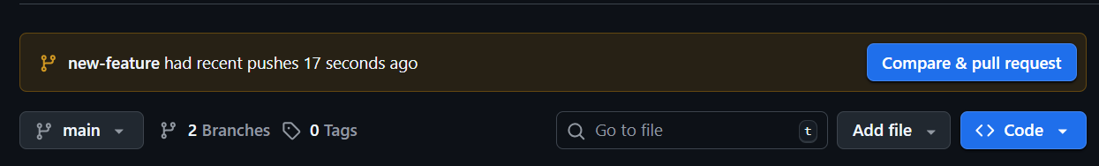
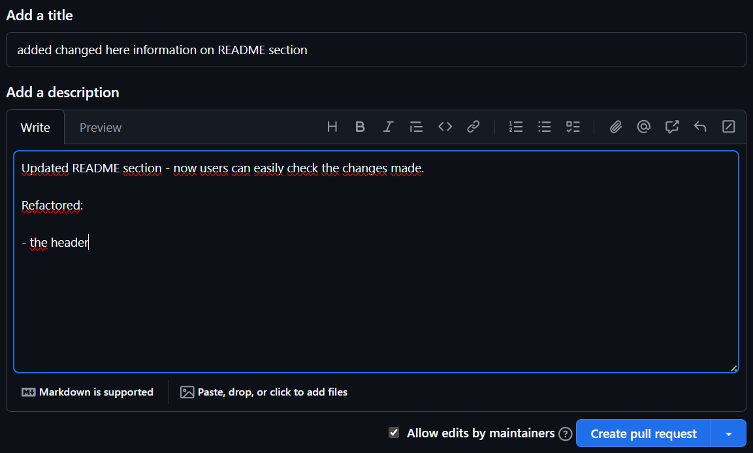
Pull Request

Slide 42
Pull Request

Slide 43
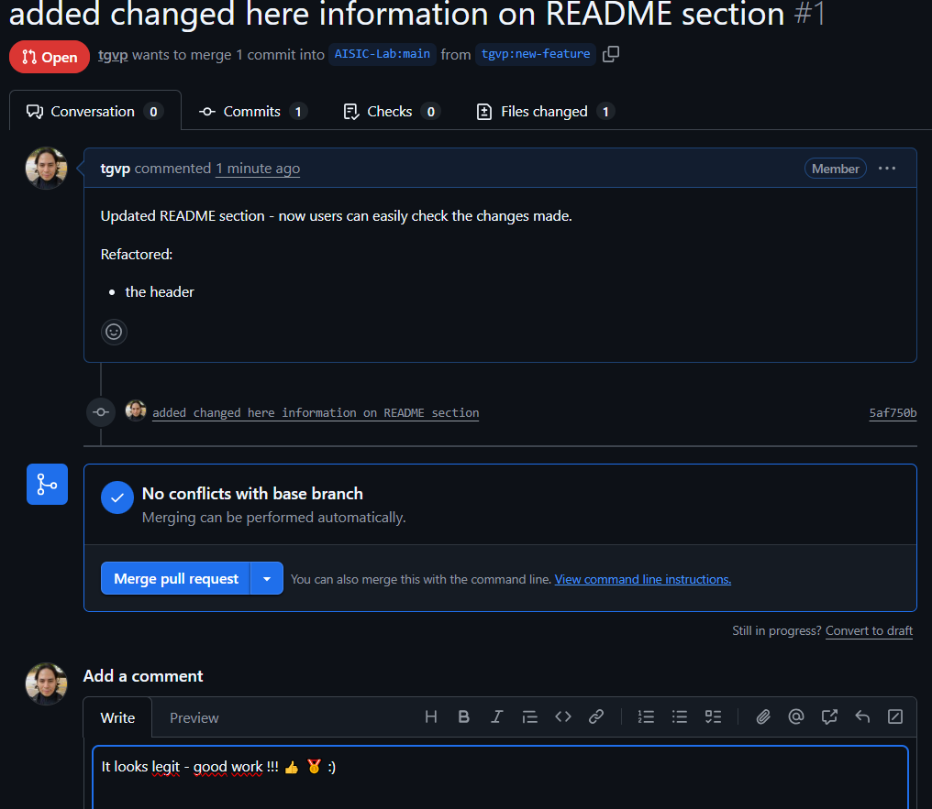
Pull Request

Slide 44
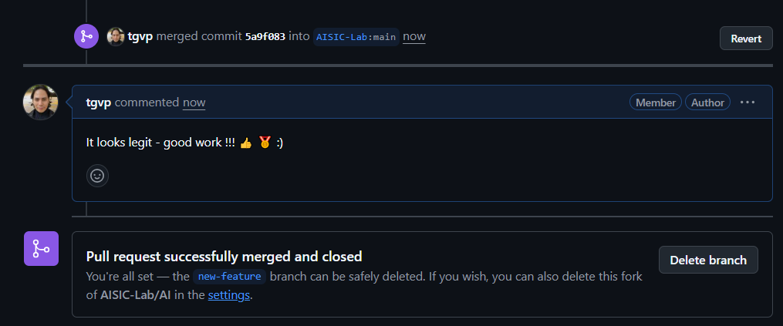
Pull Request

Slide 45
First Assignment
Create your own Repository named DE-your_initials with a README.me file
Open README.md Add only your initials on a new line.
Create a New File on main branch named after your initials - Example: TGVP.md (Add your initials as a comment inside)
Commit with an informative message (git commit –m “message”)
Create a Branch named feature-your_initials (remembre to checkout to it – git checkout feature-your_initials)
Add a new file named feature-your_initials.md (use git add)
Commit with an informative message

Slide 46
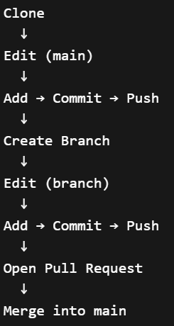
First Assignment
Push to the remote repository (git push –u origin main)
Open a Pull Request

Slide 47
First Assignment
Push to the remote repository (git push –u origin main)
Open a Pull Request

Slide 48
First Assignment
Always Pull Before Starting Work
Your friends might have pushed changes
> git pull origin main
Deadline: 10/04/2026

